Slide 1
SEGURO
A Vehicle Insurance Company

Slide 2
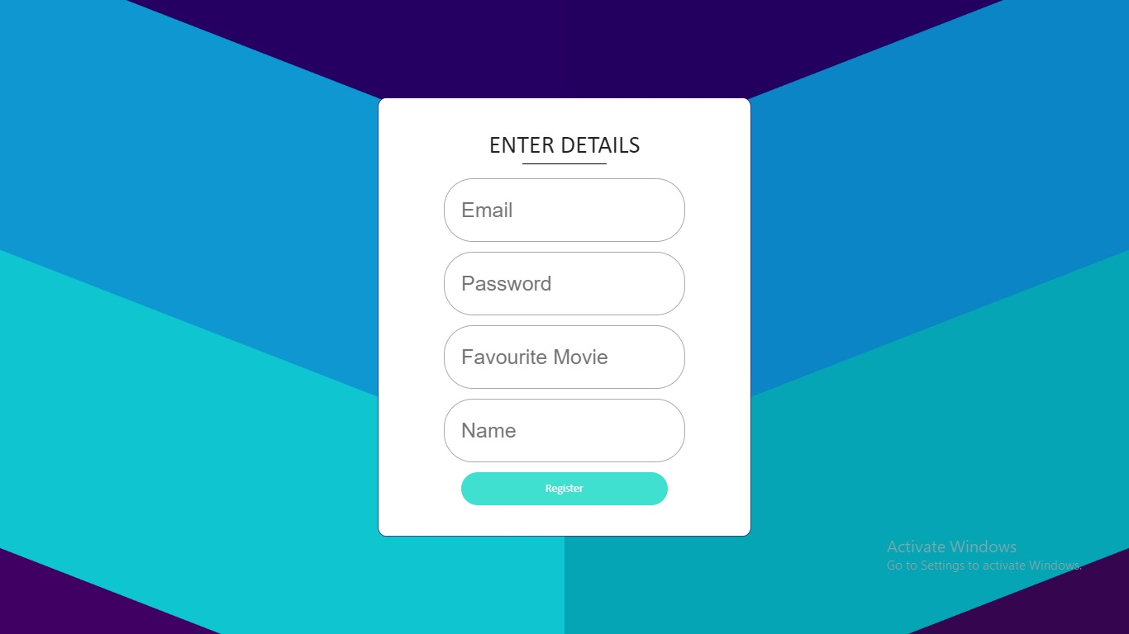
Register New User

Slide 3
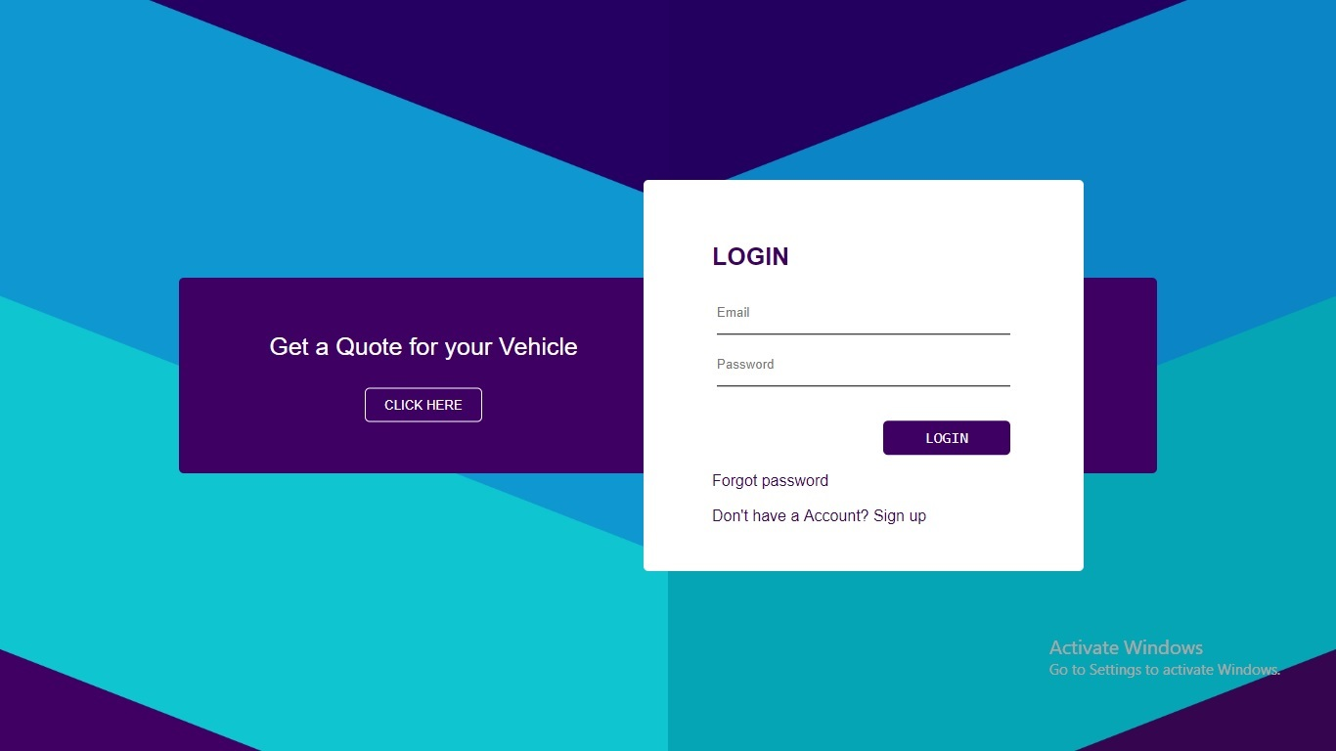
Login Page

Slide 4
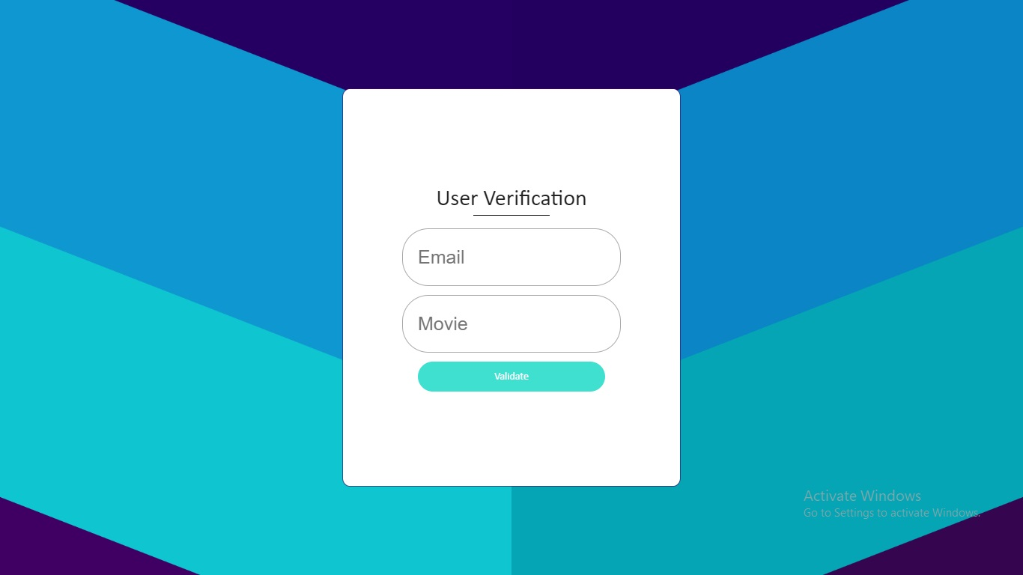
Forgot Password Page

Slide 5
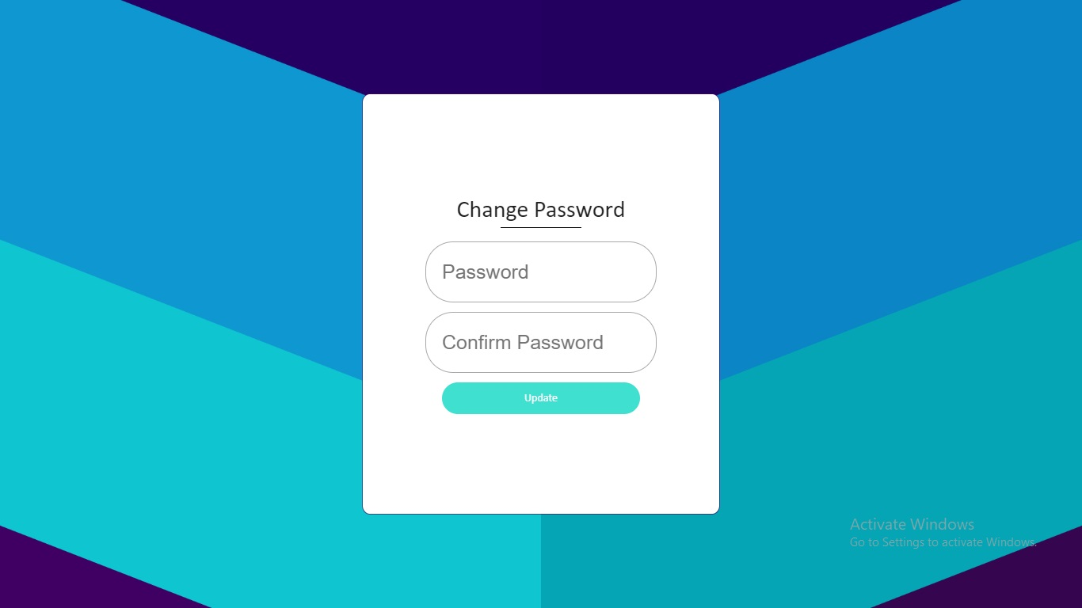
Change Password Page

Slide 6

User Dashboard

Slide 7

Buy A New Policy

Slide 8
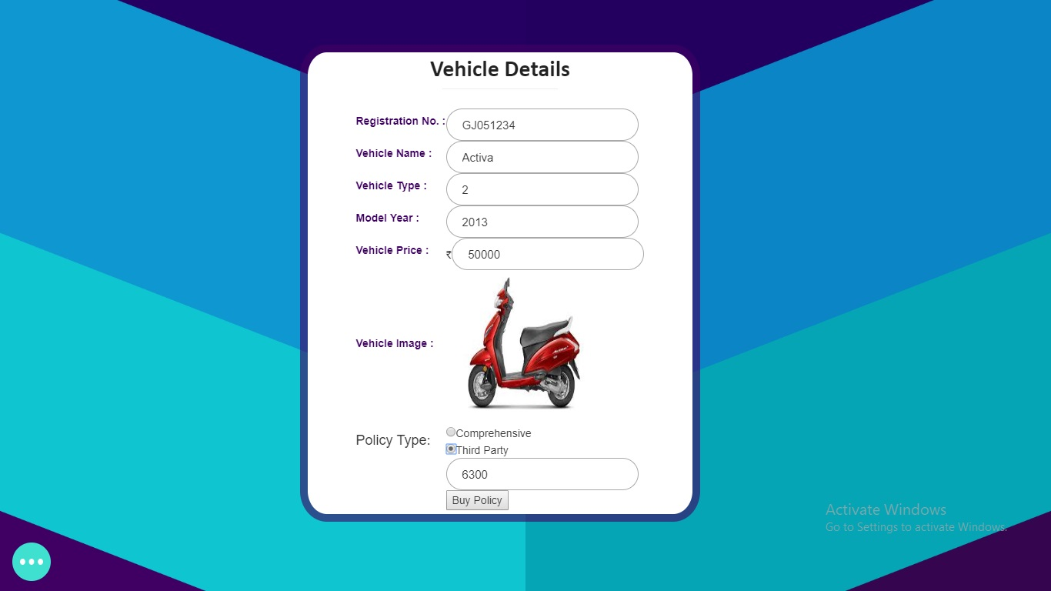
Buy Policy Confirmation Page

Slide 9
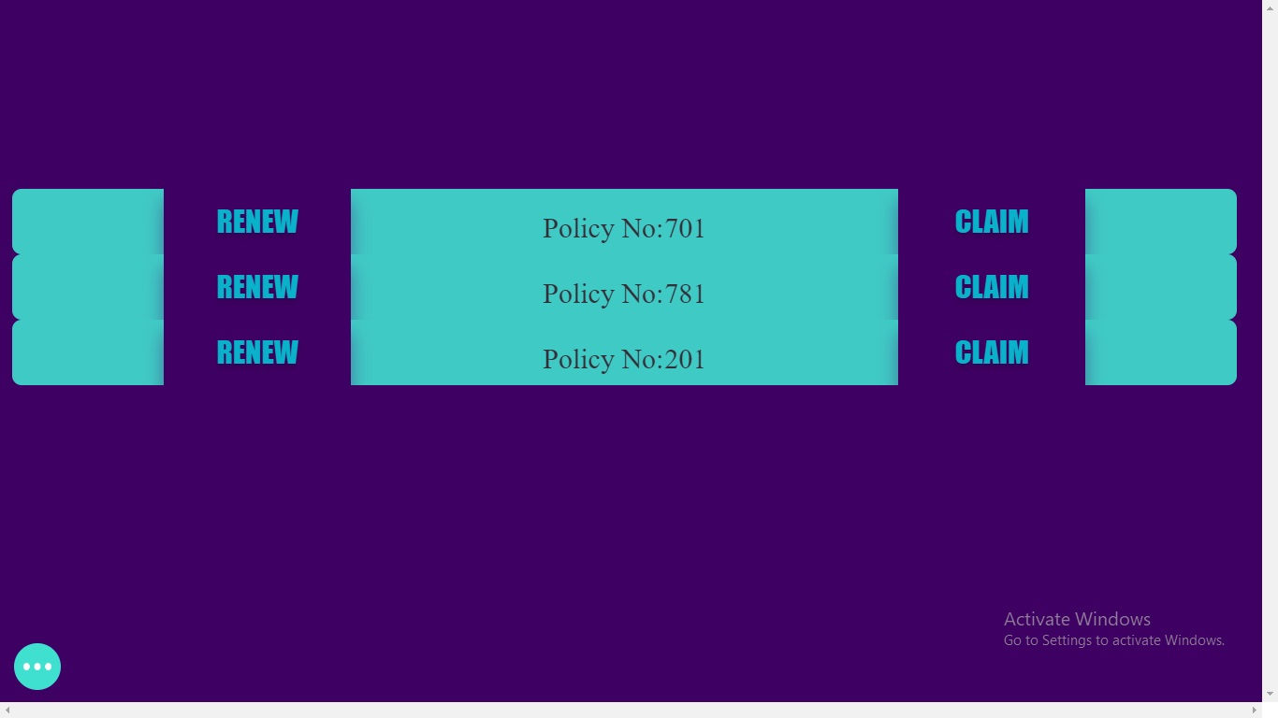
User Policies

Slide 10
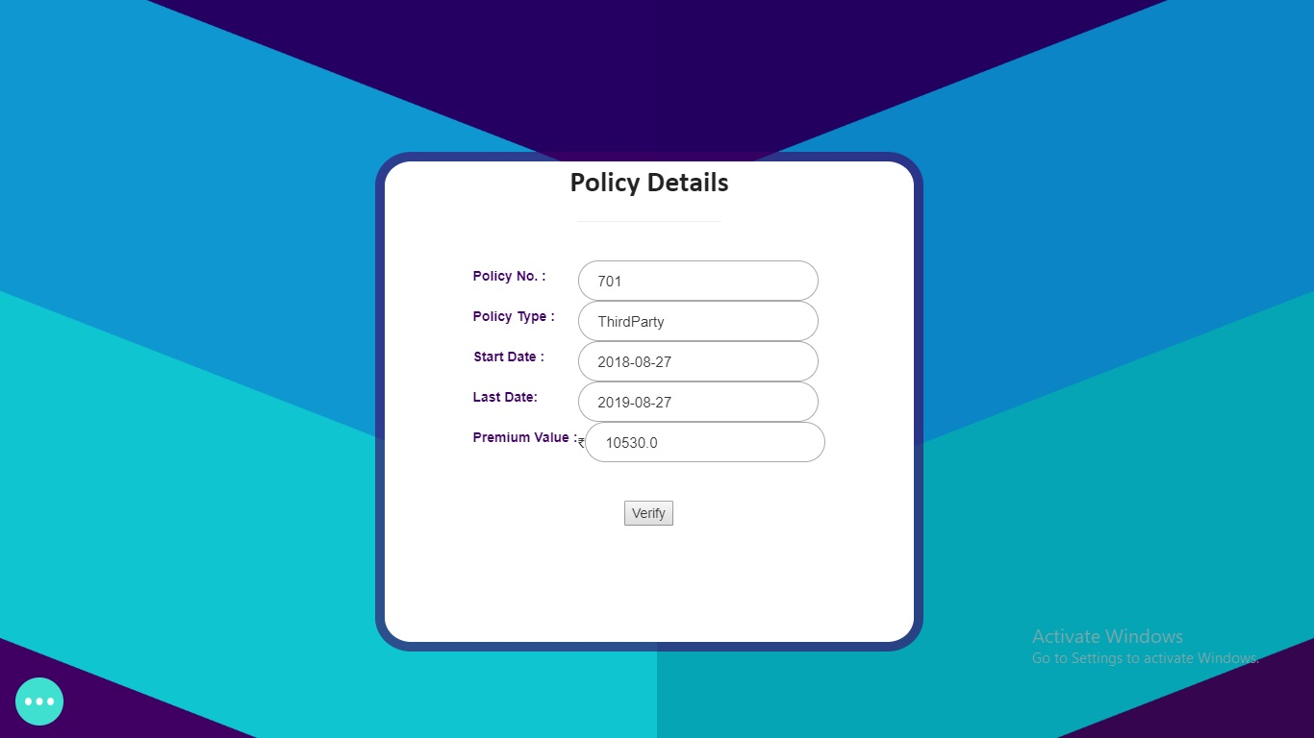
Renew Policy

Slide 11

Buy Input Page

Slide 12
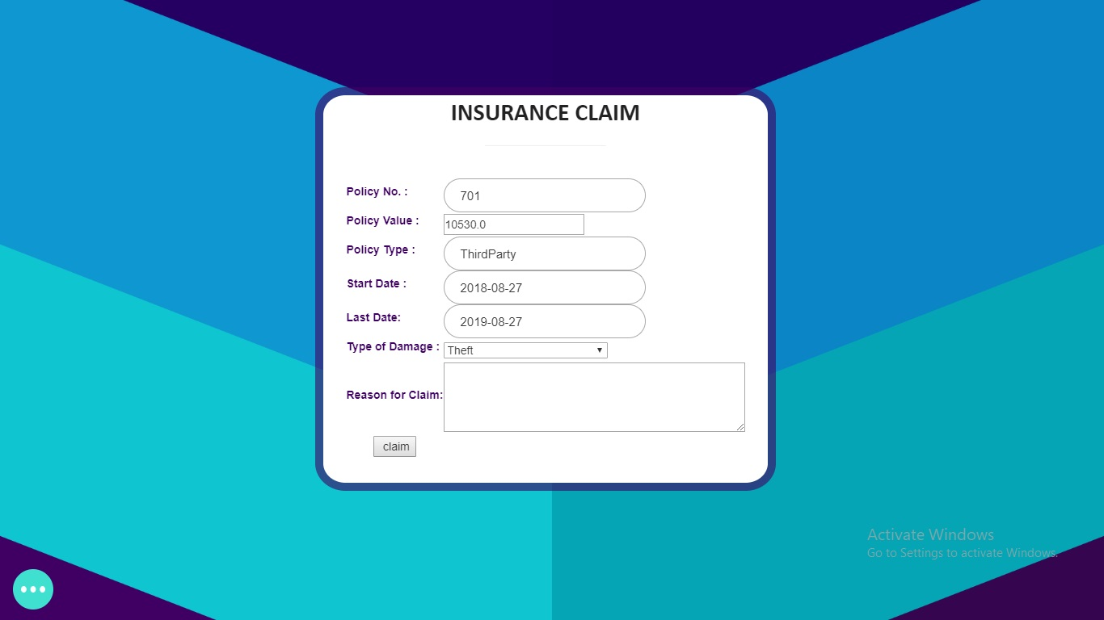
Insurance Claim Page

Slide 13
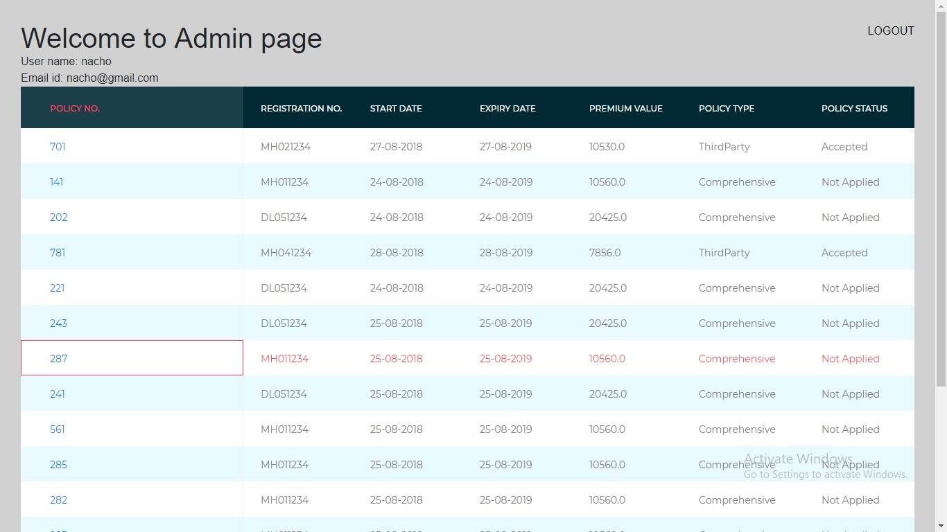
Admin Dashboard

Slide 14
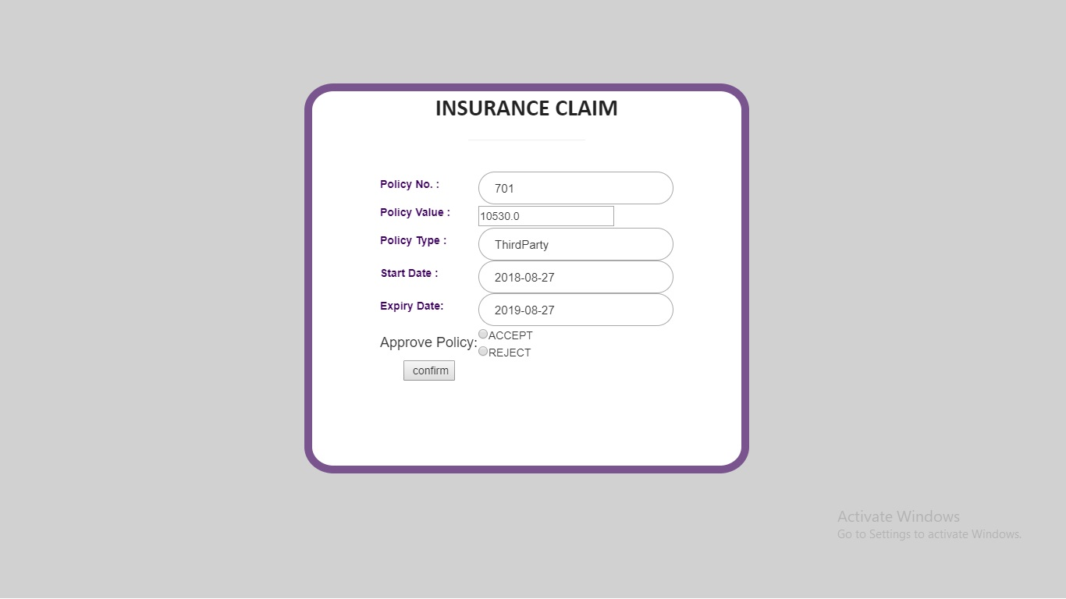
Admin Claim Approval Page

Slide 15
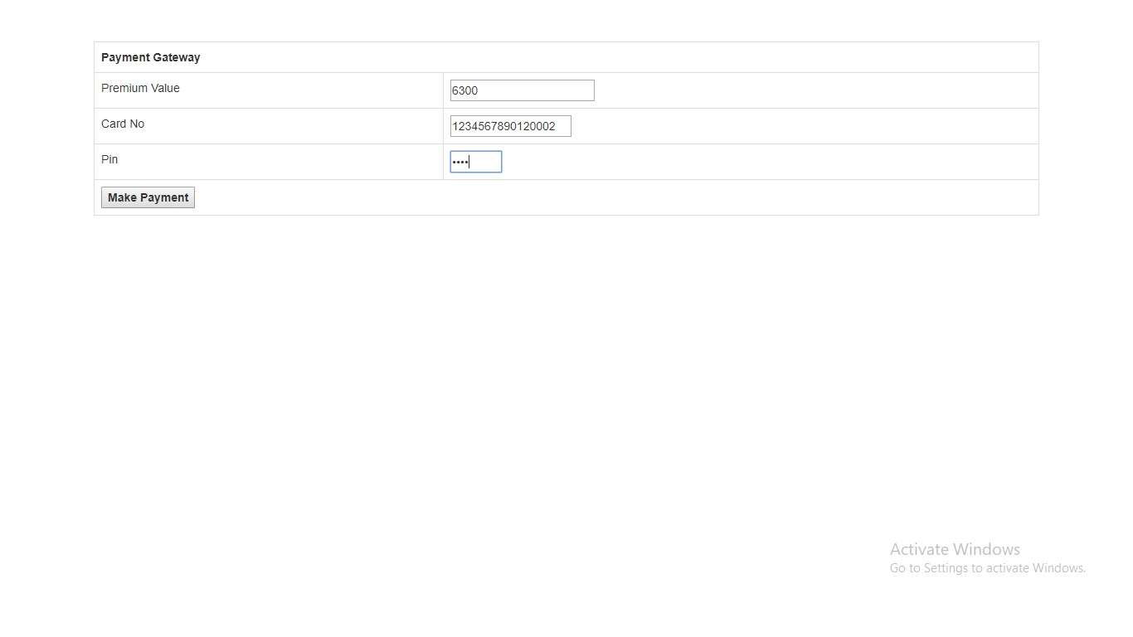
Payment Gateway

Slide 16
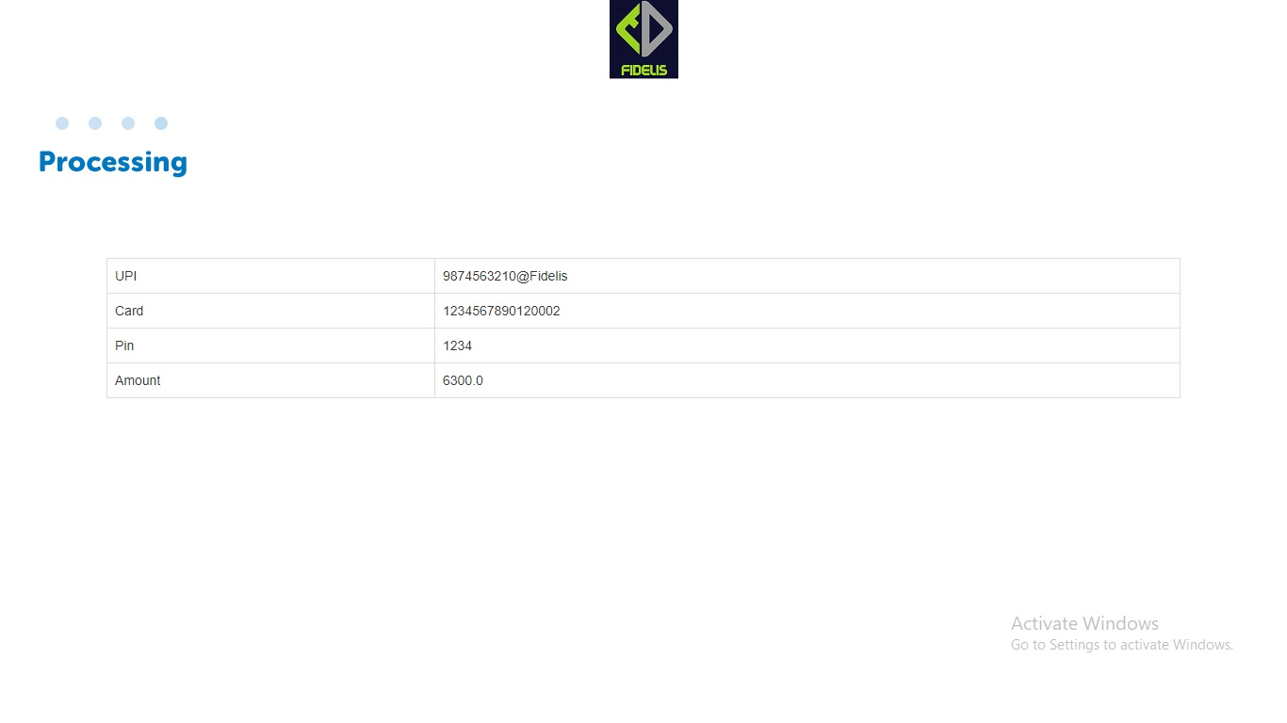
Payment Summary

Slide 17
Thank You

