Slide 1
Accenture
File created on: 6/10/2024 11:06:39 AM

Slide 2
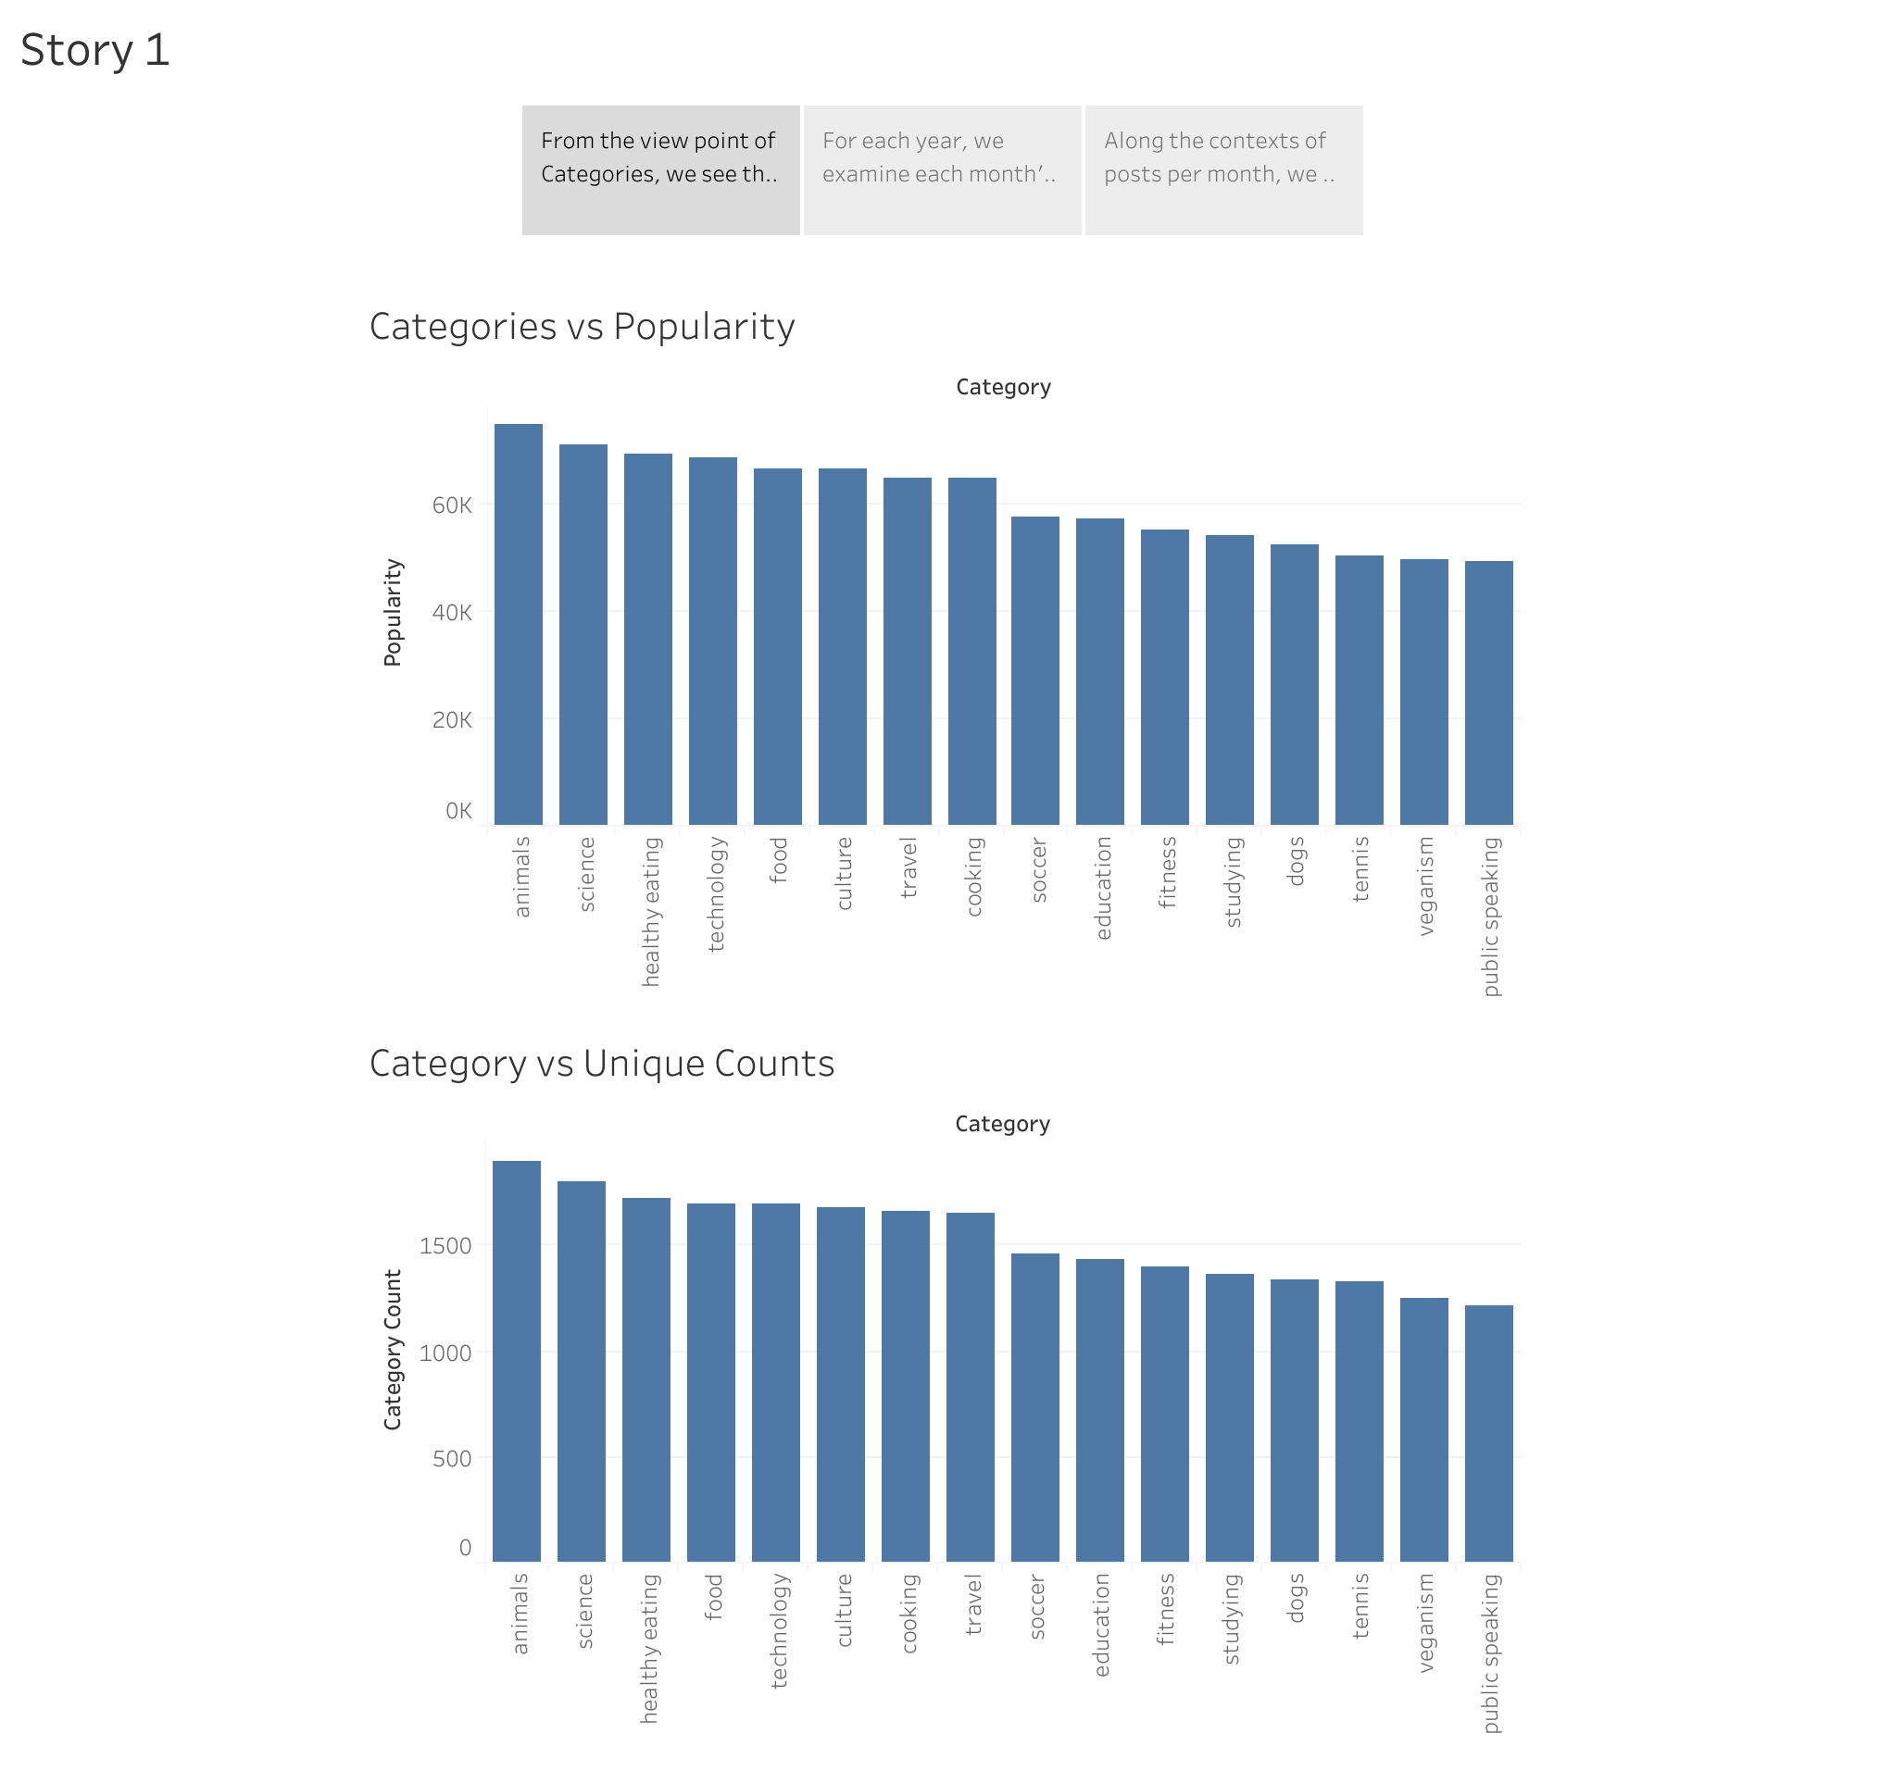

Slide 3
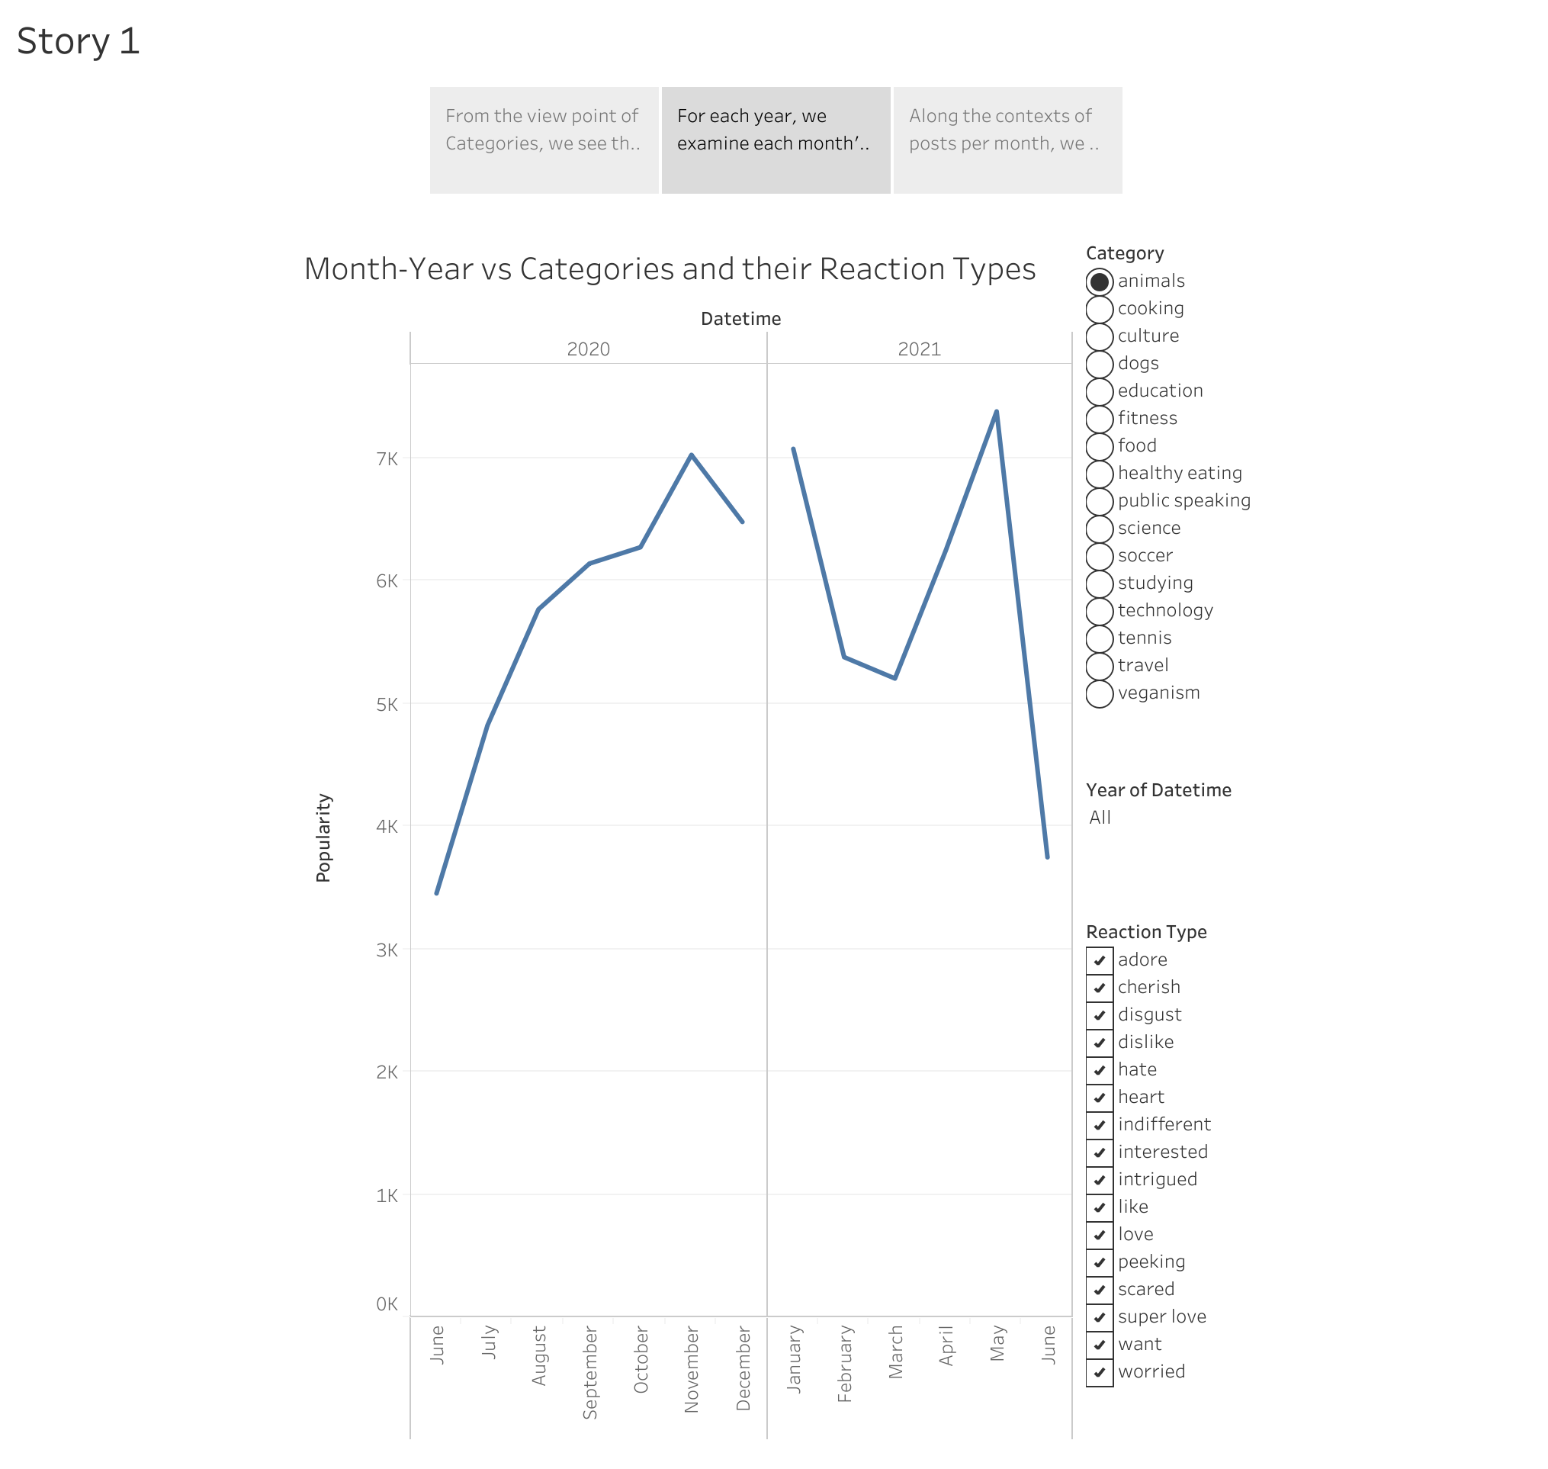

Slide 4
