Slide 1

Unveilling the impact
HOW A NEW WEBPAGE TRANSFORMS USER EXPERIENCE
Ayo Mosaku
25th August, 2024
Udacity Inc.

Slide 2
BACKGROUND
This project seeks to explain the outcomes of an A/B test conducted for our e-commerce partner, aimed at boosting the number of users who purchase their product by examining changes to their webpage.

Slide 3
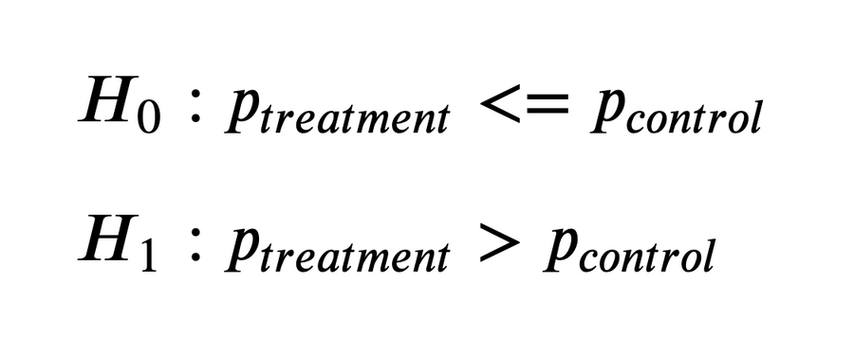
HYPOTHESES
There are two sides to this proposal of ours.
Our null Hypothesis, that is our status with no data collated, ‘Ho’ states that there is less than or no increase in purchases brought abouut by changing our homepage(Treatment <= Control)
This is opposed by our Alternate Hypothesis, ‘H1’ denoted and says there is an increase in users who purchase our item on our new homepage (Treatment > Control)

Slide 4

METHODOLOGY
We gather and randomize a bit shy of 70,000 inputs, evenly split between the Treatment and the Control samples across 3 countries
Total Control Participants: 34678
Total Treatment Participants: 35211

Slide 5
CONVERSION RATES
 | US | UK | CA
CONTROL | 10.7% | 10.16% | 9.44%
TREATMENT | 15.8% | 14.87% | 15.40%
Executive Summary:
We have analyzed our performance in converting potential users into paying customers across all countries. This analysis highlights the effectiveness of our newly developed web page, which was specifically designed to enhance user conversion rates. By examining the data, we can see a significant improvement in our ability to convert interest into purchases, thereby increasing our company's product sales globally. This success underscores the strategic impact of our web development efforts in boosting our market presence and revenue streams worldwide.

Slide 6
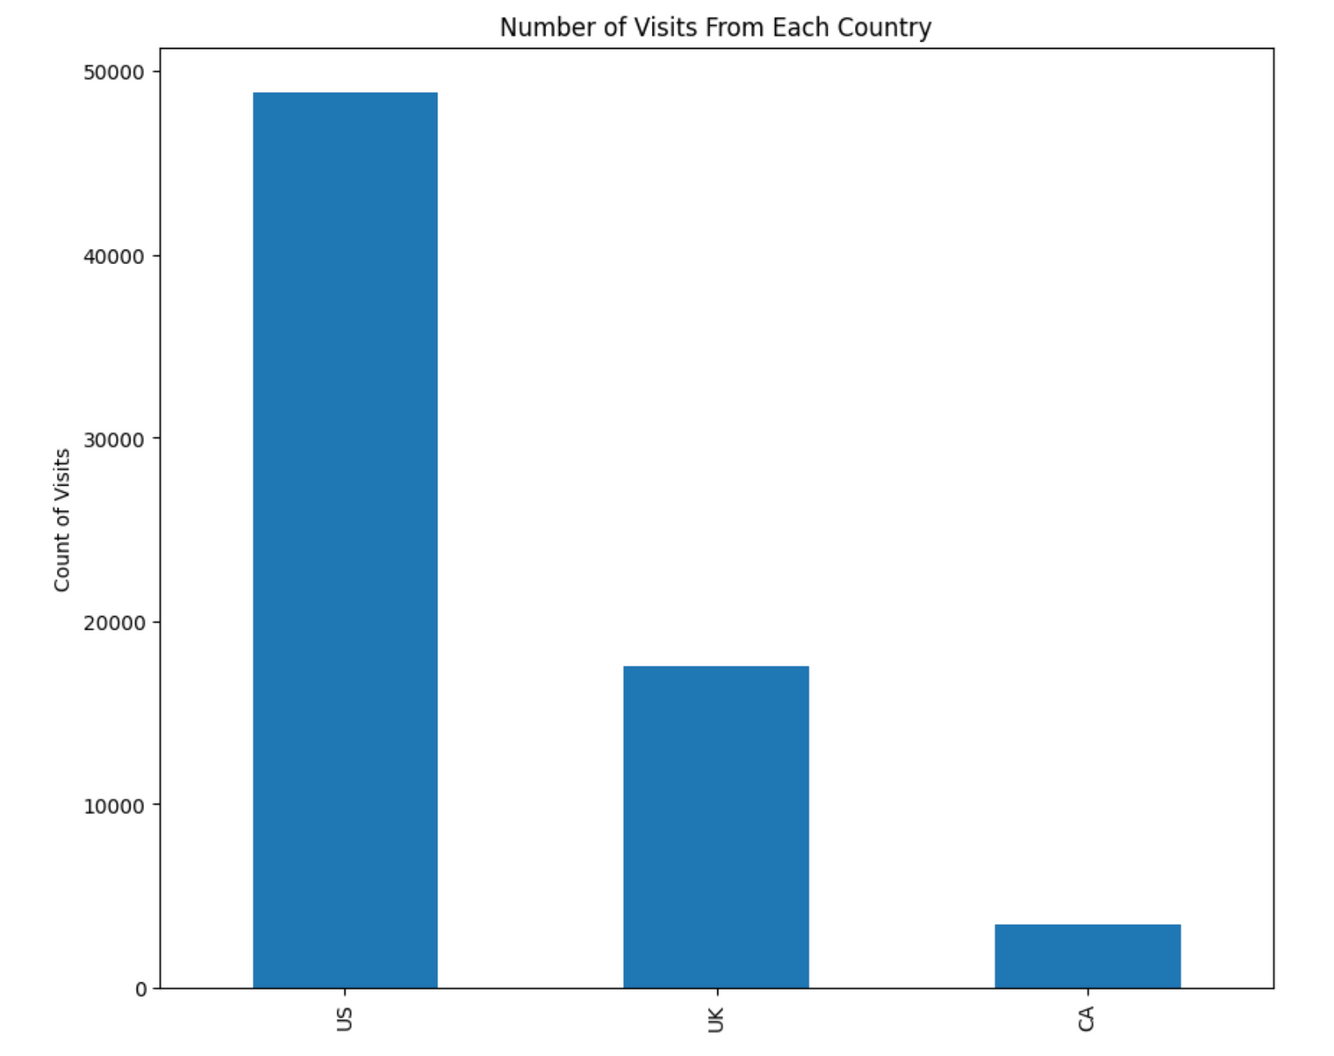
SAMPLE DISTRIBUTION
This chart shows the distribution of total visits amongst our 3 chosen countries of
The US - 48850
The UK - 17551
Canada - 3488
Sampling Distribution

Slide 7
RESULTS
Bootstrapping using a range of 500, we can compare and compute the difference in conversion between the treatment and the control groups.
To summarise:
Actual Diff(between Treatment and Control) = 0.05
Our p-value = 0.00
Our Statistical Significance = 5%

Slide 8
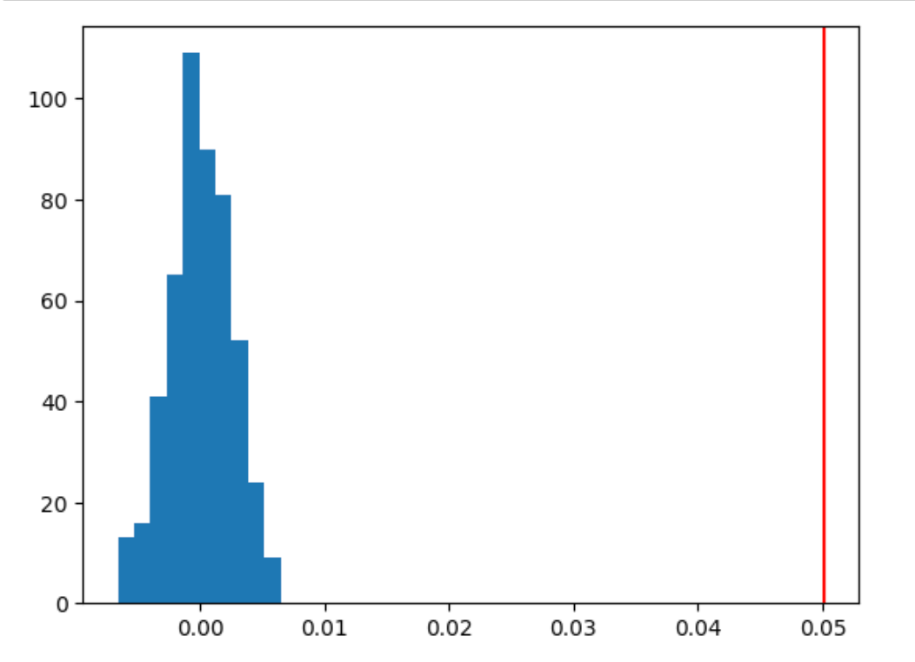
FINDINGS
After careful exploration, we are able to summarise using this graph here.
The graph shows that actual user behavior, represented by the red line, significantly deviates from the expected distribution under the null hypothesis. This deviation suggests that we have rejected the null hypothesis, indicating that more purchases are being made on the new page than anticipated.

Slide 9
Conclusion
In conclusion, obtaining a p-value of 0.00 from our analysis strongly supports rejecting the null hypothesis. The next step is to assess the practical significance to determine whether we should proceed with launching our new webpage.

