Slide 1
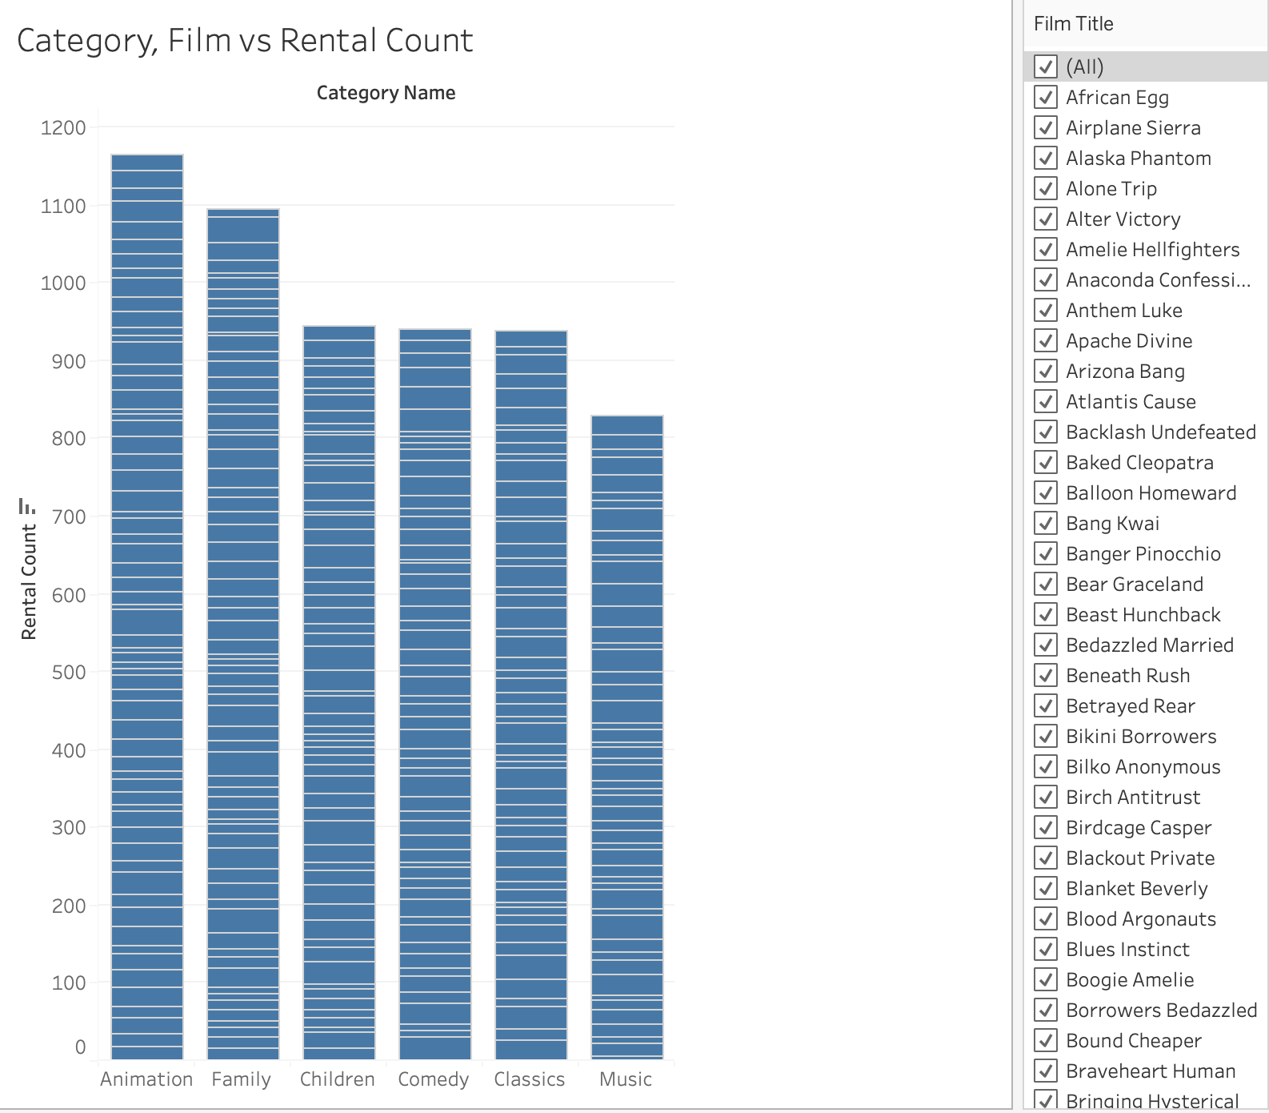
How can we analyse the rental frequency of different film categories over time using the data provided?
<visualization>
Each vertical bar symbolizes a film category, with the segments inside the bar showing rental counts for various movies, which together make up the total rentals for that category. This allows us to observe that the Animation, Family, and Children sections are indeed performing the best in our family-friendly section.

Slide 2
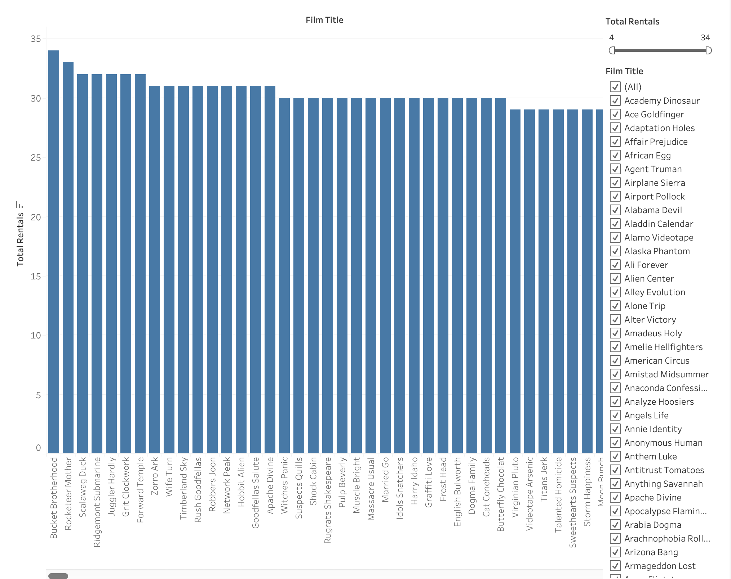
What are the most frequently rented films in the database, and how many times has each been rented?
<visualization>
The query returns a list of film titles sorted by their rental frequency, showing which movies are most popular among customers. This is inclusive of ALL categories of movies really.

Slide 3
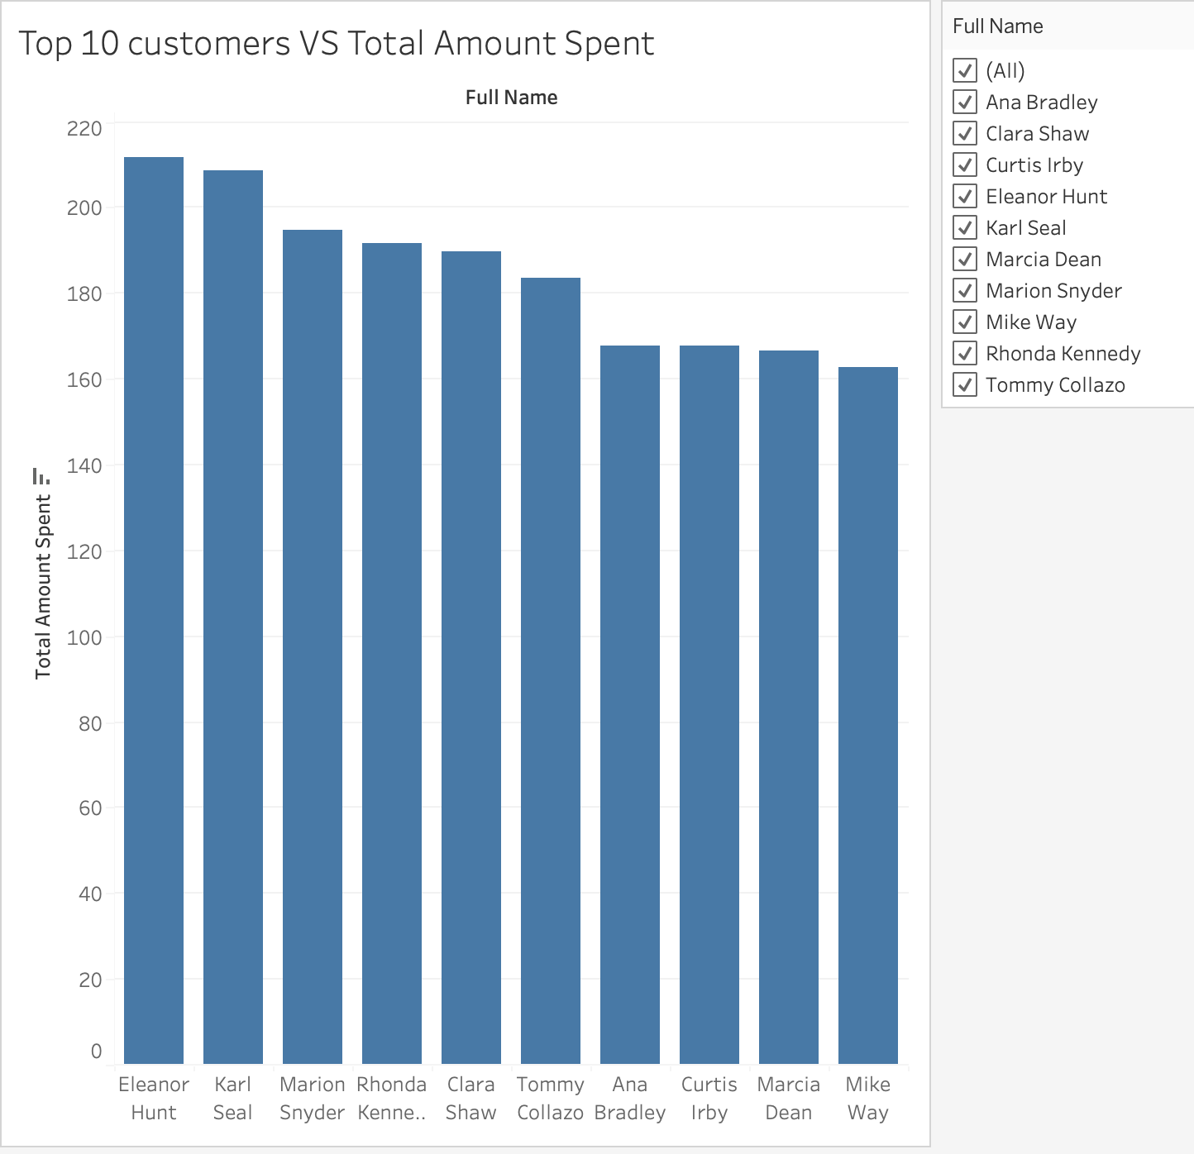
Who are our top spenders for the upcoming loyalty program. Can we find them ?
<visualization>
We can easily identify our top 10 purchasing customers.

Slide 4
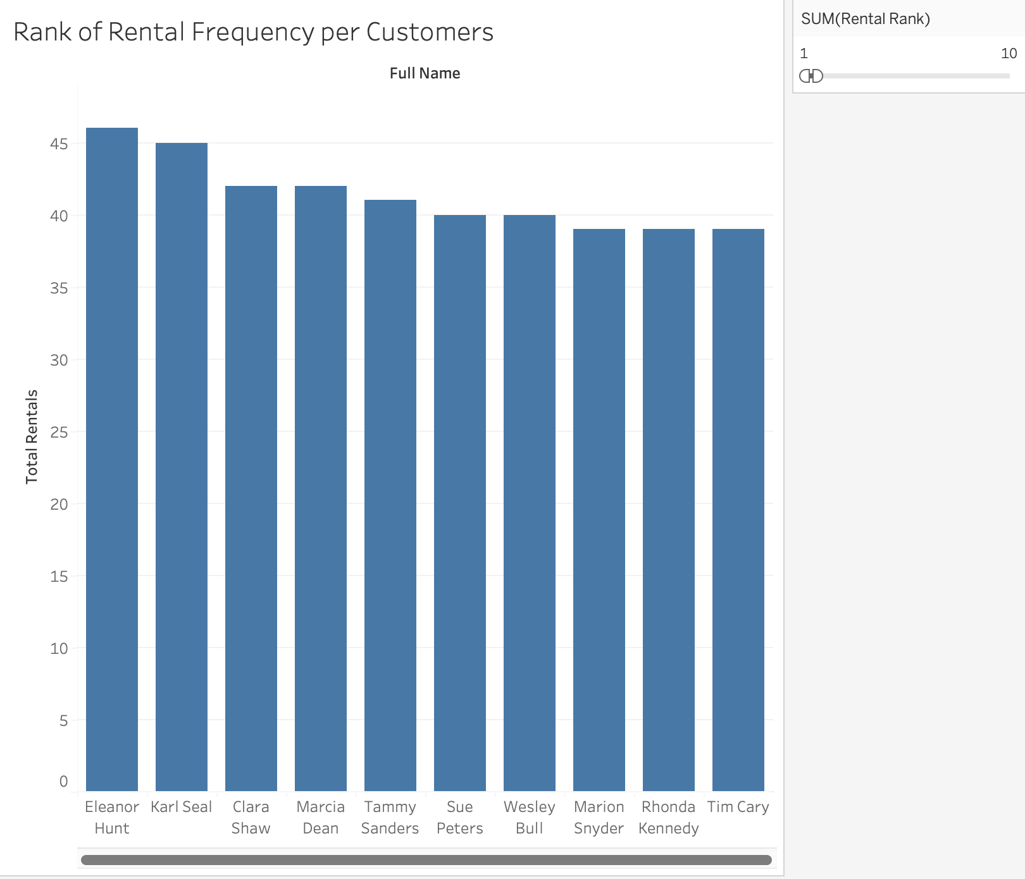
Rank our customers according to how many orders they have put through.
<visualization>
To properly manage our inventory, we can perform a thorough analysis to rank each customer according to the total number of rentals they have completed. The filter on the side makes it even easier to move across ranks.

