Slide 1
Neyer Gap Test
MATLAB implementation audit and V1.9 delivery
Decreasing-interaction gap model
Standalone MATLAB R2022b Live Script
Audit • physical workflow • simulation evidence • operation
September 2026

Slide 2
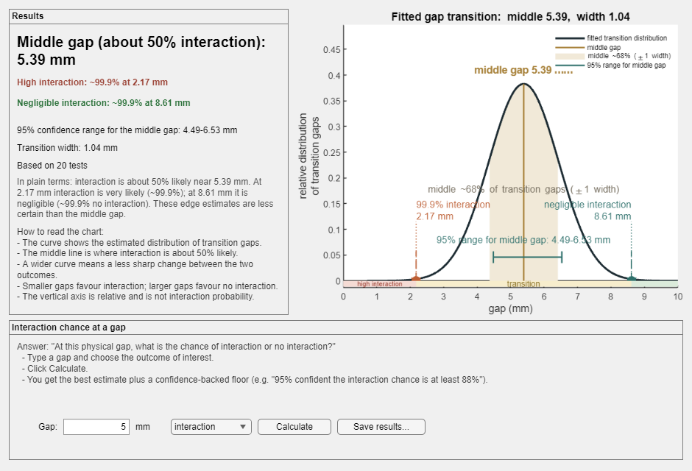
What the method estimates
02
Middle gap
The gap with about 50% interaction chance.
Transition width
How quickly the material response changes around the middle.
Smaller gap
Larger gap
interaction likely
interaction unlikely
Neyer Gap Test v1.9

Slide 3
V1.8 audit findings
03
Area | What V1.8 did | Audit result
Stage 1 | Simplified outward doubling | Reference table matched, general paper rule did not
Stage 2 transition | Used 1.5 × guessed sigma | Historical reconstruction, not Neyer's rule
0.8 shrink | Setting existed but stayed inactive | Repeated Stage-2 behavior did not match
MLE | Probit likelihood with positive sigma | Core method matched; numerical depth remains a limitation
D-optimal point | Maximised information determinant | Core rule matched; grid and fence are engineering choices
Rounding | Two decimal places | Reproduced Table 1 but did not describe the physical tool
Stopping | Fixed budget, no estimate without overlap | Sound; repeated boundary clamping needed a safe pause
Original V1.8 remains unchanged and hash-matched

Slide 4
The Stage 2 correction
04
1.5 × sigma
State | Next action | Exit condition
Part 1 | Bisect the response bracket | Bracket width reaches 1.0 guessed sigma
Part 2 | One-way D-optimal selection | Yes and No results strictly overlap
After each Part-2 test | Working sigma × 0.8 | Never return to bisection
This threshold was chosen while reconstructing Table 1. The paper uses one guessed sigma.
0.8
After each Part-2 test, multiply the working sigma by 0.8.
Table 1 hid the problem because its first D-optimal test created overlap immediately.
Neyer Gap Test v1.9

Slide 5
Physical gap workflow
05
Gap value | Plain meaning | Use in V1.9
Internal target | Mathematical best next point | Saved at full precision
Build request | Useful physical setting | Shown with exactly two decimals
Measured mean | Average of 4 or 5 readings on this new build | Used as the statistical gap
Physical control and material thickness stay separate
Foil is approximately 0.015 mm thick. Printed 0.50 mm spacers have measured about 0.49 to 0.52 mm. V1.9 therefore uses a provisional 0.05 mm usable resolution and a 0.10 mm Stage-2 planning floor. Every final assembly is measured before testing.
Neyer Gap Test v1.9

Slide 6
Usable resolution changes Stage 2 performance
06
0.10 mm is workable when the true transition is broad. It becomes restrictive when the transition itself is near 0.10 mm.
32 settings × 200 paired repetitions
Source: increment-study-results.csv

Slide 7
Corrected physical simulation: 129,600 runs
07
2 × resolution
Chosen as the Stage-2 working-sigma floor.
At 50 tests: 99.70% actual overlap, 0.009% false overlap.
These corrected values replace the earlier simulation, which used the requested gap—not the actual built gap—to decide the outcome.
432 scenarios × 300 repetitions · outcome uses actual built gap

Slide 8
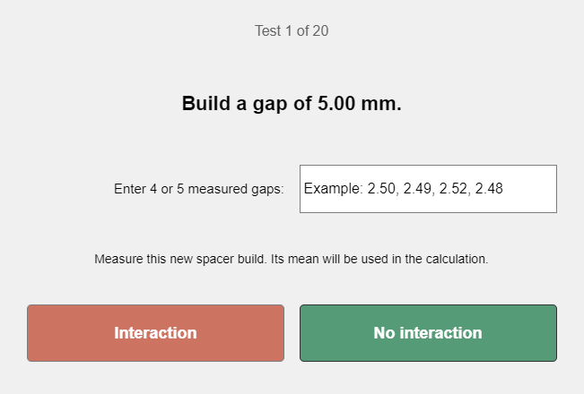
Boundaries and safe stopping
08
Default study range
0 mm to 10 mm
Unexpected result at a boundary
Repeat that same boundary once for confirmation.
Same contradiction twice
Pause for review and preserve the data. The software does not label the whole experiment a failure.
Neyer Gap Test v1.9

Slide 9
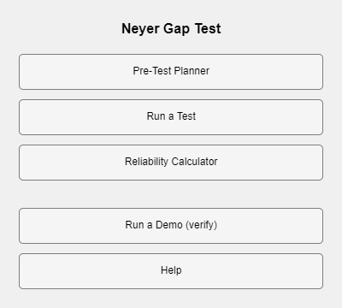
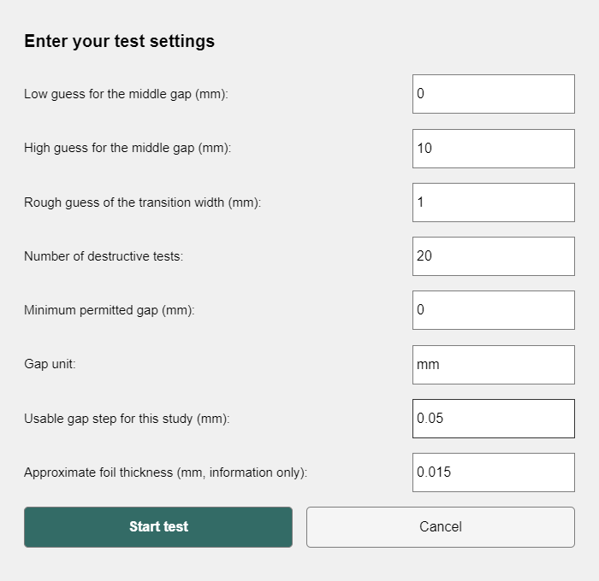
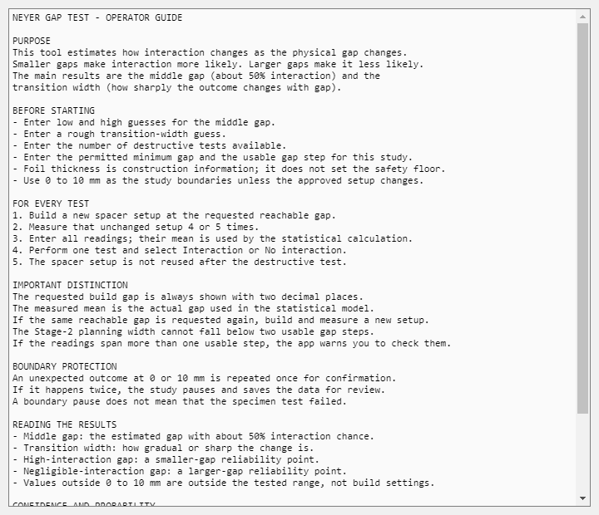
Operator screens
09
Main menu
Physical settings
Operating help
Neyer Gap Test v1.9

Slide 10
Running V1.9
10
1 | Open and run the Live Script | Neyer_Gap_Test_v1_9.mlx in MATLAB R2022b
2 | Verify the build | Run a Demo should return 5.3922 mm and 1.0412 mm
3 | Enter the study setup | Use 0–10 mm, a provisional 0.05 mm usable step, and 0.015 mm foil thickness
4 | Build and measure each new spacer | Enter four or five readings before the destructive test
5 | Record the outcome and continue | Choose Interaction or No interaction, then save the final results
No executable, helper folder, addpath, internet connection, or add-on package required

Slide 11
Saving result data
11
The operator chooses the folder and base name
Output | Complete path shown before saving | Contents
CSV data | <selected folder>\<chosen name>.csv | Internal target, build request, every reading, measured mean, warning, and outcome
HTML result report | <selected folder>\<chosen name>.html | Self-contained summary, estimates, and chart
No silent overwrite
If either intended file already exists, the app writes neither file and asks for a different name.
The selected folder remains visible in both complete paths before the user confirms

Slide 12
Final verification
104 / 104
5.3922 / 1.0412
MATLAB regression tests passed
Embedded demo result
1 file
V1.8 preserved
Live Script ran alone in an empty folder
Original and audit copy hashes remain identical
Final package folder
OneDrive\CHATGPT-Neyer\
Physical confirmation still required: prove whether the provisional 0.05 mm usable resolution is repeatable on complete builds.

