Slide 1

Weather Forecast System

Slide 2
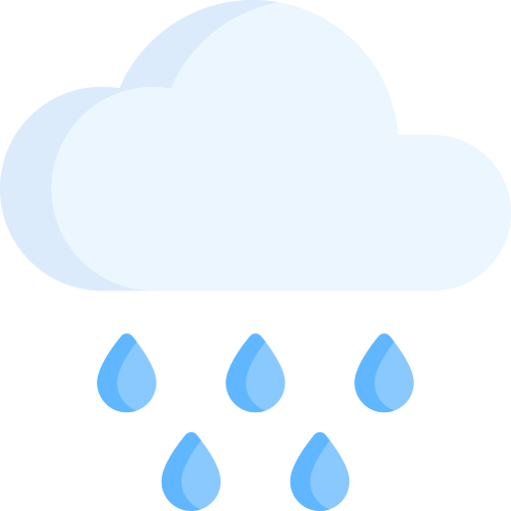
Let's look at the problem
In todays world, many businesses depend on weather e.g. agriculture where good forecast can determine the final result of crops harvested or in energetic field where information if it is going to rain enables earlier actions to prevent water turbines from damage. We also need to remember about our every day life when we check weather forecast to decide if we are going to take umbrella with us.

Slide 3
Our solution
In day of modern technology we can create tools that enables us to foreshadow the weather
Current weather station
Computers and AI models
Today, we are equipped with new sensors, collecting data non-stop no matter the daytime in every corner in the World. In addition, We can now get data from space – NASA satellites orbits around the globe and collect vast amounts of data we need to forecast e.g. tomorrow's rain.
From sensors we can only collect current data, but with use of modern computers an different algorithms we are able to create accurate forecast for next few months, maybe even years.

Slide 4
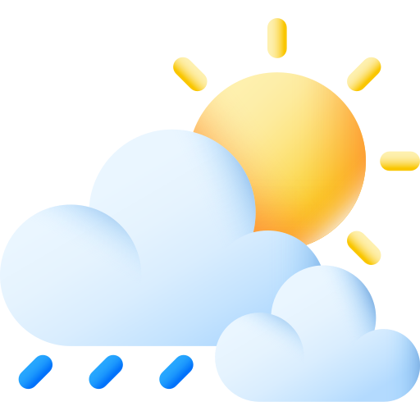
Weather forecast system
With advanced weather forecast system we could:
Maximize yields, by providing farmers with temperature , rain amount , frosts data, so farmers could produce more crops and that translates to more food being produced
Automate processes as emptying water reservoirs to prevent water overflow and floods, or adjust windmill blades to minimize potential damage caused by strong wind,
Prepare for catastrophic natural disasters by evacuating potential flooded areas, or accumulate water for future drought

Slide 5
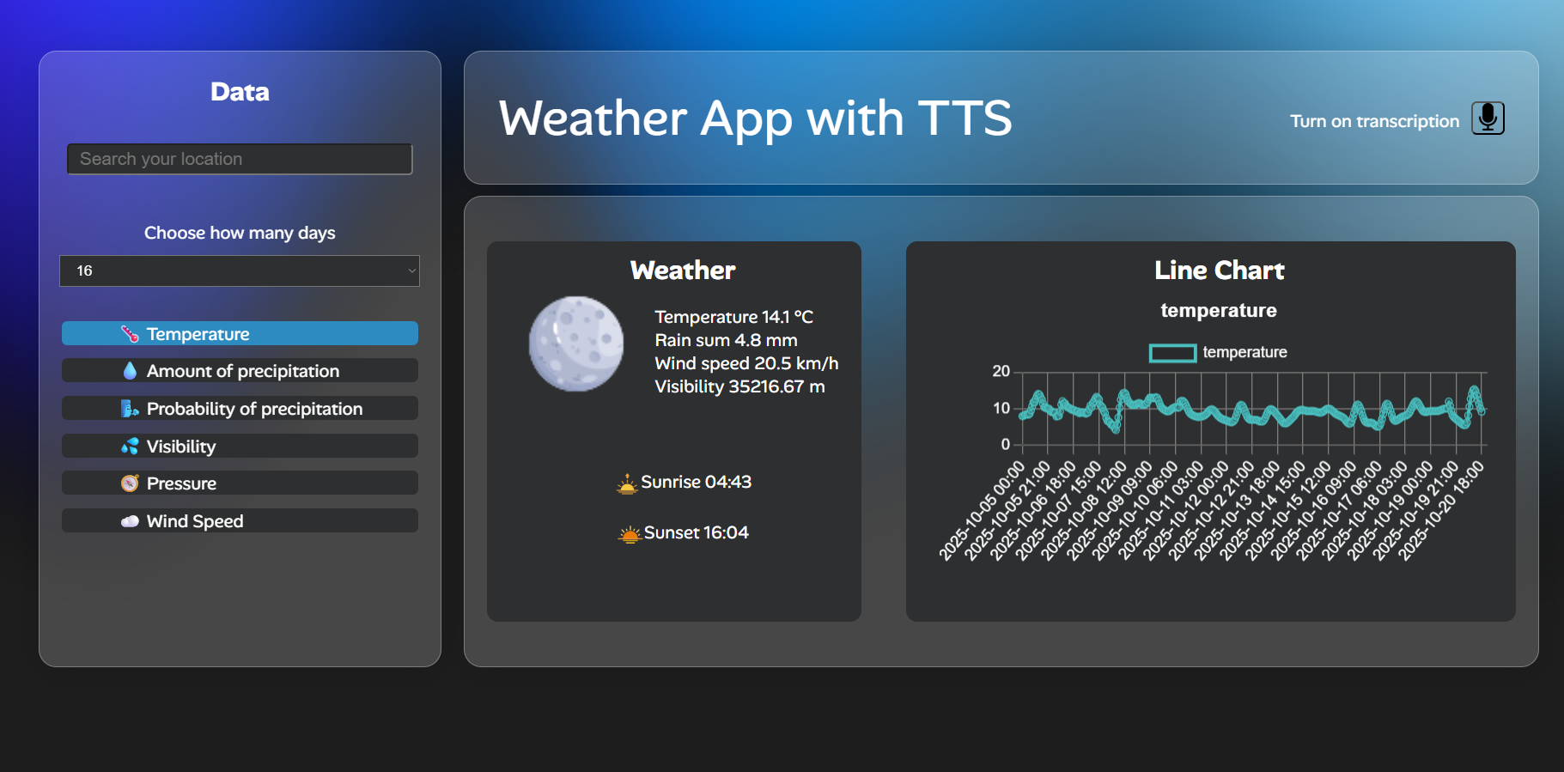
Casual user
All previously mentioned use cases for weather forecast system are aimed in big companies, farms, whole cities or even country, but What about us?
With that system we might provide data for web apps so we can see if we want to take that umbrella from house.
And that what our team build. Example of weather web app which can provide data for users. We add some features as text to speech ability so our users that commutes to work by their car and still want to know the weather, in their car they cannot simply read the forecast but they can listen to it.

Slide 6
Our plans for the future of our weather system
(01)
(02)
(03)
Build big data centers
capable of forecasting weather for years
Exploring potential use cases for domestic automation systems
Collaborate with big companies to improve our system

Slide 7
Thanks !
Members of team KAP_stdio(0):
_ Kornel Garczyński
_ Piotr Prątnicki
_ Adam Wroński

