Slide 1

ML Mini Project
Zomato Food Delivery Dataset
Dhruv Verma

Slide 2
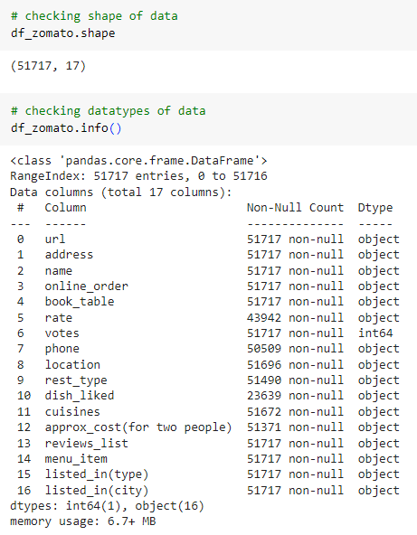
About the Data:
Zomato is an Indian multinational restaurant aggregator and food delivery company founded by Deepinder Goyal and Pankaj Chaddah in 2008. Zomato provides information, menus, and user reviews of restaurants as well as food delivery options from partner restaurants in select cities.
Exploratory Data Analysis
Attributes:
51717 Rows, 17 Columns
1. URL - Website of the Zomato for each restaurant.
2. Address - Address of the Restaurant.
3. Name - Name of the restaurant.
4. Online Order - The customer ordered the menu online or not.
5. Book table - The customer has booked the table or not.
6. Rate - Rating of the restaurant that has by the customer.
7. Votes - The votes have been given by the customer to the restaurant.
8. Phone - Contact number of the Restaurant.
9. Location - The city name where the restaurant is located.
10. Rest Type - The type of restaurant.
11. Dish liked - Dishes liked by the customer from the restaurant.
12. Cuisines - The cuisines that have been prepared by the restaurant.
13. Approx Cost for two people - The approximate cost of the customer for 2 people.
14. Reviews list - The reviews made by the customers on the restaurant.
15. Menu Item - The menu items that are usually available at the restaurant.
16. Listed in (type) - Contains the type of the meal.
17. Listed in (city) - This contains the neighborhood in which the restaurant is listed.

Slide 3
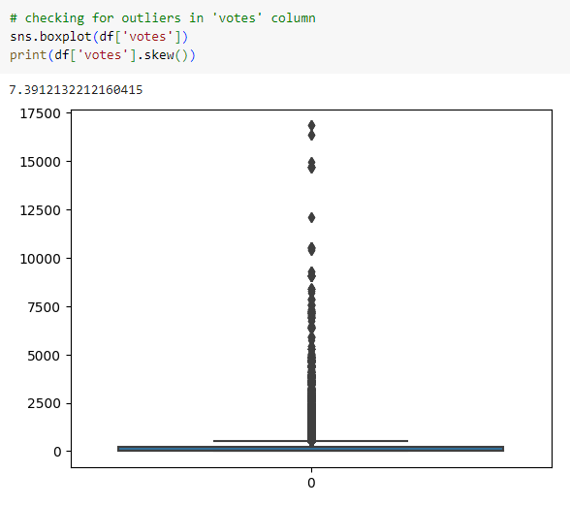
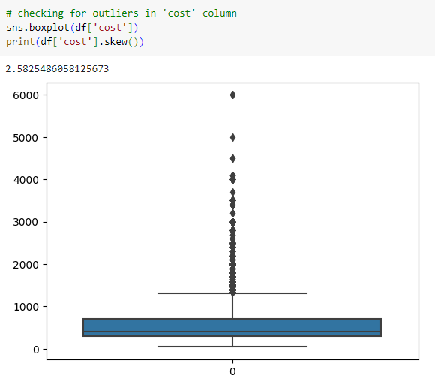
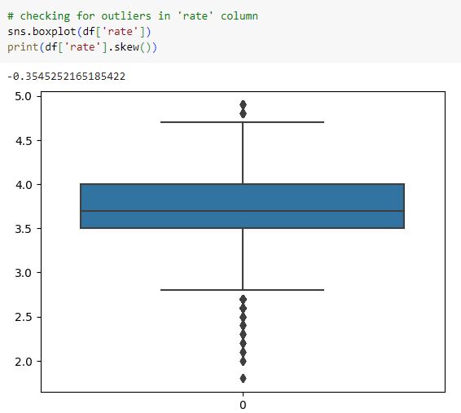

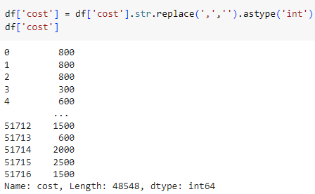
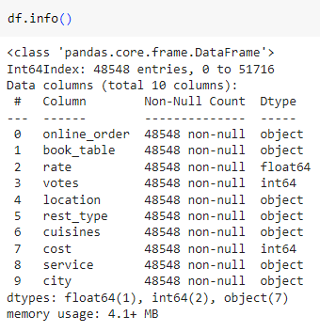
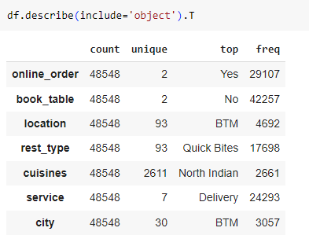
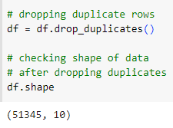

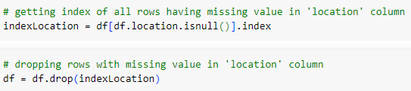
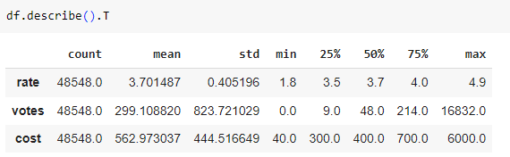
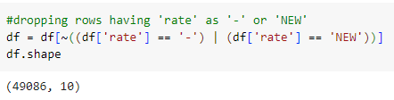
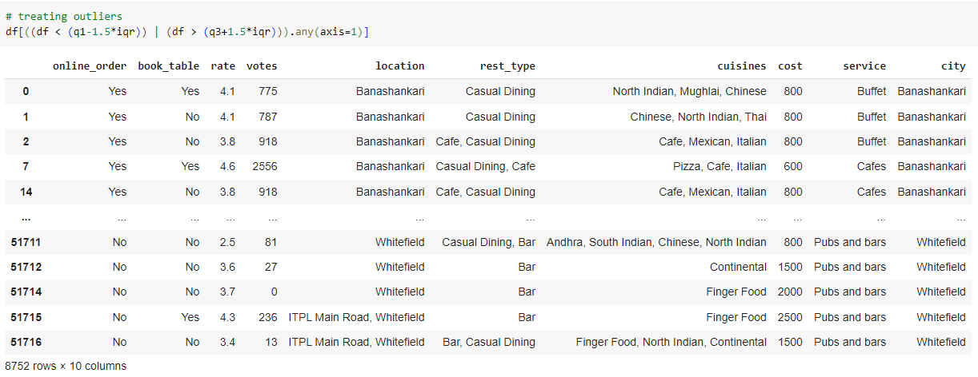


Data Cleaning:
Removed duplicate values form the dataset.
Renamed few columns for better understanding.
Non-related columns were dropped from the dataset.
“,” was removed from the numeric values..
“NAN” values in the dataset were treated.
“NEW”, “-” and “/5” values were treated from the rate column.
Outlier treatment was done.

Slide 4
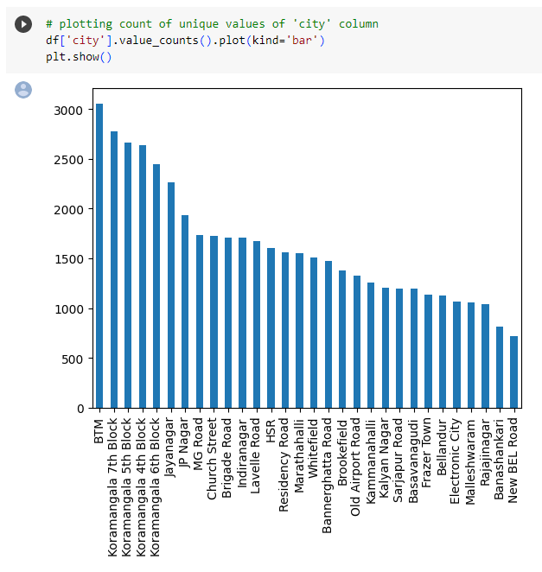
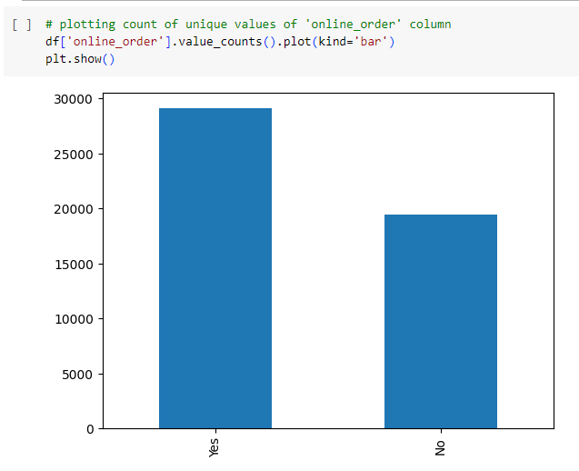
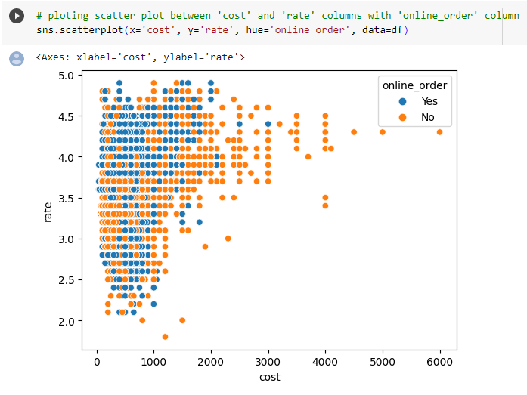
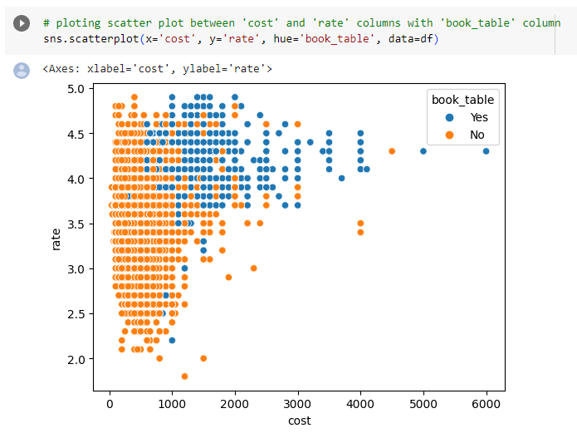
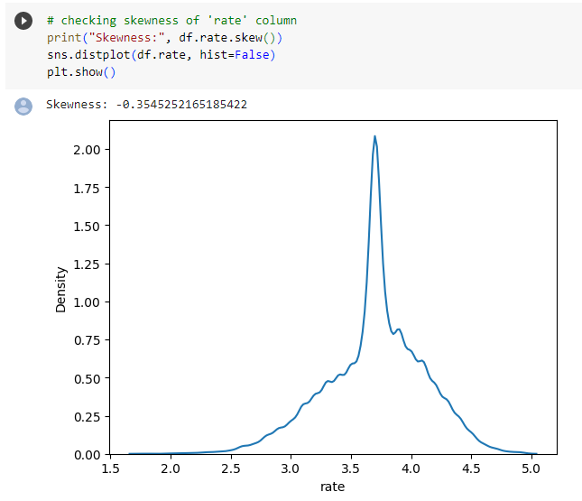
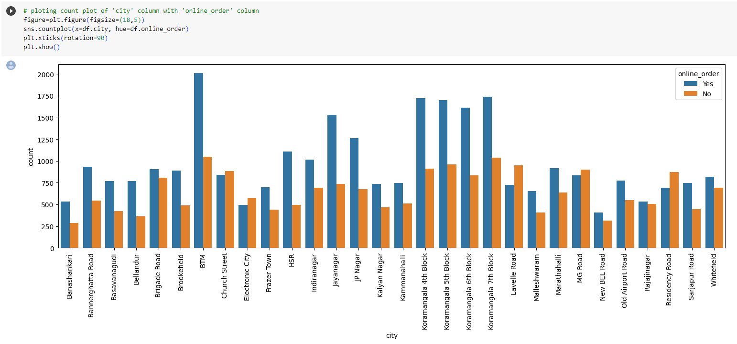
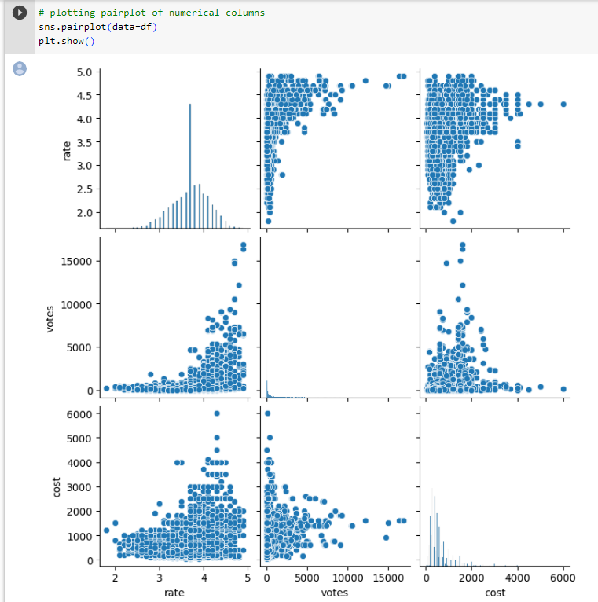
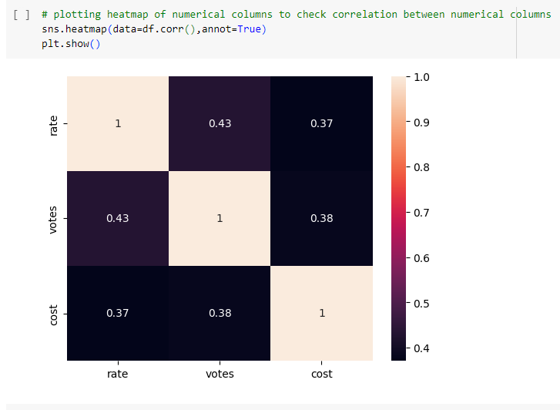
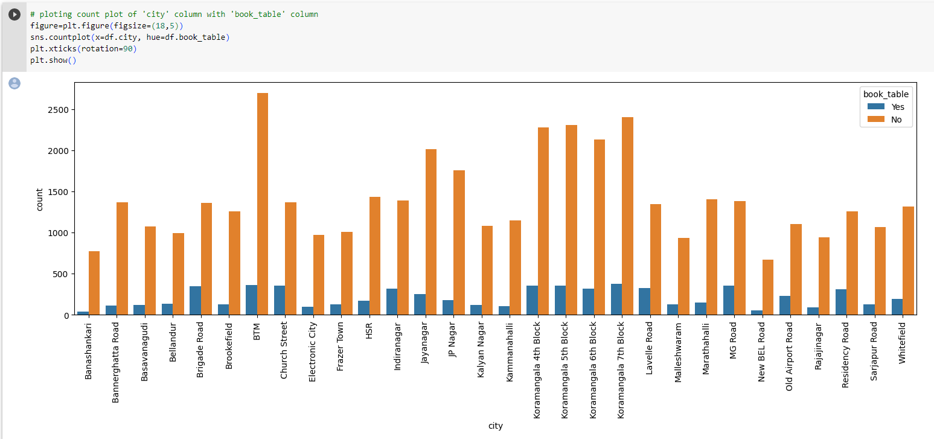
Univariate analysis of data:
Multivariate analysis of data:

Slide 5
Problem Statement
Section A: Regression model
Zomato dataset contains information of various restaurants in Bangalore and we have to help new and upcoming restaurants by letting them know the various reasons that customers look for and build a model which able to predict the cost for two people.

Slide 6
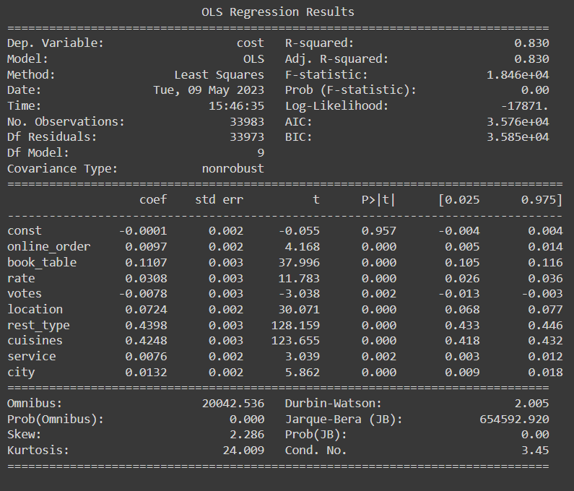
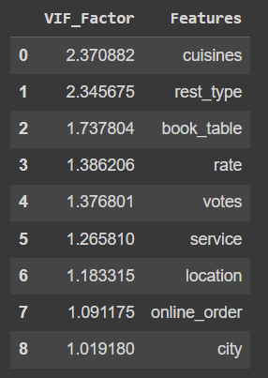
Statistical Test

Slide 7


Prob(F-statistic) < 0.05
pval < 0.05
Cond.no. < 100
Prob(JB) < 0.05
Durbin Watson = 2.005

Slide 8
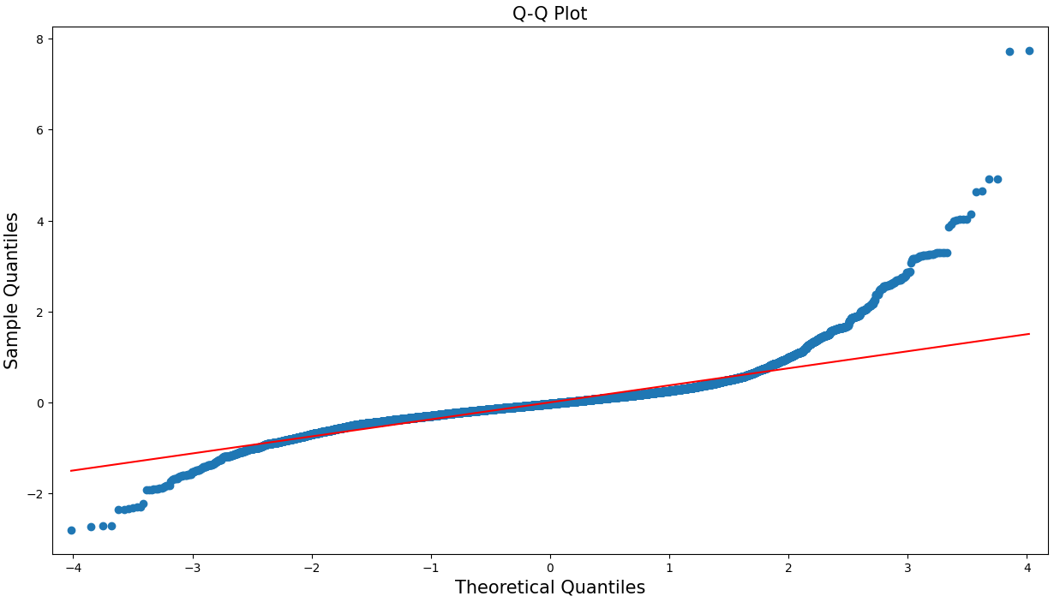
Normality Test

Slide 9
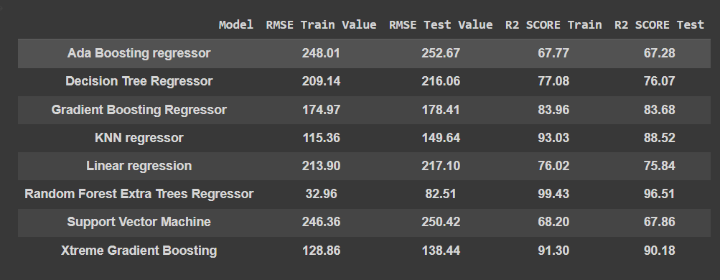
Modelling
Linear regression
Support Vector Machine
Decision Tree
Random Forest Extra Trees Regressor
KNN Regressor
Gradient Boosting
Xtreme Gradient Boosting
Ada Boosting

Slide 10
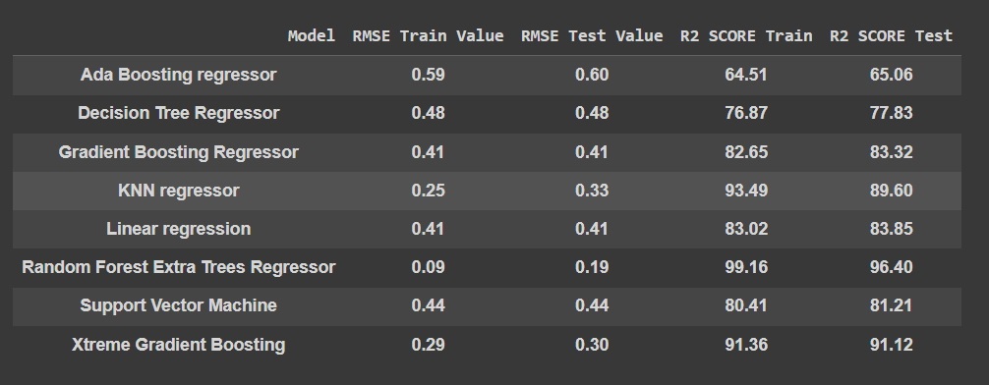
Final RMSE achieved for train and test data with respective R2_score

Slide 11
Problem Statement
Section B: Classification
Due to offline orders, Zomato is not able to attract customers with diverse items and offers, and the user subscription also getting low.The Aim is to classify the orders that have been ordered online and offline. And identify the patterns that lead to orders online orders as well as offline.

Slide 12
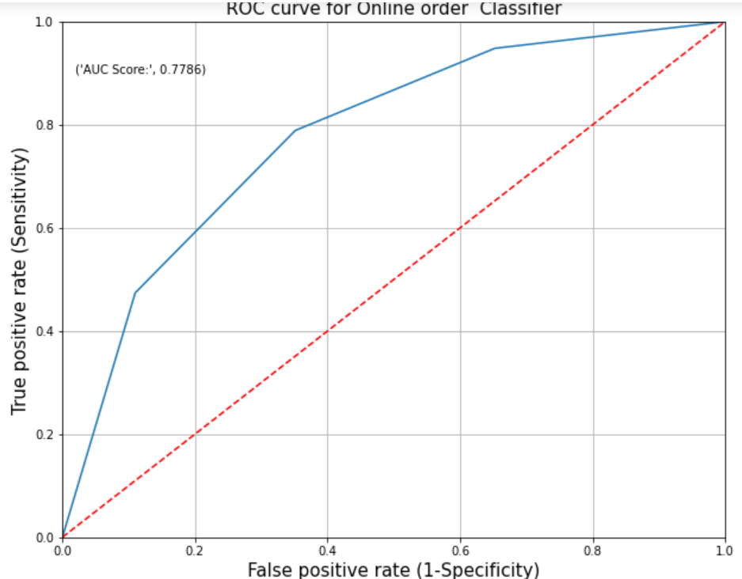
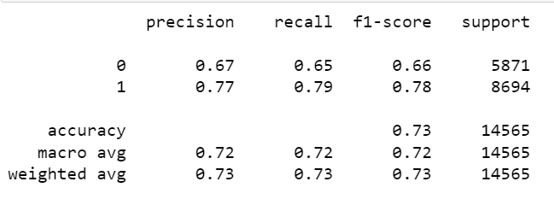
KNN Classifier Model

Slide 13
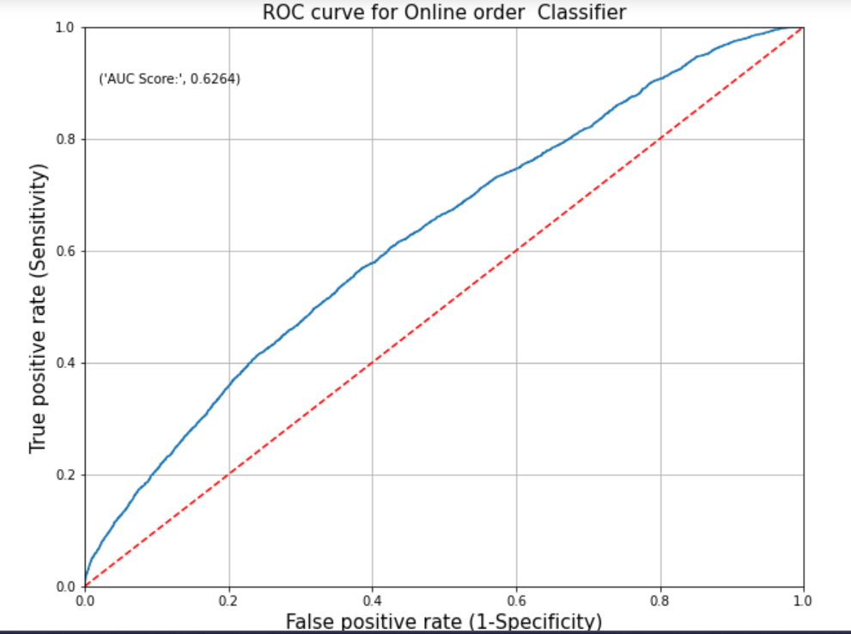
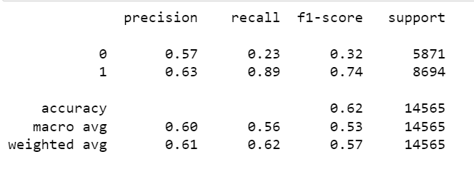
Naive-Bayes Classifier

Slide 14
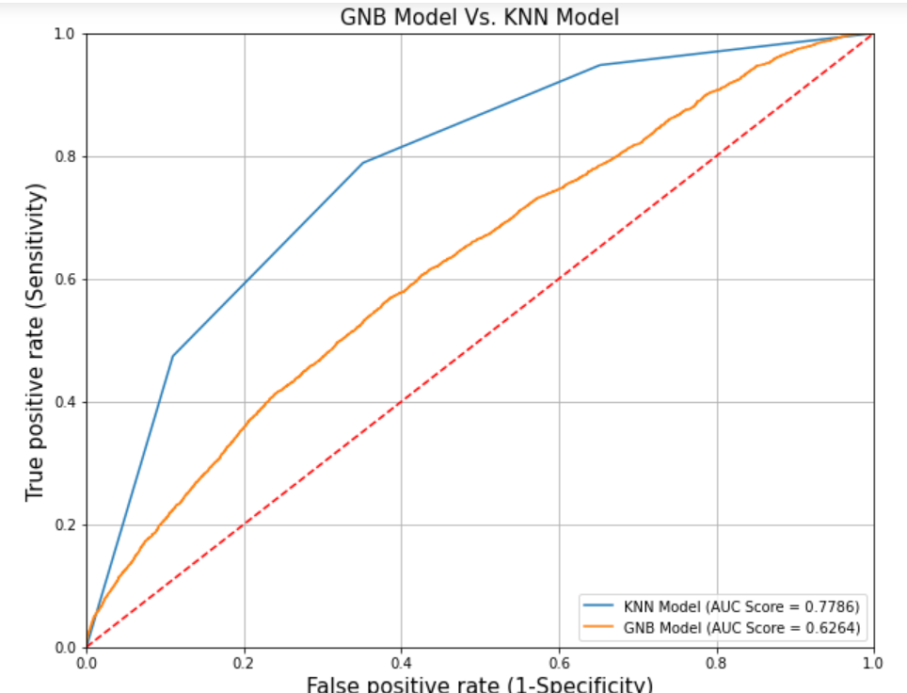
Comparison of Gaussian Naive-bayes model and KNN-classifier model

Slide 15
Conclusion
The mini project of Zomato food delivery has helped us apply the exploratory data and statistical analysis concepts learned in residency and throughout the course in a more practical application. It allowed us to build various supervised learning models and make inferences and think of various steps that may be used to solve a given business problem.
All in all, this project was useful in showing us the practical applications of machine learning and model building and how they can be used in different scenarios.

