Slide 1

PROJECT REPORT – ITP & NPV
LOAN DATASET

Slide 2
Contents : -
Our Project Team Members
Introduction to the Problem Statement.
Data Description
Data Cleaning Steps
Problem Solving Steps
Graphs &Charts used for Data visualization
Takeaways & conclusions

Slide 3


Meet Our Team
Sejal
Baweja
Vijay Kumar Singh
Our team is identified as Group-1. Everyone has worked collaboratively to approach the best outcome towards the assignment.
Sanyam Saini
Jagan Prabhakar

Slide 4
INTRODUCTION
Loans dataset aims to identify variables which indicate if a person is likely to default, which can be used for identifying the risky loan applicants to avoid any financial loss to the company.

Slide 5
DATASET DESCRIPTION
We contains the complete loan data for all loans issued through the time period 2007 to 2011.
Data Dictionary:
Annual_inc - The self-reported annual income provided by the borrower during registration.
Emp_length - Employment length in years. Possible values are between 0 and10 where 0 means less than one year and 10 means ten or more Years.
Funded_amnt - The total amount committed to that loan at that point in time.
Grade - LC assigned loan grade
Int_rate - Interest Rate on the loan
Last_pymnt_amnt-Last total payment amount received
Last_pymnt_d - Last month payment was received
Loan_amnt -The listed amount of the loan applied for by the borrower. If at some point in time, the credit department reduces the loan amount, then it will be reflected in this value.
Loan_status - Current status of the loan
.

Slide 6
Term -The number of payments on the loan. Values are in months and can be either 36 or 60.
Total_acc -The total number of credit lines currently in the borrower's credit file
Total_pymnt - Payments received to date for total amount funded
Total_pymnt_inv - Payments received to date for portion of total amount funded by investors
Total_rec_int -Interest received to date
DATA CLEANING
1. In our project Data cleaning helps to remove, incorrectly formatted, duplicate, or incomplete data within a dataset.
2. If there is any null value in dataset in particular column. If we want to find aggregate value of that particular column we are unable to fetch or it can through a error, for that null value that present in column we need to convert into numerical value by using Map function.

Slide 7
Problem Solving Steps
Import the dataset and understand it.
In order to understand the data Initially we are importing Pandas to read the csv file of loan dataset and we understood from the data having loan issued through the time period 2007-2011.
List down the number of rows and columns.
In Loan dataset file we identify the number of rows and columns by using SHAPE function and we can also LENGTH Function to identify the same.
‘Int_rate’ column is character type. With the help of lambda function convert into float type
In Loan dataset File ‘Int_rate’(Interest rate) column is character type but with the help of Lambda function we separate special character like ’%’ by using Strip function and by using Astype method to converted into float type.

Slide 8
Check the data type of each column
To Identify the data type of each column in LOAN dataset we usinginfo() function.it will give us exact data type of each column.
In addition to that if we want to identify datatype of particular column we can use dtype.
Write the code to find the value counts of the ‘loan_status’ category column and filter only the ‘fully paid’ and ‘charged off’ categories
value_counts() is used to count the ‘Loan_status’ the applicant has been ‘Full Paid’ and ’Charged off’ as well as Unique function is also used to count the unique Category.

Slide 9
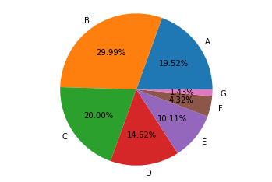
Problem solving steps
By using Pivot table we identify the sum of Loan_amnt for each grand and we plot pie chart for Loan_amnt vs Grade and we found that
The Grade B is higher percentage of distribution of loan amount i.e 30% , Grade C is the second highest percentage of distribution of loan amount

Slide 10
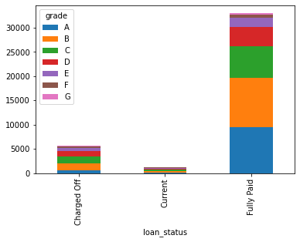
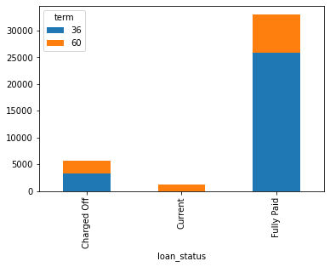
Problem solving steps
We made a bar plot against loan_status vs grade
1.we can see above most of the customer are fully paid a loan amount in each grade
2.we can also see average customer are charged off against loan in each grade
We made a bar plot against loan_status vs term and we observe
1.FULLY PAID - Most of the customer have taking loan to pay in 36 month of term
2.CURRENT - Customer has taken a loan against 60 month of term to pay the amount

Slide 11
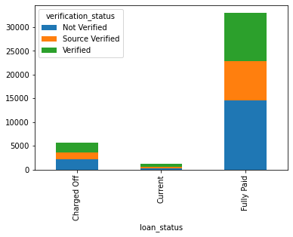
Problem solving steps
FULLY PAID - Here we can see above most of the customer are not verified for loan

Slide 12
Filter the ‘Emp_Len’ column to extract the numerical value from
the string.
We used string extract function to extract the Numeric value along with string
Using the Lambda function, remove the month from the ‘term’ Column such that ‘36 months’, ‘60 months’ appear as 36 and 60 respectively.
In Loan dataset ‘Term” column are likewise ‘36 months’&’60 months” so in order to separate Numeric value from string we used String extract function to separate numeric from string by using Lambda function
Create a new column as risky_loan_applicant by comparing loan_amntand funded_amnt with the following criteria -If loan_amnt is less than equals to funded_amnt set it as ‘0’ else set it as‘1’.
Initially we create new column as Risky_loan and then assign with Numpy where function for comparing Loan_amount Vs Funded_amount and we assign value as one if Loan_amount is greater than Funded_amount otherwise it leads to zero

Slide 13
Conclusion
We identified the loan applicant who has been paid loan amount partially and Fully paid and also we found those who are not paid loan amount on time for them how much charged has been deduct from applicant by using pie chart and bar chart

Slide 14
Future Steps
Many other analyses could be done on the data. The relationships between the attributes have many possibilities. In the future, addition can be made by using Exploratory Data Analysis and Machine Learning modelling steps to make predictions that’ll reduce the number of risky loan applicants .
Hence, it could help to understand the relations between the attributes more. For visualization purposes we can add a dashboard by using Power BI or Tableau which will bring more inferences from our feature sand patterns.

