Slide 2









Users
Biological Parents
Foster Parents
Case Worker
Access Channels
HTTP
User Registration
Sign-In
Parent Profile Management
Child(ren) Profile Management
Facility Search
Messaging
Application Layer
Angular JS, JSON, Twitter Bootstrap, HTML5, CSS
HttpRequestMessage(JSON)
HttpResponseMessage(JSON)
API Gateway
CCLD Facility
Search Service
(Open Data Portal)
Services Layer
Sign-In Service
EMail Service
SMS Service
Person Profile Service
Message Service
Facility Search
Service
Google Map API
Micro-Service, RESTFul API, MVC, C#, LINQ Query, Entity Framework 6.0, IIS 7.0
Security Data
Person Profile Data
Message Data
Data Layer
Microsoft SQL Server 2008

Slide 3

ADPQ Micro-Services
Sign-In
Service
Person Profile Service
Facility Search
Service
Message
Service
Entity Layer
(Entity Framework 6.0)
Entity Layer
(Entity Framework 6.0)
Email Service
SMS Service
CCLD Facility
Search Service
(Open Data Portal)
Google Map API
Entity Layer
(Entity Framework 6.0)
Security Data
Person Profile Data
Message Data

Slide 4





EC2 Instance
Internet
http://xfusionsafekids.org/
Web Server – IIS 7.0
MS SQL Server 2008
Windows Server 2008 R2
52.34.185.160

Slide 5
Microservice
Business Logic
Entity Layer
(Entity Framework 6.0)
Service Domain Data

Slide 6








Scrum Master, Agile Coach
Product Manager, Quality Accountability
Scrum Team
Business Analyst
Technical Architect
Visual Designer
Usability Tester
Front End Web Developer
Back End Web Developer
Front End Web Developer
Back End Web Developer
Front End Web Developer
Back End Web Developer
Front End Web Developer
Back End Web Developer
Sign-In Service Group
Person Profile Service Group
Message Service Group
Facility Search Service Group
Sign-In Service
Person Profile Service
(Parent, Child(ren))
Message Service
Facility Search Service
Continuous Delivery Pipeline

Slide 7
Scrum Master, Agile Coach
Product Manager, Quality Accountability
Scrum Team
Business Analyst
Technical Architect
Visual Designer
Usability Tester
Front End Web Developer
Back End Web Developer
Front End Web Developer
Back End Web Developer
Front End Web Developer
Back End Web Developer
Front End Web Developer
Back End Web Developer
Sign-In Service Group
Person Profile Service Group
Message Service Group
Facility Search Service Group
Sign-In Service
Person Profile Service
(Parent, Child(ren))
Message Service
Facility Search Service
Continuous Delivery Pipeline
Source Control
Artifact Repository (GitHub)
Build and Deployment Server
DEV
TEST
PROD

Slide 8
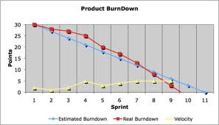

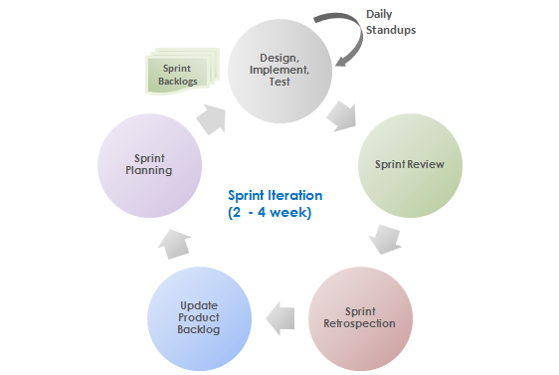


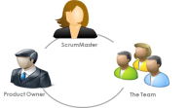

Scrum at a Glance
Product Vision & Strategy
Business Cases
Business & Technology Requirements
Milestones
Product Planning
Burndown Chart and Team Velocity
Release Cycle – x
Release Backlogs
(List of prioritized backlog for the Release scope)
Product Backlogs
(List of prioritized backlog, highest priority at the top)
Release
Cycle
Backlog Grooming
Release Planning
Release Review and Retrospection

Slide 9



Elements of Scrum Framework
Roles
The Scrum Team
Ceremonies
Release Planning
Sprint Planning
Daily Standup Meeting
Sprint Review
Sprint Retrospection
Release Review
Scrum of Scrum
produces
Project Manager
participate in
Product Owner
The
Team
Artifacts
Product Backlog
Sprint Backlog
Burn-down Chart
Potentially Shippable Product

Slide 10


Agile Requirement Granularity
User Story
Atomic requirement that can be implemented with in a short time-frame such as Sprint
Features/Epics are groomed to elaborate the requirements and broken into multiple User Stories
User Stories are broken into Tasks are are executed and completed within the Sprint Iteration
FEAT1: Online Enrollment Application Submission
US1.1: As a consumer…I like to submit my household member information so that…
US1.2: As a consumer…I like to submit my income information so that…
US1.3: As a consumer…I like to submit my citizenship information so that…

Slide 11

Components of Agile Requirement
User Story
elaborated using
Agile Requirement
Acceptance Criteria
tested using
Story Point
estimated using

Slide 12


Release Planning
Preparation
Application Processing
Eligibility Determination
Enrollment/
Disenrollment
Eligibility Inquiry

Slide 13
Release Planning
Preparation
Parent Registration and Sign In
Parent and Child(ren) Profile Management
Search for Facilities
Inbox Management

Slide 14
Product Roadmap Planning
Release Backlog – Story Map, Priority and Estimate
Application Processing
Eligibility Determination
Enrollment/
Disenrollment
Eligibility Inquiry
Online App. Submission
P: 1
50
P: 2
20
Compute Household Composition
Compute MAGI
P: 3
30
Do Program Enrollment
P: 6
20
P: 5
20
Inquire Member’s current Enrollments
Release 1
App. Data Verification
P: 8
60
Determine Eligibility
Send MEDS transaction
P: 4
60
P: 7
15
Save Application
Transfer Case to SAWS
Do Program Disenrollment
Release 2
File Clear Applicant Automatically
Transfer Case to MAXe2
Store and Track Application
Release 3

Slide 15
Product Roadmap Planning
Release Backlog – Story Map, Priority and Estimate
Parent Registration and Sign In
Parent and Child(ren) Profile Management
Search for Facilities
Inbox Management
Account Creation
Create Parent Profile
Search Facilities
Send email to Case Worker
Release 1
Upload Pictures
Send email to Foster Parent
Identity Verification
Create Child(ren) Profile
Integrate with Google Maps
Receive email from Case Worker
Release 2
Upload Pictures
CAPTCHA Validation
Change Password
Upload Supporting Documents
Edit Profile
Manage Inbox
Release 3

Slide 16
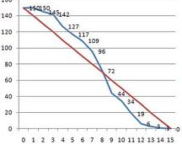
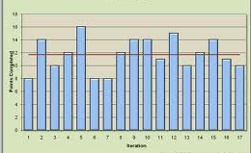
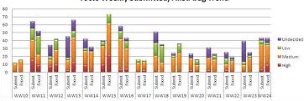
Release Cycle – Release Review & Stakeholder Demonstration
Release Review
One of the team members or the ScrumMaster provides Release overview
Release Goal
List of Backlogs committed for the Release
Backlogs Completed – in all the Sprint iterations within the Release Cycle
Release Burndown Chart
Velocity Chart
Defect Trend
Burndown Chart
Velocity Chart
Defect Trend

