Slide 1
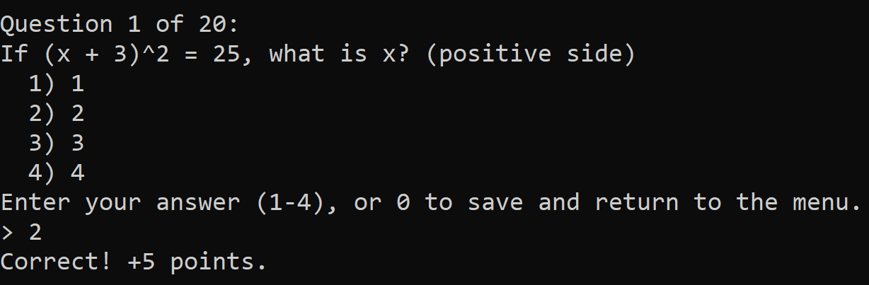
Quiz Arena
Terminal based C++ OOP final project
> run.bat
Welcome to Quiz Arena
1. New Game
2. Saved Games
3. Leaderboard
4. Quit
Course 31695 — Object Oriented Programming
GitHub Link
C++ classes
+ text files
+ terminal UI
Polymorphic
questions
Save / load
leaderboard
Cursor-assisted
workflow
Quiz Arena | OOP C++ Final Project | 1

Slide 2
Game overview
A simple math quiz game with difficulty modes, lives, saving, and a leaderboard.
Main
menu
Choose
difficulty
Load
questions
Answer
questions
Save or
finish
How it works
Game data comes from text files, so the same engine can load Easy, Normal, or Hard question sets.
• Correct answer: +5 points
• Wrong answer: lose one life
• Press 0 during a question to save and return to the menu
Quiz Arena | OOP C++ Final Project | 2

Slide 3
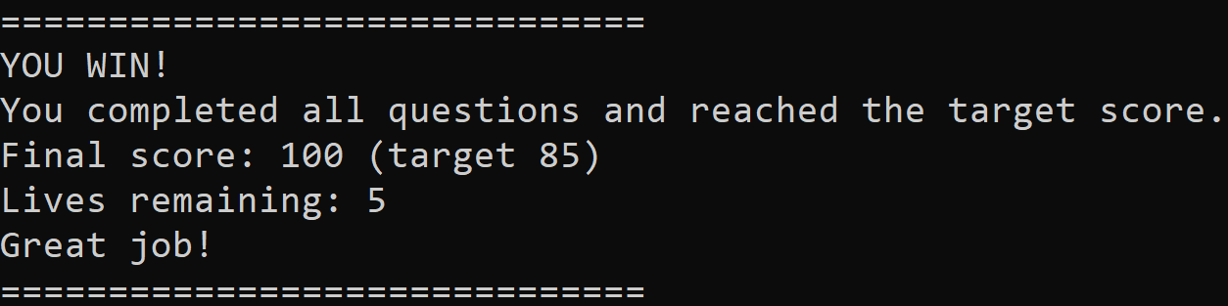
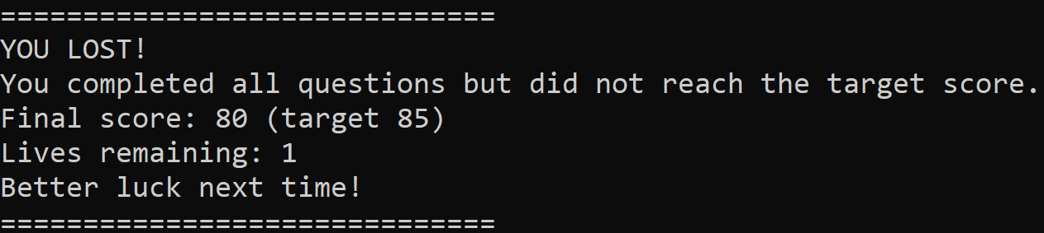
Win / lose conditions
Each difficulty has its own starting lives and target score.
Easy
5 lives
Target: 85
Normal
4 lives
Target: 90
Hard
3 lives
Target: 95
WIN
Player is still alive and reaches the target score.
LOSE
Lives reach 0 before the target score is reached.
Quiz Arena | OOP C++ Final Project | 3

Slide 4
Quiz Arena — System Architecture
How the main classes connect
📕 main.cpp
game.run(ui)
🎮 QuizGame
«abstract»
Question
💻 ConsoleUI
✓
QuizGame is the
controller
uses
vector<Question*> m_questions
Player m_player
Leaderboard m_leaderboard
m_difficulty / m_targetScore /
m_startLives / m_currentIndex
all input/output
m_text, m_points
virtual int getOptionCount() const
virtual string getOption(int i) const
virtual bool checkAnswer(int i) const
virtual Question* clone() const = 0
vector<Question*>
✓
Question hierarchy
enables
polymorphism
owns
uses
💾 SaveManager
vector<SaveSlot> m_slots
✓
SaveManager and
ConsoleUI are used,
not owned
🔢MultipleChoiceQuestion
✓× TrueFalseQuestion
💾 SaveSlot
Legend
m_options
m_questionIndex
m_correctIsTrue
mode-based save data
(e.g., settings, progress)
inherits (is-a)
♟ Player
🏆 Leaderboard
has-a (composition)
★ LeaderboardEntry
uses (dependency)
m_name, m_score, m_lives
unordered_map<string, LeaderboardEntry>
scores[3]
lastOrder
Quiz Arena | OOP C++ Final Project | 4
Notes:
[Sources]
- User-provided visual reference: ChatGPT Image Aug 1, 2026, 03_36_43 PM (2)(1).png

Slide 5
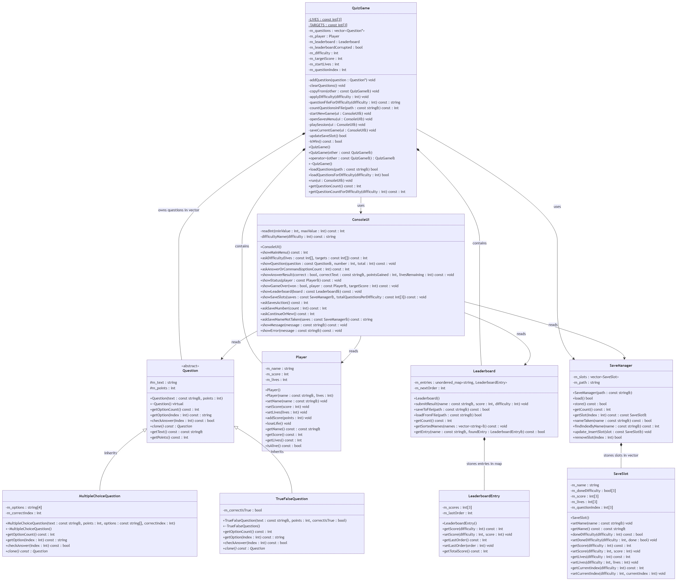
Quiz Arena UML
Quiz Arena | OOP C++ Final Project | 5

Slide 6
Why this structure?
Abstraction
Polymorphism
Separation
Encapsulation
Question defines the common interface, while each derived class implements its own answer behavior.
QuizGame stores all question types together as Question* and calls virtual functions.
ConsoleUI handles input/output; QuizGame controls rules and flow;
SaveManager handles saving and loading.
All class data members are private, except Question’s shared members, which are protected so the derived question classes can access them. This prevents unrelated classes from changing data directly.
Quiz Arena | OOP C++ Final Project | 6

Slide 7
STL containers and data ownership
Different containers were chosen based on how each part of the game is accessed.
vector<Question*>
vector<SaveSlot>
unordered_map<string, Entry>
Used in QuizGame. Stores base-class pointers to MC and TF questions. QuizGame owns and manually deletes the pointed objects.
Used in SaveManager. Stores complete SaveSlot objects by value. The vector owns them directly.
Used in Leaderboard. Player name is the key, so lookup and update by name are direct.
Files content
Question files
MC / TF blocks
saves.txt
per player + per mode
leaderboard.txt
best scores
Quiz Arena | OOP C++ Final Project | 7

Slide 8
Live demo
> run.bat
1. New Game
2. Saved Games
3. Leaderboard
4. Quit
DEMO
What we will show:
RUN GAME
• Start a new game and choose difficulty
• Answer questions and show score/lives changing
• Showcase a lose
• Use 0 to save during a game
• Open saved games and leaderboard
Quiz Arena | OOP C++ Final Project | 8

Slide 9
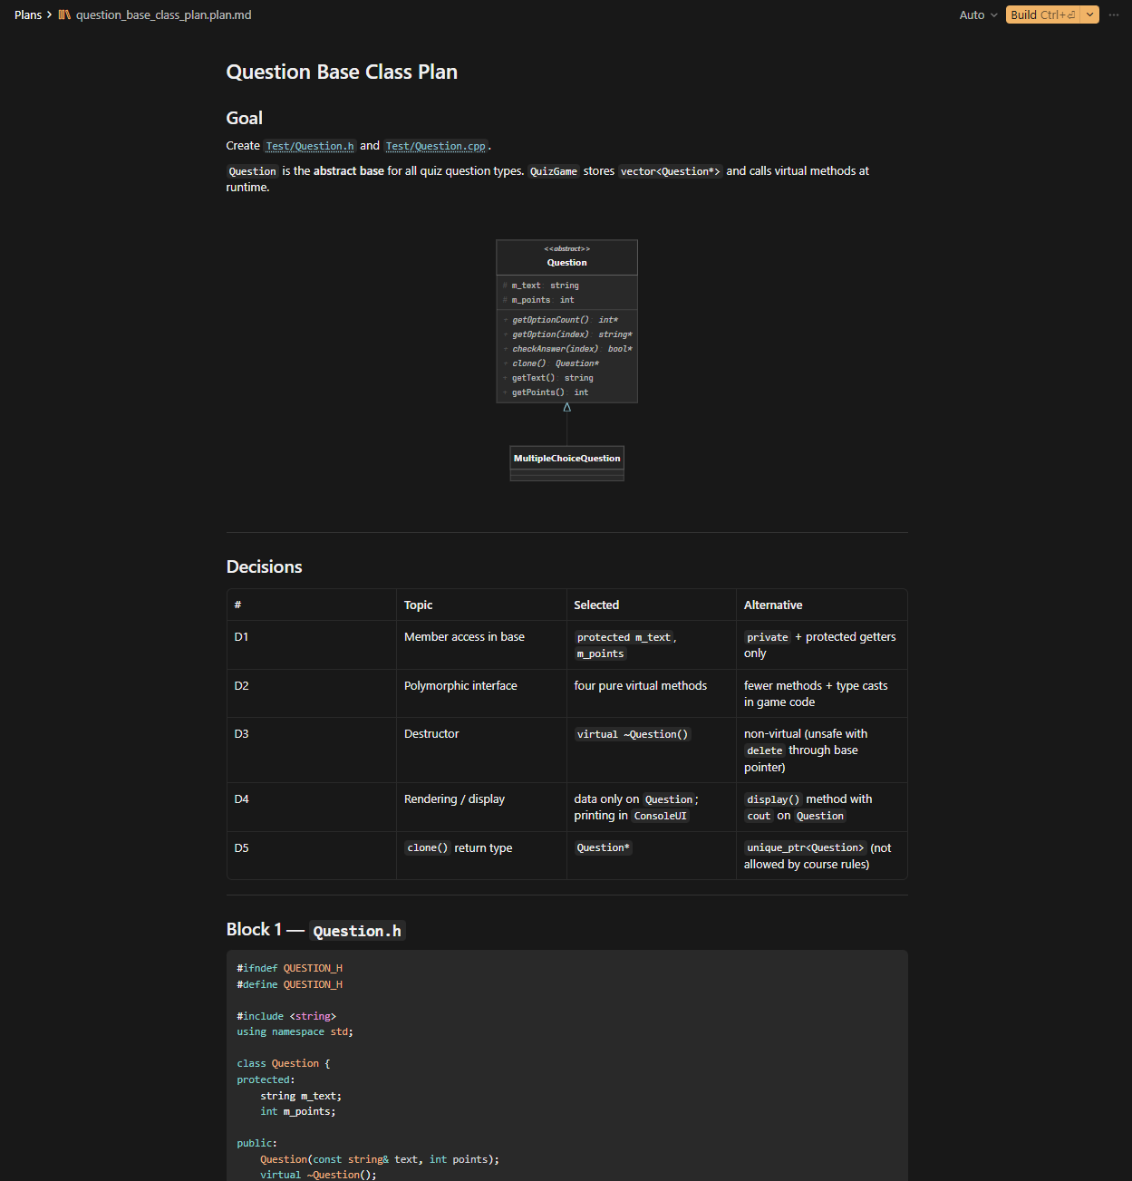
Agentic workflow: prompt log examples
We used Cursor suggestions critically: accepted, modified,
or rejected based on course rules.
Cursor suggested
Our decision
Put cout inside
Question
REJECTED
Reason
Question should store behavior/data only. All input and output stays in ConsoleUI.
Quiz Arena | OOP C++ Final Project | 9

Slide 10
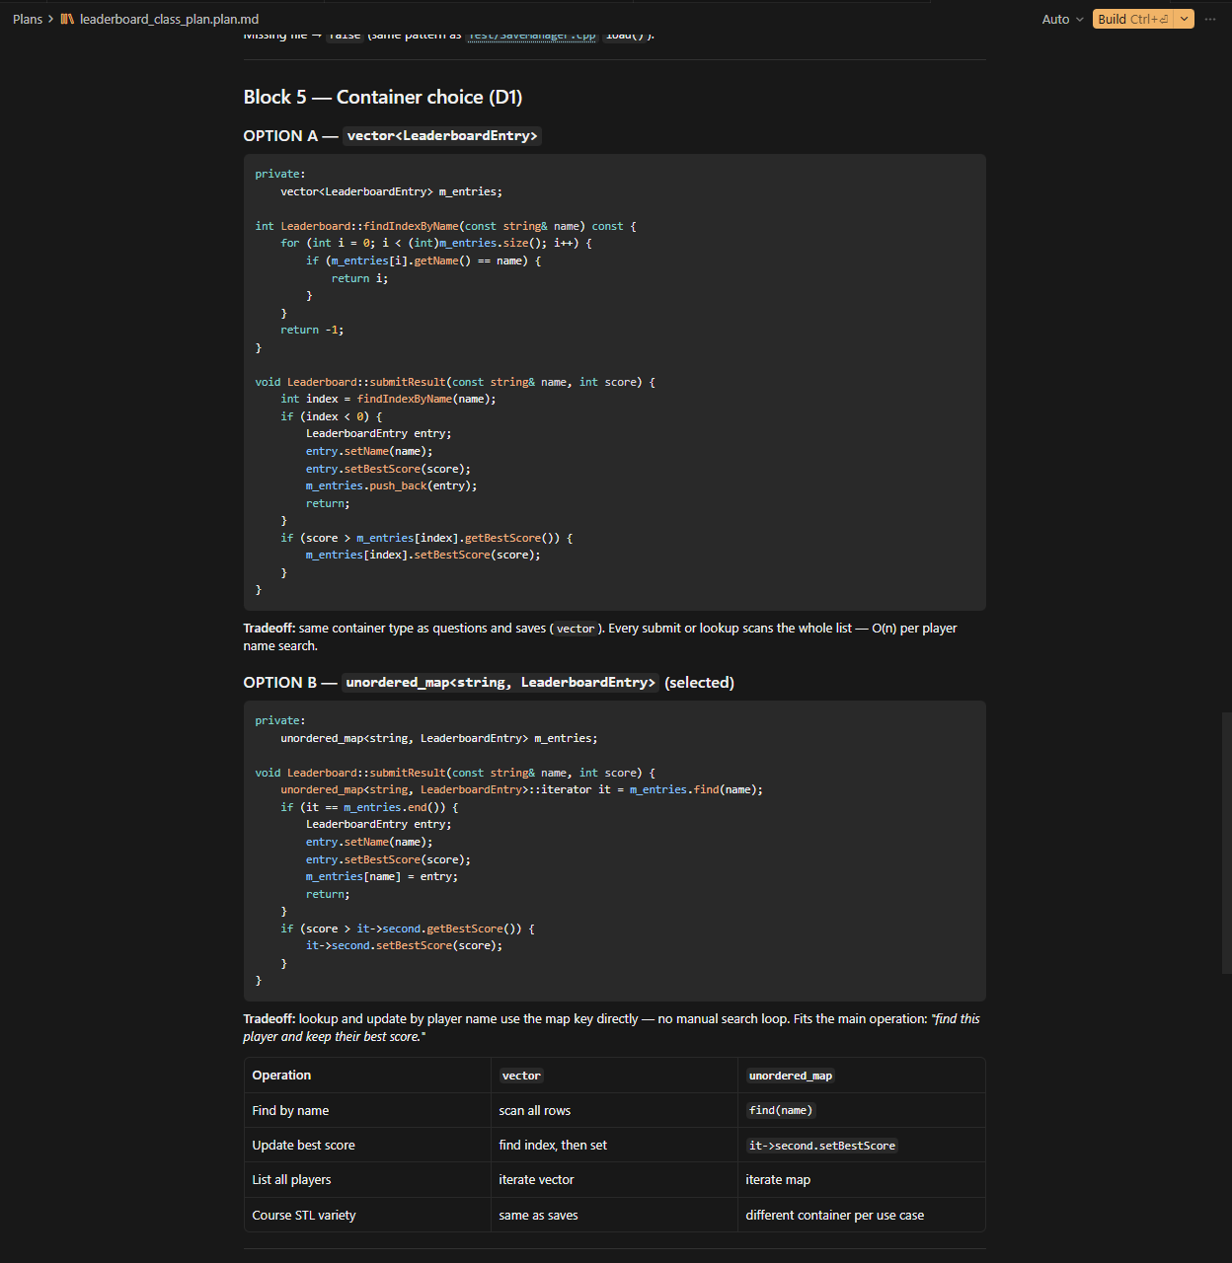
Agentic workflow: prompt log examples
We used Cursor suggestions critically: accepted, modified,
or rejected based on course rules.
Cursor suggested
Our decision
Add LeaderBoard Class with Unorderd Map stl container
MODIFIED
Reason
Cursor initially suggested vector<LeaderboardEntry>.
After discussion, we changed the design to unordered_map<string, LeaderboardEntry>, because leaderboard entries are searched and updated by player name.
We accepted Cursor's revised implementation.
Quiz Arena | OOP C++ Final Project | 10

Slide 11
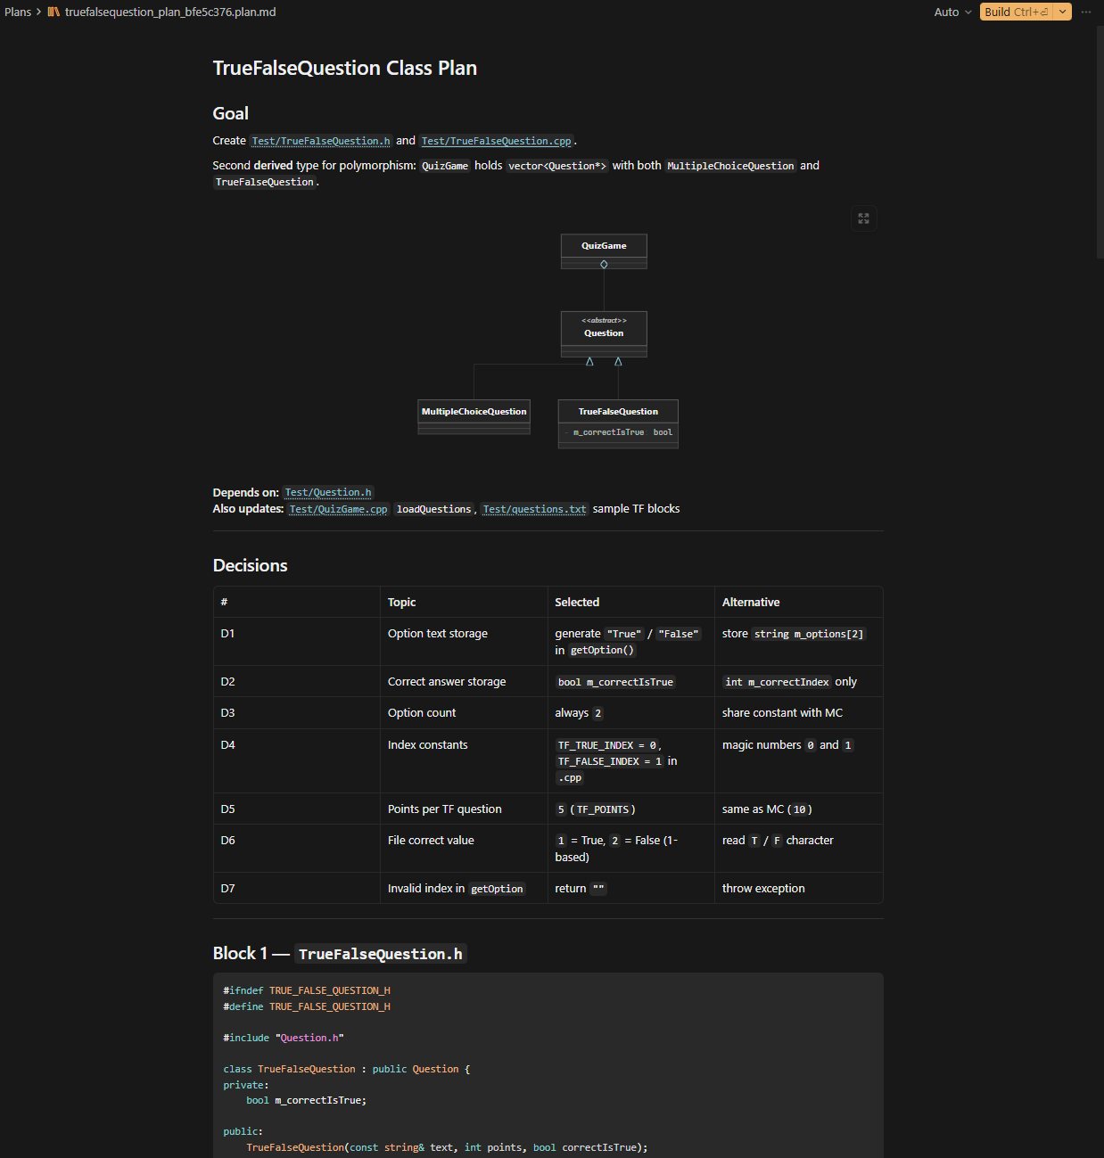
Agentic workflow: prompt log examples
We used Cursor suggestions critically: accepted, modified,
or rejected based on course rules.
Cursor suggested
Our decision
Add TrueFalseQuestion class
ACCEPTED
Reason
We asked cursor ,What additional question type would fit the game, he suggested True/ False. Its not complicated and help demonstrate better the implementaion of polymorphism.
Quiz Arena | OOP C++ Final Project | 11

