Slide 1
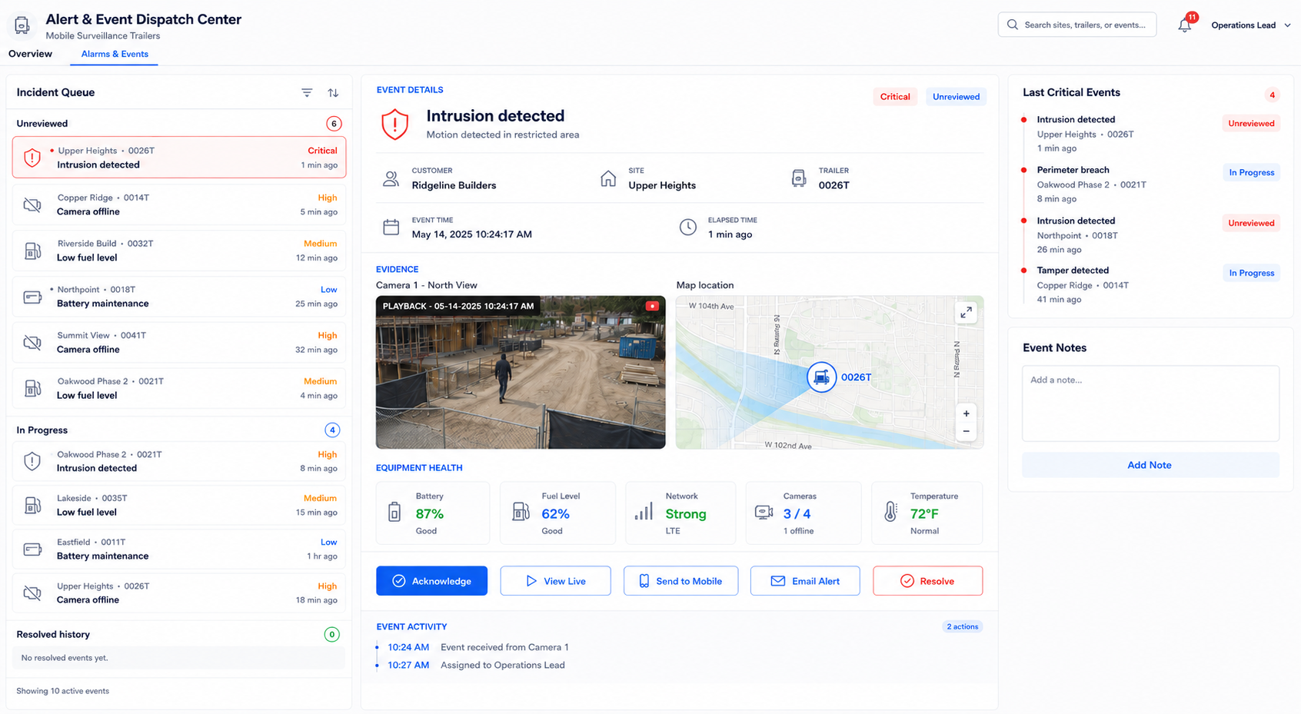
Alert & Event
Dispatch Center
Visual proposal for mobile surveillance trailers
Event review and response with a visible activity record
A unified workspace for active incidents, equipment health, and critical events across sites.
Visual proposal v2
Notes:
Source: user-supplied interface screenshot, September 2026. Visual concept based on that interface. Camera footage and map are AI-generated illustrations, not evidence of a real incident. Counts and readings are example data from the supplied screen.

Slide 2
ALERT & EVENT DISPATCH CENTER
02
A unified event workspace
The incident queue, event evidence, and recent critical events share one screen.
Notes:
Source: user-supplied interface screenshot, September 2026. Visual concept based on that interface. Camera footage and map are AI-generated illustrations, not evidence of a real incident. Counts and readings are example data from the supplied screen.

Slide 3
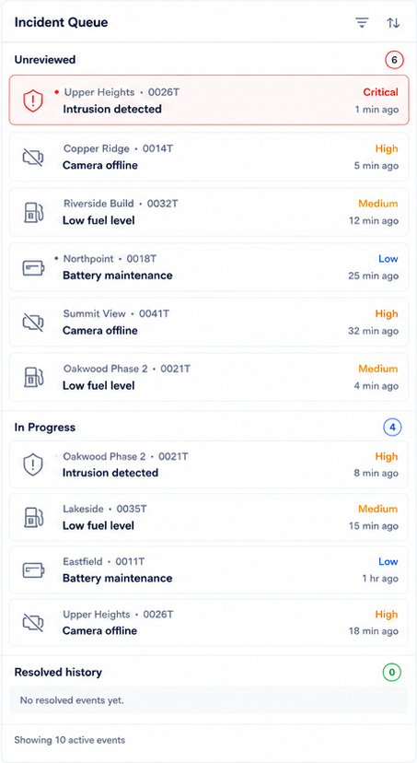
ALERT & EVENT DISPATCH CENTER
03
Incident status and priority
Active events remain grouped by review status, with resolved history below.
A visible worklist
The example shows 6 Unreviewed and 4 In Progress events. Resolved history has its own count and empty state.
Severity at a glance
Critical, High, Medium, and Low labels accompany each event, together with its site, trailer, and elapsed time.
Notes:
Source: user-supplied interface screenshot, September 2026. Visual concept based on that interface. Camera footage and map are AI-generated illustrations, not evidence of a real incident. Counts and readings are example data from the supplied screen.

Slide 4
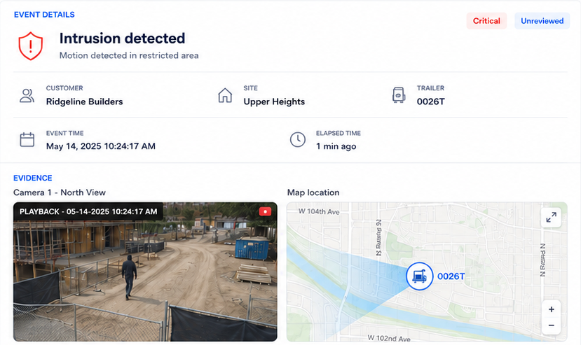
ALERT & EVENT DISPATCH CENTER
04
Event details and recorded evidence
The selected event brings its operational context, playback, and map location together.
Selected event context
Customer, site, trailer, severity, and timestamps identify the incident under review.
Playback and location
Recorded camera evidence supports review of the event. View Live remains a separate response action.
Notes:
Source: user-supplied interface screenshot, September 2026. Visual concept based on that interface. Camera footage and map are AI-generated illustrations, not evidence of a real incident. Counts and readings are example data from the supplied screen.

Slide 5
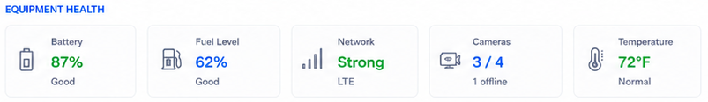
ALERT & EVENT DISPATCH CENTER
05
Equipment health and camera availability
Equipment readings stay visible while the operator reviews an incident.
Cameras shows 3 of 4 available, with 1 offline.
Battery, fuel level, network, and temperature provide the rest of the equipment context.
Notes:
Source: user-supplied interface screenshot, September 2026. Visual concept based on that interface. Camera footage and map are AI-generated illustrations, not evidence of a real incident. Counts and readings are example data from the supplied screen.

Slide 6
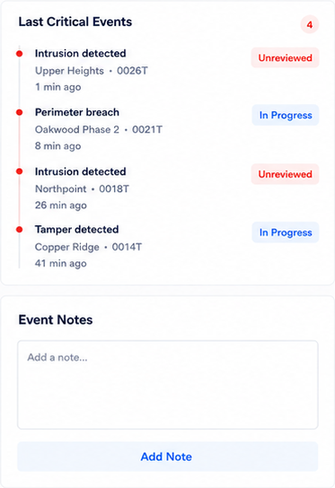
ALERT & EVENT DISPATCH CENTER
06
Recent critical events and event notes
Last Critical Events brings recent security incidents from multiple sites into view.
Critical events across sites
Each entry shows its site and trailer, elapsed time, and review status for a quick operational scan.
Notes for the selected event
The Event Notes panel provides space for observations and follow-up context, with an Add Note action.
Notes:
Source: user-supplied interface screenshot, September 2026. Visual concept based on that interface. Camera footage and map are AI-generated illustrations, not evidence of a real incident. Counts and readings are example data from the supplied screen.

Slide 7
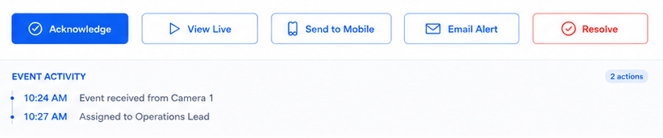
ALERT & EVENT DISPATCH CENTER
07
Response actions and event activity
The response controls sit directly above a timestamped activity record.
Five response actions remain within the event workspace
Event Activity shows when the event arrived and when it was assigned to Operations Lead.
Notes:
Source: user-supplied interface screenshot, September 2026. Visual concept based on that interface. Camera footage and map are AI-generated illustrations, not evidence of a real incident. Counts and readings are example data from the supplied screen.

