Slide 1
WPWPWP
what happened, happened and couldn't have happened any other way.
An Hu, Tianjiao Mo, Zhihao Xue

Slide 2
Table of Content
Problem Description
Solution Description
Database Design
Challenges
Demo

Slide 3
Problem Description
On-campus events is important
Announced and Received via SharePoint®
Little interaction
Schedule lookup
Notes:
The on-campus activities and events are a large portion of college life. However, currently, all those kinds of events are announced via SharePoint ®, such as Academic Seminar or posted calendar on webpages, like IM Field activities. In this way, students, faculties and staffs barely have interactions either with these events and activities, or with other friends. So, it is exigent to find a new way to keep all members be involved in. To solve this, we develop this new system, which generate a new, easy, efficient and convenient way, to tack events and schedules. Also, this this system will give students a new solution to create, join and share activities. In this way, we hope everyone can interact with campus more.

Slide 4
Solution Description
A web-based application
HTML CSS JavaScript(JQuery Bootstrap)
PHP (Library: sqlsrv)
SQL Server
Notes:
HTML CSS JS -> GUI(graphics user interface)
PHP ->connect front - end

Slide 5
Database Design
Entities: User, Organization, Event
Invitation, Tag
Notes:
run query with name - find ID - use ID
user-friendly
All primary keys are integer

Slide 6
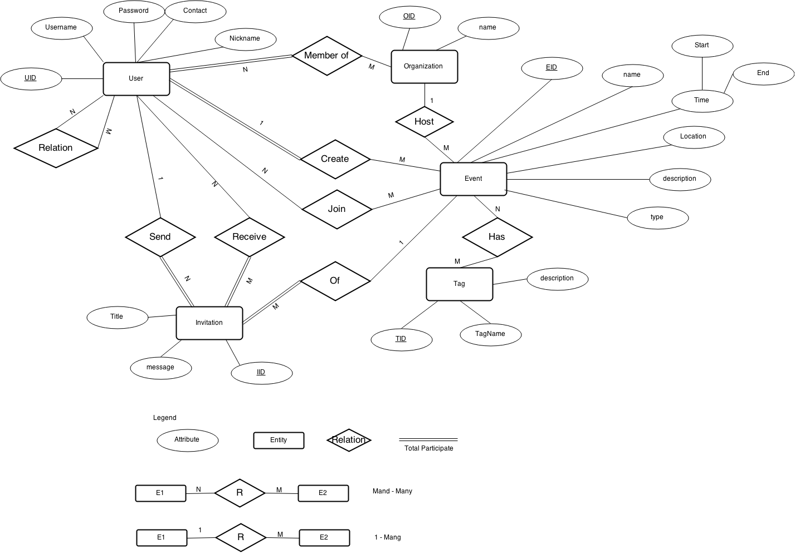
Notes:
User entity: stores the information of users
user send request to others then they can become friend -> stored in the UserRelation table
User can create an organization (but only one each user) then others can join the organization and that gets stored in the MemberOf table.
User can create Event (public → others can freely join and that gets store in the join Table)
if private : Users already in this event can send invitation to others (the information about which user has received which invitation gets stored in the receive table), and other users join this event by confirming the invitation
Tag : which indicates the actual type of an event : Academic, personal, sale
when an event gets a tag this piece of information is stored in the Has table
organization can host an event and that gets stored in the Host table.

Slide 7
Database Design
Security: Hash function and user level
Notes:
use hash function to secure user’s password,
different user level has different authorization

Slide 8
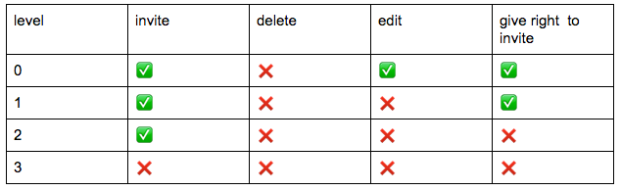
User Level
Notes:
creater can do anything including delete
users can send an invitation with a level included, and the receiver gets that level. Cannot give others a higher level than his own.

Slide 9
Challenges
PHP is buggy
Is not null and <>
Hard to alter a table with foreign keys

Slide 10
Demo

Slide 11
End
Thank you

