Slide 1

Introduction to HDFS
Sriram Mohan
RHIT
Q1

Slide 2
Best Fit
Very Large Files
Streaming Data Access
Commodity Hardware
Begin Q2
Notes:
HDFS is a filesystem designed for storing very large files with streaming data access patterns, running on clusters of commodity hardware.1 Let’s examine this statement in more detail:
Very large files
“Very large” in this context means files that are hundreds of megabytes, gigabytes, or terabytes in size. There are Hadoop clusters running today that store petabytes of data.
Streaming data access
HDFS is built around the idea that the most efficient data processing pattern is a write-once, read-many-times pattern. A dataset is typically generated or copied from source, and then various analyses are performed on that dataset over time. Each analysis will involve a large proportion, if not all, of the dataset, so the time to read the whole dataset is more important than the latency in reading the first record.
Commodity hardware
Hadoop doesn’t require expensive, highly reliable hardware. It’s designed to run on clusters of commodity hardware (commonly available hardware that can be obtained from multiple vendors)3 for which the chance of node failure across the cluster is high, at least for large clusters. HDFS is designed to carry on working without a noticeable interruption to the user in the face of such failure.

Slide 3
Bad Fit
Low Latency Data Access
Lots of Small Files
Multiple Writer, Arbitrary File Modifications
End Q2
Notes:
Low-latency data access
Applications that require low-latency access to data, in the tens of milliseconds range, will not work well with HDFS. Remember, HDFS is optimized for delivering a high throughput of data, and this may be at the expense of latency. HBase (Chapter 13) is currently a better choice for low-latency access.
Lots of small files
Because the namenode holds filesystem metadata in memory, the limit to the number of files in a filesystem is governed by the amount of memory on the name- node. As a rule of thumb, each file, directory, and block takes about 150 bytes. So, for example, if you had one million files, each taking one block, you would need at least 300 MB of memory. Although storing millions of files is feasible, billions is beyond the capability of current hardware.4
Multiple writers, arbitrary file modifications
Files in HDFS may be written to by a single writer. Writes are always made at the end of the file. There is no support for multiple writers or for modifications at arbitrary offsets in the file. (These might be supported in the future, but they are likely to be relatively inefficient.)

Slide 4
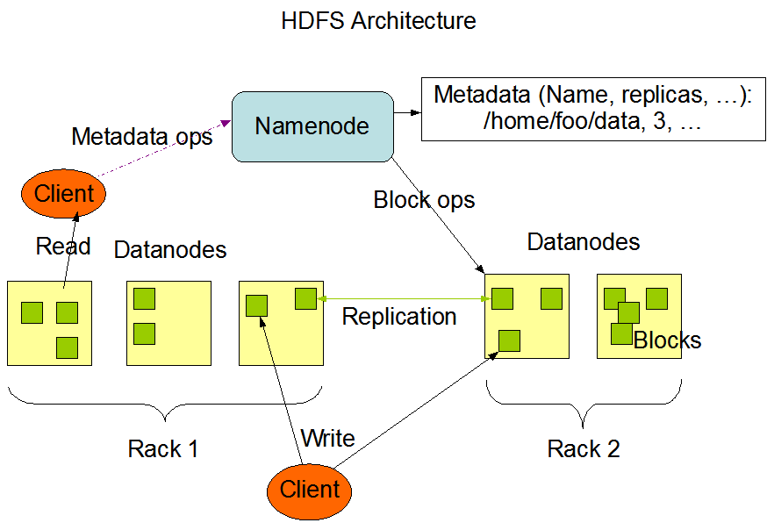
HDFS Concepts
Q3,Q4
Notes:
Block Size
A disk has a block size, which is the minimum amount of data that it can read or write. Filesystems for a single disk build on this by dealing with data in blocks, which are an integral multiple of the disk block size. Filesystem blocks are typically a few kilobytes in size, whereas disk blocks are normally 512 bytes. HDFS, too, has the concept of a block, but it is a much larger unit—64 MB by default. The block size is configurable. Like in a filesystem for a single disk, files in HDFS are broken into block-sized chunks, which are stored as independent units. Unlike a filesystem for a single disk, a file in HDFS that is smaller than a single block does not occupy a full block’s worth of underlying storage.
The use of this block abstraction simplifies the underlying storage system. The storage subsystem deals with blocks, simplifying storage management (because blocks are a fixed size, it is easy to calculate how many can be stored on a given disk) and eliminating metadata concerns (because blocks are just a chunk of data to be stored, file metadata such as permissions information does not need to be stored with the blocks, so another system can handle metadata separately).
Furthermore, blocks fit well with replication for providing fault tolerance and availability. To protect against corrupted blocks and disk and machine failure, each block is replicated to a small number of physically separate machines (typically three). If a block becomes unavailable, a copy can be read from another location in a way that is transparent to the client. A block that is no longer available due to corruption or machine failure can be replicated from its alternative locations to other live machines to bring the replication factor back to the normal level.
Namenodes and Datanodes
An HDFS cluster has two types of nodes operating in a master-worker pattern: a namenode (the master) and a number of datanodes (workers). The namenode is responsible for managing the file system. It tracks the file system hierarchy and stores any relevant metadata about the files and the directory structure. This information is persisted on disk - called a namespace image in HDFS. In addition, the namenode maintains an edit log - which tracks changes being made the namespace. Merging the changes mentioned in the edit log to the namespace image is required for reliability and is handled separately(see below). The namenode also tracks information about the various blocks associated with a given file and the location of these blocks. This information is not persisted and has to be reconstructed on namenode startup. Datanodes store the various blocks and retrieve them as needed. Datanodes provided periodic reports(also called a heartbeat) in which they inform the namenode of the lists of blocks they are currently storing.
In order to access HDFS, a client has to communicate with both name nodes and datanodes. The clients has to find the location of the blocks the users is interested in, by communicating with the name node. Without the namenode, the filesystem cannot be used. In fact, if the machine running the namenode were to go down /or be inaccessible in other ways, all the files in HDFS would be lost, since there is no direct way of reconstructing their structure and the data they contain within.
The reliability of the namenode and the ability to recover from namenode failures is very important. Hadoop has two mechanisms to ensure namenode reliability. The first technique is to backup the files that make up the persistent state of the filesystem metadata. Hadoop can be configured so that the namenode writes its persistent state to multiple filesystems. These writes are synchronous and atomic. The usual configuration choice is to write to local disk as well as a remote NFS mount.
It is also possible to run a secondary namenode - it is not meant to be a backup namenode. Rather, the main role of the secondary name node is to periodically merge the namespace image with the edit log to prevent the edit log from becoming too large. The secondary namenode usually runs on a separate physical machine because it requires plenty of CPU and as much memory as the namenode to perform the merge. It keeps a copy of the merged namespace image, which can be used in the event of the namenode failing. However, the state of the secondary namenode lags that of the primary, so in the event of total failure of the primary, data loss is almost certain. The usual course of action in this case is to copy the namenode’s metadata files that are on NFS to the secondary and run it as the new primary.

Slide 5
HDFS Concepts Continued
HDFS Federation
HDFS High Availability
  Failover & Fencing
Q5
Notes:
HDFS Federation
The namenode keeps tracks the location of every file block in the filesystem in memory. Thus on very large clusters, the limiting factor for scaling is the amount of memory available. Starting with Hadoop 2.x releases, an alternative solution is the notion of a HDFS federation. Scaling is made possible by adding multiple namenodes to the same cluster, with each namenode managing a portion of the filesystem namespace. For instance, we could have a namenode managing all files under /avalon/bigdata and a second namenode could handle all files under /avalon/smalldata. Each namenode is responsible for managing the metadata of all files in its namespace and must track the list of all blocks for files in its namespace. Namenodes in this setup are independent of each other and do not communicate with one another. This ensures that the failure of one namenode does not affect any any other namenode. Storage is not partitioned and datanodes are allowed to register with more than one namenode. If a datanode registers with more than one namenode then it has to send a heartbeat to both namenodes.
HDFS High Availability
The combination of replicating namenode metadata on multiple filesystems and using the secondary namenode to create checkpoints protects against data loss, but it does not provide high-availability of the filesystem. The namenode is still a single point of failure. As mentioned previously, the failure of the namenode, can essentially render HDFS and hence jobs running on Hadoop would be out of service, as no reads can be performed on HDFS. This state will continue, until a new namenode can be brought online.
To recover from a failed namenode in this situation, a currently available solution is to establish a new node as the primary namenode, and load one of existing replicas of the filesystem metadata(may not be entirely up to date) and configure all datanodes and clients(if any) to use this new node as the namenode. The new namenode is not able to serve requests until it has i) loaded its namespace image into memory, ii) replayed its edit log, and iii) received enough block reports from the datanodes to leave safe mode. On large clusters with many files and blocks, the time it takes for a namenode to start from cold can be 30 minutes or more.
Hadoop 2.x releases reduce the amount of time lost in case of namenode failure by providing a new architectural configuration - HDFS High Availability. In this new architecture, rather than a single namenode for a cluster, there are two namenodes in an active-standby configuration. If the active namenode where to go down, the standby takes over servicing client requests. Several changes are being made to Hadoop to facilitate this configuration.
The namenodes must use highly available shared storage to share the edit log. When a standby namenode comes up, it reads up to the end of the shared edit log to synchronize its state with the active namenode, and then continues to read new entries as they are written by the active namenode.
Datanodes must send block reports to both namenodes because the block mappings are stored in a namenode’s memory, and not on disk
Clients must be configured to handle namenode failover, using a mechanism that is transparent to users. If the active namenode fails, the standby can take over very quickly (in a few tens of seconds) because it has the latest state available in memory: both the latest edit log entries and an up-to-date block mapping.
Failover
The detection of namenode failure and the transition to the standby namenode is handled by the failover controller. Each namenode is required to run a lightweight failover controller which is responsible for monitoring the namenode for failures using the heartbeat mechanism. The failover controller will trigger a transition when it detects a namenode failure. Failover may also be initiated manually by an administrator, for example, in the case of routine maintenance. This is known as a graceful failover, since the failover controller arranges an orderly transition for both namenodes to switch roles. In the case of an ungraceful failover, it is difficult to guarantee that the original namenode has stopped running. For instance, if a network were to be partitioned or really slow, heartbeats from the original namenode may fail to arrive on time and the controller can trigger a namenode transition. The problem with this approach is that we now potentially have two namenodes (the newly active namenode and the previous active namenode) both running and thinking that they are the active namenode. To prevent the previously active namenode from making any changes or corrupting the system, the new version of HDFS implements a process known as Fencing.
The system employs a range of fencing mechanisms, including killing the namenode’s process, revoking its access to the shared storage directory, and disabling its network port via a remote management command. As a last resort, the previously active namenode can be fenced with a technique known as STONITH, or “shoot the other node in the head,” which uses a specialized power distribution unit to forcibly power down the host machine of the previous namenode.

Slide 6
Command Line Interface

Slide 7
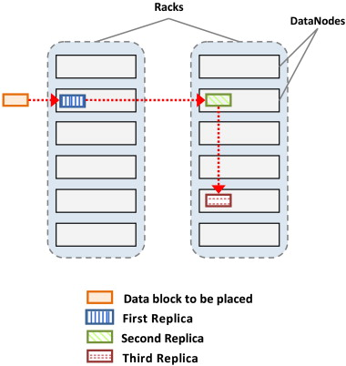
Replica Placement
Q6
Notes:
Hadoop’s default strategy is to place the first replica on the same node as the client (for clients running outside the cluster, a node is chosen at random, although the system tries not to pick nodes that are too full or too busy). The second replica is placed on a different rack from the first (off-rack), chosen at random. The third replica is placed on the same rack as the second, but on a different node chosen at random. Further replicas are placed on random nodes on the cluster, although the system tries to avoid placing too many replicas on the same rack. Once the replica locations have been chosen, a pipeline is built, taking network topology into account. For a replication factor of 3 (default replication factor), the pipeline might look like the figure below.

Slide 8
Data Flow – File Read
Notes:
The client opens the file it wishes to read by calling open() on the FileSystem object, which for HDFS is an instance of DistributedFileSystem (step 1 in Figure). DistributedFileSystem calls the namenode, using RPC, to determine the locations of the blocks for the first few blocks in the file (step 2). For each block, the namenode returns the addresses of the datanodes that have a copy of that block. Furthermore, the datanodes are sorted according to their proximity to the client (according to the topology of the cluster’s network). If the client is itself a datanode (in the case of a MapReduce task, for instance), the client will read from the local datanode if that datanode hosts a copy of the block. The distributed file system returns in input stream which can be used by the client to read data.
The client then calls read() on the stream (step 3). The read request is routed to the closest datanode for the first block that is being read. When the end of the block is reached, the connection is closed to that datanode and then the process is repeated for the next block. This happens transparently to the client, which from its point of view is just reading a continuous stream. Blocks are read in order, with new connections to datanodes opened as needed as the client reads through the stream.
When the client has finished reading, it calls close() on the input stream.
During reading, if an error is encountered,it will automatically try the next closest node for the data block. The address of the datanode that returned the error is tracked and this data node is ignored for future read requests. The client also automatically verifies checksums for the data being read. In case of an error in the checksum, the error is reported to the namenode and the client automatically moves on to the next closest node for this data block.
The client contacts datanodes directly to retrieve data and is guided by the namenode to the best datanode for each block. This design allows HDFS to scale to a large number of concurrent clients because the data traffic is spread across all the datanodes in the cluster. Meanwhile, the namenode merely has to service block location requests (which it stores in memory, making them very efficient) and does not, for example, serve data, which would quickly become a bottleneck as the number of clients grew.

Slide 9
Data Flow – File Write
Q7
Notes:
The client creates the file by calling create() on DistributedFileSystem (step 1 in Figure). DistributedFileSystem makes an RPC call to the namenode to create a new file in the filesystem’s namespace, with no blocks associated with it (step 2). The namenode performs various checks to make sure the file doesn’t already exist and that the client has the right permissions to create the file. If these checks pass, the namenode makes a record of the new file; otherwise, file creation fails and the client is thrown an IOException. The DistributedFileSystem returns an OutputStream for the client to start writing data.
As the client writes data (step 3), the OutputStream splits it into packets, which it writes to an internal queue, called the data queue. The data queue is consumed by the Data Streamer, which is responsible for asking the namenode to allocate new blocks by picking a list of suitable datanodes to store the replicas. The list of datanodes forms a pipeline, and the number of datanodes is directly dependent on the replication factor. The replication factor defaults to three, so there are three nodes in the pipeline. The DataStreamer streams the packets to the first datanode in the pipeline, which stores the packet and forwards it to the second datanode in the pipeline.Similarly, the second datanode stores the packet and forwards it to the third (and last) datanode in the pipeline (step 4).
If a datanode fails while data is being written to it, then the following actions are taken, which are transparent to the client writing the data. First, the pipeline is closed, and any packets in the ack queue are added to the front of the data queue so that datanodes that are downstream from the failed node will not miss any packets. The current block on the good datanodes is given a new identity, which is communicated to the namenode, so that the partial block on the failed datanode will be deleted if the failed datanode recovers later on. The failed datanode is removed from the pipeline, and the remainder of the block’s data is written to the two good datanodes in the pipeline. The namenode notices that the block is under-replicated, and it arranges for a further replica to be created on another node. Subsequent blocks are then treated as normal.
When the client has finished writing data, it calls close() on the stream (step 6). This action flushes all the remaining packets to the datanode pipeline and waits for acknowledgments before contacting the namenode to signal that the file is complete (step 7). The namenode already knows which blocks the file is made up of (via Data Streamer asking for block allocations), so it only has to wait for blocks to be minimally replicated before returning successfully.

Slide 10
Distcp
Inter Cluster Copying when running the same version of hdfs.
hadoop distcp hdfs://nn1:8020/foo/bar \ hdfs://nn2:8020/bar/foo
How do you specify the number of maps?
Can it work with differing versions of HDFS?
Q8
Notes:
DistCp (distributed copy) is a tool used for large inter/intra-cluster copying. It uses Map/Reduce to effect its distribution, error handling and recovery, and reporting. It expands a list of files and directories into input to map tasks, each of which will copy a partition of the files specified in the source list. Its Map/Reduce pedigree has endowed it with some quirks in both its semantics and execution. The purpose of this document is to offer guidance for common tasks and to elucidate its model.
Command:
The most common invocation of DistCp is an inter-cluster copy:
bash$ hadoop distcp hdfs://nn1:8020/foo/bar \
hdfs://nn2:8020/bar/foo
This will expand the namespace under /foo/bar on nn1 into a temporary file, partition its contents among a set of map tasks, and start a copy on each TaskTracker from nn1 to nn2. Note that DistCp expects absolute paths.
One can also specify multiple source directories on the command line:
bash$ hadoop distcp hdfs://nn1:8020/foo/a \
hdfs://nn1:8020/foo/b \
hdfs://nn2:8020/bar/foo
Or, equivalently, from a file using the -f option:
bash$ hadoop distcp -f hdfs://nn1:8020/srclist \
hdfs://nn2:8020/bar/foo
Where srclist contains
hdfs://nn1:8020/foo/a
hdfs://nn1:8020/foo/b
When copying from multiple sources, DistCp will abort the copy with an error message if two sources collide, but collisions at the destination are resolved per the options specified. By default, files already existing at the destination are skipped (i.e. not replaced by the source file). It is important that each TaskTracker can reach and communicate with both the source and destination file systems. For HDFS, both the source and destination must be running the same version of the protocol or use a backwards-compatible protocol (see Copying Between Versions).
After a copy, it is recommended that one generates and cross-checks a listing of the source and destination to verify that the copy was truly successful. Since DistCp employs both Map/Reduce and the FileSystem API, issues in or between any of the three could adversely and silently affect the copy. Some have had success running with -update enabled to perform a second pass, but users should be acquainted with its semantics before attempting this. It's also worth noting that if another client is still writing to a source file, the copy will likely fail. Attempting to overwrite a file being written at the destination should also fail on HDFS. If a source file is (re)moved before it is copied, the copy will fail with a FileNotFoundException.
Copying between versions of HDFS
For copying between two different versions of Hadoop, one will usually use HftpFileSystem. This is a read-only FileSystem, so DistCp must be run on the destination cluster (more specifically, on TaskTrackers that can write to the destination cluster). Each source is specified as hftp://<dfs.http.address>/<path> (the default dfs.http.address is <namenode>:50070)

Slide 11
Questions

