Slide 1

Sqoop
Sriram Mohan RHIT
Q1

Slide 2
Deadlines & Announcements
Lab 6 Due – Thursday, 11:55 OM
Research and Project ISR Due Friday, Class Time

Slide 3
Why Sqoop?
Need to move data from traditional data sources to hadoop for batch processing/archiving
Need to move results of hadoop jobs to relational data sources that support reporting & data visualization

Slide 4
What is Sqoop?
Sqoop is a command-line interface application for transferring data between relational databases and Hadoop. It supports incremental loads of a single table or a free form SQL query as well as saved jobs which can be run multiple times to import updates made to a database since the last import.

Slide 5
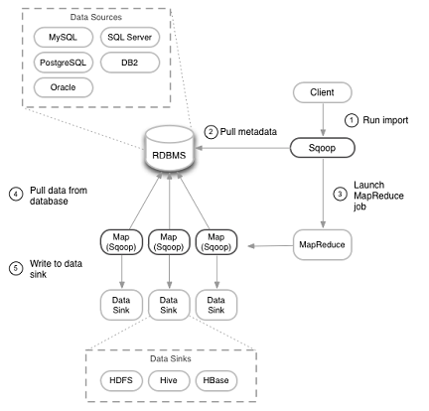
How does Sqoop work? (Import)
q2
Notes:
Sqoop uses the DBInputFormat, a connector that allows Hadoop MapReduce programs to read rows from SQL databases. DBInputFormat allows Hadoop to read input from JDBC: a Java interface to databases that most popular database vendors (Oracle, MySQL, Postgresql, etc.) implement.
In order to use DBInputFormat you need to write a class that deserializes the columns from the database record into individual data fields to work with. This is pretty tedious—and entirely algorithmic. Sqoop auto-generates class definitions to deserialze the data from the database. These classes can also be used to store the results in Hadoop’s SequenceFile format, which allows you to take advantage of built-in compression within HDFS too. The classes are written out as .java files that you can incorporate in your own data processing pipeline later. The class definition is created by taking advantage of JDBC’s ability to read metadata about databases and tables.
When Sqoop is invoked, it retrieves the table’s metadata, writes out the class definition for the columns you want to import, and launches a MapReduce job to import the table body proper.
Hadoop users know that moving large volumes of data can be a time-intensive operation. While it provides a reliable implementation-independent mechanism to read database tables, using a MapReduce JDBC job to import data from a remote database is often inefficient. Database vendors usually provide an export tool that exports data in a more high-performance manner. Sqoop is capable of using alternate import strategies as well. By examining the connect string URL that tells Sqoop which database to connect to, Sqoop will choose alternate import strategies as appropriate to the database. Sqoop can take advantage of MySQL’s export tool called mysqldump.
How is Sqoop able to parallelize imports across multiple mappers[1]? In figure 1, we showed how Sqoop's first step is to pull metadata from the database. It inspects the table being imported to determine the primary key and runs a query to determine the lower and upper bounds of the data in the table (shown in figure 3). A somewhat even distribution of data within the minimum and maximum keys is assumed by dividing the delta by the number of mappers. Each mapper is then fed a unique query containing a range of the primary key.

Slide 6
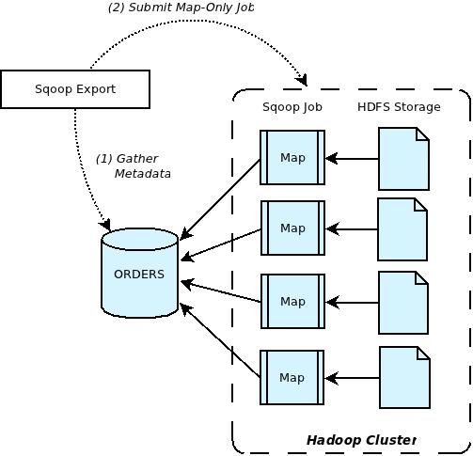
How does Sqoop work? (Export)
q3
Notes:
Export is done in two steps as depicted in Figure 2. The first step is to introspect the database for metadata, followed by the second step of transferring the data. Sqoop divides the input dataset into splits and then uses individual map tasks to push the splits to the database. Each map task performs this transfer over many transactions in order to ensure optimal throughput and minimal resource utilization.

Slide 7
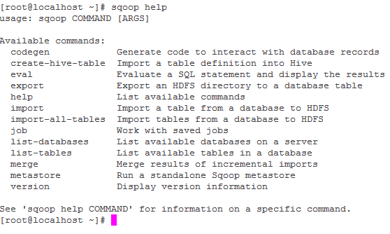
Commands

Slide 8
Sqoop Import

Slide 9
Import – Additional Arguments
Q4

Slide 10
Sqoop Export

Slide 11
Export – Additional Arguments
Q5,Q6

Slide 12
Questions

