Slide 1

Counters, Sorting & Joins
Sriram Mohan RHIT
Q1

Slide 2
Deadlines & Announcements
Exam 1 Monday - next week (In Class as well as take home)
Lab 3 Due Friday 11:55 PM
Lab 4 Due Friday 4:30 PM (Will have class time on Thursday)
Project Milestone 2 Due Friday 4:30 PM (Shouldn’t require extra work)
Research Milestone 1 Due Friday 4:30 PM (Might require extra work for some of you)

Slide 3
Counters
Why?
Are there built-in counters?
Notes:
There are often things you would like to know about the data you are analyzing but that are peripheral to the analysis you are performing. For example, if you were counting invalid records and discovered that the proportion of invalid records in the whole dataset was very high, you might be prompted to check why so many records were being marked as invalid—perhaps there is a bug in the part of the program that detects invalid records? Or if the data were of poor quality and genuinely did have very many invalid records, after discovering this, you might decide to increase the size of the dataset so that the number of good records was large enough for meaningful analysis.
Counters are a useful channel for gathering statistics about the job: for quality control or for application-level statistics. They are also useful for problem diagnosis. If you are tempted to put a log message into your map or reduce task, it is often better to see whether you can use a counter instead to record that a particular condition occurred. In addition to counter values being much easier to retrieve than log output for large distributed jobs, you get a record of the number of times that condition occurred, which is more work to obtain from a set of log files.
See Chapter 9, Tables 1-6 for a list of built-in counters.

Slide 4
User Defined Java Counters
Defining your counters
Updating Counters
Retrieving Counters
Dynamic Counters
Q2
Notes:
MapReduce allows user code to define a set of counters, which are then incremented as desired in the mapper or reducer. Counters are defined by a Java enum, which serves to group related counters. A job may define an arbitrary number of enums, each with an arbitrary number of fields. The name of the enum is the group name, and the enum’s fields are the counter names. Counters are global: the MapReduce framework aggre- gates them across all maps and reduces to produce a grand total at the end of the job.

Slide 5
Code Walkthrough

Slide 6
Sorting via MapReduce
How do you sort a data set through Hadoop?
What are the problems you run into?
Q3, Q4
Notes:
How can you produce a globally sorted file using Hadoop? The naive answer is to use a single partition.4 But this is incredibly inefficient for large files because one machine has to process all of the output, so you are throwing away the benefits of the parallel architecture that MapReduce provides.
Instead, it is possible to produce a set of sorted files that, if concatenated, would form a globally sorted file. The secret to doing this is to use a partitioner that respects the total order of the output. For example, if we had four partitions, we could put keys for temperatures less than –10°C in the first partition, those between –10°C and 0°C in the second, those between 0°C and 10°C in the third, and those over 10°C in the fourth.
Now the question is whether this will lead to an even partition? The answer is no. How do we produce even partitions?
To construct more even partitions, we need to have a better understanding of the temperature distribution for the whole dataset. It’s fairly easy to write a MapReduce job to count the number of records that fall into a collection of temperature buckets.
Although we could use this information to construct a very even set of partitions, the fact that we needed to run a job that used the entire dataset to construct them is not ideal. It’s possible to get a fairly even set of partitions by sampling the key space. The idea behind sampling is that you look at a small subset of the keys to approximate the key distribution, which is then used to construct partitions. Luckily, we don’t have to write the code to do this ourselves, as Hadoop comes with a selection of samplers.

Slide 7
Secondary Sort
Where does the sorting happen by default in MapReduce?
For instance, if I have the following key value pairs being output by my map tasks
(1,A), (1,C), (1,B) (2,A) (2,B) and let us assume one reducer what would the output of my MapReduce look like?
Begin Q5
Notes:
The MapReduce framework sorts the records by key before they reach the reducers. For any particular key, however, the values are not sorted. The order in which the values appear is not even stable from one run to the next, because they come from different map tasks, which may finish at different times from run to run. Generally speaking, most MapReduce programs are written so as not to depend on the order in which the values appear to the reduce function. However, it is possible to impose an order on the values by sorting and grouping the keys in a particular way.

Slide 8
A conceptual explanation of secondary sort
Is there a different way to write a MapReduce job to calculate Max Temperature?
Notes:
To illustrate the idea, consider the MapReduce program for calculating the maximum temperature for each year. If we arranged for the values (temperatures) to be sorted in descending order, we wouldn’t have to iterate through them to find the maximum; instead, we could take the first for each year and ignore the rest. (This approach isn’t the most efficient way to solve this particular problem, but it illustrates how secondary sort works in general.)

Slide 9
How would we do this?
A composite key composed of year and temperature
What should the sort order be?
What is the problem we run into?
Notes:
To achieve this, we change our keys to be composite: a combination of year and temperature. We want the sort order for keys to be by year (ascending) and then by temperature (descending):
1900 35°C
1900 34°C
1900 34°C ...
1901 36°C
1901 35°C
If all we did was change the key, this wouldn’t help, because then records for the same year would have different keys and therefore would not (in general) go to the same reducer. For example, (1900, 35°C) and (1900, 34°C) could go to different reducers

Slide 10
A custom partitioner
Rather than partitioning by the entire key, we partition by just the year part of the key
Notes:
By setting a partitioner to partition by the year part of the key, we can guarantee that records for the same year go to the same reducer. This still isn’t enough to achieve our goal, however. A partitioner ensures only that one reducer receives all the records for a year;
1900 35 Same Partition, Group 1
1900 34 Sam partition, Group 2
1900 34 Same Partition, Group 2
1900 34 Same partition, Group 2
1900 33 Same partition, Group 3
The final piece of the puzzle is the setting to control the grouping. If we group values in the reducer by the year part of the key, we will see all the records for the same year in one reduce group. And because they are sorted by temperature in descending order, the first is the maximum temperature:

Slide 11
Secondary Sort – A Summary
Make the key a composite of year and temperature(natural key and natural value)
The sort comparator should order by they composite key (natural key and natural value)
The partitioner and the grouping comparator for the composite key should consider only the natural key (year) for partitioning and grouping
End Q5
Notes:
Make the key a composite of the natural key and the natural value.
The sort comparator should order by the composite key, that is, the natural key
and natural value.
The partitioner and grouping comparator for the composite key should consider
only the natural key for partitioning and grouping.

Slide 12
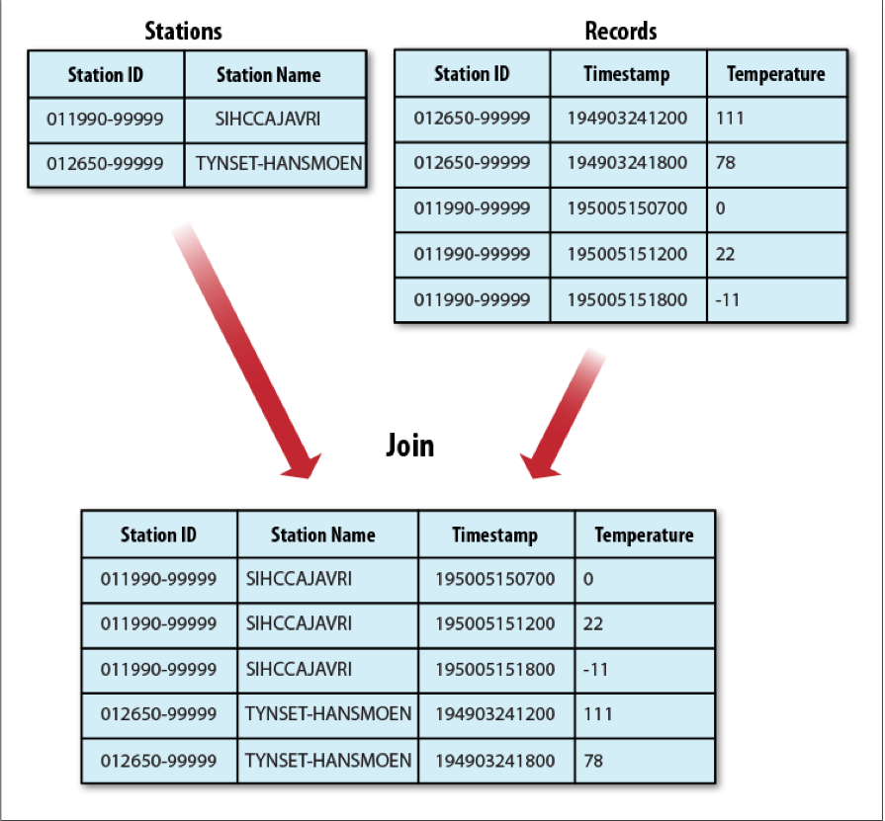
Joins
Notes:
MapReduce can perform joins between large datasets, but writing the code to do joins from scratch is fairly involved. Rather than writing MapReduce programs, you might consider using a higher-level framework such as Pig, Hive, or Cascading, in which join operations are a core part of the implementation.
How we implement the join depends on how large the datasets are and how they are partitioned. If one dataset is large (the weather records) but the other one is small enough to be distributed to each node in the cluster (as the station metadata is), the join can be effected by a MapReduce job that brings the records for each station together (a partial sort on station ID, for example). The mapper or reducer uses the smaller dataset to look up the station metadata for a station ID, so it can be written out with each record. See “Side Data Distribution” on page 288 for a discussion of this ap- proach, where we focus on the mechanics of distributing the data to tasktrackers.
If the join is performed by the mapper, it is called a map-side join, whereas if it is performed by the reducer it is called a reduce-side join.

Slide 13
Map vs Reduce Side Joins
What is the difference?
Q6
Notes:
A map-side join between large inputs works by performing the join before the data reaches the map function. For this to work, though, the inputs to each map must be partitioned and sorted in a particular way. Each input dataset must be divided into the same number of partitions, and it must be sorted by the same key (the join key) in each source. All the records for a particular key must reside in the same partition. This may sound like a strict requirement (and it is), but it actually fits the description of the output of a MapReduce job.
In the context of the weather example, if we ran a partial sort on the stations file by station ID, and another, identical sort on the records, again by station ID and with the same number of reducers, then the two outputs would satisfy the conditions for running a map-side join.
A reduce-side join is more general than a map-side join, in that the input datasets don’t have to be structured in any particular way, but it is less efficient because both datasets have to go through the MapReduce shuffle. The basic idea is that the mapper tags each record with its source and uses the join key as the map output key, so that the records with the same key are brought together in the reducer

Slide 14
Reduce Side Joins
Use of Multiple Inputs
Tagging Data on the mapper to ensure join data is available when needed
Custom partitioner and group comparator
Notes:
A reduce-side join is more general than a map-side join, in that the input datasets don’t have to be structured in any particular way, but it is less efficient because both datasets have to go through the MapReduce shuffle. The basic idea is that the mapper tags each record with its source and uses the join key as the map output key, so that the records with the same key are brought together in the reducer. We use several ingredients to make this work in practice:
Multiple inputs
The input sources for the datasets generally have different formats, so it is very convenient to use the MultipleInputs class (see “Multiple Inputs” on page 250) to separate the logic for parsing and tagging each source.
Secondary sort
As described, the reducer will see the records from both sources that have the same key, but they are not guaranteed to be in any particular order. However, to perform the join, it is important to have the data from one source before another. For the weather data join, the station record must be the first of the values seen for each key, so the reducer can fill in the weather records with the station name and emit them straightaway

Slide 15
Code Walkthrough
See Example 9.9 to 9.12

Slide 16
Extra Credit
What is the distributed cache? How can you use the distributed cache to do a join efficiently when one of the datasets is small? If you have working code, you get more points
Please turn in your submission to Moodle → Extra Credit Drop Box → Extra Credit Week 4 by 1:30 PM on Thursday the 1st of October:

Slide 17
Questions

