Slide 1

Introduction to Serialization
Sriram Mohan RHIT
Q1

Slide 2
Deadlines & Announcements
Project – Due M0. Class time on Friday
Please read the book regularly

Slide 3
Serialization
What is Serialization?
What is De-Serialization?
Notes:
Serialization is the process of turning structured objects into a byte stream for trans- mission over a network or for writing to persistent storage. Deserialization is the reverse process of turning a byte stream back into a series of structured objects.
Serialization appears in two quite distinct areas of distributed data processing: for interprocess communication and for persistent storage.
In Hadoop, interprocess communication between nodes in the system is implemented using remote procedure calls (RPCs). The RPC protocol uses serialization to render the message into a binary stream to be sent to the remote node, which then deserializes the binary stream into the original message.

Slide 4
Why Serialization?
Compact
Fast
Extensible
Interoperable
Does it impact storage?
Q2
Notes:
n Hadoop, interprocess communication between nodes in the system is implemented using remote procedure calls (RPCs). The RPC protocol uses serialization to render the message into a binary stream to be sent to the remote node, which then deserializes the binary stream into the original message. In general, it is desirable that an RPC seriali- zation format is:
Compact
A compact format makes the best use of network bandwidth, which is the most scarce resource in a data center.
Fast
Extensible
Protocols change over time to meet new requirements, so it should be straightforward to evolve the protocol in a controlled manner for clients and servers. For example, it should be possible to add a new argument to a method call and have the new servers accept messages in the old format (without the new ar- gument) from old clients.
Interoperable
For some systems, it is desirable to be able to support clients that are written in different languages to the server, so the format needs to be designed to make this possible.
On the face of it, the data format chosen for persistent storage would have different requirements from a serialization framework. After all, the lifespan of an RPC is less than a second, whereas persistent data may be read years after it was written. As it turns out, the four desirable properties of an RPC’s serialization format are also crucial for a persistent storage format. We want the storage format to be compact (to make efficient use of storage space), fast (so the overhead in reading or writing terabytes of data is minimal), extensible (so we can transparently read data written in an older format), and interoperable (so we can read or write persistent data using different languages).

Slide 5
Writable Interface
package org.apache.hadoop.io;
import java.io.DataOutput;
import java.io.DataInput;
import java.io.IOException;
public interface Writable {
void write(DataOutput out) throws IOException;
void readFields(DataInput in) throws IOException;
}
Example: IntWritable, LongWritable
Q3
Notes:
The Writable interface defines two methods: one for writing its state to a DataOutput binary stream and one for reading its state from a DataInput binary stream.

Slide 6
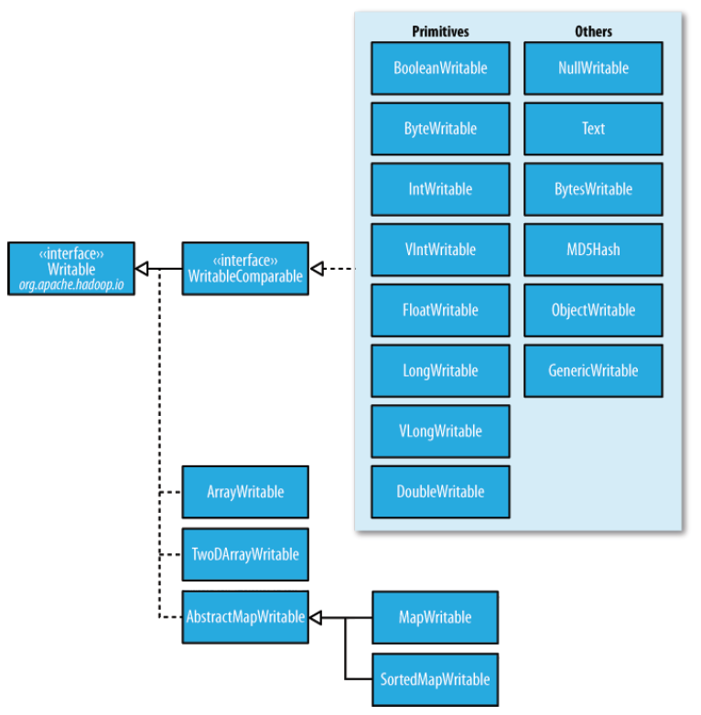
Writable Classes
Notes:
Java Primitive Writable Primitive Serialization in Bytes
Boolean BooleanWritable 1
Byte ByteWritable 1
Short ShortWritable 2
Int IntWritable 4
vIntWritable 1-5
Float FloatWritable 4
Long LongWritable 8
VLongWritable 1-9
Double DoubleWritable 8

Slide 7
WritableComparable
package org.apache.hadoop.io;
public interface WritableComparable<T> extends Writable, Comparable<T> {
}
package org.apache.hadoop.io;
import java.util.Comparator;
public interface RawComparator<T> extends Comparator<T> {
public int compare(byte[] b1, int s1, int l1, byte[] b2, int s2, int l2);
}
Q4
Notes:
IntWritable implements the WritableComparable interface, which is just a subinterface of the Writable and java.lang.Comparable interfaces:
package org.apache.hadoop.io;
public interface WritableComparable<T> extends Writable, Comparable<T> { }
Comparison of types is crucial for MapReduce, where there is a sorting phase during which keys are compared with one another. One optimization that Hadoop provides is the RawComparator extension of Java’s Comparator:
package org.apache.hadoop.io; import java.util.Comparator; public interface RawComparator<T> extends Comparator<T> {
public int compare(byte[] b1, int s1, int l1, byte[] b2, int s2, int l2); }
This interface permits implementors to compare records read from a stream without deserializing them into objects, thereby avoiding any overhead of object creation. For example, the comparator for IntWritables implements the raw compare() method by reading an integer from each of the byte arrays b1 and b2 and comparing them directly from the given start positions (s1 and s2) and lengths (l1 and l2).
WritableComparator is a general-purpose implementation of RawComparator for WritableComparable classes. It provides a default implementation of the raw compare() method that deserializes the objects to be com- pared from the stream and invokes the object compare() method.

Slide 8
Implementing a custom writable
Text Pair (Code Walkthrough)
Q5

Slide 9
Data Integrity
Why?
How?
Read
Write
Can it be done in the background?
Q6
Notes:
HDFS transparently checksums all data written to it and by default verifies checksums when reading data. A separate checksum is created for every io.bytes.per.checksum bytes of data. The default is 512 bytes. Datanodes verify the data as they receive it for storage. Upon successful verification, the datanode stores both the data as well as the checksum. During a HDFS write, the client as mentioned previouslywrites to a pipeline of nodes - the last node in the pipeline verifies the checksum. If an error is detected, a checksum exception is thrown by the last datanode.
During the read, the client is sent a copy of the checksum as well. The client independently computes the checksum for the block it has just read, verifies it agains the stored checksum. In case of a mismatch, the namenode is informed before throwing a checksum exception - which in most cases will route the client to the next closest block.
Since more than one replica is stored, HDFS can auto-recover from a corrupt block, by copying one of the good replicas to produce a new uncorrupt replica. Typically, on receipt of a checksum exception during a read, the namenode marks the replica as corrupt and any future requests are not directed to this replica. The namenode will schedule a copy of the block to be replicated to another datanode to ensure that the block in question is replicated appropriately. Once the replication has succeeded, the corrupt block is deleted.
Each datanode keeps a persistent log of checksum verifications, so it knows the last time each of its blocks was verified. When a client successfully verifies a block, it tells the datanode, which updates its log. Aside from block verification on client reads, each datanode runs a DataBlockScanner in a background thread that periodically verifies all the blocks stored on the datanode. This is to guard against corruption due to “bit rot” in the physical storage media.

Slide 10
Questions

