Slide 1

Input Formats
Sriram Mohan RHIT
Q1

Slide 2
Deadlines & Announcements
Lab 2 – Due Tomorrow at 11:55 PM On Moodle
Project – Due M1. 11:55 PM Friday
Research M0 – Due Class Time Friday

Slide 3
Shuffle Sort
Q2
Notes:
MapReduce makes the guarantee that the input to every reducer is sorted by key. The process by which the system performs the sort—and transfers the map outputs to the reducers as inputs—is known as the shuffle.
What happens on the map side?
When the map function starts producing output, it is not simply written to disk. The process is more involved, and takes advantage of buffering writes in memory and doing some presorting for efficiency reasons. Each map task has a circular memory buffer that it writes the output to. The buffer is 100 MB by default, a size that can be tuned by changing the io.sort.mb property. When the contents of the buffer reaches a certain threshold size (io.sort.spill.percent, which has the default 0.80, or 80%), a background thread will start to spill the contents to disk. Map outputs will continue to be written to the buffer while the spill takes place, but if the buffer fills up during this time, the map will block until the spill is complete.
Spills are written in round-robin fashion to the directories specified by the mapred.local.dir property, in a job-specific subdirectory. Before it writes to disk, the thread first divides the data into partitions corresponding to the reducers that they will ultimately be sent to. Within each partition, the back- ground thread performs an in-memory sort by key, and if there is a combiner function, it is run on the output of the sort. Running the combiner function makes for a more compact map output, so there is less data to write to local disk and to transfer to the reducer. Each time the memory buffer reaches the spill threshold, a new spill file is created, so after the map task has written its last output record, there could be several spill files. Before the task is finished, the spill files are merged into a single partitioned and sorted output file. If there are at least three spill files (set by the min.num.spills.for.combine property), the combiner is run again before the output file is written.
What happens on the reduce side?
The map output file is sitting on the local disk of the machine that ran the map task (note that although map outputs always get written to local disk, reduce outputs may not be), but now it is needed by the machine that is about to run the reduce task for the partition. Furthermore, the reduce task needs the map output for its particular partition from several map tasks across the cluster. The map tasks may finish at different times, so the reduce task starts copying their outputs as soon as each completes. This is known as the copy phase of the reduce task. The reduce task has a small number of copier threads so that it can fetch map outputs in parallel. The default is five threads, but this number can be changed by setting the mapred.reduce.parallel.copies property
How does the reducer where to fetch the output from?
As map tasks complete successfully, they notify their parent tasktracker of the status update, which in turn notifies the jobtracker. (In MapReduce 2, the tasks notify their application master directly.) These notifications are transmitted over the heartbeat communication mechanism described earlier. Therefore, for a given job, the jobtracker (or applica- tion master) knows the mapping between map outputs and hosts. A thread in the reducer periodically asks the master for map output hosts until it has retrieved them all. Hosts do not delete map outputs from disk as soon as the first reducer has retrieved them, as the reducer may subsequently fail. Instead, they wait until they are told to delete them by the jobtracker (or application master), which is after the job has completed.
The map outputs are copied to the reduce task JVM’s memory if they are small enough, otherwise, they are copied to disk. When the in-memory buffer reaches a threshold size (controlled by mapred.job.shuffle.merge.percent) or reaches a threshold number of map outputs (mapred.inmem.merge.threshold), it is merged and spilled to disk. If a combiner is specified, it will be run during the merge to reduce the amount of data written to disk.
As the copies accumulate on disk, a background thread merges them into larger, sorted files. This saves some time merging later on. Note that any map outputs that were compressed (by the map task) have to be decompressed in memory in order to perform a merge on them. When all the map outputs have been copied, the reduce task moves into the sort phase (which should properly be called the merge phase, as the sorting was carried out on the map side), which merges the map outputs, maintaining their sort ordering

Slide 4
Speculative Execution
Can a slow task bring down an entire job?
How do we get around this?
When would you want to turn off speculative execution?
Q3
Notes:
This makes the job execution time sensitive to slow-running tasks, as it takes only one slow task to make the whole job take significantly longer than it would have done otherwise. When a job consists of hundreds or thousands of tasks, the possibility of a few straggling tasks is very real.
Tasks may be slow for various reasons, including hardware degradation or software misconfiguration, but the causes may be hard to detect because the tasks still complete successfully, albeit after a longer time than expected. Hadoop doesn’t try to diagnose and fix slow-running tasks; instead, it tries to detect when a task is running slower than expected and launches another equivalent task as a backup. This is termed speculative execution of tasks.
It’s important to understand that speculative execution does not work by launching two duplicate tasks at about the same time so they can race each other. This would be wasteful of cluster resources. Rather, a speculative task is launched only after all the tasks for a job have been launched, and then only for tasks that have been running for some time (at least a minute) and have failed to make as much progress, on average, as the other tasks from the job. When a task completes successfully, any duplicate tasks that are running are killed since they are no longer needed. So if the original task com- pletes before the speculative task, the speculative task is killed; on the other hand, if the speculative task finishes first, the original is killed.
mapred.map.tasks.speculative.execution or mapred.reduce.tasks.speculative.execution
Type - boolean Default value – true
yarn.app.mapreduce.am.job. speculator.class
Type - Class Default value org.apache.hadoop.mapre duce.v2. app.speculate.DefaultSpeculator
Why would you ever want to turn off speculative execution? The goal of speculative execution is to reduce job execution time, but this comes at the cost of cluster efficiency. On a busy cluster, speculative execution can reduce overall throughput, since redundant tasks are being executed in an attempt to bring down the execution time for a single job. For this reason, some cluster administrators prefer to turn it off on the cluster and have users explicitly turn it on for individual jobs. This was especially relevant for older versions of Hadoop, when speculative execution could be overly aggressive in scheduling speculative tasks.
There is a good case for turning off speculative execution for reduce tasks, since any duplicate reduce tasks have to fetch the same map outputs as the original task, and this can significantly increase network traffic on the cluster.
Another reason for turning off speculative execution is for tasks that are not idempotent. However, in many cases it is possible to write tasks to be idempotent and use an OutputCommitter to promote the output to its final location when the task succeeds. This technique is explained in more detail in the next section.

Slide 5
Skipping Bad Records
Clean records in Map/Reduce Phase
Turn on Hadoop’s skipping mode
Q4
Notes:
Large datasets are messy. They often have corrupt records. They often have records that are in a different format. They often have missing fields. In an ideal world, your code would cope gracefully with all of these conditions. In practice, it is often expedient to ignore the offending records. Depending on the analysis being performed, if only a small percentage of records are affected, then skipping them may not significantly affect the result. However, if a task trips up when it encounters a bad record—by throwing a runtime exception—then the task fails. Failing tasks are retried (since the failure may be due to hardware failure or some other reason outside the task’s control), but if a task fails four times, the whole job is marked as failed. If it is the data that is causing the task to throw an exception, rerunning the task won’t help, since it will fail in exactly the same way each time
The best way to handle corrupt records is in your mapper or reducer code. You can detect the bad record and ignore it, or you can abort the job by throwing an exception. You can also count the total number of bad records in the job using counters to see how widespread the problem is. In rare cases, though, you can’t handle the problem because there is a bug in a third- party library that you can’t work around in your mapper or reducer. In these cases, you can use Hadoop’s optional skipping mode for automatically skipping bad records
When skipping mode is enabled, tasks report the records being processed back to the tasktracker. When the task fails, the tasktracker retries the task, skipping the records that caused the failure. Because of the extra network traffic and bookkeeping to maintain the failed record ranges, skipping mode is turned on for a task only after it has failed twice.
Thus, for a task consistently failing on a bad record, the tasktracker runs the following task attempts with these outcomes:
Task fails.
Task fails.
Skipping mode is enabled. Task fails, but the failed record is stored by the task- tracker.
Skippingmodeisstillenabled.Tasksucceedsbyskippingthebadrecordthatfailed in the previous attempt.

Slide 6
Minimal MapReduce
Code Walkthrough
Q5

Slide 7
Input Format
What is an input split?
public abstract class InputSplit {
public abstract long getLength() throws IOException, InterruptedException;
￼￼public abstract String[] getLocations() throws IOException, InterruptedException;
}
Q6
Notes:
an input split is a chunk of the input that is processed by a single map. Each map processes a single split. Each split is divided into records, and the map processes each record—a key-value pair—in turn. Splits and records are logical: there is nothing that requires them to be tied to files, for example, although in their most common incarnations, they are. In a database context, a split might correspond to a range of rows from a table and a record to a row in that range (this is precisely what DBInputFormat does, which is an input format for reading data from a relational data- base).
An InputSplit has a length in bytes and a set of storage locations, which are just host- name strings. Notice that a split doesn’t contain the input data; it is just a reference to the data. The storage locations are used by the MapReduce system to place map tasks as close to the split’s data as possible, and the size is used to order the splits so that the largest get processed first, in an attempt to minimize the job runtime (this is an instance of a greedy approximation algorithm).

Slide 8
Input Format
public abstract class InputFormat<K, V> {
public abstract List<InputSplit> getSplits(JobContext context)
throws IOException, InterruptedException;
public abstract RecordReader<K, V> createRecordReader(InputSplit split, TaskAttemptContext context) throws IOException, InterruptedException;
}
Notes:
As a MapReduce application writer, you don’t need to deal with InputSplits directly, as they are created by an InputFormat. An InputFormat is responsible for creating the input splits and dividing them into records. Before we see some concrete examples of InputFormat, let’s briefly examine how it is used in MapReduce. Here’s the interface:
public abstract class InputFormat<K, V> { public abstract List<InputSplit> getSplits(JobContext context)
throws IOException, InterruptedException;
public abstract RecordReader<K, V> createRecordReader(InputSplit split, TaskAttemptContext context) throws IOException, InterruptedException;
}
The client running the job calculates the splits for the job by calling getSplits(), then sends them to the jobtracker, which uses their storage locations to schedule map tasks that will process them on the tasktrackers. On a tasktracker, the map task passes the split to the createRecordReader() method on InputFormat to obtain a RecordReader for that split. A RecordReader is little more than an iterator over records, and the map task uses one to generate record key-value pairs, which it passes to the map function
Within the mappers run method, After running setup(), the nextKeyValue() is called repeatedly on the Context (which delegates to the identically-named method on the RecordReader) to populate the key and value objects for the mapper. The key and value are retrieved from the Record Reader by way of the Context and are passed to the map() method for it to do its work. When the reader gets to the end of the stream, the nextKeyValue() method returns false, and the map task runs its cleanup() method and then completes.

Slide 9
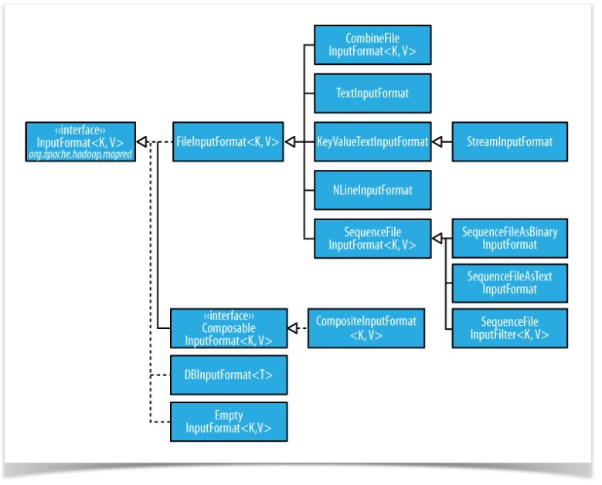
Input Format Hierarchy
Q7,Q8
Notes:
FileInputFormat is the base class for all implementations of InputFormat that use files as their data source (see Figure). It provides two things: a place to define which files are included as the input to a job, and an implementation for generating splits for the input files. The job of dividing splits into records is performed by subclasses.
The input to a job is specified as a collection of paths, which offers great flexibility in constraining the input to a job. FileInputFormat offers four static convenience methods for setting a Job’s input paths:
public static void addInputPath(Job job, Path path) public static void addInputPaths(Job job, String commaSeparatedPaths)
public static void setInputPaths(Job job, Path... inputPaths) public static void setInputPaths(Job job, String commaSeparatedPaths)
The addInputPath() and addInputPaths() methods add a path or paths to the list of inputs. You can call these methods repeatedly to build the list of paths. The setInput Paths() methods set the entire list of paths in one go (replacing any paths set on the Job in previous calls).
FileInputFormat splits only large files. Here “large” means larger than an HDFS block. The split size is normally the size of an HDFS block, which is appropriate for most applications. You can control this by adjusting the value of the following properties - mapred.min.split.size and mapred.max.split.size
Hadoop works better with a small number of large files than a large number of small files. One reason for this is that FileInputFormat generates splits in such a way that each split is all or part of a single file. If the file is very small (“small” means significantly smaller than an HDFS block) and there are a lot of them, each map task will process very little input, and there will be a lot of them (one per file), each of which imposes extra bookkeeping overhead. Compare a 1 GB file broken into sixteen 64 MB blocks and 10,000 or so 100 KB files. The 10,000 files use one map each, and the job time can be tens or hundreds of times slower than the equivalent one with a single input file and 16 map tasks. The situation is alleviated somewhat by CombineFileInputFormat, which was designed to work well with small files. Where FileInputFormat creates a split per file, CombineFileInputFormat packs many files into each split so that each mapper has more to process. Crucially, CombineFileInputFormat takes node and rack locality into account when deciding which blocks to place in the same split, so it does not compromise the speed at which it can process the input in a typical MapReduce job.
Text Input Format: TextInputFormat is the default InputFormat. Each record is a line of input. The key, a LongWritable, is the byte offset within the file of the beginning of the line. The value is the contents of the line, excluding any line terminators (e.g., newline or carriage return), and is packaged as a Text object
KeyValueTextInputFormat: TextInputFormat’s keys, being simply the offset within the file, are not normally very useful. It is common for each line in a file to be a key-value pair, separated by a delimiter such as a tab character. For example, this is the output produced by TextOutputFor mat, Hadoop’s default OutputFormat. To interpret such files correctly, KeyValueTextIn putFormat is appropriate
NLineInputFormat: With TextInputFormat and KeyValueTextInputFormat, each mapper receives a variable number of lines of input. The number depends on the size of the split and the length of the lines. If you want your mappers to receive a fixed number of lines of input, then NLineInputFormat is the InputFormat to use. Like TextInputFormat, the keys are the byte offsets within the file and the values are the lines themselves
Although the input to a MapReduce job may consist of multiple input files (constructed by a combination of file globs, filters, and plain paths), all of the input is interpreted by a single InputFormat and a single Mapper. What often happens, however, is that the data format evolves over time, so you have to write your mapper to cope with all of your legacy formats. Or you have data sources that provide the same type of data but in different formats.
hese cases are handled elegantly by using the MultipleInputs class, which allows you to specify which InputFormat and Mapper to use on a per-path basis. For example, if we had weather data from the UK Met Office6 that we wanted to combine with the NCDC data for our maximum temperature analysis, we might set up the input as follows:
6. Met Office data is generally available only to the research and academic community. However, there is a small amount of monthly weather station data available at http://www.metoffice.gov.uk/climate/uk/ stationdata/.
MultipleInputs.addInputPath(job, ncdcInputPath, TextInputFormat.class, MaxTemperatureMapper.class);
MultipleInputs.addInputPath(job, metOfficeInputPath, TextInputFormat.class, MetOfficeMaxTemperatureMapper.class);
This code replaces the usual calls to FileInputFormat.addInputPath() and job.setMapperClass()
The MultipleInputs class has an overloaded version of addInputPath() that doesn’t take a mapper:
public static void addInputPath(Job job, Path path, Class<? extends InputFormat> inputFormatClass)
This is useful when you only have one mapper (set using the Job’s setMapperClass() method) but multiple input formats

Slide 10
Writing a Custom Input Format
Whole Input Format
Converting Small Files to a Sequence File
Q2,Q3
Notes:
Preventing Splitting:
Some applications don’t want files to be split, as this allows a single mapper to process each input file in its entirety. For example, a simple way to check if all the records in a file are sorted is to go through the records in order, checking whether each record is not less than the preceding one. Implemented as a map task, this algorithm will work only if one map processes the whole file.3
There are a couple of ways to ensure that an existing file is not split. The first (quick and dirty) way is to increase the minimum split size to be larger than the largest file in your system. Setting it to its maximum value, Long.MAX_VALUE, has this effect. The sec- ond is to subclass the concrete subclass of FileInputFormat that you want to use, to override the isSplitable() method4 to return false

Slide 11
Code Walkthrough
Example 8-2, 8-3 & 8-4

Slide 12
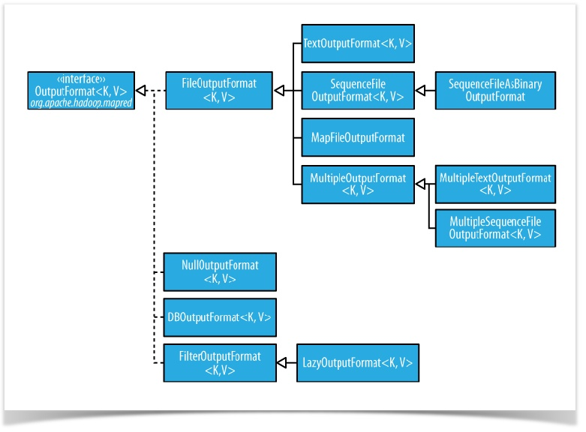
OutputFormat
Notes:
The default output format, TextOutputFormat, writes records as lines of text. Its keys and values may be of any type, since TextOutputFormat turns them to strings by calling toString() on them. Each key-value pair is separated by a tab character, although that may be changed using the mapreduce.output.textoutputformat.separator property (mapred.textoutputformat.separator in the old API). The counterpart to TextOutput Format for reading in this case is KeyValueTextInputFormat, since it breaks lines into key- value pairs based on a configurable separator
You can suppress the key or the value (or both, making this output format equivalent to NullOutputFormat, which emits nothing) from the output using a NullWritable type. This also causes no separator to be written, which makes the output suitable for reading in using TextInputFormat.

Slide 13
Multiple Outputs
Sample Code.
Q4
Notes:
FileOutputFormat and its subclasses generate a set of files in the output directory. There is one file per reducer, and files are named by the partition number: part-r-00000, part- r-00001, etc. Sometimes there is a need to have more control over the naming of the files or to produce multiple files per reducer. MapReduce comes with the MultipleOut puts class to help you do this
MultipleOutputs allows you to write data to files whose names are derived from the output keys and values, or in fact from an arbitrary string. This allows each reducer (or mapper in a map-only job) to create more than a single file. Filenames are of the form name-m-nnnnn for map outputs and name-r-nnnnn for reduce outputs, where name is an arbitrary name that is set by the program, and nnnnn is an integer designating the part number, starting from zero. The part number ensures that outputs written from dif- ferent partitions (mappers or reducers) do not collide in the case of the same name

Slide 14
LazyOutput
What is it?
Why do we need it?
Q5
Notes:
ileOutputFormat subclasses will create output (part-r-nnnnn) files, even if they are empty. Some applications prefer that empty files not be created, which is where Lazy OutputFormat helps. It is a wrapper output format that ensures that the output file is
created only when the first record is emitted for a given partition. To use it, call its setOutputFormatClass() method with the JobConf and the underlying output format.
Streaming and Pipes support a -lazyOutput option to enable LazyOutputFormat.

Slide 15
Questions

