Slide 1

MapReduce - Coding
Sriram Mohan RHIT
Q1

Slide 2
MapReduce Paradigm
Map Phase
Reduce Phase
Everything is a key value pair
Notes:
MapReduce is a programming model and an associated implementation for processing and generating large data sets with a parallel, distributed algorithm on a cluster.[1][2]
A MapReduce program is composed of a Map() procedure that performs filtering and sorting (such as sorting students by first name into queues, one queue for each name) and a Reduce() procedure that performs a summary operation (such as counting the number of students in each queue, yielding name frequencies). The "MapReduce System" (also called "infrastructure" or "framework") orchestrates the processing by marshalling the distributed servers, running the various tasks in parallel, managing all communications and data transfers between the various parts of the system, and providing for redundancy andfault tolerance.

Slide 3
Example – Count the number of times each word appears
Mary had a little lamb,
His fleece was white as snow,
And everywhere that Mary went,
The lamb was sure to go.
He followed her to school one day,
Which was against the rule,
It made the children laugh and play
To see a lamb at school.
And so the teacher turned it out,
But still it lingered near,
And waited patiently about,
Till Mary did appear.
"Why does the lamb love Mary so?"
The eager children cry.
"Why, Mary loves the lamb, you know."
The teacher did reply.
Notes:
How will you do it?

Slide 4
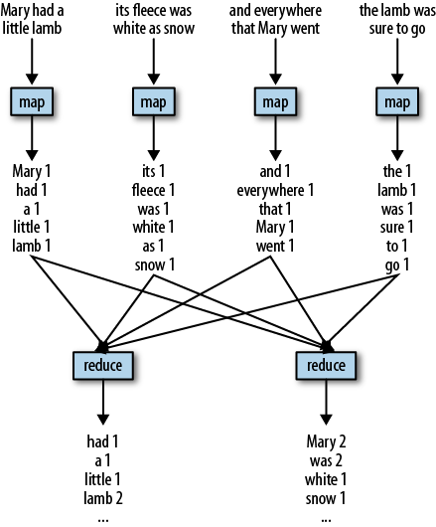

Slide 5
MapReduce Code Walkthrough
Q2, Q3
Notes:
See Chapter 2 (Pages 20-30)

Slide 6
Locality Revisited
Notes:
Hadoop divides the input to a MapReduce job into fixed-size pieces called input splits, or just splits. Hadoop creates one map task for each split, which runs the user- defined map function for each record in the split
Having many splits means the time taken to process each split is small compared to the time to process the whole input. So if we are processing the splits in parallel, the processing is better load-balanced when the splits are small, since a faster machine will be able to process proportionally more splits over the course of the job than a slower machine. Even if the machines are identical, failed processes or other jobs running concurrently make load balancing desirable, and the quality of the load balancing in- creases as the splits become more fine-grained.
On the other hand, if splits are too small, the overhead of managing the splits and of map task creation begins to dominate the total job execution time. For most jobs, a good split size tends to be the size of an HDFS block, 64 MB by default, although this can be changed for the cluster (for all newly created files) or specified when each file is created.
Hadoop does its best to run the map task on a node where the input data resides in HDFS. This is called the data locality optimization because it doesn’t use valuable clus- ter bandwidth. Sometimes, however, all three nodes hosting the HDFS block replicas for a map task’s input split are running other map tasks, so the job scheduler will look for a free map slot on a node in the same rack as one of the blocks.
It should now be clear why the optimal split size is the same as the block size: it is the largest size of input that can be guaranteed to be stored on a single node. If the split spanned two blocks, it would be unlikely that any HDFS node stored both blocks, so some of the split would have to be transferred across the network to the node running the map task, which is clearly less efficient than running the whole map task using local data.

Slide 7
MapReduce Data Flow
Notes:
Map tasks write their output to the local disk, not to HDFS. Why is this? Map output is intermediate output: it’s processed by reduce tasks to produce the final output, and once the job is complete, the map output can be thrown away. So storing it in HDFS with replication would be overkill. If the node running the map task fails before the map output has been consumed by the reduce task, then Hadoop will automatically rerun the map task on another node to re-create the map output.
Reduce tasks don’t have the advantage of data locality; the input to a single reduce task is normally the output from all mappers. In the present example, we have a single reduce task that is fed by all of the map tasks. Therefore, the sorted map outputs have to be transferred across the network to the node where the reduce task is running, where they are merged and then passed to the user-defined reduce function. The output of the reduce is normally stored in HDFS for reliability.

Slide 8
Combiner Function
What is it?
Do we need it?
How many times does it run?
Q4,Q5
Notes:
Many MapReduce jobs are limited by the bandwidth available on the cluster, so it pays to minimize the data transferred between map and reduce tasks. Hadoop allows the user to specify a combiner function to be run on the map output, and the combiner function’s output forms the input to the reduce function. Because the combiner function is an optimization, Hadoop does not provide a guarantee of how many times it will call it for a particular map output record, if at all. In other words, calling the combiner function zero, one, or many times should produce the same output from the reducer.

Slide 9
Does MapReduce work for every use case?
Batch Query
Shared nothing architecture & degree of control
Q6
Notes:
Batch Processing – Map Reduce operates on the premise that the entire dataset—or at least a good portion of it—is processed for each query. But this is its power. MapReduce is a batch query processor, and the ability to run an ad hoc query against your whole dataset and get the results in a reasonable time is transformative. If you need to update or process only a small portion of the data, mapreduce is not a good fit.
MPI gives great control to the programmer, but requires that he explicitly handle the mechanics of the data flow, exposed via low-level C routines and constructs such as sockets, as well as the higher-level algorithm for the analysis. MapReduce operates only at the higher level: the programmer thinks in terms of functions of key and value pairs, and the data flow is implicit.
MapReduce spares the programmer from having to think about failure, since the implementation detects failed map or reduce tasks and reschedules replacements on machines that are healthy. MapReduce is able to do this because it is a shared-noth- ing architecture, meaning that tasks have no dependence on one other. (This is a slight oversimplification, since the output from mappers is fed to the reducers, but this is under the control of the MapReduce system; in this case, it needs to take more care rerunning a failed reducer than rerunning a failed map because it has to make sure it can retrieve the necessary map outputs, and if not, regenerate them by running the relevant maps again.) So from the programmer’s point of view, the order in which the tasks run doesn’t matter. By contrast, MPI programs have to explicitly manage their own checkpointing and recovery, which gives more control to the programmer but makes them more difficult to write.

Slide 10
Extra Credit – Week 0
How do we use the MapReduce paradigm with other programming languages? Explain Hadoop streaming with an example using your favorite programming language.
Due: Tuesday September 9th 1:30 PM. Submit on Moodle – Extra Credit Drop Box – Extra Credit Week 0

Slide 11
Questions

