Slide 1

Introduction to MapReduce
Sriram Mohan RHIT
Q1

Slide 2
Tour of the Sandbox

Slide 3
How do you analyze a lot of data?

Slide 4
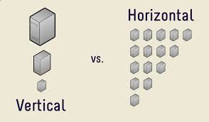
Why do we need to scale horizontally?
Begin Q2
Notes:
The problem is simple: although the storage capacities of hard drives have increased massively over the years, access speeds—the rate at which data can be read from drives —have not kept up
It takes a long time to read all data on a single drive—and writing is even slower. The obvious way to reduce the time is to read from multiple disks at once. Imagine if we had 100 drives, each holding one hundredth of the data. Working in parallel, we could read the data in under two minutes.
Using only one hundredth of a disk may seem wasteful. But we can store one hundred datasets, each of which is one terabyte, and provide shared access to them. We can imagine that the users of such a system would be happy to share access in return for shorter analysis times, and, statistically, that their analysis jobs would be likely to be spread over time, so they wouldn’t interfere with each other too much.

Slide 5
Problems with horizontal scaling
Reliability
Data analysis might require joins
Finish Q2
Notes:
The first problem to solve is hardware failure: as soon as you start using many pieces of hardware, the chance that one will fail is fairly high. A common way of avoiding data loss is through replication: redundant copies of the data are kept by the system so that in the event of failure, there is another copy available. This is how RAID works, for instance, although Hadoop’s filesystem, the Hadoop Distributed Filesystem (HDFS), takes a slightly different approach, as you shall see later.
The second problem is that most analysis tasks need to be able to combine the data in some way, and data read from one disk may need to be combined with the data from any of the other 99 disks. Various distributed systems allow data to be combined from multiple sources, but doing this correctly is notoriously challenging.

Slide 6
Data locality
Network bandwidth is precious in a cluster
Avoid moving data if possible
Run the algorithm where the data resides rather than moving the data to a powerful machine.
Q3

Slide 7
MapReduce Paradigm
Map Phase
Reduce Phase
Everything is a key value pair
Notes:
MapReduce is a programming model and an associated implementation for processing and generating large data sets with a parallel, distributed algorithm on a cluster.[1][2]
A MapReduce program is composed of a Map() procedure that performs filtering and sorting (such as sorting students by first name into queues, one queue for each name) and a Reduce() procedure that performs a summary operation (such as counting the number of students in each queue, yielding name frequencies). The "MapReduce System" (also called "infrastructure" or "framework") orchestrates the processing by marshalling the distributed servers, running the various tasks in parallel, managing all communications and data transfers between the various parts of the system, and providing for redundancy andfault tolerance.

Slide 8
Example – Count the number of times each word appears
Mary had a little lamb,
His fleece was white as snow,
And everywhere that Mary went,
The lamb was sure to go.
He followed her to school one day,
Which was against the rule,
It made the children laugh and play
To see a lamb at school.
And so the teacher turned it out,
But still it lingered near,
And waited patiently about,
Till Mary did appear.
"Why does the lamb love Mary so?"
The eager children cry.
"Why, Mary loves the lamb, you know."
The teacher did reply.
Notes:
How will you do it?

Slide 9
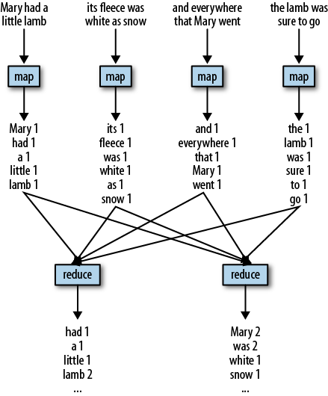

Slide 10
How will you calculate the mode?
Q4

Slide 11
Questions

