Slide 1

Custom Input Formats, Output Formats & Counters
Sriram Mohan RHIT
Q1

Slide 2
Writing a Custom Input Format
Whole Input Format
Converting Small Files to a Sequence File
Q2,Q3
Notes:
Preventing Splitting:
Some applications don’t want files to be split, as this allows a single mapper to process each input file in its entirety. For example, a simple way to check if all the records in a file are sorted is to go through the records in order, checking whether each record is not less than the preceding one. Implemented as a map task, this algorithm will work only if one map processes the whole file.3
There are a couple of ways to ensure that an existing file is not split. The first (quick and dirty) way is to increase the minimum split size to be larger than the largest file in your system. Setting it to its maximum value, Long.MAX_VALUE, has this effect. The sec- ond is to subclass the concrete subclass of FileInputFormat that you want to use, to override the isSplitable() method4 to return false

Slide 3
Code Walkthrough
Example 8-2, 8-3 & 8-4

Slide 4
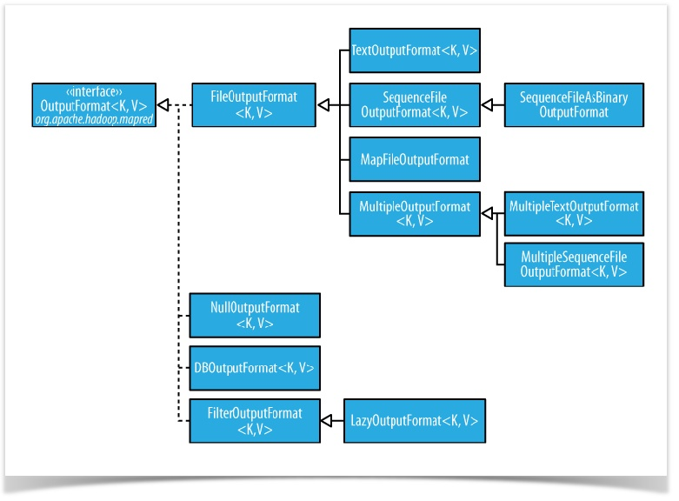
OutputFormat
Notes:
The default output format, TextOutputFormat, writes records as lines of text. Its keys and values may be of any type, since TextOutputFormat turns them to strings by calling toString() on them. Each key-value pair is separated by a tab character, although that may be changed using the mapreduce.output.textoutputformat.separator property (mapred.textoutputformat.separator in the old API). The counterpart to TextOutput Format for reading in this case is KeyValueTextInputFormat, since it breaks lines into key- value pairs based on a configurable separator
You can suppress the key or the value (or both, making this output format equivalent to NullOutputFormat, which emits nothing) from the output using a NullWritable type. This also causes no separator to be written, which makes the output suitable for reading in using TextInputFormat.

Slide 5
Multiple Outputs
Sample Code.
Q4
Notes:
FileOutputFormat and its subclasses generate a set of files in the output directory. There is one file per reducer, and files are named by the partition number: part-r-00000, part- r-00001, etc. Sometimes there is a need to have more control over the naming of the files or to produce multiple files per reducer. MapReduce comes with the MultipleOut puts class to help you do this
MultipleOutputs allows you to write data to files whose names are derived from the output keys and values, or in fact from an arbitrary string. This allows each reducer (or mapper in a map-only job) to create more than a single file. Filenames are of the form name-m-nnnnn for map outputs and name-r-nnnnn for reduce outputs, where name is an arbitrary name that is set by the program, and nnnnn is an integer designating the part number, starting from zero. The part number ensures that outputs written from dif- ferent partitions (mappers or reducers) do not collide in the case of the same name

Slide 6
LazyOutput
What is it?
Why do we need it?
Q5
Notes:
ileOutputFormat subclasses will create output (part-r-nnnnn) files, even if they are empty. Some applications prefer that empty files not be created, which is where Lazy OutputFormat helps. It is a wrapper output format that ensures that the output file is
created only when the first record is emitted for a given partition. To use it, call its setOutputFormatClass() method with the JobConf and the underlying output format.
Streaming and Pipes support a -lazyOutput option to enable LazyOutputFormat.

Slide 7
Counters
Why?
Are there built-in counters?
Q6
Notes:
There are often things you would like to know about the data you are analyzing but that are peripheral to the analysis you are performing. For example, if you were counting invalid records and discovered that the proportion of invalid records in the whole dataset was very high, you might be prompted to check why so many records were being marked as invalid—perhaps there is a bug in the part of the program that detects invalid records? Or if the data were of poor quality and genuinely did have very many invalid records, after discovering this, you might decide to increase the size of the dataset so that the number of good records was large enough for meaningful analysis.
Counters are a useful channel for gathering statistics about the job: for quality control or for application-level statistics. They are also useful for problem diagnosis. If you are tempted to put a log message into your map or reduce task, it is often better to see whether you can use a counter instead to record that a particular condition occurred. In addition to counter values being much easier to retrieve than log output for large distributed jobs, you get a record of the number of times that condition occurred, which is more work to obtain from a set of log files.
See Chapter 8, Tables 1-6 for a list of built-in counters.

Slide 8
User Defined Java Counters
Defining your counters
Updating Counters
Retrieving Counters
Dynamic Counters
Q7
Notes:
MapReduce allows user code to define a set of counters, which are then incremented as desired in the mapper or reducer. Counters are defined by a Java enum, which serves to group related counters. A job may define an arbitrary number of enums, each with an arbitrary number of fields. The name of the enum is the group name, and the enum’s fields are the counter names. Counters are global: the MapReduce framework aggre- gates them across all maps and reduces to produce a grand total at the end of the job.

Slide 9
Code Walkthrough

Slide 10
Questions

