Slide 1

Pig - Statements
Sriram Mohan RHIT
Q1

Slide 2
Deadlines & Announcements
Project – Due M3 11:55 PM Tuesday
Email me a link to your dataset

Slide 3
Diagnostic Operators
DESCRIBE
EXPLAIN
ILLUSTRATE
Notes:
The diagnostic operators—DESCRIBE, EXPLAIN, and ILLUSTRATE—are provided to allow the user to interact with the logical plan for debugging purposes
Describe - Print a schema
Explain – prints the logical plan
Illustrate - Shows a sample execution of the logical plan, using a generated subset of the input

Slide 4
Load
Records = Load ‘/tmp/input’ using PigStorage(‘\t’) as (year:int, temp:int,quality:int)
Records = Load ‘/tmp/input’ using PigStorage(‘\t’) as (year,temp,quality)
Records = Load ‘/tmp/input’ using PigStorage(‘\t’)
projected_records = FOREACH records GENERATE $0, $1, $2
Notes:
A relation in Pig may have an associated schema, which gives the fields in the relation names and types
Pig’s flexibility in the degree to which schemas are declared con- trasts with schemas in traditional SQL databases, which are declared before the data is loaded into to the system. Pig is designed for analyzing plain input files with no associated type information, so it is quite natural to choose types for fields later than you would with an RDBMS.
It’s possible to omit type declarations completely, too:
In this case, we have specified only the names of the fields in the schema: year, temperature, and quality. The types default to bytearray, the most general type, rep- resenting a binary string.
You don’t need to specify types for every field; you can leave some to default to byte array,
However, if you specify a schema in this way, you do need to specify every field. Also, there’s no way to specify the type of a field without specifying the name. On the other hand, the schema is entirely optional and can be omitted by not specifying an AS clause

Slide 5
Store Functions
Pig Storage (‘Field Delimiter)
BinStorage – Used to load binary data, typically used by Pig to handle temporary data
TextLoader() – Used to load unstructured text, Tuples will contain a single field with each line as a separate tuple
JsonLoader()/JsonStorer()
HBaseLoader() – Handles both storage and load
HCatLoader()/HCatStorer()
Notes:
The formats for complex data types are shown here:
Tuple: enclosed by (), items separated by ","
Non-empty tuple: (item1,item2,item3)
Empty tuple is valid: ()
Bag: enclosed by {}, tuples separated by ","
Non-empty bag: {code}{(tuple1),(tuple2),(tuple3)}{code}
Empty bag is valid: {}
Map: enclosed by [], items separated by ",", key and value separated by "#"
Non-empty map: [key1#value1,key2#value2]
Empty map is valid: []

Slide 6
Comments in Pig
--Dump Max_temp
Or
/* The following two lines have been commented out Dump Max_temp; Store MAX_temp; */

Slide 7
Corrupt Records/Dealing with Null
Null Handling is similar to Null. Unknown value or missing
If a value cannot be cast during load, Pig will substitute a load
Example
Notes:
An SQL database will enforce the constraints in a table’s schema at load time; for example, trying to load a string into a column that is declared to be a numeric type will fail. In Pig, if the value cannot be cast to the type declared in the schema, it will substitute a null value.

Slide 8
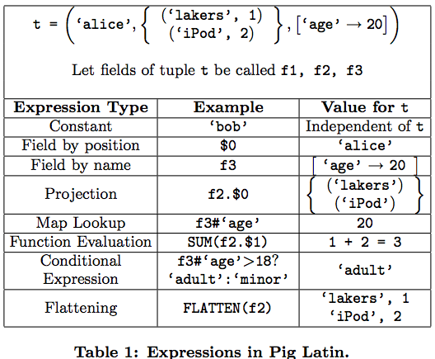

Slide 9
Other Pig Commands
JOIN(inner)
JOIN(outer)
CROSS
COGROUP
ORDER BY
LIMIT
UNION
SPLIT

Slide 10
Pig Built-in Functions
Lots and Lots of them – See here: (http://pig.apache.org/docs/r0.15.0/func.html)

Slide 11
Questions

