Slide 1

A Presentation on “Automated Student Attendance using Face Recognition and Machine Learning”
Presented By Priyanka Angane (TU8F2122036)
Suryansh Gupta (TU8F2122033)
Harshit Mhatre (TU8F2122024)
Manas Thosar (TU8F2122028) Under the Guidance of Prof. Vishal Gotarane

Slide 2
Outline
Introduction
Challenges
Problem Statement
Literature Review
Objectives
Methodology
Progress Work
Future Scope
Conclusion
References

Slide 3
Introduction
Presenting the Attendance System using Face Recognition: a revolutionary solution that employs AI and computer vision to effortlessly track student attendance.
By analyzing facial biostatistics and leveraging high-definition monitoring, this system eliminates manual marking, reducing administrative load and ensuring precise results.

Slide 4
Challenges
Accuracy and Reliability
Data Privacy and Security
Adverse Environmental Conditions
Hardware and Infrastructure
Scalability
Cost and Resource Allocation
User friendly

Slide 5
Problem Statement
Develop an automated student attendance system utilizing face recognition and machine learning to accurately track and record student attendance during class sessions. The system address challenges such as real-time processing, generating and training data, enhance face detection and recognition accuracy, database management, and improved user interface.

Slide 6
Literature Review
Sr. No. | Title | Problem Addressed | Methodology | Advantages | Limitations
1 | Prof. Shweta S Bagali, Dr K Amuthabala, Prof. Iranna Amargol. “Smart Attendance System using Machine Learning” International Journal of Engineering Research & Technology, Volume 10, Issue 12, ISSN: 2278-0181, 2022 | Inefficiency and errors associated with traditional manual attendance systems. | Face Detection and Extraction Face Recognition and Matching Data Storage and Management Attendance Recording User Interface | Accuracy Efficiency Real-time Tracking Reduced Administrative Burden | Privacy Concerns Lighting and Environmental Factors Variability in Appearance False Positives and Negatives

Slide 7
Sr. No. | Title | Problem Addressed | Methodology | Advantages | Limitations
2 | Sachin Wakurdekar, Utkarsh Nagpure, Eshika Kothari. “Python GUI intergrated attendance system using face recognition” International Journal of Scientific Development and Research, Volume 7 Issue 7, ISSN: 2455-2631, July 2022 | Creating a system that is secure, efficient, time-saving, and user-friendly | Utilizing facial recognition technology Image processing techniques Feature extraction methods GUI Integration | User-Friendly Database Management | Hardware Requirements Accuracy Concerns Environmental Factors

Slide 8
Sr. No. | Title | Problem Addressed | Methodology | Advantages | Limitations
3 | Md Abu Talha Reyaz, K Sunil Kumar, Arun Kumar, Aathimuthu. “Facial Recognition Attendance System Using Deep Learning” International Journal for Research in Applied Science & Engineering Technology, Volume 10, Issue VI, ISSN: 2321-9653, June 2022 | Inaccurate Attendance Tracking Time and Effort in Attendance Taking Aims to provide accurate, efficient, secure, and convenient attendance tracking | Image Data Collection Data Implementation Model Training Image predictions | Enhanced Security Time and Resource Efficiency | Data Requirements Computational Resources

Slide 9
Sr. No. | Title | Problem Addressed | Methodology | Advantages | Limitations
4 | Mohd Azlan Abu1, Nurul Hazirah Indra1, Abdul Halim. “A study on Image Classification based on Deep Learning and TensorFlow” International Journal of Engineering Research and Technology. Volume 12, ISSN 0974-3154, Number 4 (2019), pp. 563-569 | Improving image classification accuracy through the utilization of deep learning techniques and the TensorFlow framework | Data collection Implementing a DNN using TensorFlow and MobileNet Configuring the parameters for optimal performance | By utilizing DNN with the TensorFlow framework, the researchers are likely to achieve high accuracy rates. | Dependency on Pre-trained Models Limited Domain

Slide 10
Sr. No. | Title | Problem Addressed | Methodology | Advantages | Limitations
5 | Ankit Yadav, Ibtesaam Rais, Manoj Kumar. “Image Classification using Deep Learning and Tensorflow” International Journal for Research in Applied Science & Engineering Technology, Volume 10, Issue V, ISSN: 2321-9653, May 2022 | Improving image classification accuracy and efficiency. | Deep Learning and TensorFlow Neural Network Architecture Transfer Learning Model Training and Evaluation | Feature Extraction Hierarchical Representations Efficiency with TensorFlow | Data Requirements Model Complexity Dataset Bias

Slide 11
Sr. No. | Title | Problem Addressed | Methodology | Advantages | Limitations
6 | Dr. V Suresh, Srinivasa Chakravarthi Dumpa, Chiranjeevi Deepak Vankayala. “Facial Recognition Attendance System Using Python and OpenCv” Quest Journals, Journal of Software Engineering and Simulation, Volume 5, Issue 2, ISSN: 2321-3795, (2019) pp: 18-29 | Inaccurate Data Collection Time-Consuming Process Limited Accessibility Resource Intensive | Image Acquisition and Pre-processing Database Creation CSV File Creation Recognition Process | Ease of Use Versatile Face Recognition Efficient Feature Extraction | Accuracy Concerns

Slide 12
Sr. No. | Title | Problem Addressed | Methodology | Advantages | Limitations
7 | Bharath Tej Chinimilli, Anjali T, Akhil Kotturi. “Face Recognition based Attendance System using Haar Cascade and Local Binary Pattern Histogram Algorithm” 4th International Conference on Trends in Electronics and Informatics (ICOEI)(48184) 2020 | Variability in Student Appearance Unknown Person Detection | Haar Cascade for face detection Local Binary Pattern Histogram (LBPH) algorithm for face recognition | Recognize student’s faces in real-time video streams, even when there are variations in appearance | Limited to Detection False Positives/Negatives

Slide 13
Sr. No. | Title | Problem Addressed | Methodology | Advantages | Limitations
8 | Dr.Vinayak Bharadi, Mr.Rutik Sansare, Mr.Tushar Padelkar. “Real Time Face Recognition System Using Convolutional Neural Network” International journal of creative research thoughts, Volume 10, Issue 4, ISSN: 2320-2882, 4 April 2022 | Need for a reliable and accurate method of identifying individuals through their faces. | Convolutional Neural Networks (CNNs) with the VGG16 architecture and Transfer Learning. | High Accuracy Real-Time Processing Robust to Variability | Variability in Lighting and Pose Small Training Data Performance in Crowded Scenes

Slide 14
Sr. No. | Title | Problem Addressed | Methodology | Advantages | Limitations
9 | Rishabh Karmakar “FACIAL ATTENDANCE SYSTEM USING MTCNN AND FEATURE MAPPING” Department of Computer Engineering International Institute of Information Technology, Pune, Maharashtra, India | Inefficiency of Manual Attendance Potential for Errors: Fraudulent Attendance | Uses a compounded deep learning model, including (MTCNN), for feature extraction and landmark detection. Features of individuals are saved in a No-SQL MongoDB database | Elimination of Manual Work Accuracy Real-Time Attendance Fraud Prevention Database Maintenance | Privacy Concerns Hardware Requirements False: Positives/Negatives

Slide 15
Sr. No. | Title | Problem Addressed | Methodology | Advantages | Limitations
10 | Rishabh Karmakar “FACIAL ATTENDANCE SYSTEM USING MTCNN AND FEATURE MAPPING” Department of Computer Engineering International Institute of Information Technology, Pune, Maharashtra, India | Traditional attendance marking system is manual, time-consuming, and prone to errors. Overcoming the limitations of existing attendance systems, such as portability, accessibility, authenticity, accuracy, efficiency, and cost. | Utilization of Multi-Task Cascaded Convolutional Neural Network (MTCNN) for face detection. Training of the FaceNet model with extracted features. Support Vector Classifier (SVC) used for classification based on trained models | Automation of attendance marking, reducing the need for manual effort. Increased accuracy in attendance records. Reduced chances of proxies and errors in marking attendance. High security through face recognition. | Initial setup and data collection can be time-consuming. Dependence on a reliable facial recognition system. Cost associated with implementing the technology (camera, software, training). Potential issues with recognizing faces in varying lighting conditions.

Slide 16
Objectives
Generating and training data
Enhance face detection and recognition accuracy
Real-time performance
Database management
User experience improvement
Scalability

Slide 17
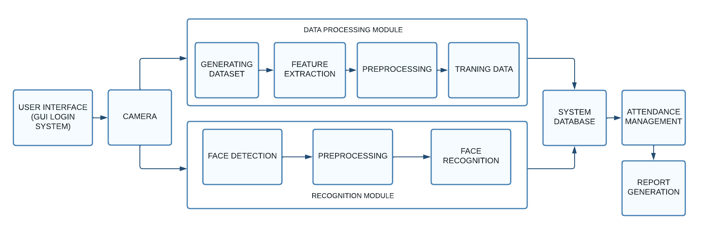
Architecture

Slide 18
Methodology
Haar Cascade: Haar Cascade is a machine learning object detection method used to identify objects in images or video. It employs a set of simple features called Haar-like features and a trained classifier to detect objects' presence based on these features.
CNN (Convolutional Neural Network): CNN is a deep learning architecture specifically designed for processing grid-like data, such as images and videos. It uses convolutional layers to automatically learn hierarchical patterns and features from the data, making it highly effective for tasks like image classification and object detection.
OpenCV (Open Source Computer Vision Library): OpenCV is an open-source computer vision and machine learning software library. It provides a wide range of tools and functions for tasks like image and video processing, feature extraction, object tracking, and more. It's widely used in research and application development.

Slide 19
Methodology
MTCNN (Multi-task Cascaded Convolution Networks); is a deep learning model designed for efficient and accurate face detection. It employs a multi-stage architecture to detect faces at various scales, making it suitable for real-time applications like attendance systems.
Face-Net: is a deep learning model specialized in face recognition. It transforms faces into fixed-length vectors called embeddings, ensuring that similar faces have similar embeddings. This makes it valuable for face verification and recognition tasks in attendance systems and security applications.

Slide 20
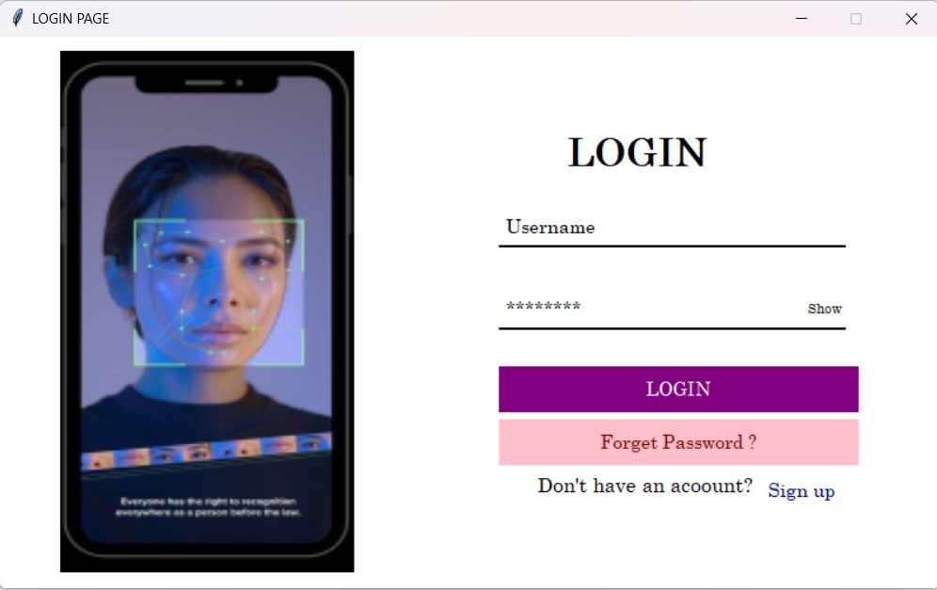
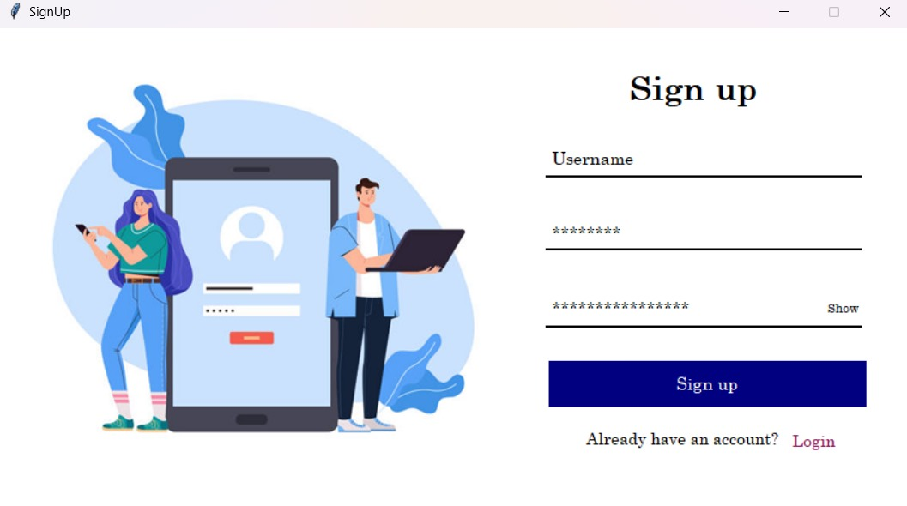
Progress Work

Slide 21
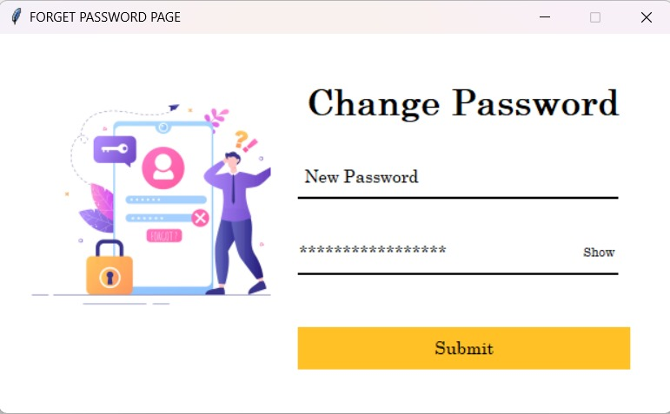
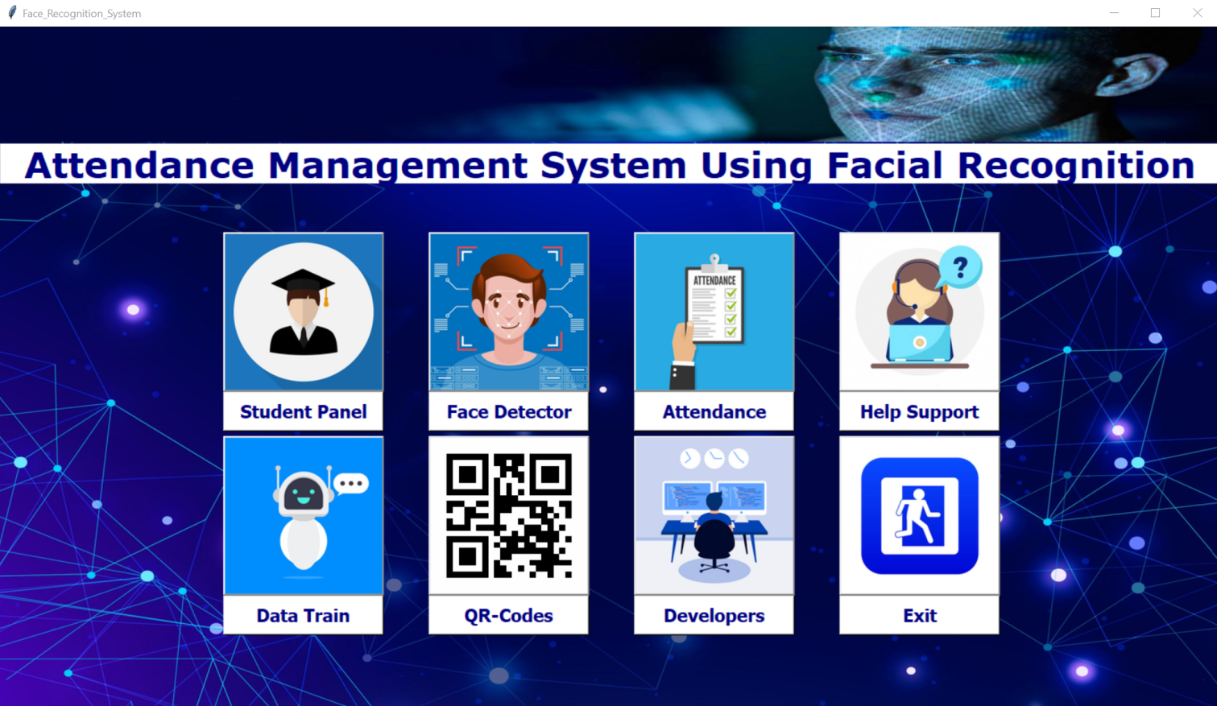

Slide 22
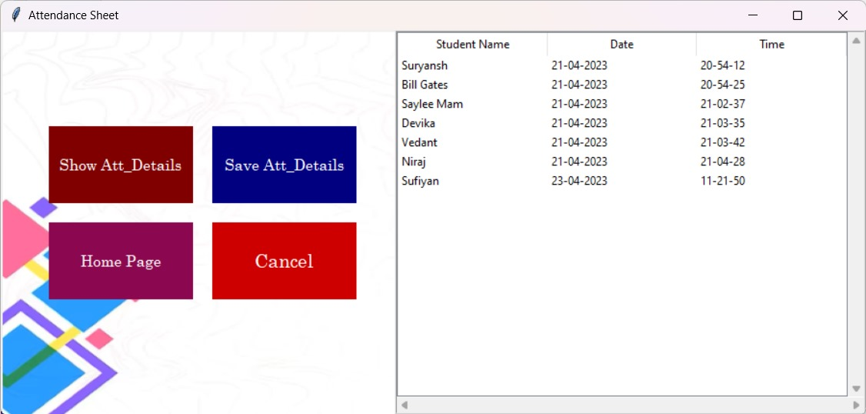
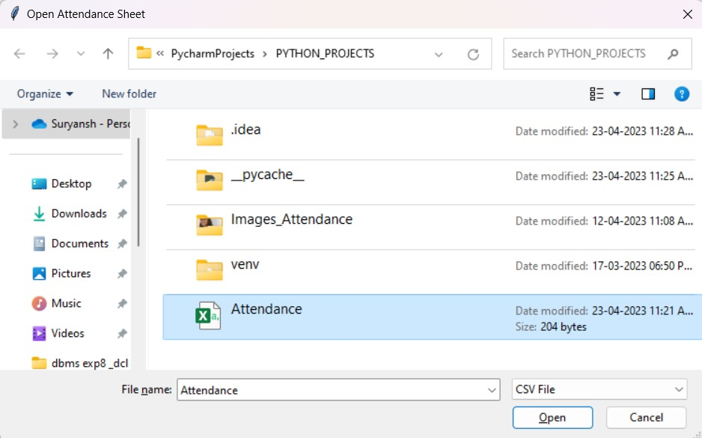

Slide 23
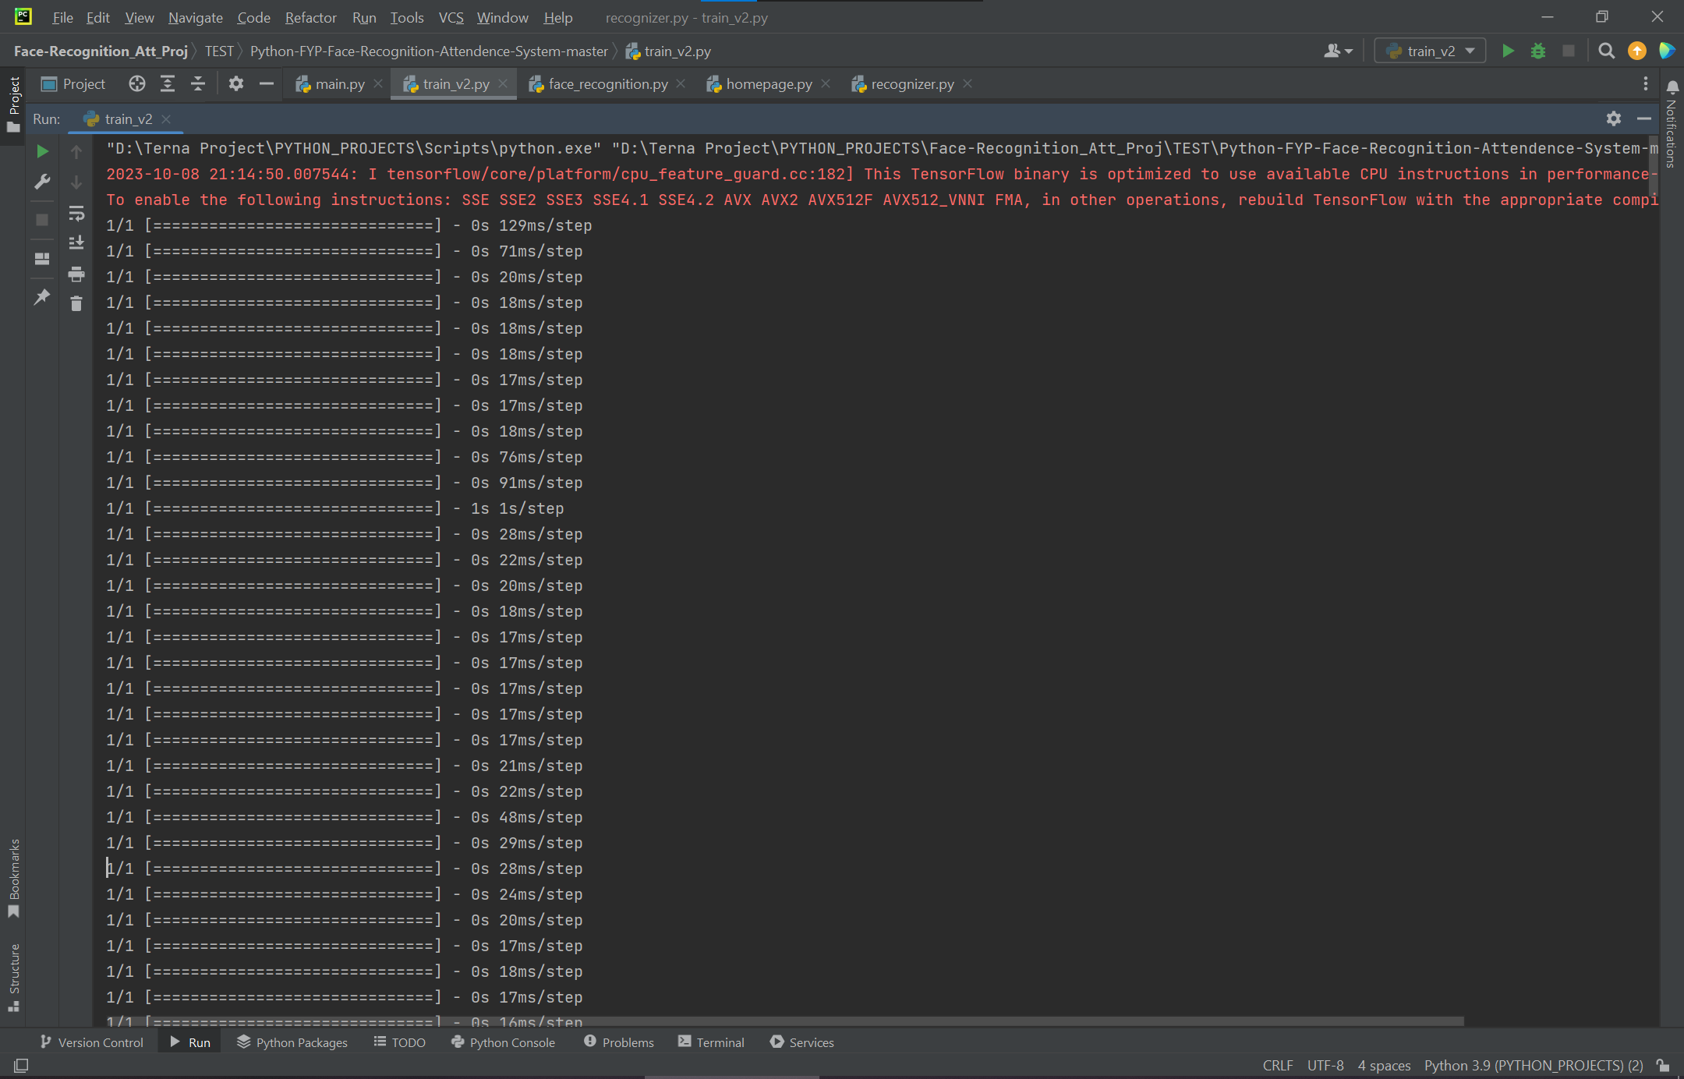
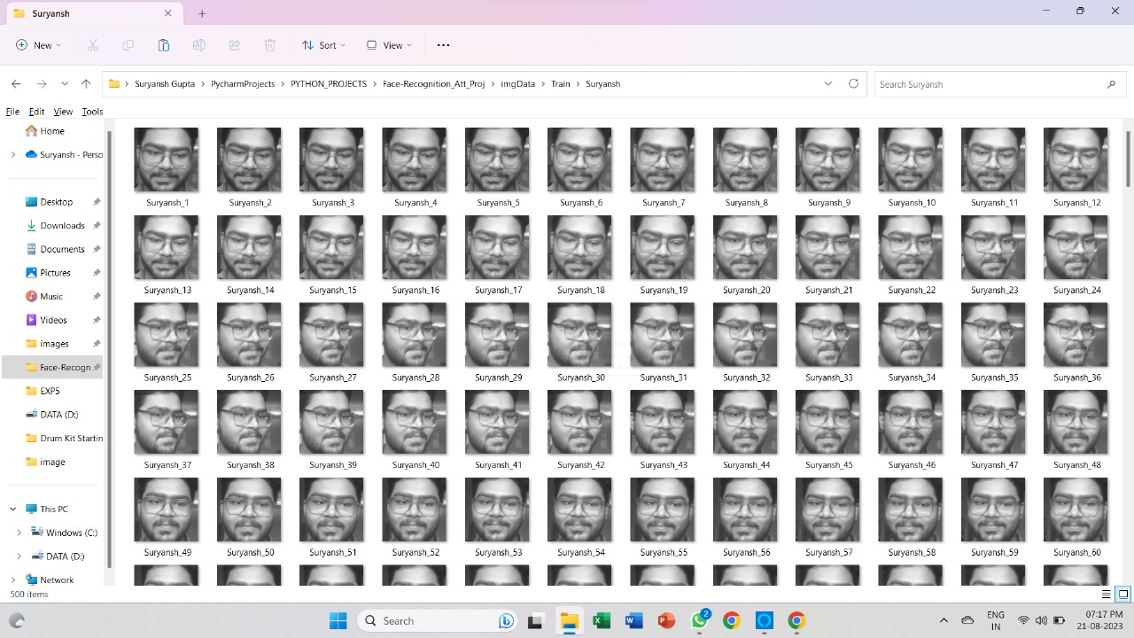
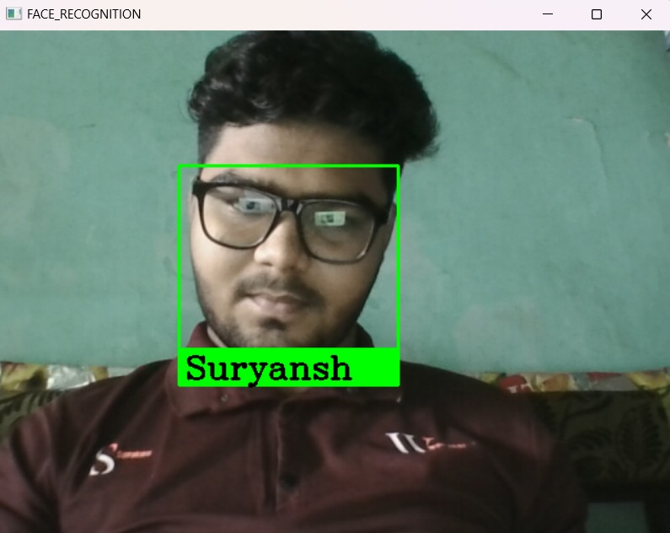

Slide 24
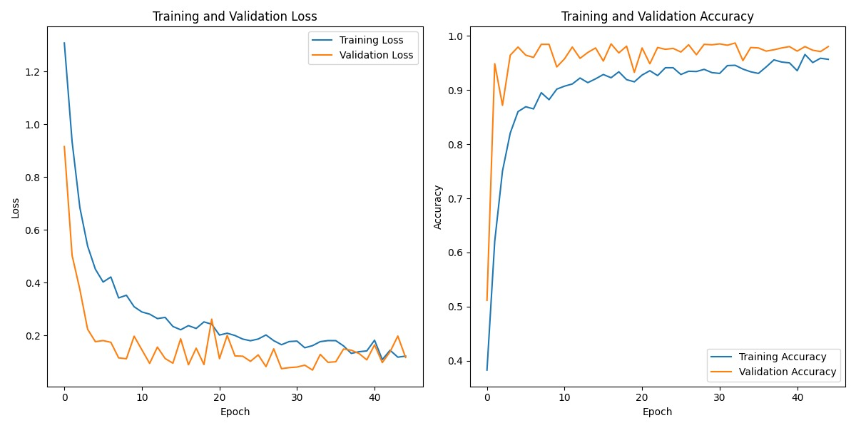

Slide 25
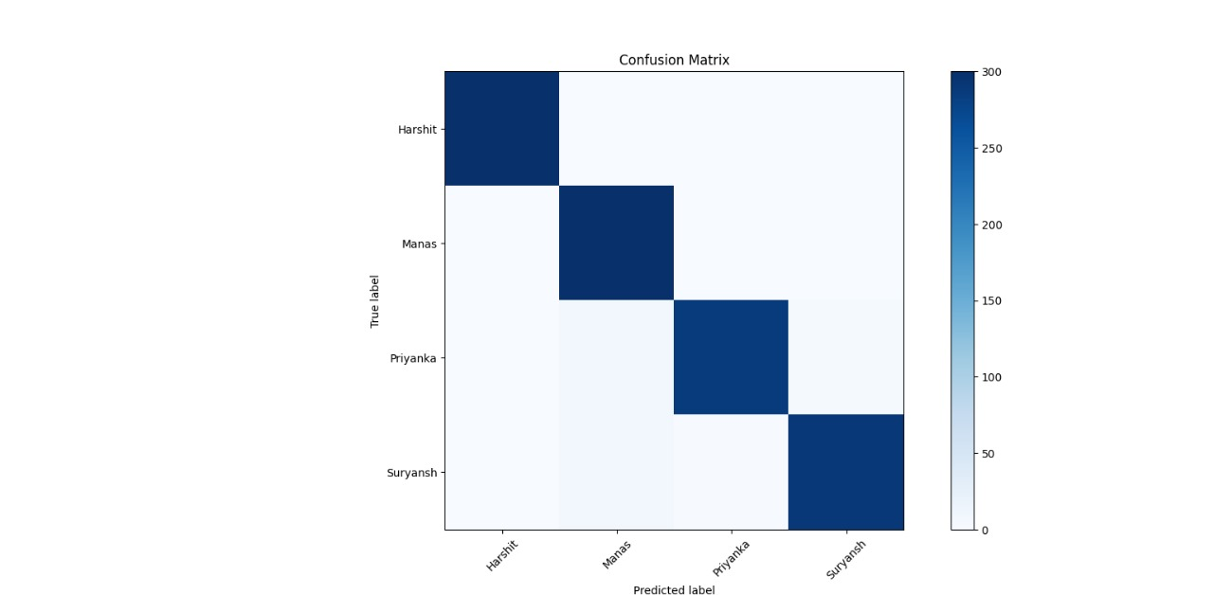

Slide 26
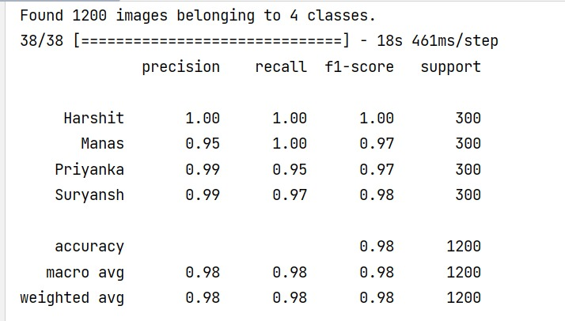

Slide 27
Future Scope
Enhanced Security Features: Implementing additional security measures, such as liveness detection, to prevent spoofing and unauthorized access.
Mobile Application Development: Creating dedicated mobile apps for teachers and students to view attendance records, receive notifications, and manage attendance-related tasks.
Multi-modal Biometrics: Exploring multi-modal biometric recognition, combining facial recognition with other biometric measures like fingerprint or iris scans for enhanced accuracy and security.

Slide 28
Conclusion
In conclusion, our automated attendance system, leveraging the power of face recognition through MTCNN and FaceNet, coupled with the seamless integration of OpenCV and Firebase database, offers a robust and efficient solution for modern attendance management. This innovative approach not only enhances accuracy but also streamlines the process, reducing manual efforts and errors. It stands as a testament to the potential of cutting-edge technology in transforming traditional practices, ensuring both convenience and reliability in attendance tracking.

Slide 29
References
Prof. Shweta S Bagali, Dr K Amuthabala, Prof. Iranna Amargol, “Smart Attendance System using Machine Learning”, International Journal of Engineering Research & Technology, Volume 10, Issue 12, ISSN: 2278-0181, 2022
Sachin Wakurdekar, Utkarsh Nagpure, Eshika Kothari, “Python GUI intergrated attendance system using face recognition”, International Journal of Scientific Development and Research, Volume 7 Issue 7, ISSN: 2455-2631, July 2022
Md Abu Talha Reyaz, K Sunil Kumar, Arun Kumar, Aathimuthu, “Facial Recognition Attendance System Using Deep Learning”, International Journal for Research in Applied Science & Engineering Technology, Volume 10, Issue VI, ISSN: 2321-9653, June 2022
Mohd Azlan Abu1, Nurul Hazirah Indra1, Abdul Halim, “A study on Image Classification based on Deep Learning and TensorFlow”, International Journal of Engineering Research and Technology. Volume 12, ISSN 0974-3154, Number 4 (2019), pp. 563-569

Slide 30
Ankit Yadav, Ibtesaam Rais, Manoj Kumar, “Image Classification using Deep Learning and Tensorflow”, International Journal for Research in Applied Science & Engineering Technology, Volume 10, Issue V, ISSN: 2321-9653, May 2022
Dr. V Suresh, Srinivasa Chakravarthi Dumpa, Chiranjeevi Deepak Vankayala, “Facial Recognition Attendance System Using Python and OpenCv”, Quest Journals, Journal of Software Engineering and Simulation, Volume 5, Issue 2, ISSN: 2321-3795, (2019) pp: 18-29
Bharath Tej Chinimilli, Anjali T, Akhil Kotturi, “Face Recognition based Attendance System using Haar Cascade and Local Binary Pattern Histogram Algorithm”, 4th International Conference on Trends in Electronics and Informatics (ICOEI)(48184) 2020
Dr.Vinayak Bharadi, Mr.Rutik Sansare, Mr.Tushar Padelkar, “Real Time Face Recognition System Using Convolutional Neural Network”, International journal of creative research thoughts, Volume 10, Issue 4, ISSN: 2320-2882, 4 April 2022

