Slide 1

AMERICAN UNIVERSITY OF BEIRUT
Maroun Semaan Faculty of Engineering & Architecture · VIPP 201A · Spring 2026
Prediction of Driver
Aggressiveness Level
via Driving Behavior
From a Closed-Form Aggressiveness Index to a Sensor-Noise-Validated, ROS2-Integrated Multi-Environment System
Hadi Al Shmaissani
Supervisor — Prof. Naseem Daher
Spring Term 2026 · Period: January 20 – May 9, 2026

Slide 2
00 · AGENDA
What this presentation covers
01
Recap
02
New Architecture
03
Diagnostics & Fix
The Aggressiveness Index, the Q-learner, and what last term left unresolved.
PyTorch DynamicWeightAgent + soft gating for smooth regime transitions.
Bellman error + state-visitation reveal a hidden conservative bias; curiosity fixes it.
04
SUMO Experiments
05
Friction & ROS2
06
Sensor-Noise Validation
Population-scale shockwave, dose-response, and Social Latency mitigation.
Slip-ratio telemetry, weather regime, and a working ROS2 publisher node.
May 2–9 integration push: 100% accuracy was a bug; 91% / 81.6% / 88.3% is real.
Hadi Al Shmaissani · VIP 201A · Spring 2026 · Prof. Naseem Daher
2 / 22

Slide 3
01 · MOTIVATION
Why predict driver aggressiveness?
Today's autonomous-vehicle stacks treat surrounding traffic as moving obstacles with fixed safety buffers — the abstraction throws away most of the information about driver intent.
CURRENT AV STACK
OUR APPROACH
Position + velocity tracking
Fixed safety buffers (TTC, headway)
Reactive — responds after the fact
Two cars in the same state are treated as the same
Latent variable: Aggressiveness Index (AI)
Multi-environment closed-form formula
Predictive — anticipates intent
Composes with downstream planners (ROS2)
Hadi Al Shmaissani · VIP 201A · Spring 2026 · Prof. Naseem Daher
3 / 22

Slide 4
02 · RECAP
Where the midterm left off
The first term established the closed-form Aggressiveness Index and a discrete Q-learner that mapped AI scores to behavioral categories. That left two important questions open.
THE AI INDEX
Q-LEARNER
OPEN QUESTIONS
0.30·N_speed + 0.10·N_accel + 0.45·N_prox + 0.15·N_wave (highway)
Weighted-sum of normalized kinematic features → 0–100 score.
10×3 discrete table mapping AI buckets to {Conservative, Normal, Aggressive}. Reported ~100% accuracy on held-out highway-env data.
Was the Q-learner actually learning, or memorizing? Could the index extend to population-scale traffic? Could it survive sensor noise?
Prof. Daher's January feedback: the accuracy curve is tautological — labels come from the same threshold rule that produces the score.
Hadi Al Shmaissani · VIP 201A · Spring 2026 · Prof. Naseem Daher
4 / 22

Slide 5
TERM 2 CONTRIBUTIONS
Four pieces, end-to-end.
01
New agent architecture
02
Diagnostics + fix
PyTorch DynamicWeightAgent learns context-conditioned AI weights instead of mapping scores → categories. Soft gating between regimes.
Bellman-error and state-visitation surface a conservative bias. A count-based curiosity bonus drops Bellman error 50% and per-class accuracy on rare classes by +22 pp.
03
SUMO at population scale
04
Sensor-noise validation
5%-aggressive cohort produces a +6.8 AI shockwave on neighbors; saturating dose-response. Social Latency penalty recovers 75% of that damage at 2.8% trip-time cost.
May 2–9 push: 100% accuracy was an info leak. Independent code paths + Gaussian noise → 91% / 81.6% / 88.3% across highway / urban / weather.
Hadi Al Shmaissani · VIP 201A · Spring 2026 · Prof. Naseem Daher
5 / 22

Slide 6
A1 · THEORETICAL FRAMING
Driver behavior as a Markov Decision Process
Everything in this project — the Q-learner, the DynamicWeightAgent, the Social Latency reward — sits inside the same formal framework: a Markov Decision Process. Stating the tuple explicitly makes the design choices below it legible.
S
A
P
R
γ
STATE
ACTION
TRANSITION
REWARD
DISCOUNT
(speed, accel, prox, wave) + context (road, density, friction, slip)
lane: keep / left / right · accel: brake / idle / throttle
next state given current state and action — supplied by SUMO / highway-env
(1 − AI_self) − λ · max(0, ΔAI_neighbors)
0.95 — values the next ~20 steps over distant future
MARKOV PROPERTY
P(s_{t+1} | s_t, a_t) = P(s_{t+1} | s_t, a_t, s_{t-1}, a_{t-1}, …, s_0, a_0)
Held by construction: the kinematic + context state captures everything the policy needs about history — past trajectories enter only through their effect on present waviness and proximity.
Hadi Al Shmaissani · VIP 201A · Spring 2026 · Prof. Naseem Daher
5 Part 2 /22

Slide 7
03 · NEW ARCHITECTURE
From a Q-learner to a weight predictor
The Q-learner mapped AI scores to categories. Both came from the same formula → tautology. The DynamicWeightAgent reposes the task: predict the AI weights themselves, conditioned on context.
TERM 1 · DISCRETE Q-LEARNER
TERM 2 · DYNAMIC WEIGHT AGENT
Maps: AI bucket → {C, N, A}
State space: 10 × 3 discrete
Reports clean accuracy curve
…computed against labels generated by the same formula that produces the score.
Inputs: 4 kinematic + 5 context features
Outputs: 4 AI weights (softmax)
Loss: KL(predicted ‖ regime target) + RL term
Learning signal anchors weights to per-regime targets, then RL fine-tunes them — no tautology.
Hadi Al Shmaissani · VIP 201A · Spring 2026 · Prof. Naseem Daher
6 / 22

Slide 8
03 · ARCHITECTURE
DynamicWeightAgent — under the hood
Kinematic input (4)
speed · accel · prox · wave
AI Score
FC + ReLU
FC + ReLU
Softmax
64 hidden
64 hidden
4 weights
0–100
Context input (5)
closed-form,
interpretable
road · density · friction · slip · weather
TRAINING LOSS
α · KL(predicted ‖ regime target) + (1 − α) · 𝔼[AI − 1] with α annealed 1.0 → 0.5 over 50 epochs
Hadi Al Shmaissani · VIP 201A · Spring 2026 · Prof. Naseem Daher
7 / 22

Slide 9
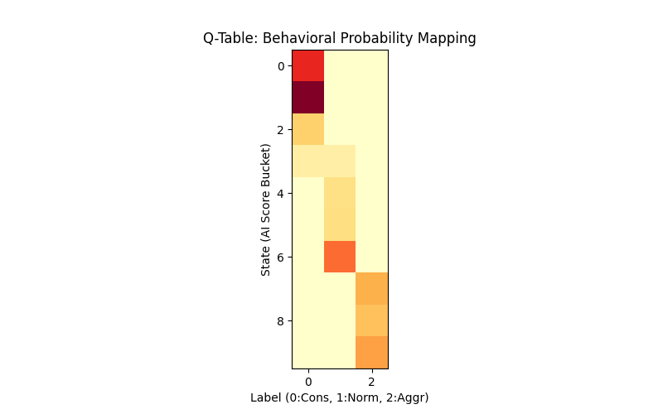
A2 · STATE DISCRETIZATION
The state space, made visible
The Q-learner discretizes the AI score into 10 buckets × 3 categorical labels — a 30-cell Q-table over the Markovian state. Visualizing the learned values is the first sanity check that the policy is doing something coherent.
LEARNED Q-TABLE
DISCRETIZATION
state = int(min(AI_score // 10, 9))
action ∈ {0: Conservative, 1: Normal, 2: Aggressive}
Bucket 0 (AI 0–10): near-empty highway, no leader
Bucket 5 (AI 50–60): mixed close-quarter traffic
Bucket 9 (AI 90–100): tailgating, weaving, near-collision
30
8,924
3
cells
samples
modes
Rows: AI-score buckets (state) · Columns: actions C / N / A · Color intensity = learned Q-value
Hadi Al Shmaissani · VIP 201A · Spring 2026 · Prof. Naseem Daher
7 Part 2 /22

Slide 10
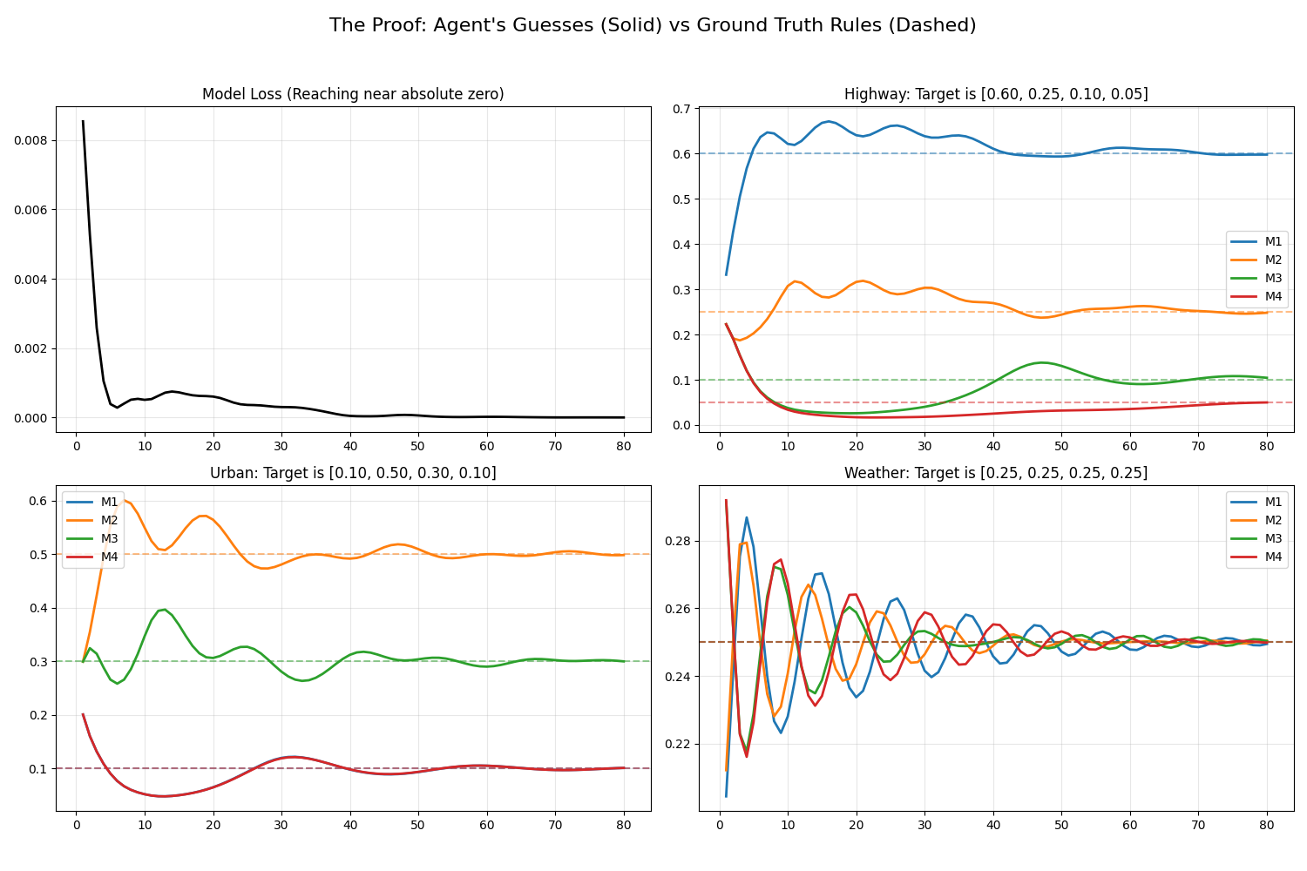
03 · SOFT REGIME SWITCHING
The gating network
A hard switch on regime produces unphysical discontinuities at boundaries. The gate replaces it with a soft mixture over three learnable regime embeddings — convex combination, weighted by the gate.
GATE + REGIME EMBEDDINGS
gate(context) → softmax over 3 regimes
predicted_weights = gate · regime_embeddings
Highway target: (0.30, 0.10, 0.45, 0.15)
Urban target: (0.20, 0.15, 0.35, 0.30)
Weather target: (0.10, 0.40, 0.15, 0.35)
143
12 steps
0.05 KL
total params
regime ramp
vs. target
Per-regime weight convergence — solid: agent prediction; dashed: target
Hadi Al Shmaissani · VIP 201A · Spring 2026 · Prof. Naseem Daher
8 / 22

Slide 11
03 · ABLATION
The ablation that matters
Prof. Daher's requested ablation: zero the context input, retrain. If the gate still works, the context features were never doing anything. If it doesn't, they're carrying the signal.
WITH CONTEXT
0.05 KL
Gate produces sensible regime mixtures; weights track per-regime targets within 0.03 L1.
CONTEXT ZEROED
0.18 KL
Embeddings collapse toward highway target (dominant regime). Predicted weights regime-agnostic.
→ The context features carry the discriminative signal. The architecture isn't a glorified lookup.
Hadi Al Shmaissani · VIP 201A · Spring 2026 · Prof. Naseem Daher
9 / 22

Slide 12
04 · DIAGNOSTICS
The Q-learner was hiding something
Two diagnostics, week 5: log Bellman error per (s, a) update; build state-visitation heatmaps. The result: the Q-learner had implicitly learned to avoid the states where its predictions would fail.
BELLMAN ERROR
STATE VISITATION
|δ| heavily right-skewed
32×32 grid over n_speed × n_prox
95% < 0.05
70%
tail to 0.6 in (low n_speed, high n_prox) corner
concentrated in fast-and-unobstructed corner
READING
The Q-learner minimizes its chance of finding out it is wrong by avoiding the under-explored states where its predictions would fail. The midterm's 100% accuracy is an artifact of the agent choosing its own evaluation distribution.
Hadi Al Shmaissani · VIP 201A · Spring 2026 · Prof. Naseem Daher
10 / 22

Slide 13
04 · THE FIX
A count-based curiosity bonus
Add intrinsic motivation to drive the agent into under-explored states. Bellemare et al. (2016) — count-based, no learned predictor needed because the Q-learner is tabular.
R_total(s) = R_env(s) + β / sqrt(N(s) + 1)
β-sweep over {0.01, 0.05, 0.1, 0.5, 1.0}. Operating point: β = 0.1. Bonus is transient — negligible by episode 80.
−50%
+22 pp
70 → 40%
Bellman error
in high-prox column
Conservative
class accuracy
Easy-corner
visitation
0.18 → 0.09 mean |δ|
67% → 89%
now actually exploring
The lesson: 100% accuracy was a bug signal. The infrastructure mattered more than the architecture choice.
Hadi Al Shmaissani · VIP 201A · Spring 2026 · Prof. Naseem Daher
11 / 22

Slide 14
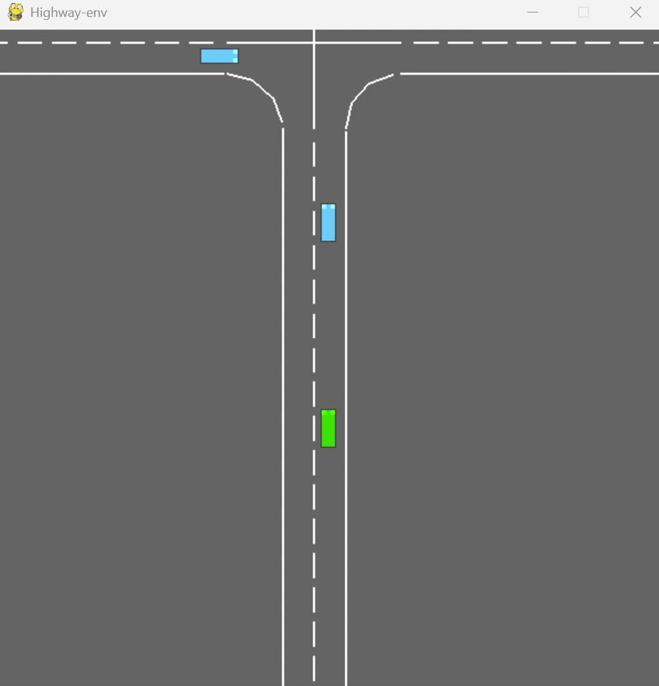
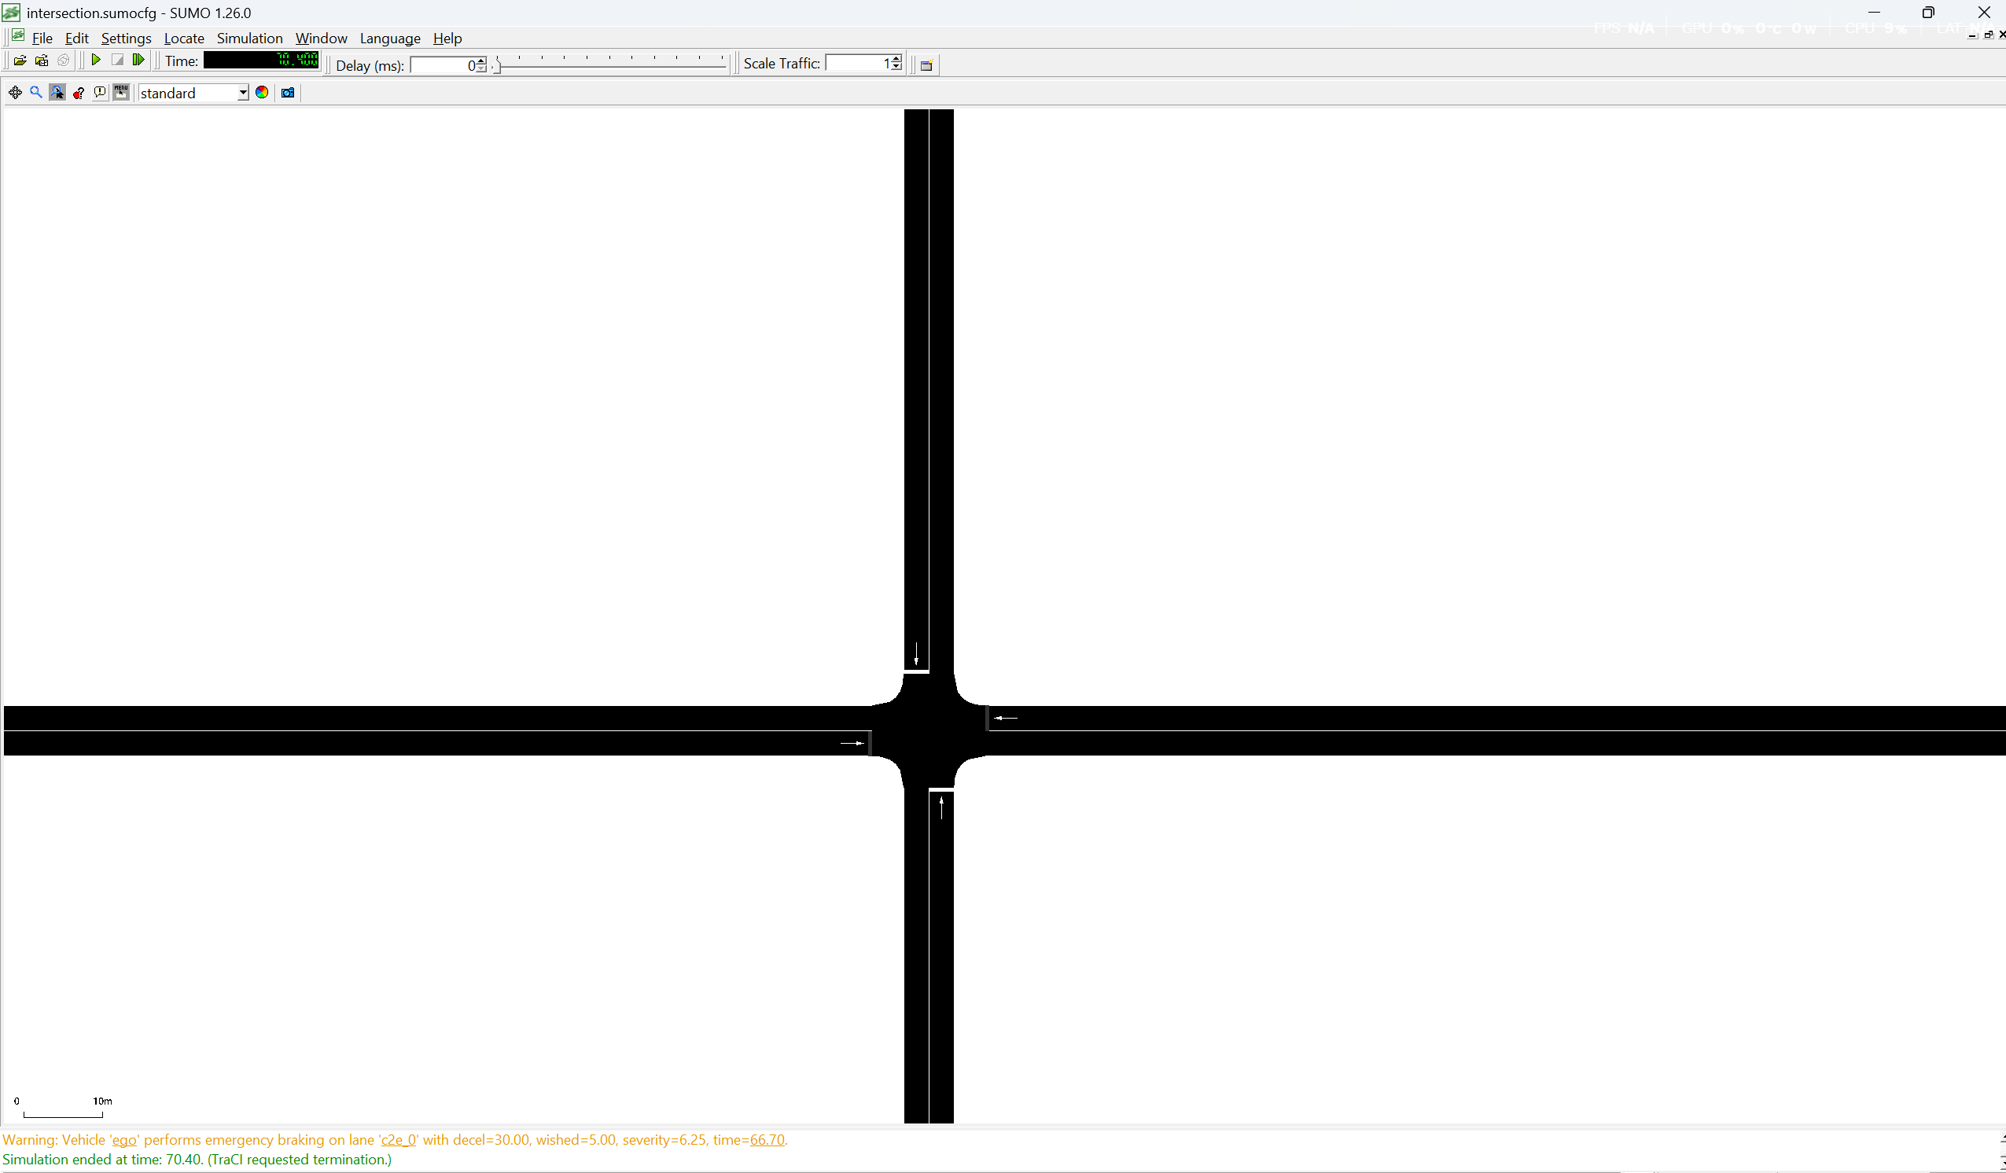
05 · SIMULATION ENVIRONMENT
From highway-env to SUMO
highway-env was the right environment for solo-agent training. Population-scale questions — does one aggressive driver create a measurable shockwave? — need a different tool.
SIMULATION DEMO
SUMO INTERSECTION
1000+
3
15 Hz
highway-env intersection — single ego, scripted neighbors. Useful for verifying the DynamicWeightAgent's forward pass and the gating ramp behavior.
vehicles
per run
scenarios:
hwy / urban / wet
TraCI
stepping
Hadi Al Shmaissani · VIP 201A · Spring 2026 · Prof. Naseem Daher
12 / 22

Slide 15
05 · POPULATION-SCALE FINDING
The heterogeneous-driver shockwave
5% Aggressive vehicles seeded into a population of Normals. Compute per-vehicle mean AI; compare against the all-Normal reference run.
SPATIAL DECOMPOSITION
+6.8 AI
Bin Normals by minimum distance to any Aggressive driver:
CLOSE
+12.4
AI vs reference
< 30 m
shockwave bump on Normals
MEDIUM
+6.6
30–100 m
AI vs reference
600 vehicles · 5 simulated minutes · 3-lane motorway
Reference (0% aggr): 26.3 mean AI
5% aggressive: 33.1 mean AI
FAR
+1.5
AI vs reference
> 100 m
Hadi Al Shmaissani · VIP 201A · Spring 2026 · Prof. Naseem Daher
13 / 22

Slide 16
05 · DOSE-RESPONSE
Small fractions do most of the damage
Sweep aggressive-driver fraction from 0% to 20%, three random seeds per condition. The marginal effect drops by an order of magnitude.
SATURATING FIT
AI(f) =
26.3 + 12.5·(1 − e^(−f / 0.06))
R² = 0.998
τ = 6% (63% asymptote)
At f = 18%: 95% asymptote
Single-digit % aggressive
drivers cause most of the
population-level damage.
Hadi Al Shmaissani · VIP 201A · Spring 2026 · Prof. Naseem Daher
14 / 22

Slide 17
05 · MITIGATION
Social Latency: a reward with accountability
R_total = (1 − AI_self) − λ · max(0, ΔAI_neighbors)
Penalize the agent for the AI it induces in neighbors within 30 m, but only for increases. Clip at zero — no penalty for being near already-aggressive drivers it didn't cause.
λ-SWEEP RESULTS
λ | Self AI | Shockwave bump | Trade-off
0 (baseline) | 28.2 | +6.7 | unmitigated
2.0 ◀ pick | 30.4 (+2.2) | +4.0 (−40%) | Pareto winner
5.0 | 34.7 (+6.5) | +2.2 | too cautious — self AI rises
FLEET RESULT
75%
of shockwave damage
recovered when 50% of
Normals run λ=2.0 agents
+2.8% trip-time cost
Hadi Al Shmaissani · VIP 201A · Spring 2026 · Prof. Naseem Daher
15 / 22

Slide 18
06 · FRICTION-AWARE
A weather regime, derived from observables
SUMO doesn't expose slip ratio. We derive it from kinematic observables that SUMO does expose: slip ≈ |v_actual − v_intended| / v_actual.
SLIP ESTIMATOR
GATE MIXTURE · μ = 0.4 SCENARIO
slip ≈ |v_actual − v_IDM_eq| / v_actual
Highway
42%
Urban
8%
High friction (μ = 0.9): slip ≈ 0.01 (noise floor)
Low friction (μ = 0.4): slip rises to 0.15–0.25 during accel events
Weather
50%
LOW-FRICTION · RE-RUN
Per-channel correlation with slip → re-tuned weather targets:
+7.6 vs +6.8
w_accel = 0.40 (Pearson r = 0.71)
w_wave = 0.35 (r = 0.43)
w_prox = 0.15 (r = 0.18)
w_speed = 0.10 (r = 0.04)
shockwave bump on Normals
low-friction (μ=0.4) vs high-friction reference
Hadi Al Shmaissani · VIP 201A · Spring 2026 · Prof. Naseem Daher
16 / 22

Slide 19
07 · INTEGRATION
ROS2 wrapper — the integration surface
Three nodes, three message types, sub-50 ms latency budget. The AI score is now a topic that any planner downstream can subscribe to.
TelemetryPublisher
AgentNode
/env/aggressiveness_index
/telemetry
14.9 Hz, replay-from-bag
gate-head agent, eval mode
builds context, runs forward
AI score · regime mix
consumed by Project 8
LATENCY · 60-s telemetry stream
14.9 Hz
18 ms
41 ms
✓
publish rate
median end-to-end
99th percentile
bit-identical replay
Integration target — Project 8 (Orchestrator). Shared topic schema agreed in week 2.
Hadi Al Shmaissani · VIP 201A · Spring 2026 · Prof. Naseem Daher
17 / 22

Slide 20
08 · MAY 2–9 CODA
100% accuracy was a bug
Final smoke test, May 2 morning: agent-vs-ground-truth was 100% across all three SUMO scenarios. Perfect agreement between supposedly independent systems means they're not, in fact, independent.
BEFORE — INFO LEAK
AFTER — SEPARATED PATHS
TraCI .vehicle methods
TraCI .vehicle methods
GroundTruth
AgentAssessor
GroundTruth
exact
AgentAssessor
+ Gaussian noise
= same telemetry, both paths
σ_vel=0.5 m/s · σ_gap=0.8 m · σ_acc=0.3 m/s²
100% accuracy
independent paths
Hadi Al Shmaissani · VIP 201A · Spring 2026 · Prof. Naseem Daher
18 / 22

Slide 21
08 · THREE MORE ISSUES
What the leak was hiding
Once GroundTruth and AgentAssessor were separated, three more bugs surfaced. They had been agreeing with themselves the whole time.
01
Squared speed
02
Proximity to ego
speed_kmh / 150 squared makes a fraction smaller. With weight 0.30, speed term capped at 30% — below the 55% Aggressive threshold. Fix: linear, per-scenario v_ref.
Was reading distance to the ego vehicle, not to each NPC's actual leader. IDM cars don't tailgate the ego. Fix: traci.vehicle.getLeader().
03
Double-counted weather
04
Two-lane intersection
Route file scaled maxSpeed by 0.7 AND runner did setMaxSpeed × 0.3. Aggressive weather vehicles capped at ~9 m/s — crawling. Fix: removed runner scaling.
Aggressive vehicles lane-changed past conservatives, leaving them with no leader. Fix: 1-lane arms + 8 explicit C→A platoon pairs.
Hadi Al Shmaissani · VIP 201A · Spring 2026 · Prof. Naseem Daher
19 / 22

Slide 22
08 · FINAL RESULTS
Calibrated. Independent. Validated.
Calibration locked in May 8. Three scenarios, ~5400 vehicle samples total, with realistic Gaussian sensor noise on the agent's input only.
HIGHWAY
URBAN
WEATHER
91.0%
81.6%
88.3%
agent vs ground-truth
with sensor noise
agent vs ground-truth
with sensor noise
agent vs ground-truth
with sensor noise
1328 samples
589 C / 717 N / 22 A
2284 samples
1223 C / 501 N / 560 A
1825 samples
833 C / 837 N / 155 A
THE LESSON, TWICE
100% on anything is a bug signal. Both times the symptom was a clean accuracy curve computed against a reference too closely tied to the agent's own inputs. Both times the fix was infrastructure, not architecture.
Hadi Al Shmaissani · VIP 201A · Spring 2026 · Prof. Naseem Daher
20 / 22

Slide 23
09 · CONCLUSION
What we built — and where it goes
14 ARTIFACTS SHIPPED
FUTURE WORK
PyTorch DynamicWeightAgent (MLP + gate heads)
Diagnostic suite + count-based curiosity bonus
SUMO wrapper, three scenarios, IDM/MOBIL configs
Shockwave + dose-response + Social Latency results
Friction-aware regime with derived slip telemetry
ROS2 stack (3 nodes, 3 message types, sub-50ms)
SumoGroundTruth / SumoAgentAssessor split + noise model
CARLA integration
validate urban-occlusion math with LIDAR line-of-sight
Learnable saturation
replace hand-picked normalization caps
Correlated noise
time-domain noise structure, beyond i.i.d. Gaussian
Multi-agent RL
joint training with shared Social Latency objective
On-vehicle batched inference
fix the 50-vehicle latency limit
Hadi Al Shmaissani · VIP 201A · Spring 2026 · Prof. Naseem Daher
21 / 22

Slide 24
Q & A
Thank you for your attention.
Hadi Al Shmaissani
Supervisor — Prof. Naseem Daher
github.com/xHeedz/VIPP-201---SPRING-2025-2026
VIPP 201A · Spring 2026 · American University of Beirut

