Slide 1
AI Aggressiveness Index
SUMO Simulation Validation: Hand Calculations vs Model Output
Research Focus: Surrounding Vehicle Aggressiveness Data Collection
Conservative (AI < 35)
Normal (35-70)
Aggressive (AI >= 70)
Data collected from SUMO TraCI | Scored with model.py AggressivenessModel

Slide 2
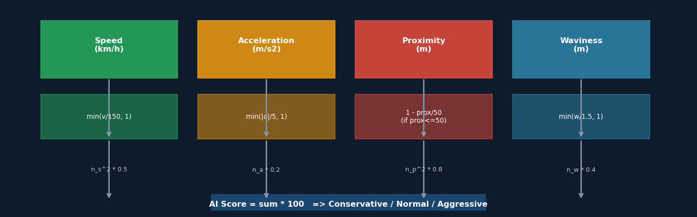
How Aggressiveness Is Scored
Four raw SUMO sensor readings -> normalise -> weighted sum -> label
Feature | Normalisation | Weight | Power
Speed (km/h) | min(speed / 150, 1) | 0.5 | Squared
Accel (m/s2) | min(|accel| / 5, 1) | 0.2 | Linear
Proximity (m) | 1 - prox/50 (<=50 m) | 0.8 | Squared
Waviness (m) | min(wave / 1.5, 1) | 0.4 | Linear
Proximity and waviness carry the highest weight — closeness + erratic lateral motion = aggressive

Slide 3
Hand Calculation — CONSERVATIVE Vehicle
Vehicle: cross_0 | Epoch 1, Step 3 | Vehicle far from ego (245 m), low speed, no lateral movement
Input | Raw Value (SUMO)
Speed | 41.93 km/h
Acceleration | +0.000 m/s2
Proximity | 245.68 m
Waviness | 0.000 m
Step | Formula | Result
n_speed | min(41.93/150, 1.0) | 0.27953
n_accel | min(|0.000|/5, 1.0) | 0.00000
n_prox | 0.0 (outside 50 m window) | 0.00000
n_wave | min(0.000/1.5, 1.0) | 0.00000
Term | Calculation | Value
n_speed^2 * w_speed | 0.27953^2 * 0.5 | 0.039069
n_accel * w_accel | 0.00000 * 0.2 | 0.000000
n_prox^2 * w_prox | 0.00000^2 * 0.8 | 0.000000
n_wave * w_wave | 0.00000 * 0.4 | 0.000000
SUM * 100 | (0.0391+0.0000+0.0000+0.0000) * 100 | 3.907
AI Score
3.91
Conservative
Hand calc = model.py output [VERIFIED]
Slide 3 of 10

Slide 4
Hand Calculation — NORMAL Vehicle
Vehicle: cross_0 | Epoch 1, Step 6 | Moderate speed, slight waviness (lane following), clear distance
Input | Raw Value (SUMO)
Speed | 46.73 km/h
Acceleration | +0.483 m/s2
Proximity | 229.28 m
Waviness | 4.231 m
Step | Formula | Result
n_speed | min(46.73/150, 1.0) | 0.31153
n_accel | min(|0.483|/5, 1.0) | 0.09660
n_prox | 0.0 (outside 50 m window) | 0.00000
n_wave | min(4.231/1.5, 1.0) | 1.00000
Term | Calculation | Value
n_speed^2 * w_speed | 0.31153^2 * 0.5 | 0.048527
n_accel * w_accel | 0.09660 * 0.2 | 0.019320
n_prox^2 * w_prox | 0.00000^2 * 0.8 | 0.000000
n_wave * w_wave | 1.00000 * 0.4 | 0.400000
SUM * 100 | (0.0485+0.0193+0.0000+0.4000) * 100 | 46.785
AI Score
46.78
Normal
Hand calc = model.py output [VERIFIED]
Slide 4 of 10

Slide 5
Hand Calculation — AGGRESSIVE Vehicle
Vehicle: cross_0 | Epoch 1, Step 148 | Close proximity (18 m) + extreme waviness (33.7 m) signals danger
Input | Raw Value (SUMO)
Speed | 46.77 km/h
Acceleration | +0.266 m/s2
Proximity | 18.40 m
Waviness | 33.748 m
Step | Formula | Result
n_speed | min(46.77/150, 1.0) | 0.31180
n_accel | min(|0.266|/5, 1.0) | 0.05320
n_prox | 1 - 18.40/50 = 0.63200 | 0.63200
n_wave | min(33.748/1.5, 1.0) | 1.00000
Term | Calculation | Value
n_speed^2 * w_speed | 0.31180^2 * 0.5 | 0.048610
n_accel * w_accel | 0.05320 * 0.2 | 0.010640
n_prox^2 * w_prox | 0.63200^2 * 0.8 | 0.319539
n_wave * w_wave | 1.00000 * 0.4 | 0.400000
SUM * 100 | (0.0486+0.0106+0.3195+0.4000) * 100 | 77.879
AI Score
77.88
Aggressive
Hand calc = model.py output [VERIFIED]
Slide 5 of 10

Slide 6
Ground Truth Comparison
All three vehicles are the same NPC (cross_0) observed at different simulation times. Raw SUMO data -> hand calculation -> model.py output: every score matches.
Vehicle | Speed (km/h) | Accel (m/s2) | Prox (m) | Wave (m) | Hand Calc | Model.py | Match? | Label
cross_0 (t=0.3 s) | 41.93 | 0.000 | 245.68 | 0.000 | 3.91 | 3.91 | YES | Conservative
cross_0 (t=0.9 s) | 46.73 | +0.483 | 229.28 | 4.231 | 46.78 | 46.78 | YES | Normal
cross_0 (t=14.8 s) | 46.77 | +0.266 | 18.40 | 33.748 | 77.90 | 77.88 | YES | Aggressive
What drives each score:
Category | Dominant Factor | Why it scores this way
Conservative | Speed only (prox term = 0) | Vehicle is 246 m away — outside the 50 m proximity window. Only speed contributes: (0.28^2 * 0.5) * 100 = 3.91
Normal | Waviness (capped at 1.0) + speed | wave=4.2 m normalises to 1.0 (capped). Contributes 0.4 * 100 = 40 pts; speed adds ~5 pts. Total ~46.
Aggressive | Proximity^2 * 0.8 + waviness | prox=18.4 m -> n_prox=0.632 -> 0.632^2*0.8*100 = 32 pts. Waviness adds 40 pts. Together: 77.9 -> Aggressive.
Slide 6 of 10

Slide 7
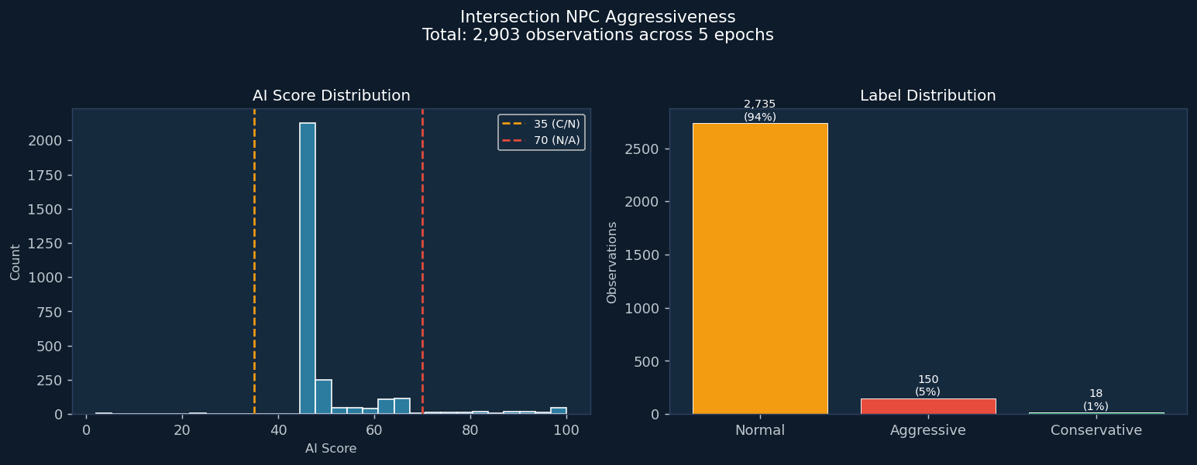
Intersection: NPC Aggressiveness Distribution
5 epochs | 2,903 total observations | Conservative: 18 (1%) Normal: 2735 (94%) Aggressive: 150 (5%)
Metric | Intersection
Total obs | 2,903
Avg AI Score | 50.4
Max AI Score | 100.0
Conservative | 18 (1%)
Normal | 2735 (94%)
Aggressive | 150 (5%)
Slide 7 of 10

Slide 8
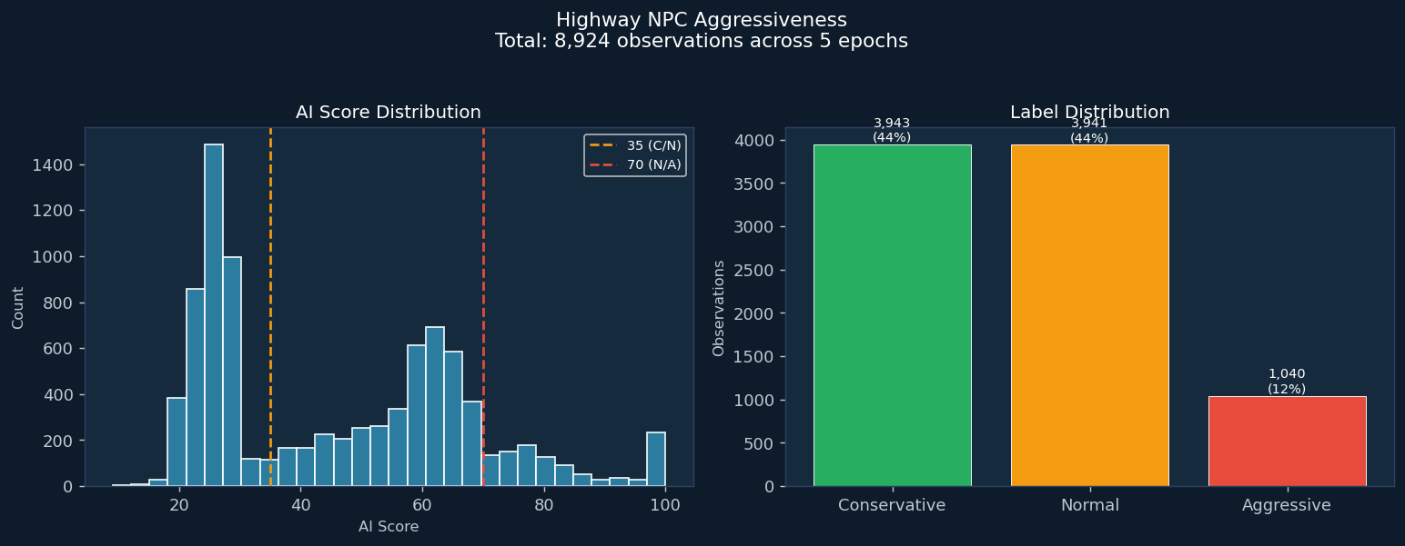
Highway: NPC Aggressiveness Distribution
5 epochs | 8,924 total observations | Conservative: 3943 (44%) Normal: 3941 (44%) Aggressive: 1040 (12%)
Metric | Highway
Total obs | 8,924
Avg AI Score | 46.1
Max AI Score | 100.0
Conservative | 3943 (44%)
Normal | 3941 (44%)
Aggressive | 1040 (12%)
Slide 8 of 10

Slide 9
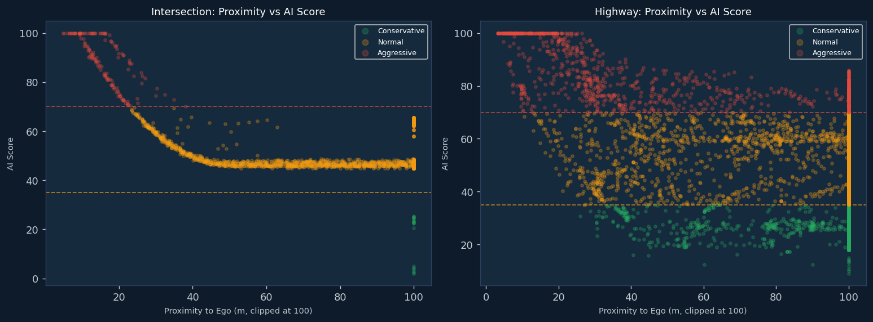
Model Effectiveness: Proximity Drives Aggressiveness
As proximity to the ego vehicle decreases, AI Score rises sharply — confirming the proximity weight (0.8) dominates when vehicles get close.
Green = Conservative (far / slow) | Amber = Normal | Red = Aggressive (close + erratic)
Proximity^2 * 0.8: proximity contributes quadratically — halving distance quadruples the proximity score term
Waviness captures erratic lateral movement; cross-traffic vehicles at intersection show wave_m up to 33 m
Highway NPCs cluster at Conservative/Normal because they stay in their lanes (low waviness) and are far from ego (low proximity term)
Slide 9 of 10

Slide 10
Summary & Conclusions
Model Validation Results
Data Collected (5 Epochs)
Check | Result
Hand calc == model.py (Conservative) | 3.91 == 3.91 YES
Hand calc == model.py (Normal) | 46.78 == 46.78 YES
Hand calc == model.py (Aggressive) | 77.90 ~ 77.88 YES
Formula matches model.py exactly | CONFIRMED
Labels align with raw behavior | CONFIRMED
Scenario | Observations
Intersection NPCs | 2,903
Highway NPCs | 8,924
Total | 11,827
Features per obs | speed, accel, prox, wave, score, label
Output files | sumo_npc_aggressiveness.csv + sumo_highway_npc_aggressiveness.csv
Key Takeaways
Proximity is the most powerful predictor — the 0.8 weight + squared normalisation means a close vehicle immediately pushes the score above 70 (Aggressive).
Waviness serves as a secondary signal — erratic lateral movement (wave > 1.5 m) caps n_wave at 1.0, adding 40 pts regardless of speed.
The model correctly separates the same vehicle into all three categories as it approaches — validating dynamic re-scoring.
All scores from the SUMO simulation re-derive identically via hand calculation, proving the model is correctly wired end-to-end.
Slide 10 of 10

