Slide 1
Locke(Virtual Lock Assistant)
By: John Herrera
Final Project Presentation
CSE480HA
8/06/18

Slide 2
Project Description and Purpose
Locke is a virtual assistant which will generate and store passwords for the users based on their input.
The purpose of this program is to simplify the way you create, save your passwords, and update them.
The passwords will be generated randomly with some criteria attached such as including uppercase letters, numbers, and symbols to be more secure.
Additionally, this program will not be connected online so that hackers will have to get it from the website you used your password on or if your computer is stolen.

Slide 3
Use Cases & Examples
Primarily used to generate passwords for the user to use.
Will also save passwords and provide to user when asked.
The passwords can be saved in a document by request.
The passwords can be destroyed by request.
The passwords can be updated by request.
User: Generate password for BestBuy
Locke: A&CKADGF@15461 generated for BestBuy and stored
User: Display password for Amazon
Locke: The password for Amazon is AbfrD412&
User: Update password for Bestbuy FreddyAM9812@
Locke: Bestbuy password updated to FreddyAM9812@

Slide 4
Scope & Functionality
Students, Adults, and those who are forgetful of their passwords.
Will be a bot that responds to user input but return an error when non-supported request are inputted.
Will only responds to greetings and any requests that pertain to your passwords such as creating or updating them.
Will have multiple pages that will have a chat box, passwords, and about page.
Project will run on Eclipse using Java

Slide 5
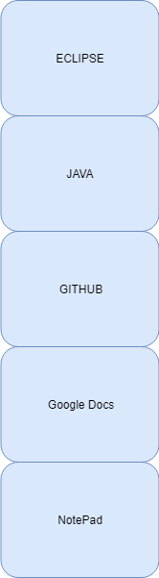
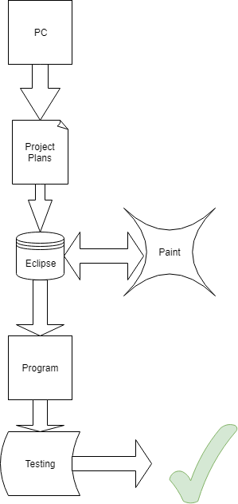
Technology Stack & Architecture Diagram

Slide 6
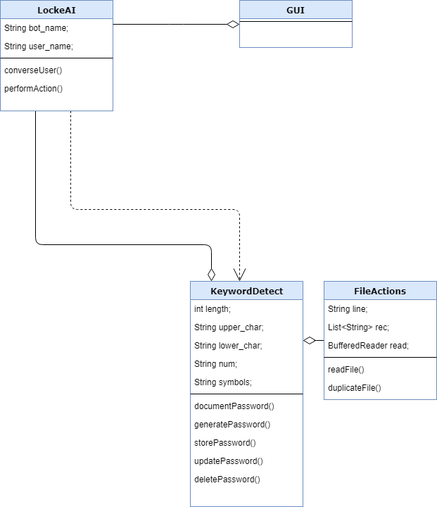
Class Diagram
Basic representation of classes and methods.

Slide 7
Test Cases
storePassword method. Input: Store CleayQ123# for PSN Return: CleayQ123# stored for PSN Completed the imputed exercise Detects keyword store and performs action on PSN which was added into file and then attaching user inputted password
deletePassword method. Input: Delete Gamestop password Return: Gamestop and attached password deleted Completed the imputed exercise Detects keyword delete and performs action on Gamestop which is stored on file and then removes it.

Slide 8
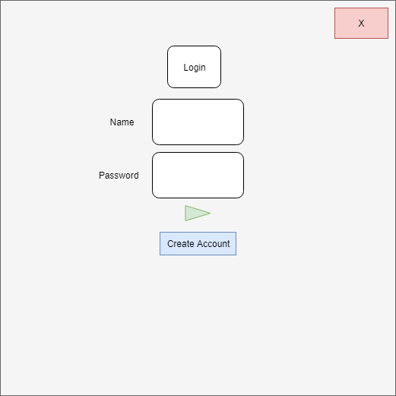
Login or Create Account

Slide 9
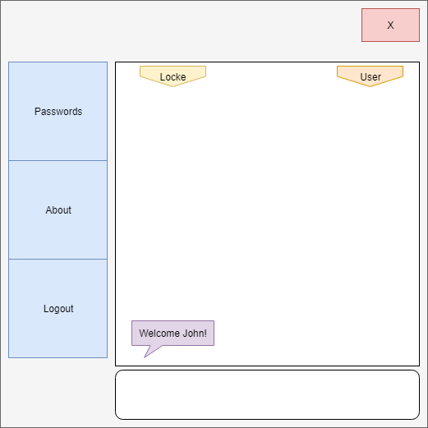
Welcome Page

Slide 10
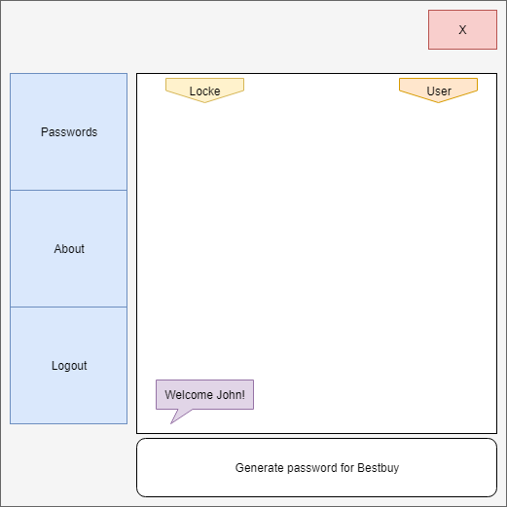
Example 1

Slide 11
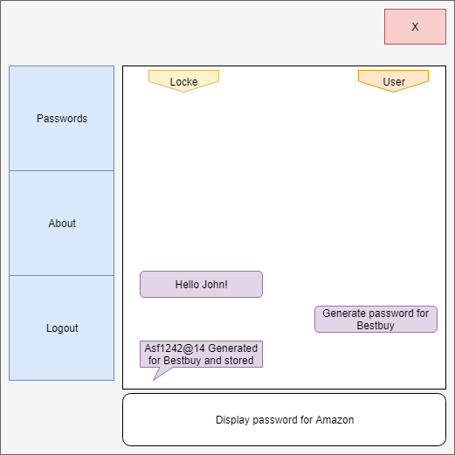
Example 1 Result

Slide 12
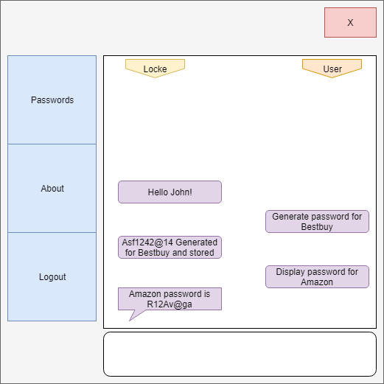
Example 2 Result

Slide 13
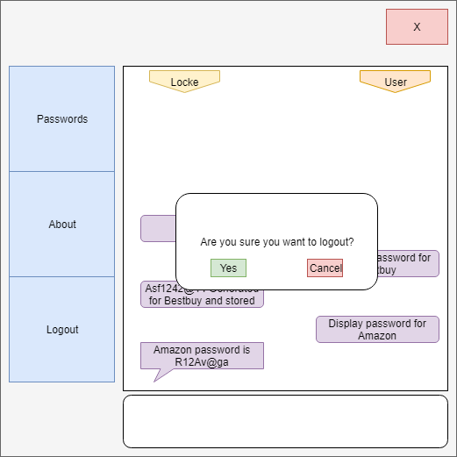
Logout?

Slide 14
Back to login screen

Slide 15
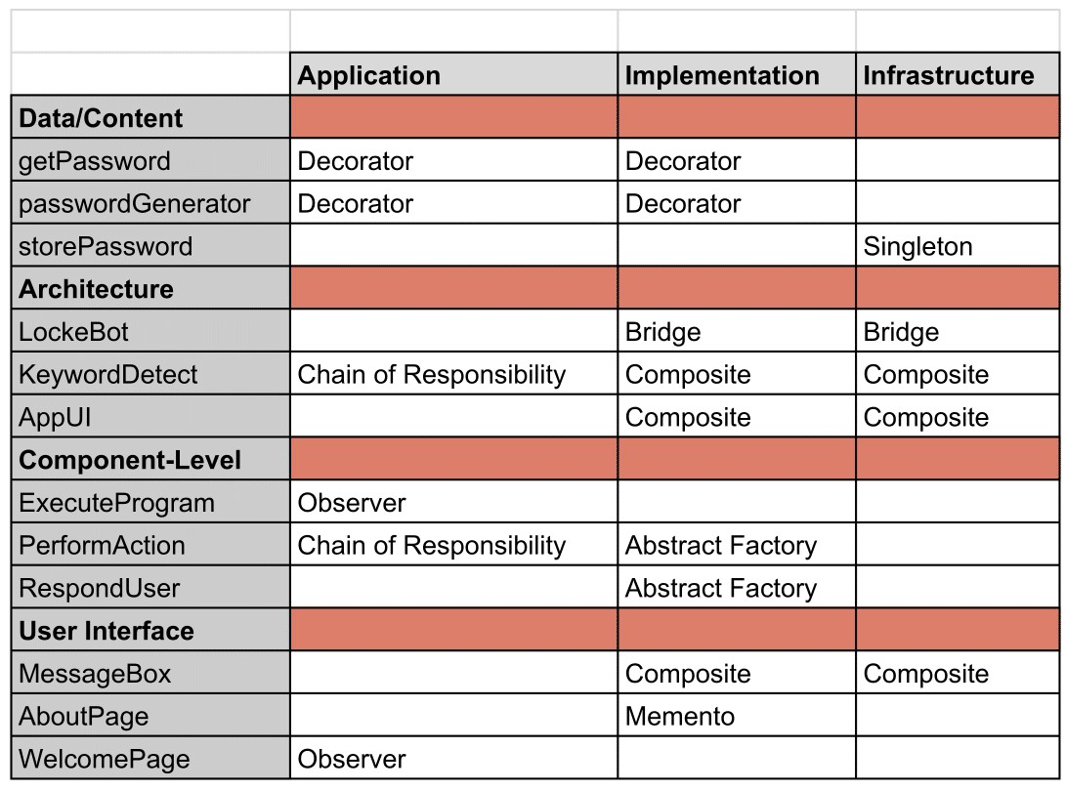
Pattern Organizing Table
Patterns that I will possibly be using during the execution phase.
Chain of Responsibility: Process elements in pipeline abstraction and have users launch and leave requests at start of pipeline.

Slide 16
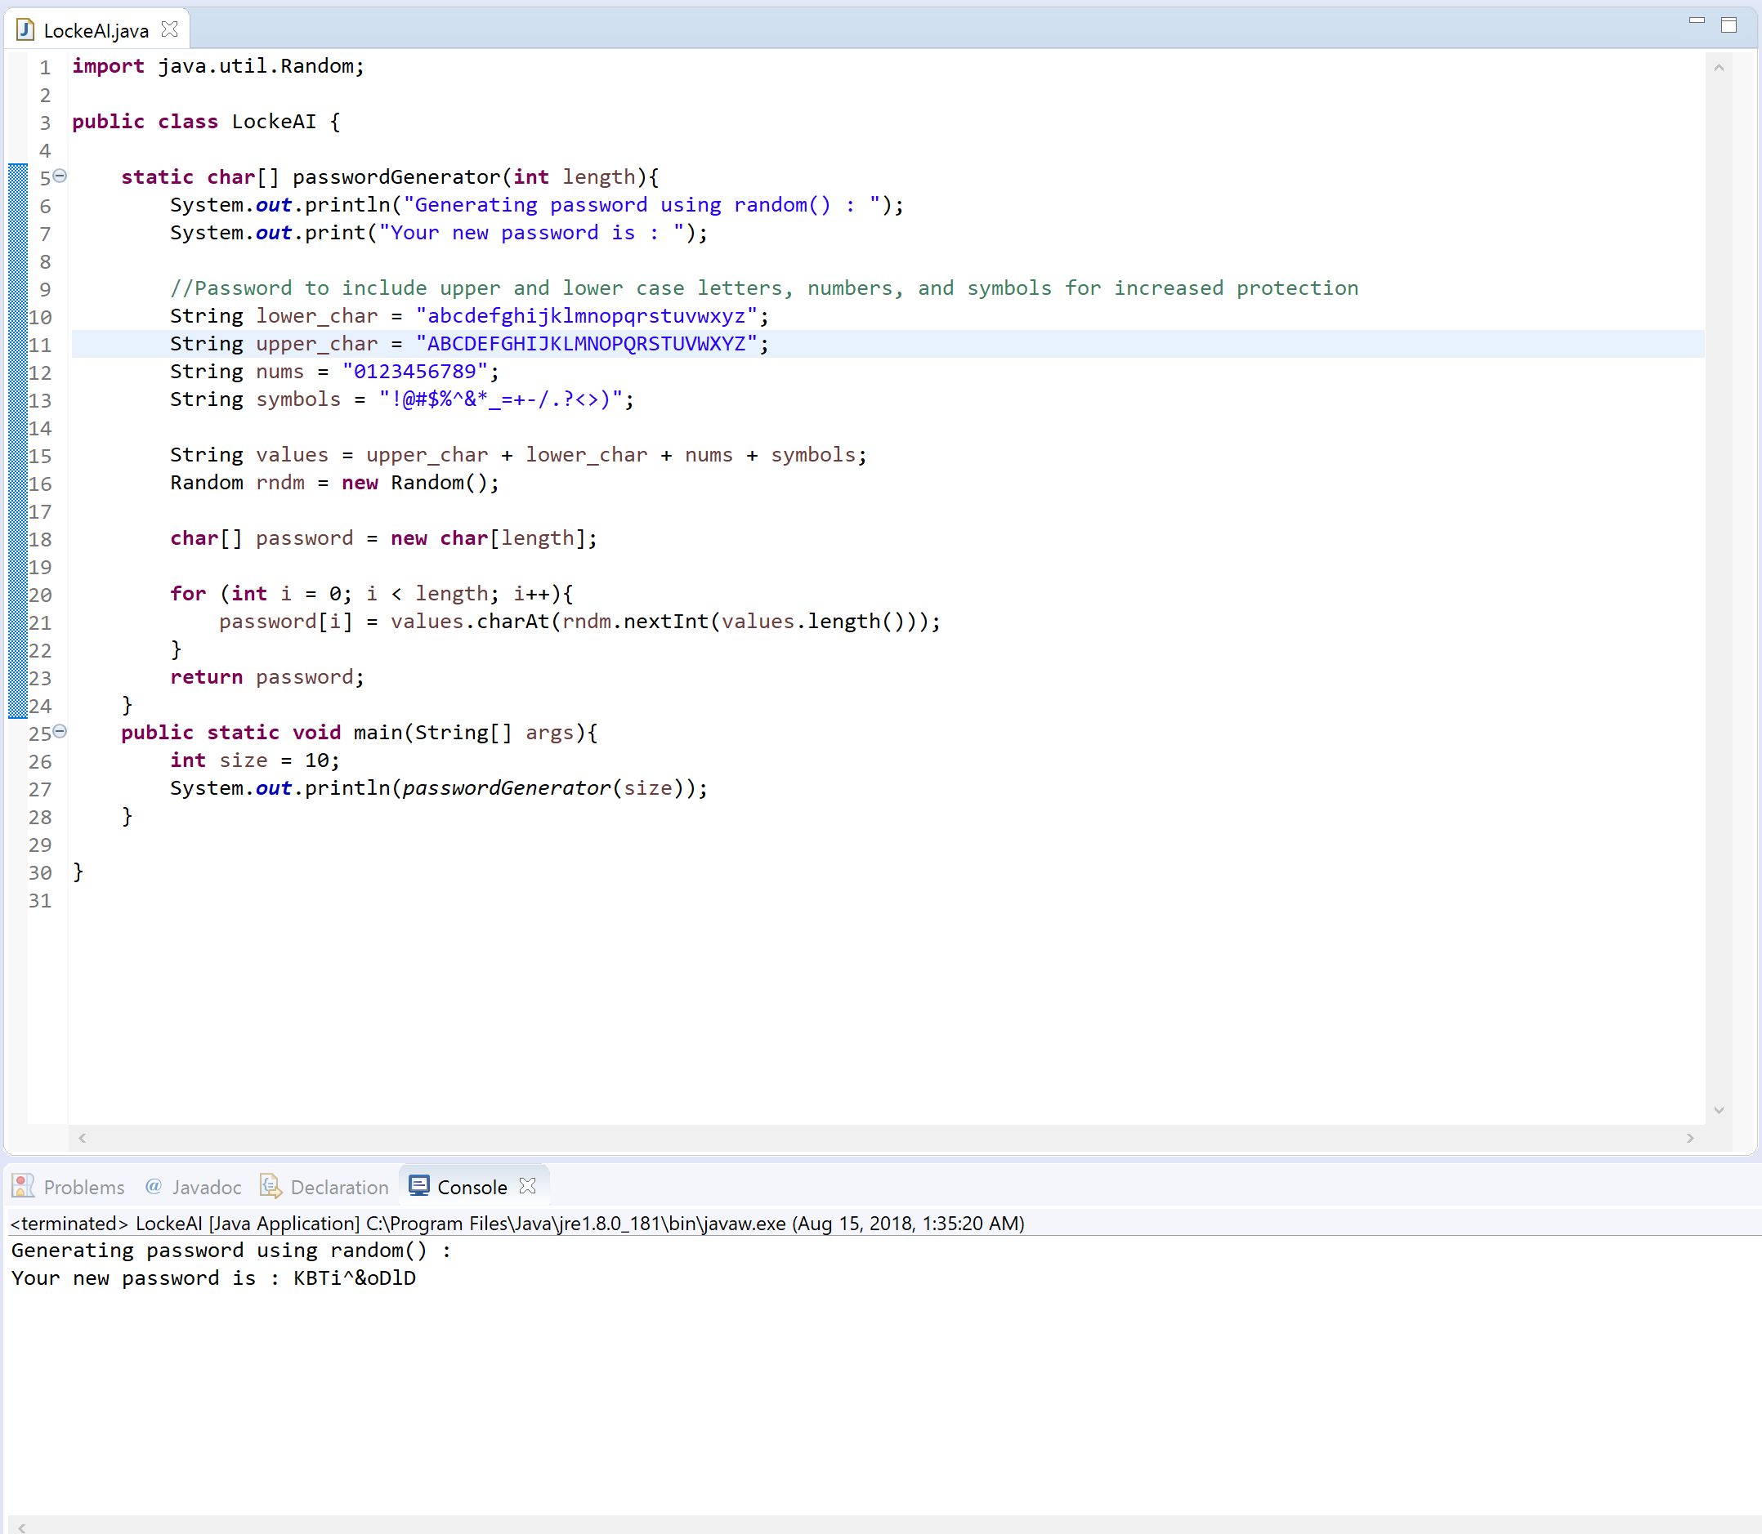
Code
passwordGenerator method

Slide 17
Future Expansion
Password encryption
Login page
More advanced UI

Slide 18
Conclusion
This does not represent the final product and may be changed or different.

