Slide 1
Locke(Virtual Lock Assistant)
By: John Herrera
Final Project Presentation
CSE480HA
8/06/18

Slide 2
Project Description and Purpose
Locke is a virtual assistant which will generate and store passwords for the users based on their input. The application will have multiple pages ranging from the chat box to the passwords page.
The purpose of this program is to simplify the way you create, save your passwords, and update them. The passwords will be generated randomly with some criteria attached such as including uppercase letters, numbers, and symbols to be more secure. Additionally, this program will not be connected online so that hackers will have to get it from the website you used your password on or if your computer is stolen.

Slide 3
Use Cases & Examples
Primarily used to generate passwords for the user to use.
Will also save passwords and provide to user when asked.
The passwords can be saved in a document by request.
The passwords can be destroyed by request.
The passwords can be updated by request.
User: Generate password for BestBuy
Locke: A&CKADGF@15461 generated for BestBuy and stored
User: Display password for Amazon
Locke: The password for Amazon is AbfrD412&
User: Update password for Bestbuy FreddyAM9812@
Locke: Bestbuy password updated to FreddyAM9812@

Slide 4
Scope & Functionality
Students, Adults, and those who are forgetful of their passwords.
Will be a bot that responds to user input but return an error when non-supported request are inputted. Will only responds to greetings and any requests that pertain to your passwords such as creating or updating them. Will have multiple pages that will have a chat box, passwords, and about page.
Project will run on Eclipse using Java

Slide 5
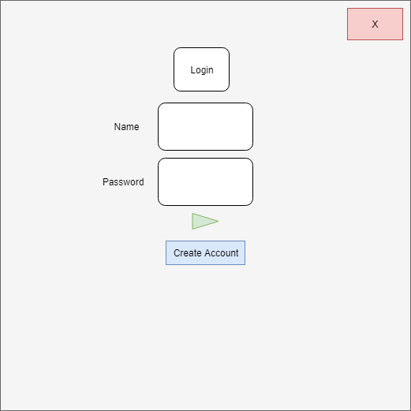
Login or Create Account

Slide 6
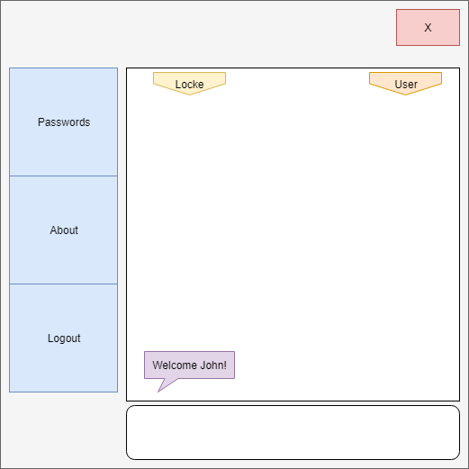
Welcome Page

Slide 7
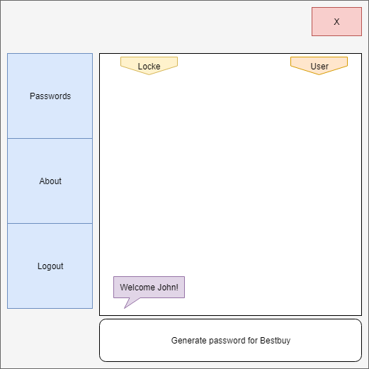
Example 1

Slide 8
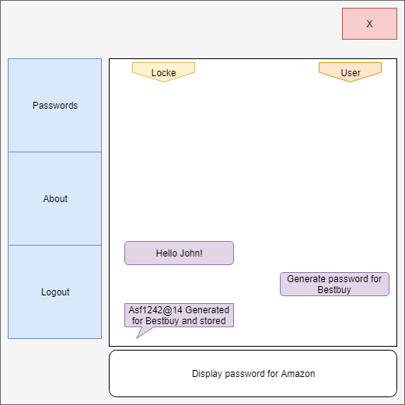
Example 1 Result

Slide 9
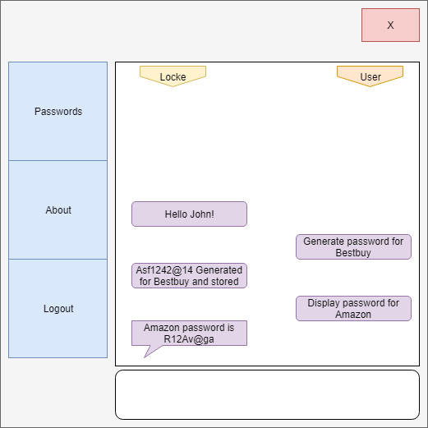
Example 2 Result

Slide 10
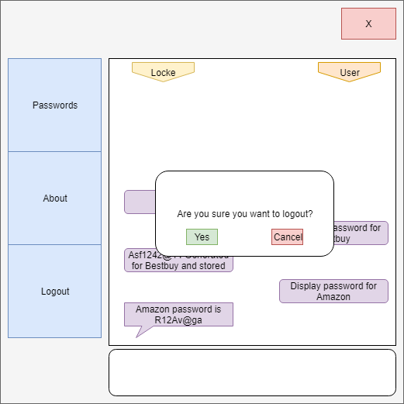
Logout?

Slide 11
Back to login screen

Slide 12
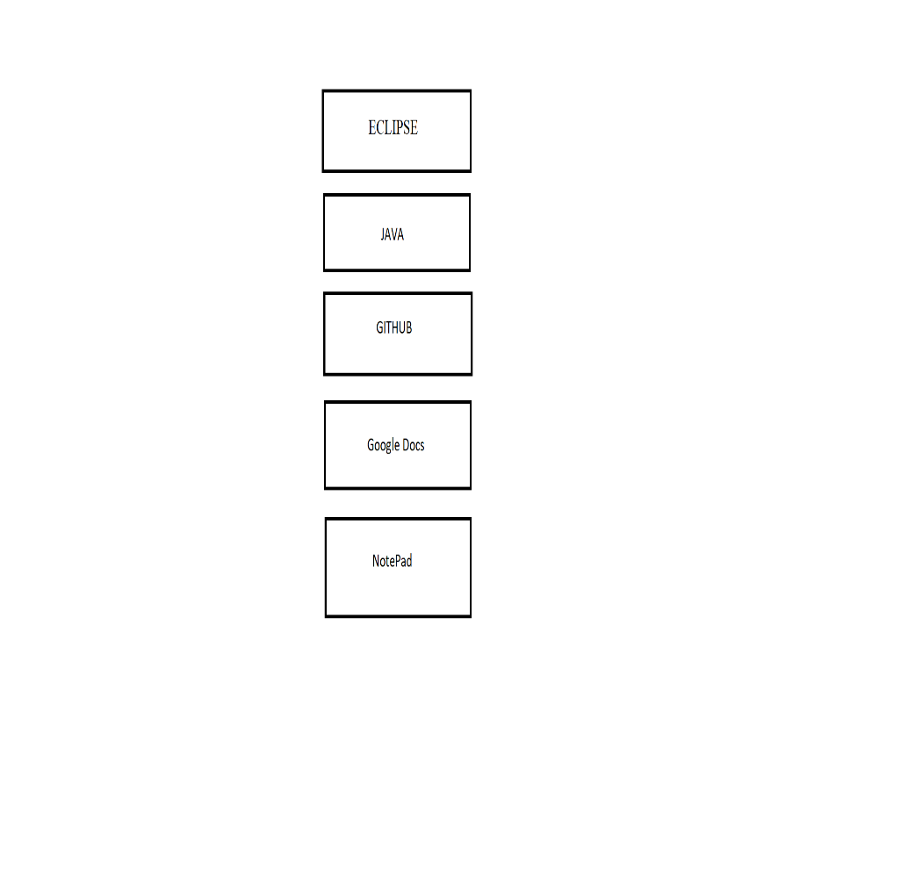
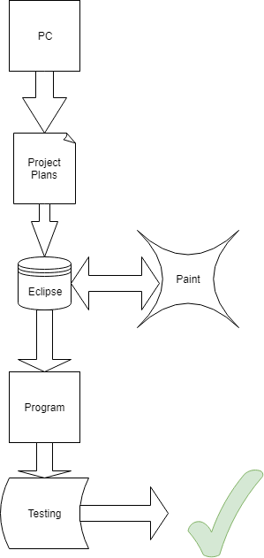
Technology Stack & Architecture Diagram

Slide 13
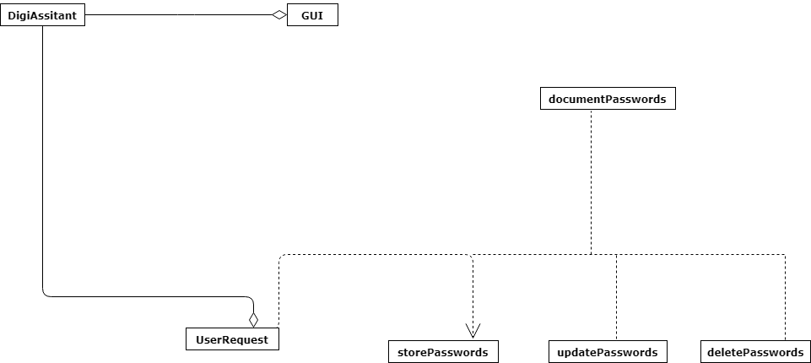
Class Diagram
A very basic outlook of how my project will be laid out. Will be updated for final presentation.

Slide 14
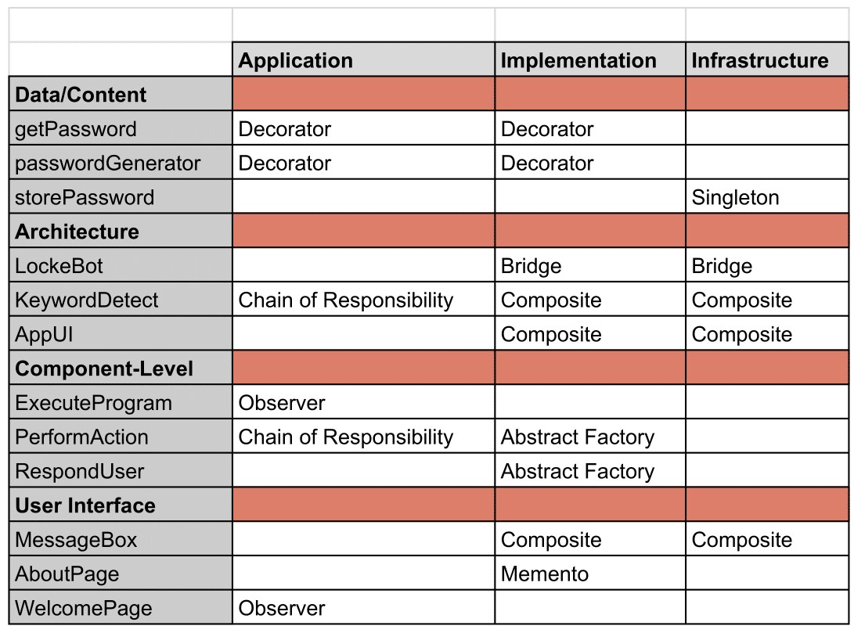
Pattern Organizing Table
Patterns that I will possibly be using during the execution phase.

Slide 15
Test Cases
storePassword method. Input: Store CleayQ123# for PSN Return: CleayQ123# stored for PSN Completed the imputed exercise Detects keyword store and performs action on PSN which was added into file and then attaching user inputted password
deletePassword method. Input: Delete Gamestop password Return: Gamestop and attached password deleted Completed the imputed exercise Detects keyword delete and performs action on Gamestop which is stored on file and then removes it.

Slide 16
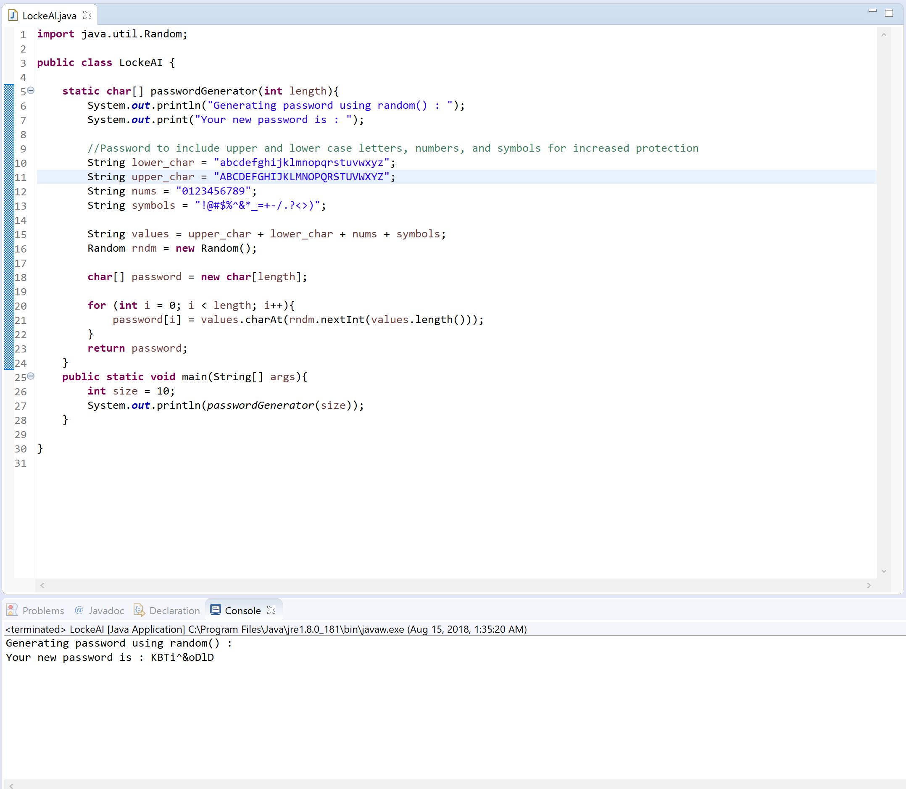
Code
passwordGenerator method

Slide 17
Conclusion
This does not represent the final product and may be changed or different.

