Slide 1
Locke(Virtual Lock Assistant)
By: John Herrera
Final Project Presentation
CSE480HA
8/06/18

Slide 2
Project Description and Purpose
Locke is a virtual assistant which will generate and store passwords for the users based on their input. The application will have multiple pages ranging from the chat box to the passwords page.
The purpose of this program is to simplify the way you create, save your passwords, and update them. The passwords will be generated randomly with some criteria attached such as including uppercase letters, numbers, and symbols to be more secure. Additionally, this program will not be connected online so that hackers will have to get it from the website you used your password on or if your computer is stolen.

Slide 3
Examples
User: Generate password for BestBuy
Locke: A&CKADGF@15461 generated for BestBuy and stored
User: Display password for Amazon
Locke: The password for Amazon is AbfrD412&
User: Update password for Bestbuy FreddyAM9812@
Locke: Bestbuy password updated to FreddyAM9812@

Slide 4
End Users of Application & Scope
Students, Adults, and those who are forgetful of their passwords like my mother.
Will be a bot that responds to user input but return an error when non-supported request are inputted. Will only responds to greetings and any requests that pertain to your passwords such as creating or updating them. Will have multiple pages that will have a chat box, passwords, and about page.

Slide 5
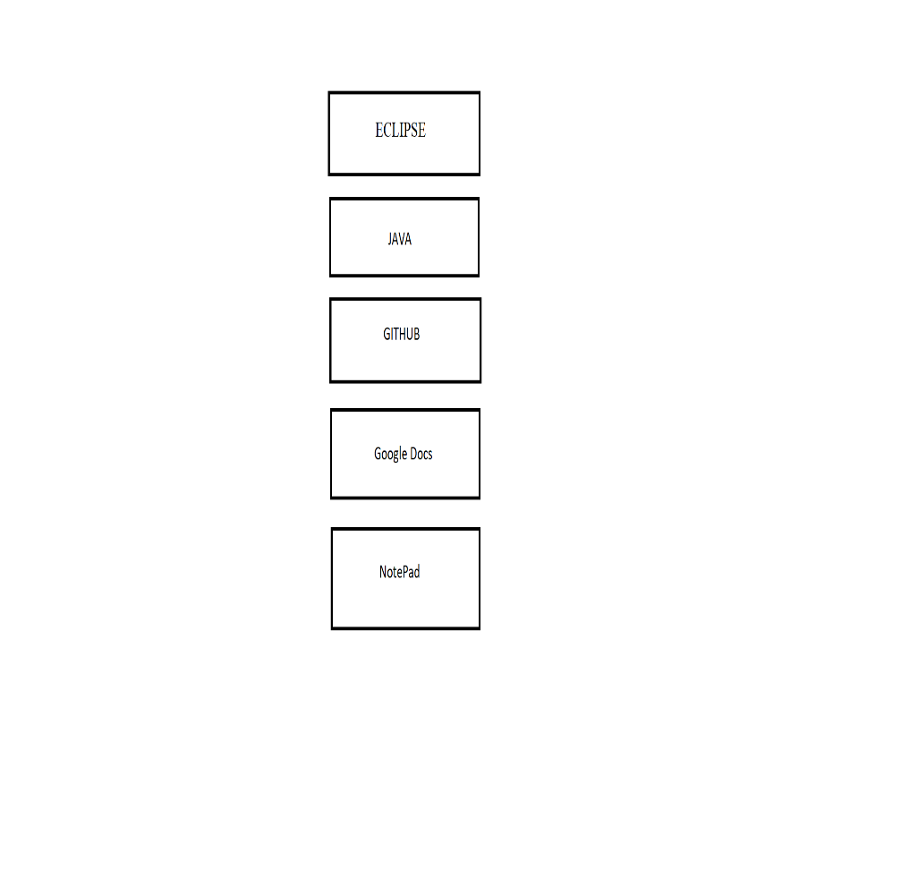
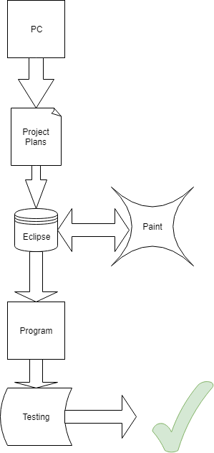
Technology Stack & Architecture Diagram

Slide 6
Two Content Layout with Table
First bullet point here
Second bullet point here
Third bullet point here
Class | Group 1 | Group 2
Class 1 | 82 | 95
Class 2 | 76 | 88
Class 3 | 84 | 90

Slide 7
Title and Content Layout with SmartArt
Step 1 Title
Step 2 Title
Task description
Task description
Task description
Task description
Task description
Task description
Task description
Step 3 Title
Task description
Task description
Step 4 Title
Task description
Task description

Slide 8
Add a Slide Title - 1

Slide 9
Add a Slide Title - 2

Slide 10
Add a Slide Title - 3

Slide 12
Add a Slide Title - 4

Slide 13
Add a Slide Title - 5

