Slide 1
Locke(Virtual Lock Assistant)
By: John Herrera CSE480HA

Slide 2
Project Description and Purpose
Locke is a virtual assistant which will generate and store passwords for the users based on their input.
The purpose of this program is to simplify the way you create, save your passwords, and update them.
The passwords will be generated randomly with some criteria attached such as including uppercase letters, numbers, and symbols to be more secure.
Additionally, this program will not be connected online so that hackers will have to get it from the website you used your password on or if your computer is stolen.

Slide 3
Use Cases
Primarily used to generate passwords for the user to use.
Will also save passwords and provide to user when asked.
The passwords can be saved in a document by request.
The passwords can be destroyed by request.
The passwords can be updated by request.
User: Generate password for BestBuy
Locke: A&CKADGF@15461 generated for BestBuy and stored
User: Display password for Amazon
Locke: The password for Amazon is AbfrD412&
User: Update password for Bestbuy FreddyAM9812@
Locke: Bestbuy password updated to FreddyAM9812@

Slide 4
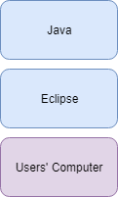
Current Status + Technology Stack
Encryption Research
Scheduling Project Milestones
File preparations

Slide 5
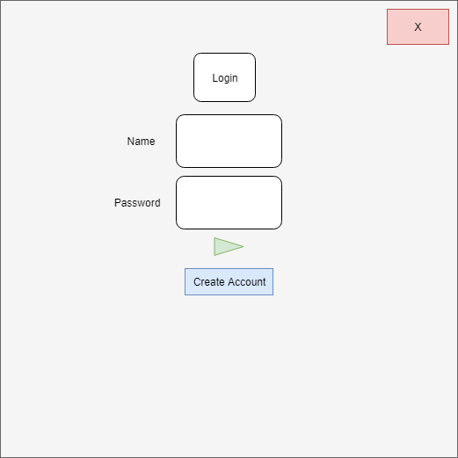
Login or Create Account

Slide 6
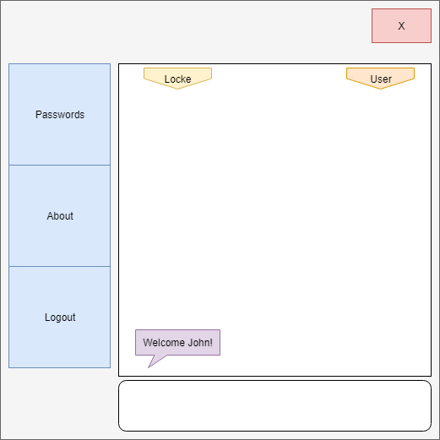
Welcome Page

Slide 7
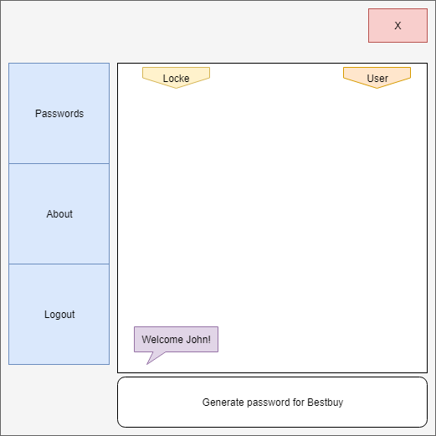
Example 1

Slide 8
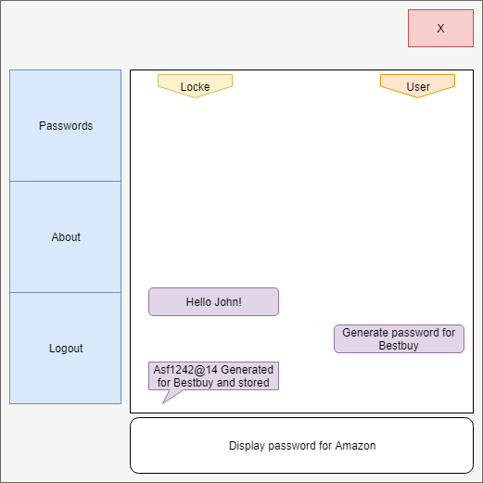
Example 1 Result + Example 2

Slide 9
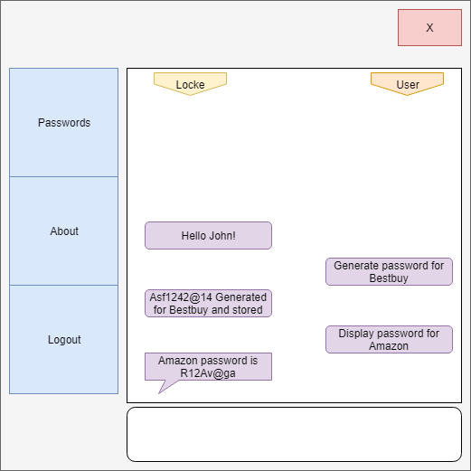
Example 2 Result

Slide 10
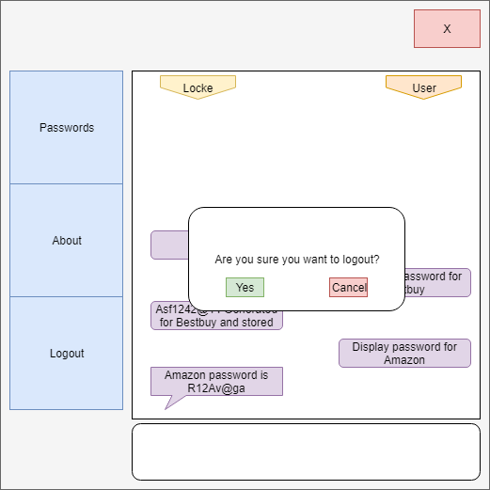
Logout?

Slide 11
Back to login screen

Slide 12
Conclusion

