Slide 1
REPELSEC Security Tool
25/04/2024
Author - Jonah Reader
Supervisor – Paul Grace
Notes:
Introduce myself and tool.

Slide 2
Contents
Introduction
Project Motivation
Tool Overview
SAST
SCA
Background Research
Demo
Conclusion
Questions
Notes:
Outline structure of presentation and how long it will take.

Slide 3
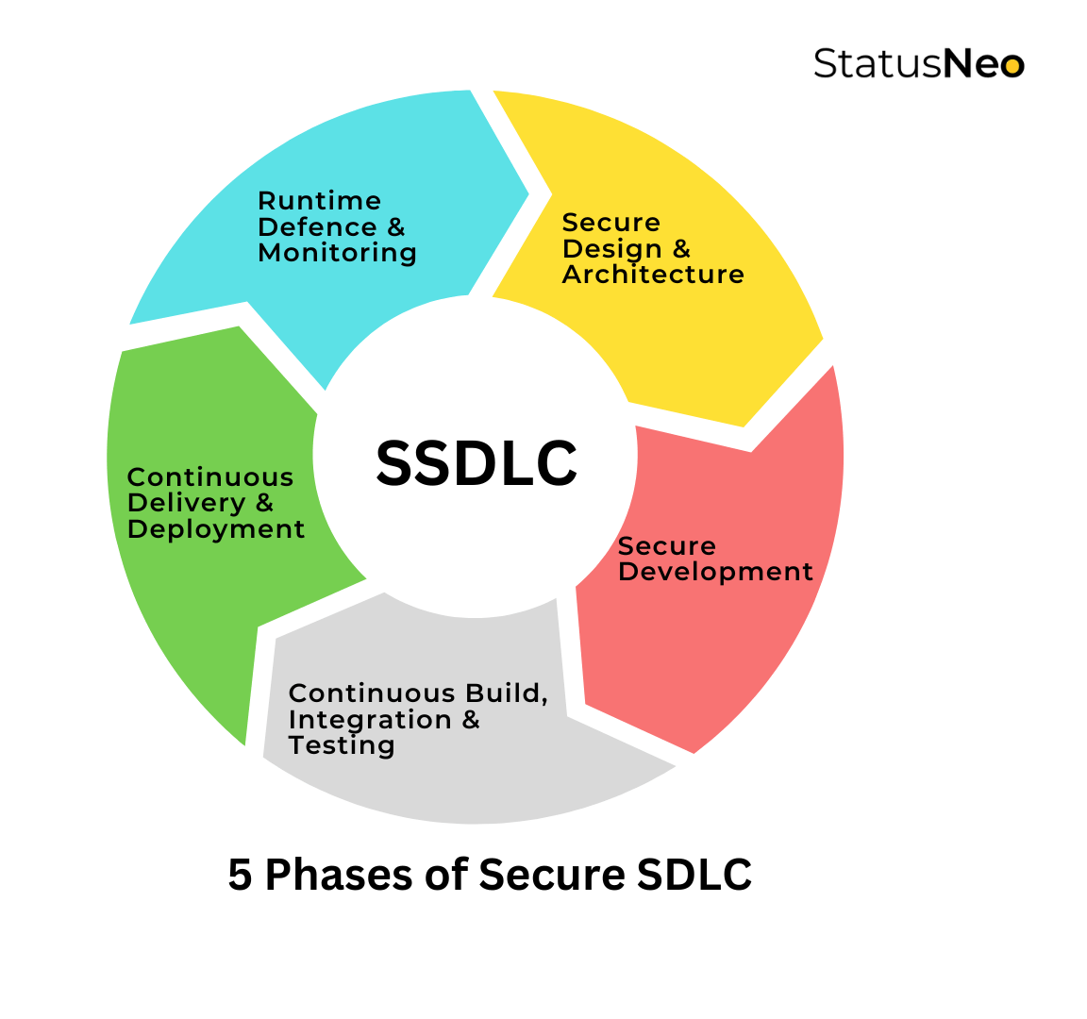
Introduction
What is the purpose of REPELSEC?
Software Security
Shift Left Security
Secure Software Development Lifecycle (SSDLC)
Nanda (2023)
Notes:
Software security - aims to avoid the appearance of security vulnerabilities by ensuring Secure Software Development (SSD) methods are employed.
Shift Left Security - ‘designing and testing for security early and continuously in each software iteration’
REPELSEC was created to easily integrate into a SSDLC process and support the secure development stage.

Slide 4
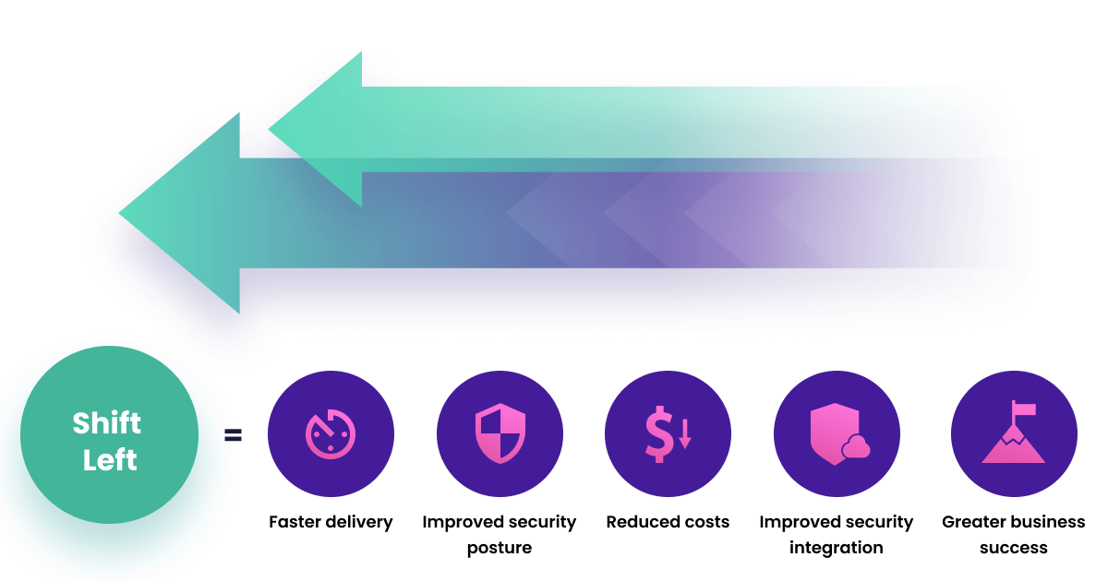
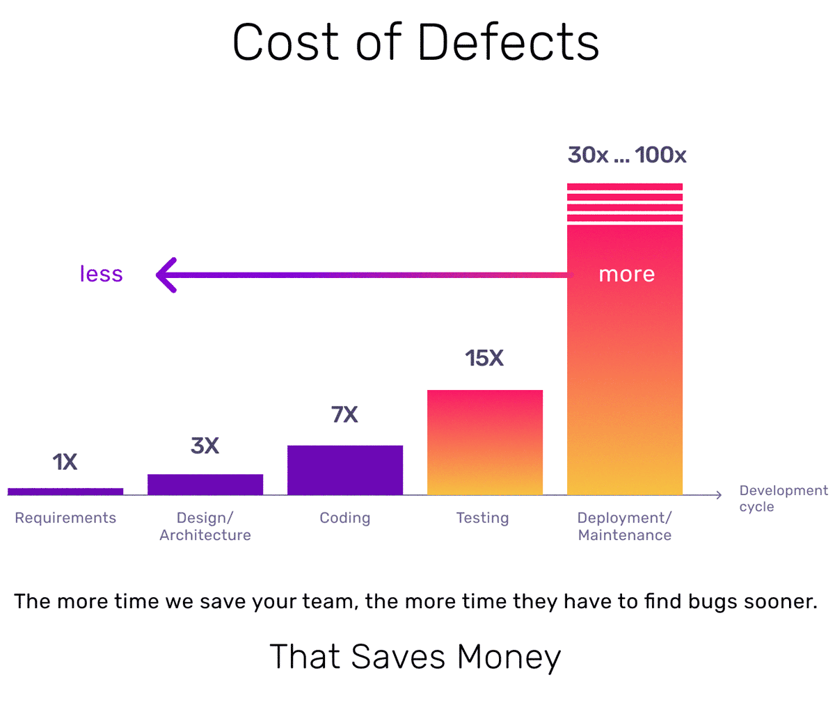
Project Motivation
Synk (2024)
Cser (2023)
Notes:
Importance of shift left security
Personal motivation - placement

Slide 5
Tool Overview
Lightweight Security Testing for the Java Programming Language
Performs Static Application Security Testing (SAST)
Performs Software Composition Analysis (SCA) / Dependency Analysis
Provide user with the results of the test – vulnerability details, remediation advice
Notes:
Explain Lightweight – performance, offline, low reliance on external integrations, quick setup.
REPELSEC looks for vulnerabilities using SAST and SCA and then provides report on vulnerabilities found and how to remediate them.

Slide 6
Static Application Security Testing
CWE-89: Improper Neutralization of Special Elements used in an SQL Command ('SQL Injection')
CWE-111: Direct Use of Unsafe JNI
CWE-209: Generation of Error Message Containing Sensitive Information
CWE-246: J2EE Bad Practices: Direct Use of Sockets
CWE-259: Use of Hard-coded Password
CWE-321: Use of Hard-coded Cryptographic Key
CWE-326: Inadequate Encryption Strength
CWE-382: J2EE Bad Practices: Use of System.exit()
CWE-395: Use of NullPointerException Catch to Detect NULL Pointer Dereference
CWE-396: Declaration of Catch for Generic Exception
CWE-397: Declaration of Throws for Generic Exception
CWE-481: Assigning instead of Comparing
CWE-491: Public cloneable() Method Without Final ('Object Hijack')
CWE-493: Critical Public Variable Without Final Modifier
CWE-500: Public Static Field Not Marked Final
CWE-572: Call to Thread run() instead of start()
CWE-582: Array Declared Public, Final, and Static
CWE-583: finalize() Method Declared Public
CWE-585: Empty Synchronized Block
CWE-586: Explicit Call to Finalize()
CWE-595: Comparison of Object References Instead of Object Contents
CWE-766: Critical Data Element Declared Public
CWE-798: Use of Hard-coded Credentials
Analyses source code files (.java, .jsp)
Tests for 24 Common Weakness Enumerations (CWE)
Pattern matching – regex, string queries
Notes:
Looks for CWEs – vulnerabilities and bugs
CWE - a category system for hardware and software weaknesses and vulnerabilities sustained by the security community. List hosted by the MITRE corporation.

Slide 7
Software Composition Analysis
Analyses Maven Pom.xml file
Common Platform Enumerations (CPE)
National Institute of Standards and Technology (NIST)
National Vulnerability Database (NVD)
Common Vulnerabilities and Exposures (CVE)
Notes:
CPE - a structured naming scheme for information technology systems, software, and packages.

Slide 8
Background Research
Tools Researched:
Veracode
Semgrep
Spotbugs
SonarQube
SonarLint
Black Duck
Checkmarx
Sonatype Lifecycle
Snyk
OWASP Dependency Checker
Common Weaknesses Identified
IDE Integrations
Separate SAST and SCA functionality
Diverse analysis approach
Heavyweight approach
Learning curves
Notes:
Limited developer to specific environment
Inconvenient as additional tool needed
Vulnerabilities outside of CWE Top 10 and niche Java vulnerabilities overlooked.
Heavyweight – time consuming, not suitable for software engineers who focus on features.
Require complicated setup and configuration. REPELSEC quick to install and minimalist.

Slide 9
Demo
Notes:
GitHub - https://github.com/xJonah/REPELSEC
PyPi - https://pypi.org/project/repelsec/

Slide 10
Conclusion
Shift Left Security
Lightweight command-line SAST & SCA tool
Audience
Future Work
Notes:
SLS – support developers in testing early to save resources and time
Key features – quick installation and setup, combined SAST & SCA functionality, lightweight and high performance
Audience –new to security tools, value flexibility, value their time
Future work – supporting tests for more vulnerabilities and dependencies

Slide 11
Questions
Notes:
Any questions? – Happy to clarify on anything unclear and I of course haven’t spoken about a lot of things like project management, requirements, design, and testing.

