Slide 1
Patent Indeterminacy: Towards Investment Protection?
Shamnad Basheer
Honorary Research Chair Professor of IP Law, Nirma University
Founder, SpicyIP
IGIDR and Vanderbilt
Mumbai
13th December 2016

Slide 2
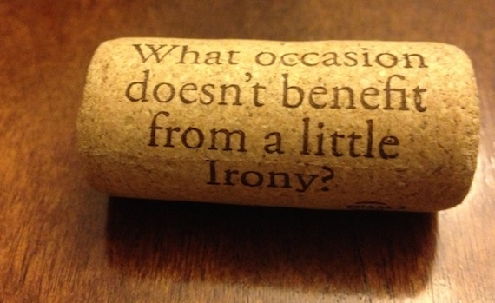

The Irony of IP!
IP is about innovation and creativity
And yet IP regimes have been shielded from innovative experimentation
All well with patents?
Economically Inefficient!
  Costs vs Benefits
  High degree of indeterminacy

Slide 3
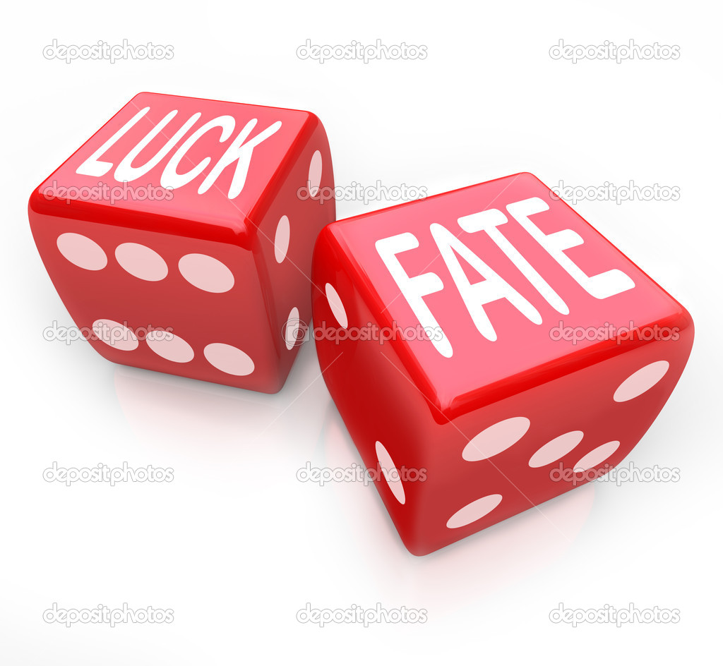
Indeterminacy/Uncertainty
Patent Uncertainty:
  Legal
    Will we get a patent?
    Will we keep the patent?
  Technological
    Will we be able to translate the invention to an innovation?
  Commercial
    Will the innovative product succeed in the market?
Indeterminacy: Tolerable Level/Baseline?
Patent Value?
  Arbitrary
  Heuristics

Slide 4

Patents: Indeterminacy
Windsurfer
  12 year old kid (Chilvers)
  Viagra patents
  “Obvious to try”?
Not sure when it will be invalidated
Around 50% or more (Germany/US/UK/Japan)
  India (80% strike rate)
AI: machine intelligence as the judge?
  Combinational creativity (vs transformational)
Reading Claims: Unclear boundaries
  Paradox: Patents as trade secrets too!

Slide 5

Patents as Trade Secrets?
Viagra: Canadian lower court decision:
“Why did the disclosure not simply state that [the] compound in Claim 7 was sildenafil? The patent plays “hide and seek” with the reader. The reader is expected to look for the “needle in the haystack”, or “the tree in the forest”. Remember, Claim 1 is for a range of compounds which includes 260 quintillion compounds.”
“Quintillion”
  A whooping 18 zeros!

Slide 6
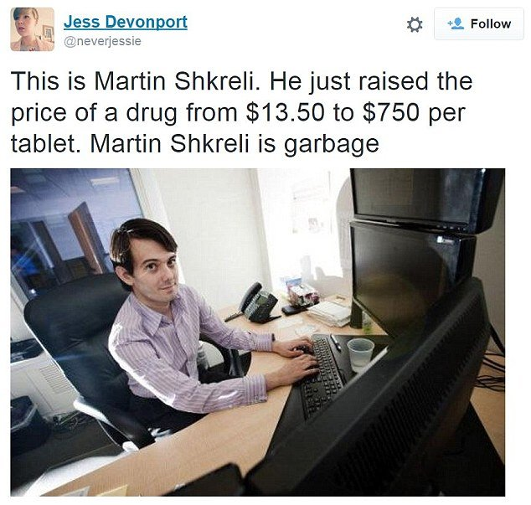
Investment Protection Regime?
Why not protect investments directly?
  Vs Cognitive Filter (Patents)
Pharma Model
  Mandatorily disclose costs
  Protect till costs plus ROI
Pricing transparency: US
What of other sectors?
Do patents trigger innovation?
  Brands/Trade secrecy
  Shorter patent terms
  Liability Rules vs Property Rules

Slide 7

Thank you very much!
There are some things in Indian IP that cannot be explained
For everything else, there’s SpicyIP!
<www.spicyip.com>
  shamnad@gmail.com

Slide 8
Reasonable Royalty?
Arbitrary?
SEP’s: no fair disclosure. Different bargains with different people
Not clear whether it is on the component or the final product
And not clear whether for all patents or just a handful
Heuristics..

Slide 9
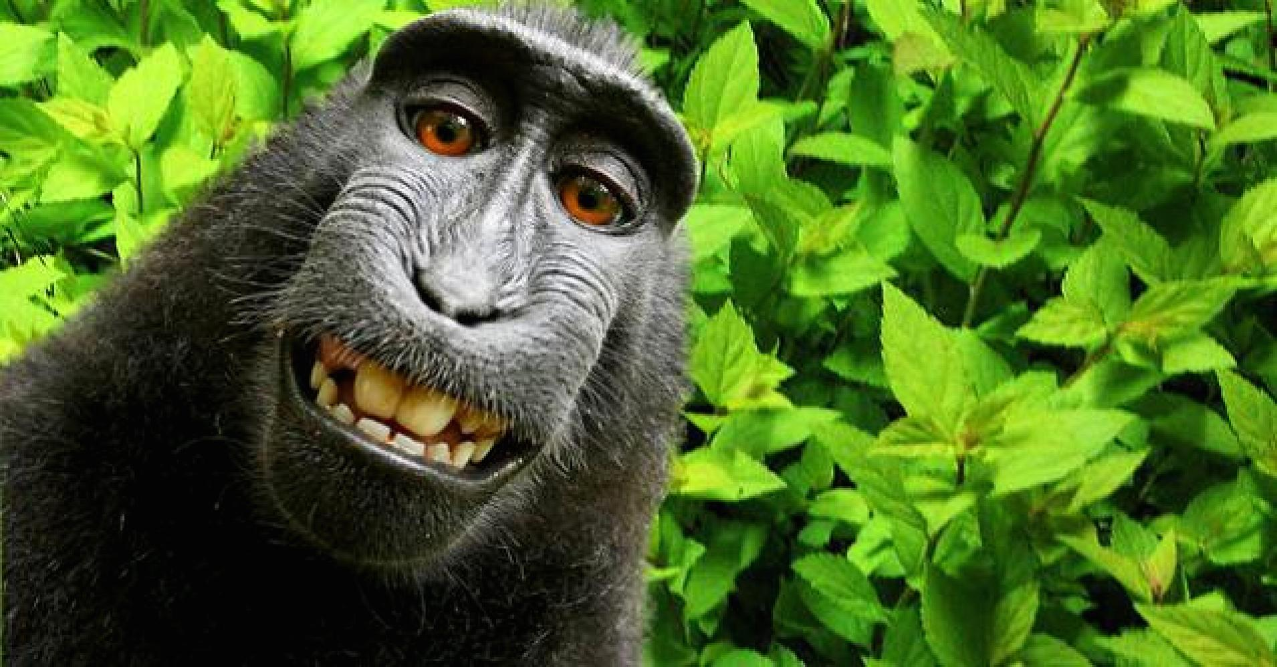
Conclusion: “Intellectual Property”: Misleading Moniker?
Strong “Property” Narrative
But IP vs Real Property
  Non-Excludable/Rivalrous
  Unclear Boundaries
  Uncertainty
  Windsurfer case
    Lottery!
Monkey Selfie: Intellectual?
Relabel as: “Regulation of “Distinctive Info”
  RDI Law

