Slide 1


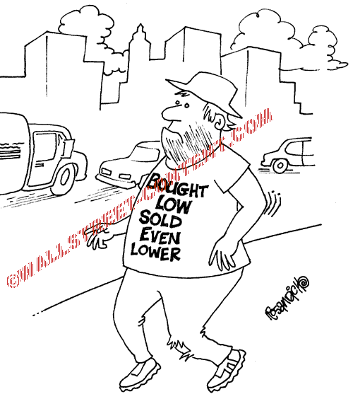
Do Demand Curves For Stocks Slope Down?:
Evidence From a Regulation Induced Supply Shock
Discussant: Pawan Jain

Slide 2
Summary
SEBI mandated that all listed companies in India should have at least 25% public shareholding at all times
Using this as a natural experiment this study tests if the affected stocks experience a negative price reaction.
If so, when?
Significant negative excess return in the 11 days surrounding the sale of securities.
A majority of the negative excess returns occurs on the issue date and during the following week.
Negative excess return is not information driven

Slide 3
Comments
Demand?
Two aspects: price and quantity demanded
How do you capture quantity demanded?
number of trades vs. quotes (?); trade direction (?)
Kaul et al (2000): “since the revision was done on a single day for all stocks, it raises the possibility of some other actual or anticipated event influencing prices.”
This setting might be better as you capture true reaction, instead of learning
If the promoters can choose any day to sell their stake within 3 years, won’t they pick the most overvalued day?

Slide 4
Comments
Excess supply or price impact?
“If the price reaction documented is a result of price pressure, then the negative returns should reverse as soon as abnormal volume subsides.”
Non necessarily: If the promoters chose a day when the stock was significantly overvalued, their trades may result in permanent price impact.
Demand curve shifts?
Firms that try to meet the regulation which improves the stock’s market quality might result in a shift in demand curve

Slide 5
Comments
“PSUs are highly-constrained and regulated firms and are likely to have a steeper demand curve”
Not necessarily true. PSUs are much more transparent as compared to non-PSUs
“companies that issue bonus or rights shares to existing non-promoter shareholders in order to comply with the regulation do not experience any negative price reaction.”
Flatter demand curve?
Small sample: 10 firms
Notes:
Prices may reflect all the information at all times and hence change in price may not significantly affect the demand=> flatter demand curve.

Slide 6
Comments
SEBI Announcement day effect
Day 0:depends on timing of the announcement
Positive announcement effect and maybe traders were penalizing firms for not meeting the requirements during the first few days (?)
Company’s Announcement day effect
Authors do not find any effect. However, there is negative excess return of 2.71% during the first 2 days following the anouncement.

Slide 7
Comments
More robust analysis for “overpricing” explanation:
Comparing compliant vs. non-compliant firms might not be enough
Analyze the timing of the “new supply”
Price movement around the deadline to comply
Factor models for calculating AR:
HML, SMB, Momentum, Illiquidity

Slide 8
Comments
Interesting paper
Solid data and analysis
Has a potential for deeper investigation

