Slide 1




Now Playing
Systemic Microstructure Risks of
High Frequency Trading

Slide 2
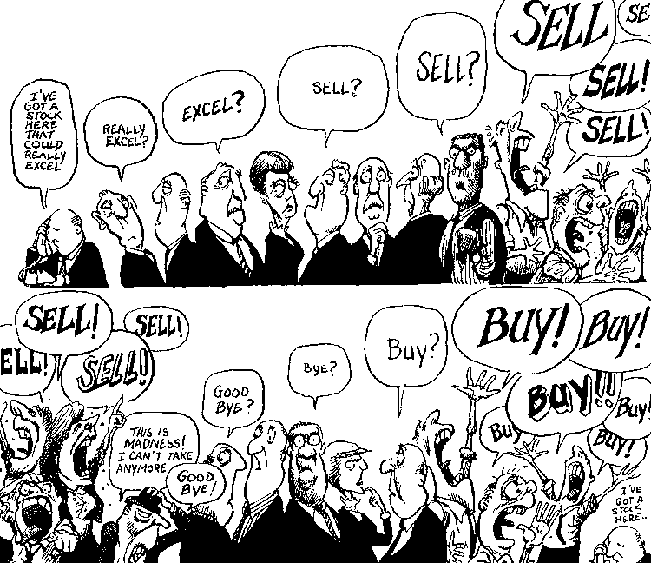
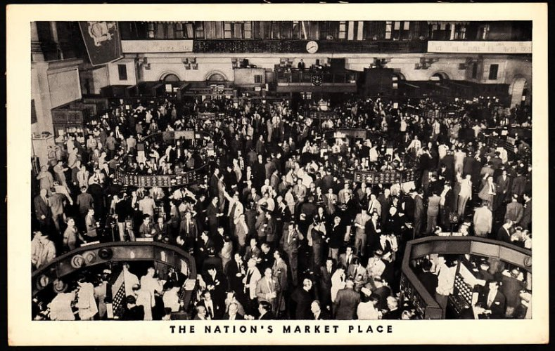

Notes:
Delete 4 pictures

Slide 3


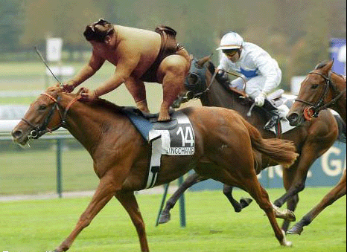
Systemic Microstructure Risks of High Speed Trading
Pankaj Jain, Pawan Jain, and Thomas H. McInish
Presented by:
Pawan Jain
Email: jain1p@cmich.edu
Cell #: 307-220-1900
Web:https://umdrive.memphis.edu/pjain1/public/PawanJain.html

Slide 4
Implementing Arrowhead: A Natural Experiment
Event:
January 4, 2010 – Tokyo Stock Exchange (TSE) launches enhanced trading platform: “Arrowhead”
1500x Increase in System Speed vs. Prior System
Order processing latency reduced to 3 milliseconds
No more delayed trading (Lehmann and Modest, 1994; Ahn, Hamao and Ho, 2002; Uno and Shibata, 2012)
Outcome:
HFT increased from 0% of total TSE trade volume to 36% within 24 months
How does low latency effect Market Quality?

Slide 5
Institutional Details
Total listed market cap over $3 trillion
largest stock exchange headquartered outside the US
NYSE Euronext /TSE agreement: linked network access
Electronic automated trading system
two trading sessions: 0900–1100 and 1230–1500
Purely order-driven market.
No “Upstairs Market” => no hidden orders
Varying tick sizes and minimum trading
Not Fragmented (TSE has 91% of total volume)
Ideal non-fragmented set-up to study pure effects
Chan, Hamao & Lakonishok, 1991; Bremer, Hiraki, & Sweeney, 1997; Ahn, Hamao, & Ho, 2002
Notes:
Now it is very much like the US markets but historically it has lot of special features such as warning quotes, and delayed trading

Slide 6
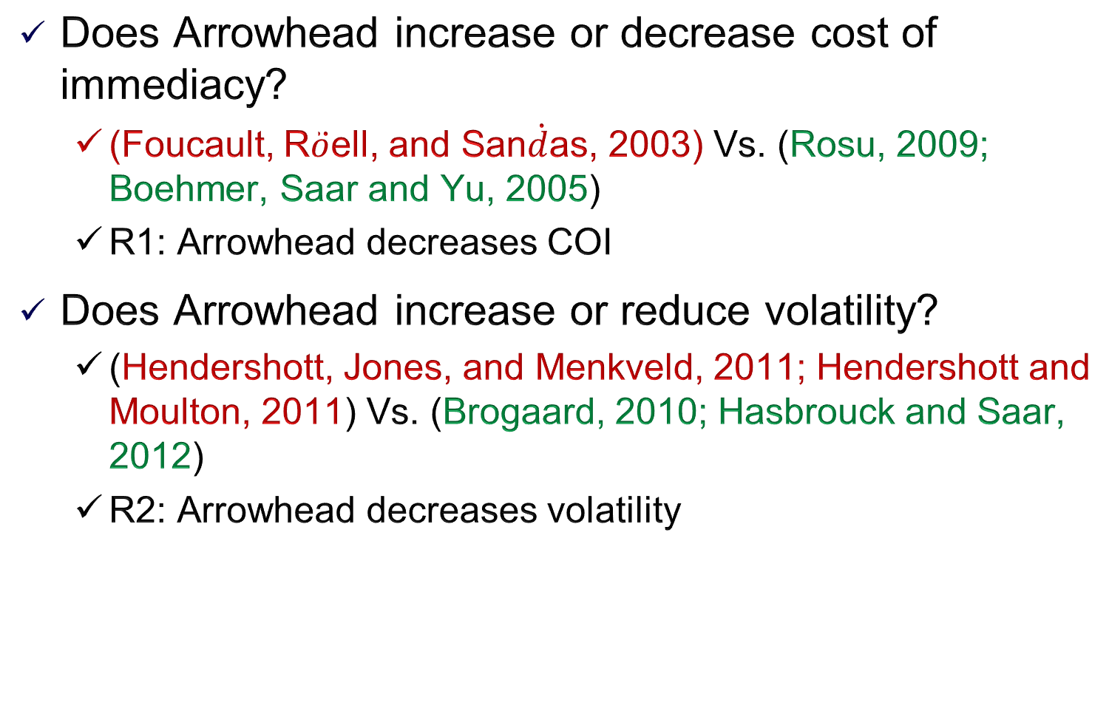
Low Latency Trading and Market Quality
Does Arrowhead increase or decrease cost of immediacy?
(Foucault, R$\ddot{o}$ell, and San$\dot{d}$as, 2003) Vs. (Rosu, 2009; Boehmer, Saar and Yu, 2005)
R1: Arrowhead decreases COI
Does Arrowhead increase or reduce volatility?
(Hendershott, Jones, and Menkveld, 2011; Hendershott and Moulton, 2011) Vs. (Brogaard, 2010; Hasbrouck and Saar, 2012)
R2: Arrowhead decreases volatility
Notes:
Foucault, R$\ddot{o}$ell, and San$\dot{d}$as, 2003: theoretical model show that faster markets can raise adverse selection costs because informed liquidity demanders can more closely monitor the market for any temporary mispricing or stale quotes.
Boehmer, Saar and Yu (2005) suggest that the increased transparency and higher speed of trading can increase the competition among liquidity suppliers at various price points that, in turn, should reduce the cost of immediacy for liquidity demanders.
Hendershott, Jones, and Menkveld (2011) and Hendershott and Moulton (2011) find that HFT increases COI and, thereby, leads to a significant increase in volatility whereas Brogaard (2010) and Hasbrouck and Saar (2011) argue that HFT enables aggressively competitive electronic liquidity provision at a much lower cost than that of traditional market makers and, therefore dampens short-term volatility.

Slide 7
HFT and Microstructure Risk
Systemic risks
CoVaR (Adrian & Brunnermeier, 2011); CoVaQ
Shock Propagation risks
Autocorrelation:
Parlour (1998) Vs. Biais, Hillion, and Spatt (1995)
Cross correlation:
Barker (2006) Vs. Chordia, Roll, & Subhramanyam (2000)
Quote stuffing risks: Quotes-to-trades Ratio
runs in process (Hasbrouck and Saar, 2013), Message traffic (Hendershott, Jones, and Menkveld, 2011)
Notes:
Quotes-to-trade ratio is good if there is true intent to trade, since TSE is not fragmented.
Negative autocorrelation: an order increasing the depth of the LOB is followed by order reducing the depth due to lower cost of trading.
Positive autocorr due to stealth trading
Arrowhead can intensify the order slicing activity leading to increase in autocorr.
Baker and Wurgler: Lower cross corr due to stock specific information generation, leading to trading in individual stocks.
Chordia, Roll, and Subrahmanyam: Liquidity makes it easier to trade baskets of informationally related securities.
Arrowhead should increase cross corr due to increase in program trading. The co-located servers have access to similar information.

Slide 8
Low Latency and Evolution of LOB
Does low latency effect the future evolution of the LOB?
Price Placement
COI’s effect on market quality measures
Rosu’s (2009) theory of Attrition:
Does lower COI in faster markets attract Fleeting orders?
Notes:
market orders (Glosten, 1994; Rock, 1996; Seppi, 1997).
limit orders (Chung, Van Ness, and Van Ness, 1999; Bloomfield, O’Hara, and Saar, 2005; Kaniel and Liu, 2006).
HFT should increase the informativeness of LOB
Write the dictionary meaning of Fleeting Synonyms: brief, deciduous, ephemeral, evanescent, flash,momentary, fugacious, fugitive, impermanent, passing,short-lived, temporary, transient, transitory
Fleeting orders: Traders are hiding like cops, and comes out only when someone is speeding.

Slide 9
Best Quotes
 | Stock 1 |  |  |  |  | Stock 2
Bid Vol | Bid | Ask Vol | Ask |  | Bid Vol | Bid | Ask Vol | Ask
200 | 20 | 200 | 21 |  | 200 | 20 | 200 | 21
100 | 18 | 100 | 24 |  | 900 | 19 | 900 | 22
100 | 15 | 100 | 26 |  | 900 | 18 | 900 | 23
200 | 12 | 200 | 29 |  | 800 | 17 | 800 | 24
1200 | 10 | 1200 | 31 |  | 600 | 16 | 600 | 25
Avg. Daily 1,000,000 1,000,000
Volume:
Both stocks are equally liquid?
Traditional Liquidity Measures:
Bid-Ask Spread
Depth
Volume

Slide 10
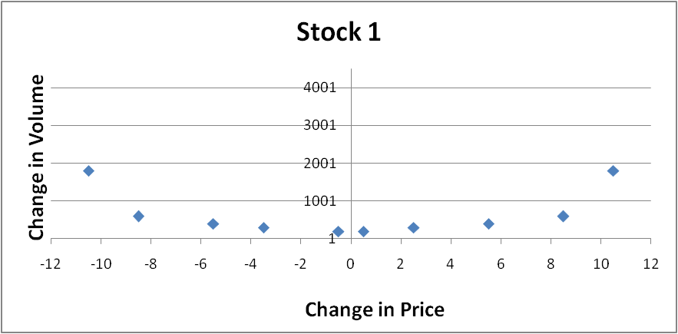
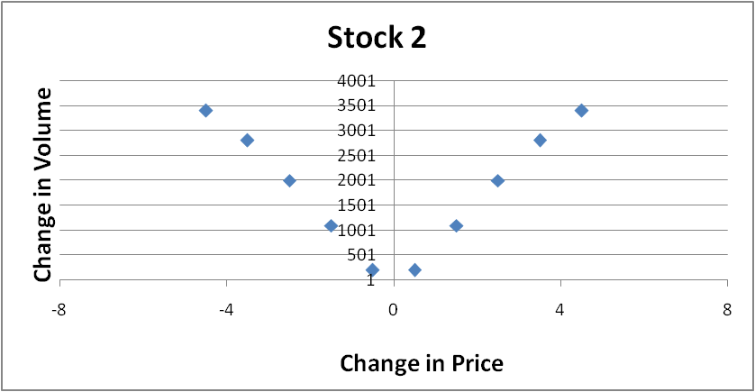
Complete Limit Order Book
 | Stock 1 |  |  |  |  | Stock 2
Bid Vol | Bid | Ask Vol | Ask |  | Bid Vol | Bid | Ask Vol | Ask
200 | 20 | 200 | 21 |  | 200 | 20 | 200 | 21
100 | 18 | 100 | 24 |  | 900 | 19 | 900 | 22
100 | 15 | 100 | 26 |  | 900 | 18 | 900 | 23
200 | 12 | 200 | 29 |  | 800 | 17 | 800 | 24
1200 | 10 | 1200 | 31 |  | 600 | 16 | 600 | 25
To Buy 0.1% of average daily volume =1000 shares:
For Stock 1, the order will have to walk up all the 5 steps
For Stock 2, the order will have to walk up only 2 steps

Slide 11


Liquidity Measures
Limit Order Book Slope:
(Naes & Skjeltorp, 2006)
LOB Cost of Immediacy:
(Benston, Irvine, and
Kandel,2002)
Traditional Measures: Proportionate Spreads, Depth, Number of Trades, Average Trade Size.
Advanced measures: Quotes-to-trade ratio (Hasbrouck and Saar, 2012; Hendershott, Jones, and Menkveld, 2011)

Slide 12
DATA
150 TSE first section firms before & after Arrowhead
June 2008 pre-crisis, January 2009, and January 2011.
50 large-, 50 mid-, and 50 small-cap TOPIX firms
Source: Nikkei Digital Media Inc.’s Nikkei Economic Electronic Database Systems (NEEDS)
Limit Order Book Data: info. on each order and trade, date and time, stock code, order/trade price, order/trade volume, 5 best bid and ask quotes and sizes (Sample).
Intraday analysis: Data aggregated at 1 minute frequency.
Notes:
Nikkei Digital Media Inc.’s Nikkei Economic Electronic Database Systems (NEEDS) database. Add an external link to sample data in excel. Test in the classroom.

Slide 13
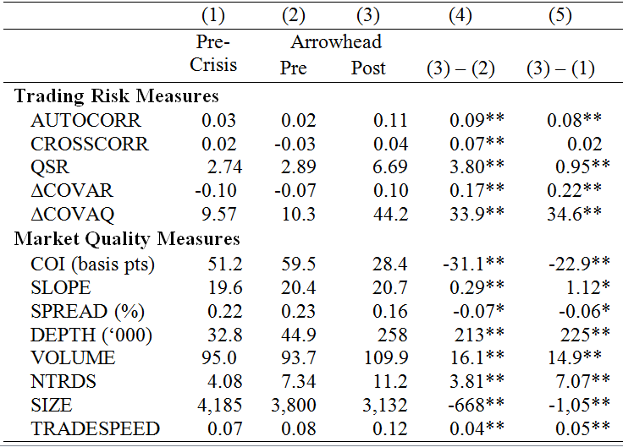

Slide 14
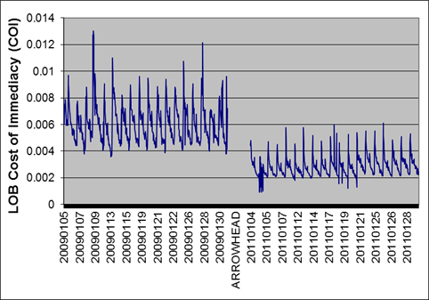
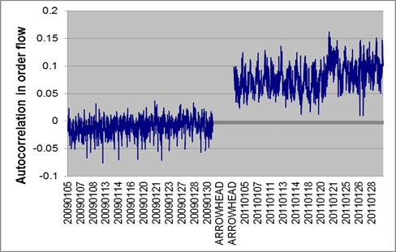
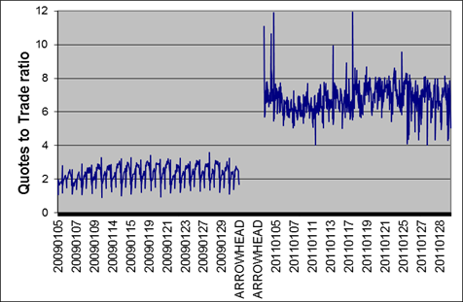
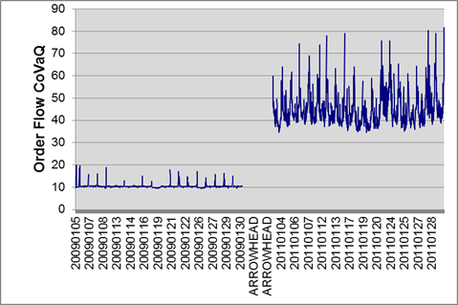
Notes:
W-shaped for the Japanese markets instead of U-shape for US markets
People wait to know the price before the true price is revealed

Slide 15
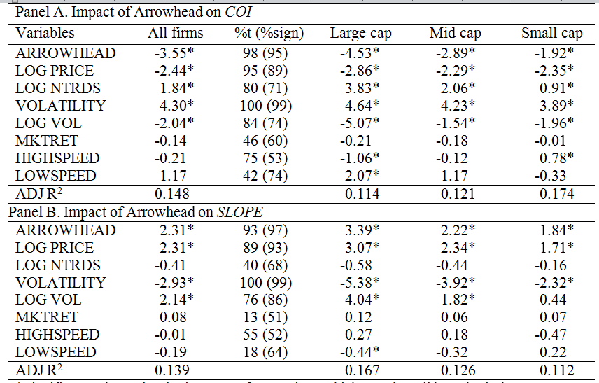

Slide 16
Cross-correlation
Lower cross correlation during highly liquid markets (Baker and Wurgler, 2006).
Higher Cross correlation (Chordia, Roll, and Subrahmanyam, 2000; Hasbrouck and Seppi, 2001)
H1:Low Latency increases Cross-correlation due to increase in program trading
Notes:
Baker and Wurgler: Lower cross corr due to stock specific information generation, leading to trading in individual stocks.
Chordia, Roll, and Subrahmanyam: Liquidity makes it easier to trade baskets of informationally related securities.
Arrowhead should increase cross corr due to increase in program trading. The co-located servers have access to similar information.

Slide 17
LOB COI Predicts future Cross Correlation
CROSSCORR_{i,t+1} = α_{i} + β_{1i}COI_{i,t} + β_{2i}SLOPE_{i,t} + β_{3i} NTRDS_{i,t} + β_{4i} ATS_{i,t} + β_{5i} SPREAD_{i,t} + β_{6i} DEPTH_{i,t} +β_{7i} TRADING SPEED_{i,t} +β_{8i} VOLATILITY_{i,t} +β_{9i} RETURN_{i,t} +β_{10i} ARROWHEAD_{i,t} +β_{11i} MKTRET_{i,t} +β_{12i} ARROWHEAD_{i,t}*COI_{i,t} +β_{13i} ARROWHEAD_{i,t}*SLOPE_{it} +µ_{i,t+1}
Variables | (β) | %t (%sign)
ARROWHEAD | 0.91* | 64 (79)
COI | 0.41* | 72 (65)
SLOPE | -0.22* | 50 (62)
ARROW*COI | 0.38 | 18 (71)
ARROW*SLOPE | -0.14 | 28 (66)
ARROWHEAD increased Cross correlation
The higher the COI, the higher is the Cross correlation

Slide 18
LOB COI Predicts the future Quotes-to-trade ratio
QUOTES-TO-TRADE RATIO_{i,t+1} = α_{i} + β_{1i} COI_{i,t}+ β_{2i} SLOPE_{i,t}+ β_{3i} MONDAY_{t+1}+β_{4i} NTRDS_{i,t}+β_{5i} ATS_{i,t}+β_{6i} SPREAD_{i,t}+β_{7i} DEPTH_{i,t}+ β_{8i}VOLATILITY_{i,t} +β_{9i}MKTRET_{i,t} +β_{10i}ARROWHEAD_{i,t} +β_{11i}ARROWHEAD_{i,t}*COI_{i,t} +β_{12i}ARROWHEAD_{i,t}*SLOPE_{it} +µ_{i,t+1}
Variables | (β) | %t (%sign)
ARROWHEAD | 2.59* | 88 (97)
COI | -1.31* | 64 (72)
SLOPE | 2.03* | 79 (92)
ARROW*COI | -1.54* | 81 (88)
ARROW*SLOPE | 2.33* | 83 (96)
ARROWHEAD increased Quote-to-trade ratio; strengthens COI =>Quotes-to-trade ratio relation.
Higher COI => Lower Quotes-to-trade ratio

Slide 19
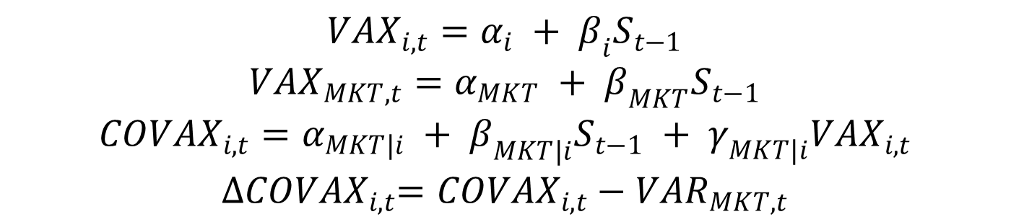
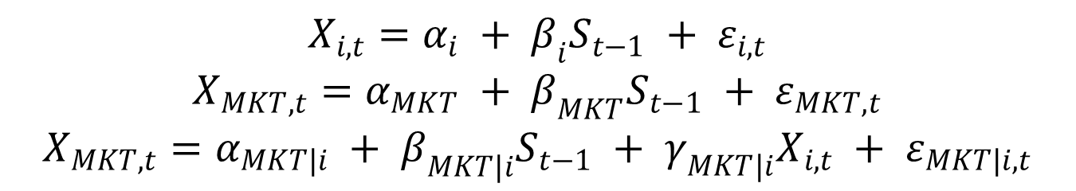
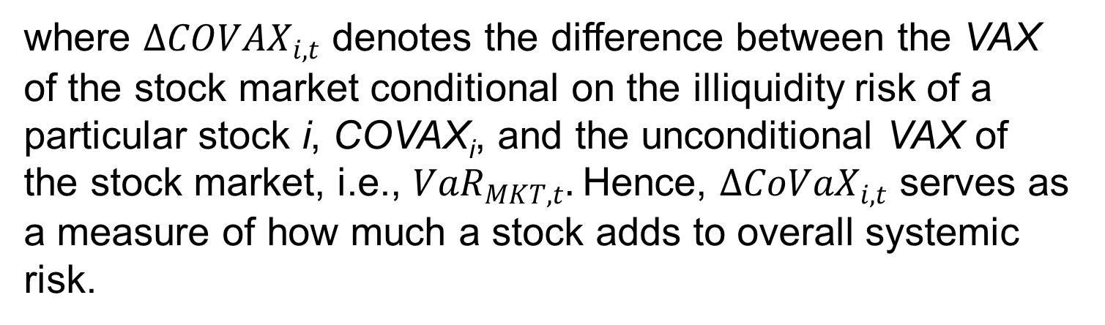
$$X_{i,t}=α_{i} + β_{i}S_{t−1} + ε_{i,t}$$
$$X_{MKT,t}=α_{MKT} + β_{MKT}S_{t−1} + ε_{MKT,t}$$
$$X_{MKT,t}=α_{MKT|i} + β_{MKT|i}S_{t−1} + γ_{MKT|i}X_{i,t} + ε_{MKT|i,t}$$
$${VAX}_{i,t}=α_{i} + β_{i}S_{t−1}$$
$${VAX}_{MKT,t}=α_{MKT} + β_{MKT}S_{t−1}$$
$${COVAX}_{i,t}=α_{MKT|i} + β_{MKT|i}S_{t−1} + γ_{MKT|i}{VAX}_{i,t}$$
$${∆COVAX}_{i,t}={COVAX}_{i,t}−{VAR}_{MKT,t}$$
where ${∆COVAX}_{i,t}$ denotes the difference between the VAX of the stock market conditional on the illiquidity risk of a particular stock i, COVAX_{i}, and the unconditional VAX of the stock market, i.e., ${VaR}_{MKT,t}.$Hence, ${∆CoVaX}_{i,t}$ serves as a measure of how much a stock adds to overall systemic risk.

Slide 20
LOB COI Predicts the future CoVaQ
X_{i,t + 1} = α_{i} + β_{0i} ARROWHEAD_{i,t} + β_{1i}COI_{i,t} + β_{2i}SLOPE_{i,t} + β_{3i} NTRDS_{i,t} + β_{4i} ATS_{i,t} + β_{5i} SPREAD_{i,t} + β_{6i} DEPTH_{i,t} + β_{7i}VOLATILITY_{i,t} + β_{8i}RETURN_{i,t} + β_{9i} HIGHSPEED_{i,t} + β_{10i} LOWSPEED_{i,t} + β_{11i} ARROWHEAD_{i,t}*COI_{i,t} + β_{12i} ARROWHEAD_{i,t}*SLOPE_{it} + µ_{i,t + 1}
Variables | (β) | %t (%sign)
ARROWHEAD | 1.21* | 77(88)
COI | 1.08* | 85(81)
SLOPE | -0.36 | 48(71)
ARROW*COI | 1.96* | 82(88)
ARROW*SLOPE | -1.18* | 66(78)
ARROWHEAD increased CoVaQ

Slide 21


Fleeting orders
Rosu (2009): when the LOB is full, traders play a “game of attrition”
H1: Low Latency facilitates fleeting orders.
Bid Vol | Bid | Ask Vol | Ask
200 | 20 | 200 | 21
900 | 19 | 900 | 22
900 | 18 | 900 | 23
800 | 17 | 800 | 24
600 | 16 | 600 | 25
Buy@20.5
Sell@20.5
Notes:
Add animation for new order arrival at 20.5

Slide 22
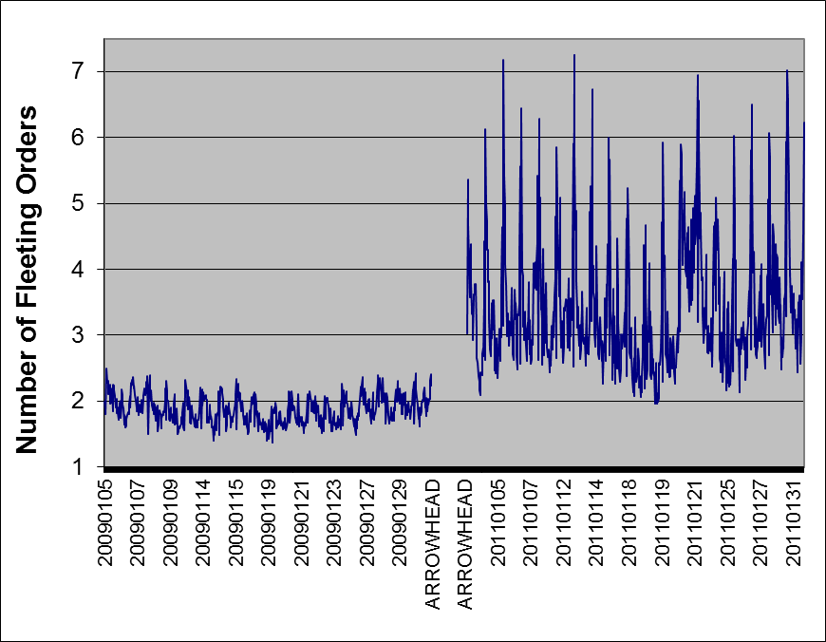

Slide 23
LOB COI Predicts the fleeting orders
FLEET_{i,t+1} = α_{i} + β_{1i}COI_{i,t} + β_{2i}SLOPE_{i,t} + β_{3i} NTRDS_{i,t} + β_{4i} ATS_{i,t} + β_{5i} SPREAD_{i,t} + β_{6i} DEPTH_{i,t} +β_{7i} TRADING SPEED_{i,t} +β_{8i} VOLATILITY_{i,t} +β_{9i} RETURN_{i,t} +β_{10i} ARROWHEAD_{i,t} +β_{11i} MKTRET_{i,t} +β_{12i} ARROWHEAD_{i,t}*COI_{i,t} +β_{13i} ARROWHEAD_{i,t}*SLOPE_{it} +µ_{i,t+1}
Variables | (β) | %t (%sign)
ARROWHEAD | 1.74* | 89(91)
COI | -1.19* | 68(79)
SLOPE | 1.85* | 93(85)
ARROW*COI | -0.62* | 53(69)
ARROW*SLOPE | 0.89* | 79(80)
Higher COI discourages fleeting orders
ARROWHEAD increased the frequency of fleeting orders; strengthened COI => fleeting orders relation.

Slide 24
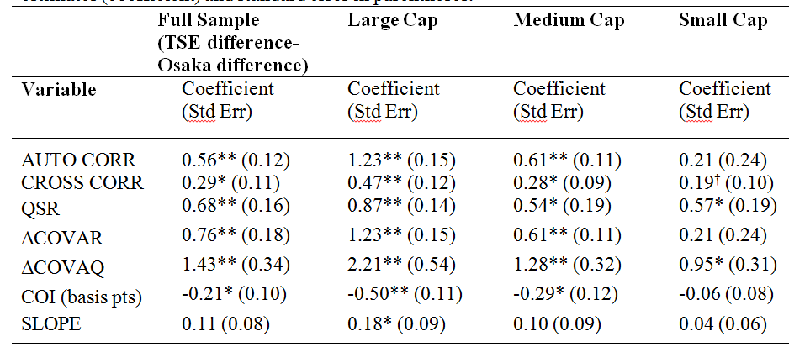

Slide 25
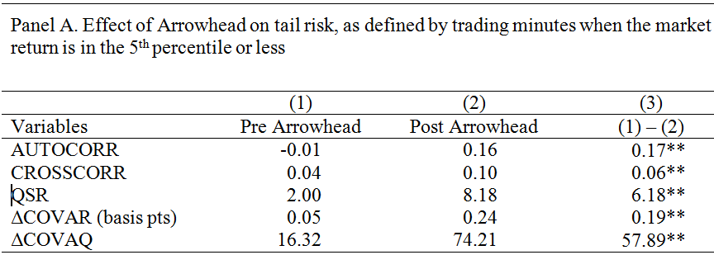

Slide 26
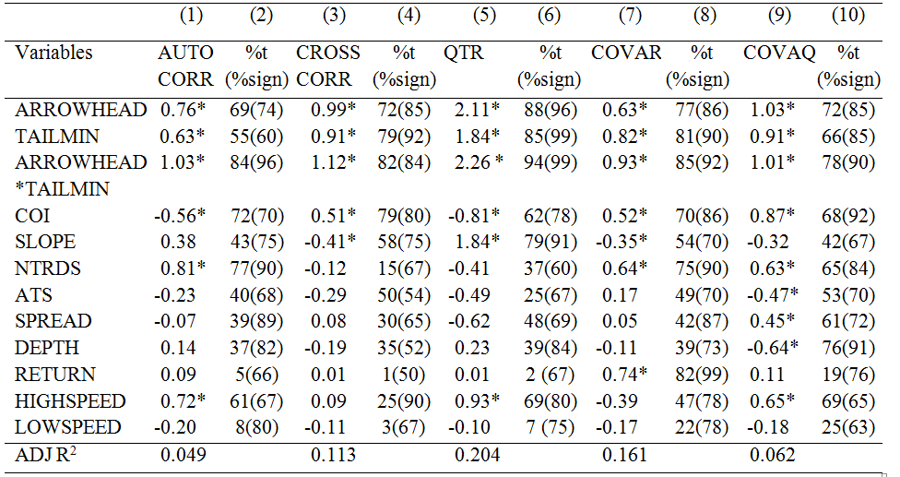

Slide 27
Robustness Tests
Alternate sample selection:
MTU of 1,000
Drop special quotes
Time dummies for intraday seasonality
Analyses based on 5 minutes, 10 minutes and 30 minutes snapshot of LOB

Slide 28
Conclusions
Low-latency affects market quality:
Reduced COI and volatility; Increased #of trades
Increased Quotes-to-trade ratio, autocorrelation & cross correlation, CoVaR and CoVaQ
Arrowhead increased the probability of systemic crash, especially during tail events.
Notes:
Autocorr: Spiral and Cross corr: cascade effects and systemic risk

