Slide 1
The Value of a Millisecond Chen, Foley, Goldstein and Ruf
A Discussion
Venky Panchapagesan
IIM Bangalore
December 2016
Notes:
Bring out my Canada connection from dissertation

Slide 2
Key Contribution
Important to assess regulatory interventions using data
Difficult to do well controlled assessments because of overlapping issues
Difficult to assess identify and quantify externalities
Authors make a very good attempt to do both with great data and creative methodology
Clubbing trades to create trade chains to overcome timestamp issues
Comparing with CX2 to tease out effects of speed bump keeping inverted pricing model constant
Notes:
Most interventions are tradeoffs anyway…so there is bound to be some negative consequences
Regulatory actions are like a game…industry moves first, regulators move second, industry moves again….

Slide 3
Overall Assessment
Creating discriminatory speed bumps favors one set of traders over others
Significant externality effects on other markets that don’t follow
Difficult to justify continuing such interventions

Slide 4
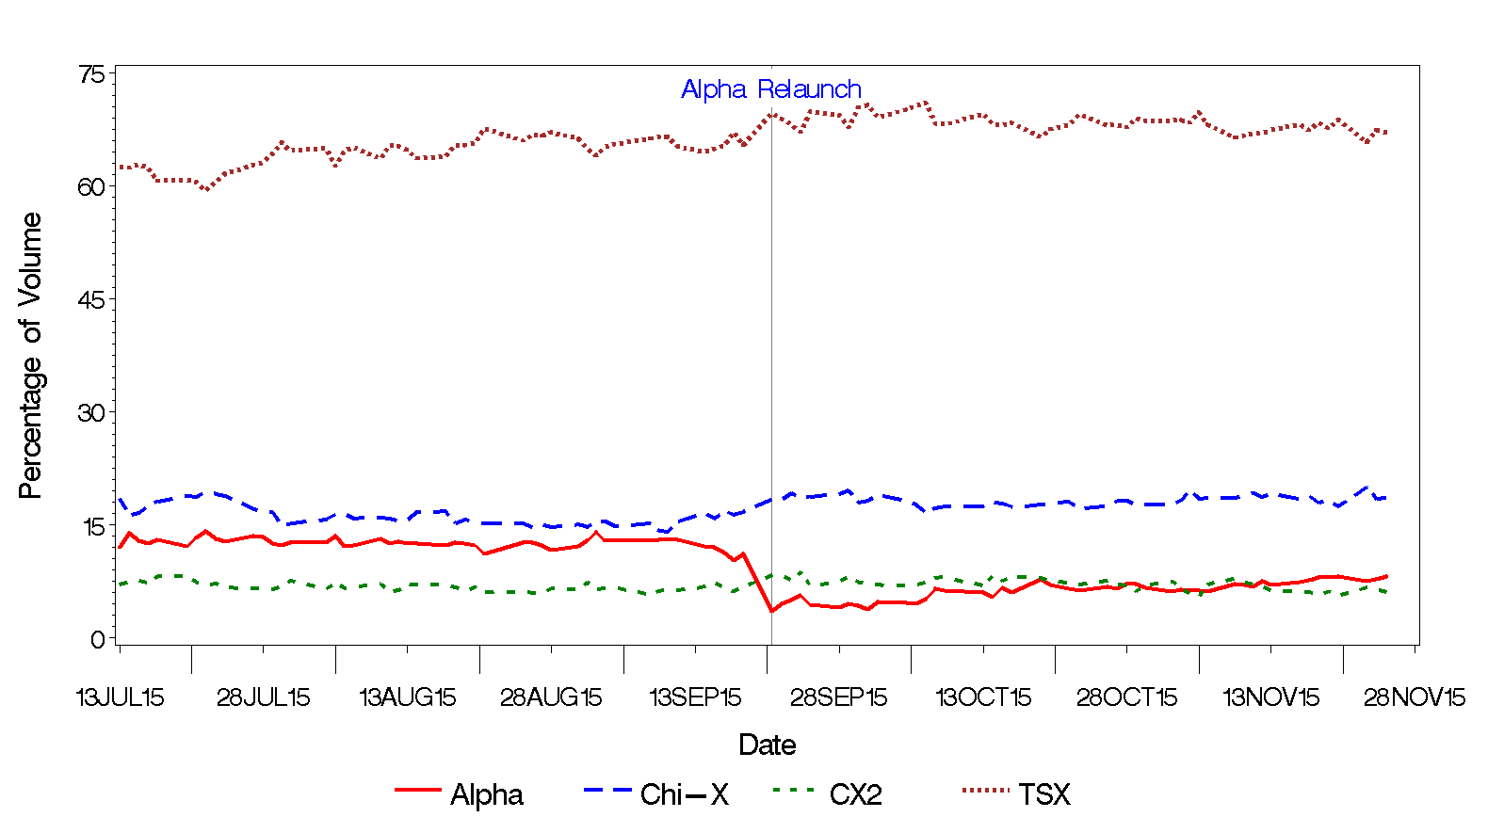
Big Picture – Market Share
Notes:
Alpha is a tiny market; TSX sees no blip in market share
Also no major change in effective spreads in other markets (Table 2)

Slide 5
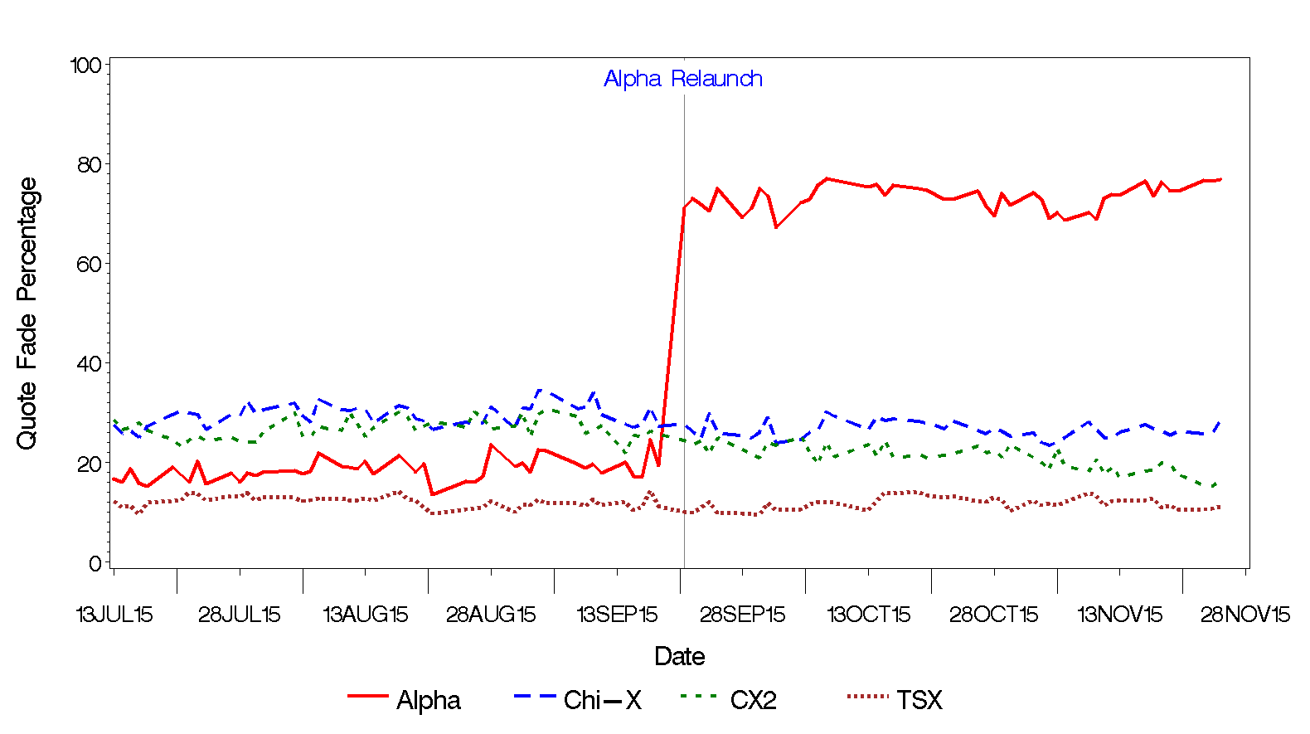
Big Picture – Quote Fade
Notes:
Alpha is a tiny market; TSX sees no blip in market share

Slide 6
A Diligent Investor’s Perspective
Diligent investor → one who delegates trading decision to brokers but monitors their performance; so investor-broker incentives are likely to be aligned
Pre-change:
All markets provide price protection; so I use SOR to sweep market
Majority of my trades get done in TSX
I will seek to avoid markets where pinging is prevalent (pinging > dark venues, cancellation fees are low etc.)
Post-change:
I find Alpha less attractive
No price protection
Random speed delay for market/marketable orders
I disconnect Alpha from my SOR algorithm
Maker/Taker pricing model does not matter much because I negotiate my commission rates accordingly (large investors estimate maker/taker fees earned by brokers by using execution data)
Notes:
Abstracting from large and small investors etc…

Slide 7
A Non-Diligent Investor’s Perspective
Non-diligent investor → one who delegates trading decision to brokers but does not monitor their performance; so investor-broker incentives are less likely to be aligned
Pre-change:
All markets provide price protection; so I use SOR to sweep market for my client orders
Majority of my client trades get done in TSX
Will seek to preference markets where I get additional fees that I don’t need to pass on to clients (without breaking my fiduciary responsibility)
Post-change:
I find Alpha greatly attractive
Harder to establish fiduciary responsibility as there is no price protection
Can afford to absorb speed delay for my marketable orders
I use Alpha as my starting destination
Maker/Taker pricing model matters much because I earn fees that I do not have to pass on to clients

Slide 8
A HFT Investor’s Perspective
Pre-change:
All markets provide price protection; so I don’t worry where I post
Majority of my trades get done in TSX
Will seek to preference markets where I get faster access and lower costs
Post-change:
I find Alpha greatly attractive
Greater chance of interacting with stale orders waiting in the queue
Likely to compete by posting orders aggressively at the last instant only under favorable conditions
Other times I don’t post aggressively
I use Alpha as my selective destination
Maker/Taker pricing model matters much because I need to trade off maker fees against posting orders to avoid speed bumps.
Notes:
Instant → minute used in language (no longer relevant)

Slide 9
Open Questions
Will Alpha survive in the long run?
Who is sending market/marketable orders to Alpha post-change?
Brokers controlling retail order flow?
Why?
What happens to the fiduciary responsibility of brokers when price protection is not guaranteed in one market?
Should speed bumps be mandated by regulators for all markets as opposed to having markets compete?
Should regulators intervene to protect retail investors?

Slide 10
Other Comments
Interpretation
Increase in quote fading since posting orders are not subject to speed delay
Trade strings are computed by clubbing trades within 30 ms. But speed delay is only for 1-3 ms.
Quote fading to avoid institutional SOR sprays
SOR is less likely to use Alpha in the mix
Informed trading definition
Market resiliency is affected by speed bump rule; so quotes are more likely to stay moved after a trade
Empirics that were missed out
More price improving orders post-change
Time between posting and trading should have come down for limit orders post-change
Use of 1-min volatility measures (about 2000 trade strings)
Were these Canadian shares traded in the US markets as well as ordinaries?

