Slide 1
IGIDR Emerging Markets Finance Conference
Financial Regulation: The Long View
Michael S. Barr
Roy F. and Jean Humphrey Proffitt Professor of Law
University of Michigan Law School
Faculty Director, Center on Finance, Law, and Policy
December 2016

Slide 2
Five Things We Don’t Know
What we once knew but have now forgotten
What is knowable but is kept hidden
What we know, but don’t know what it means
What we don’t know that we don’t know
What we should do about things we know

Slide 3
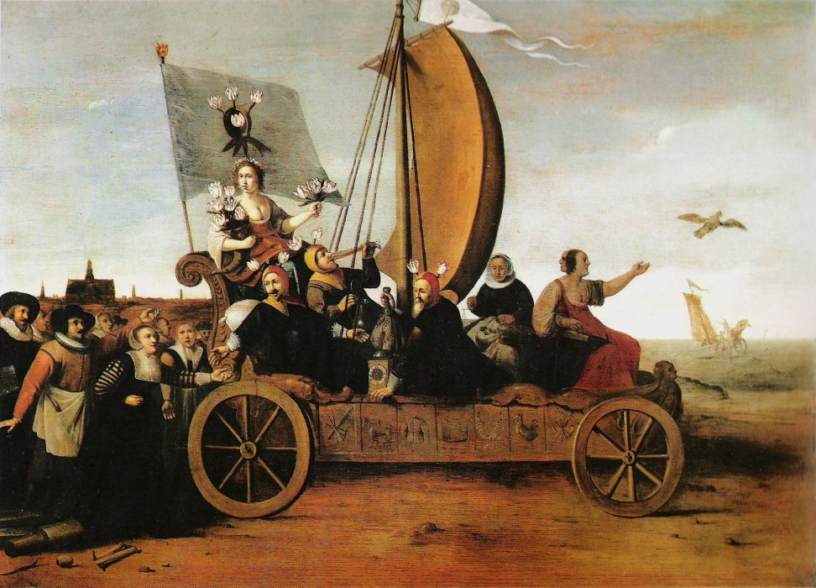

Slide 4
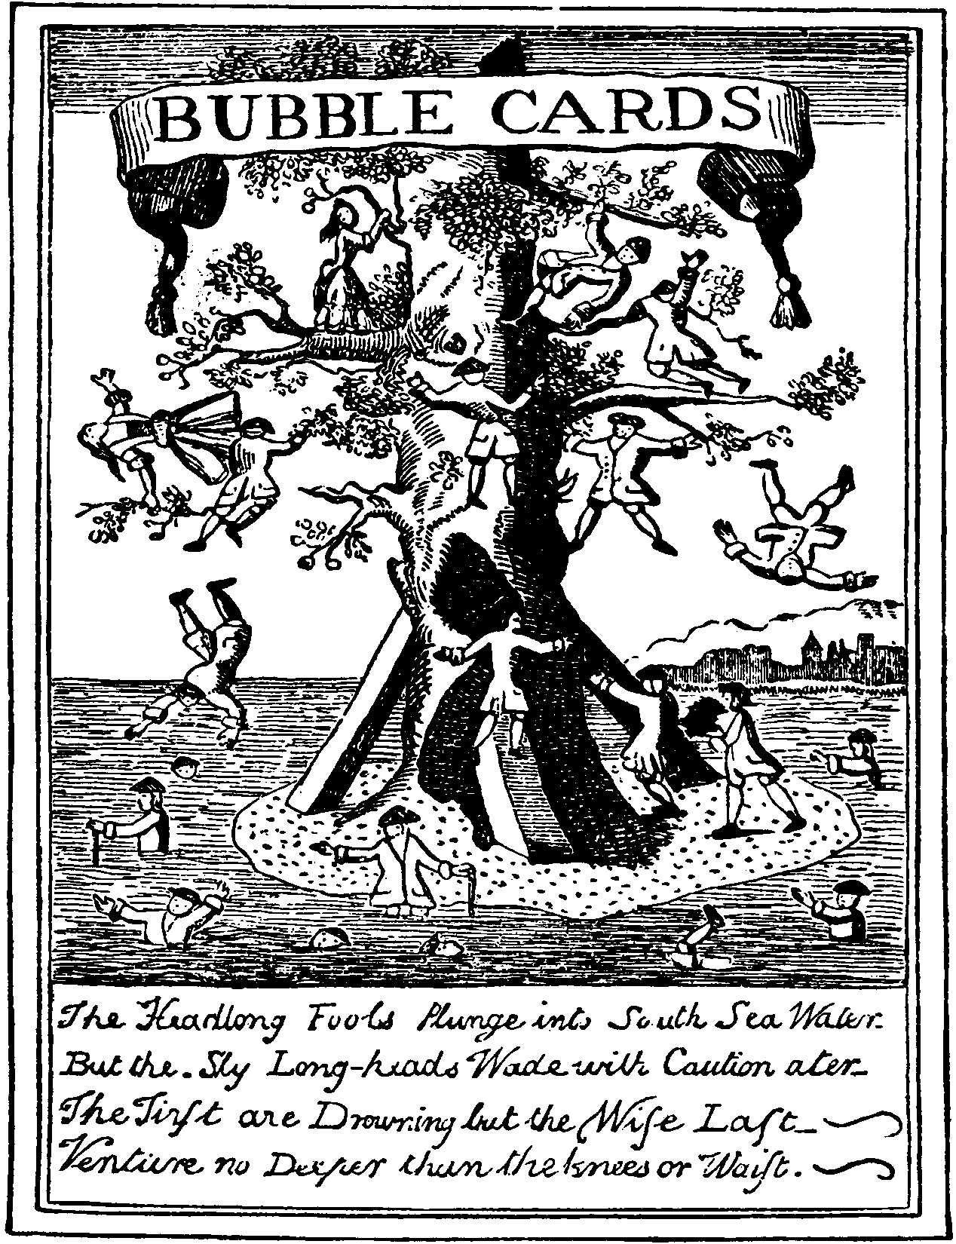

Slide 5
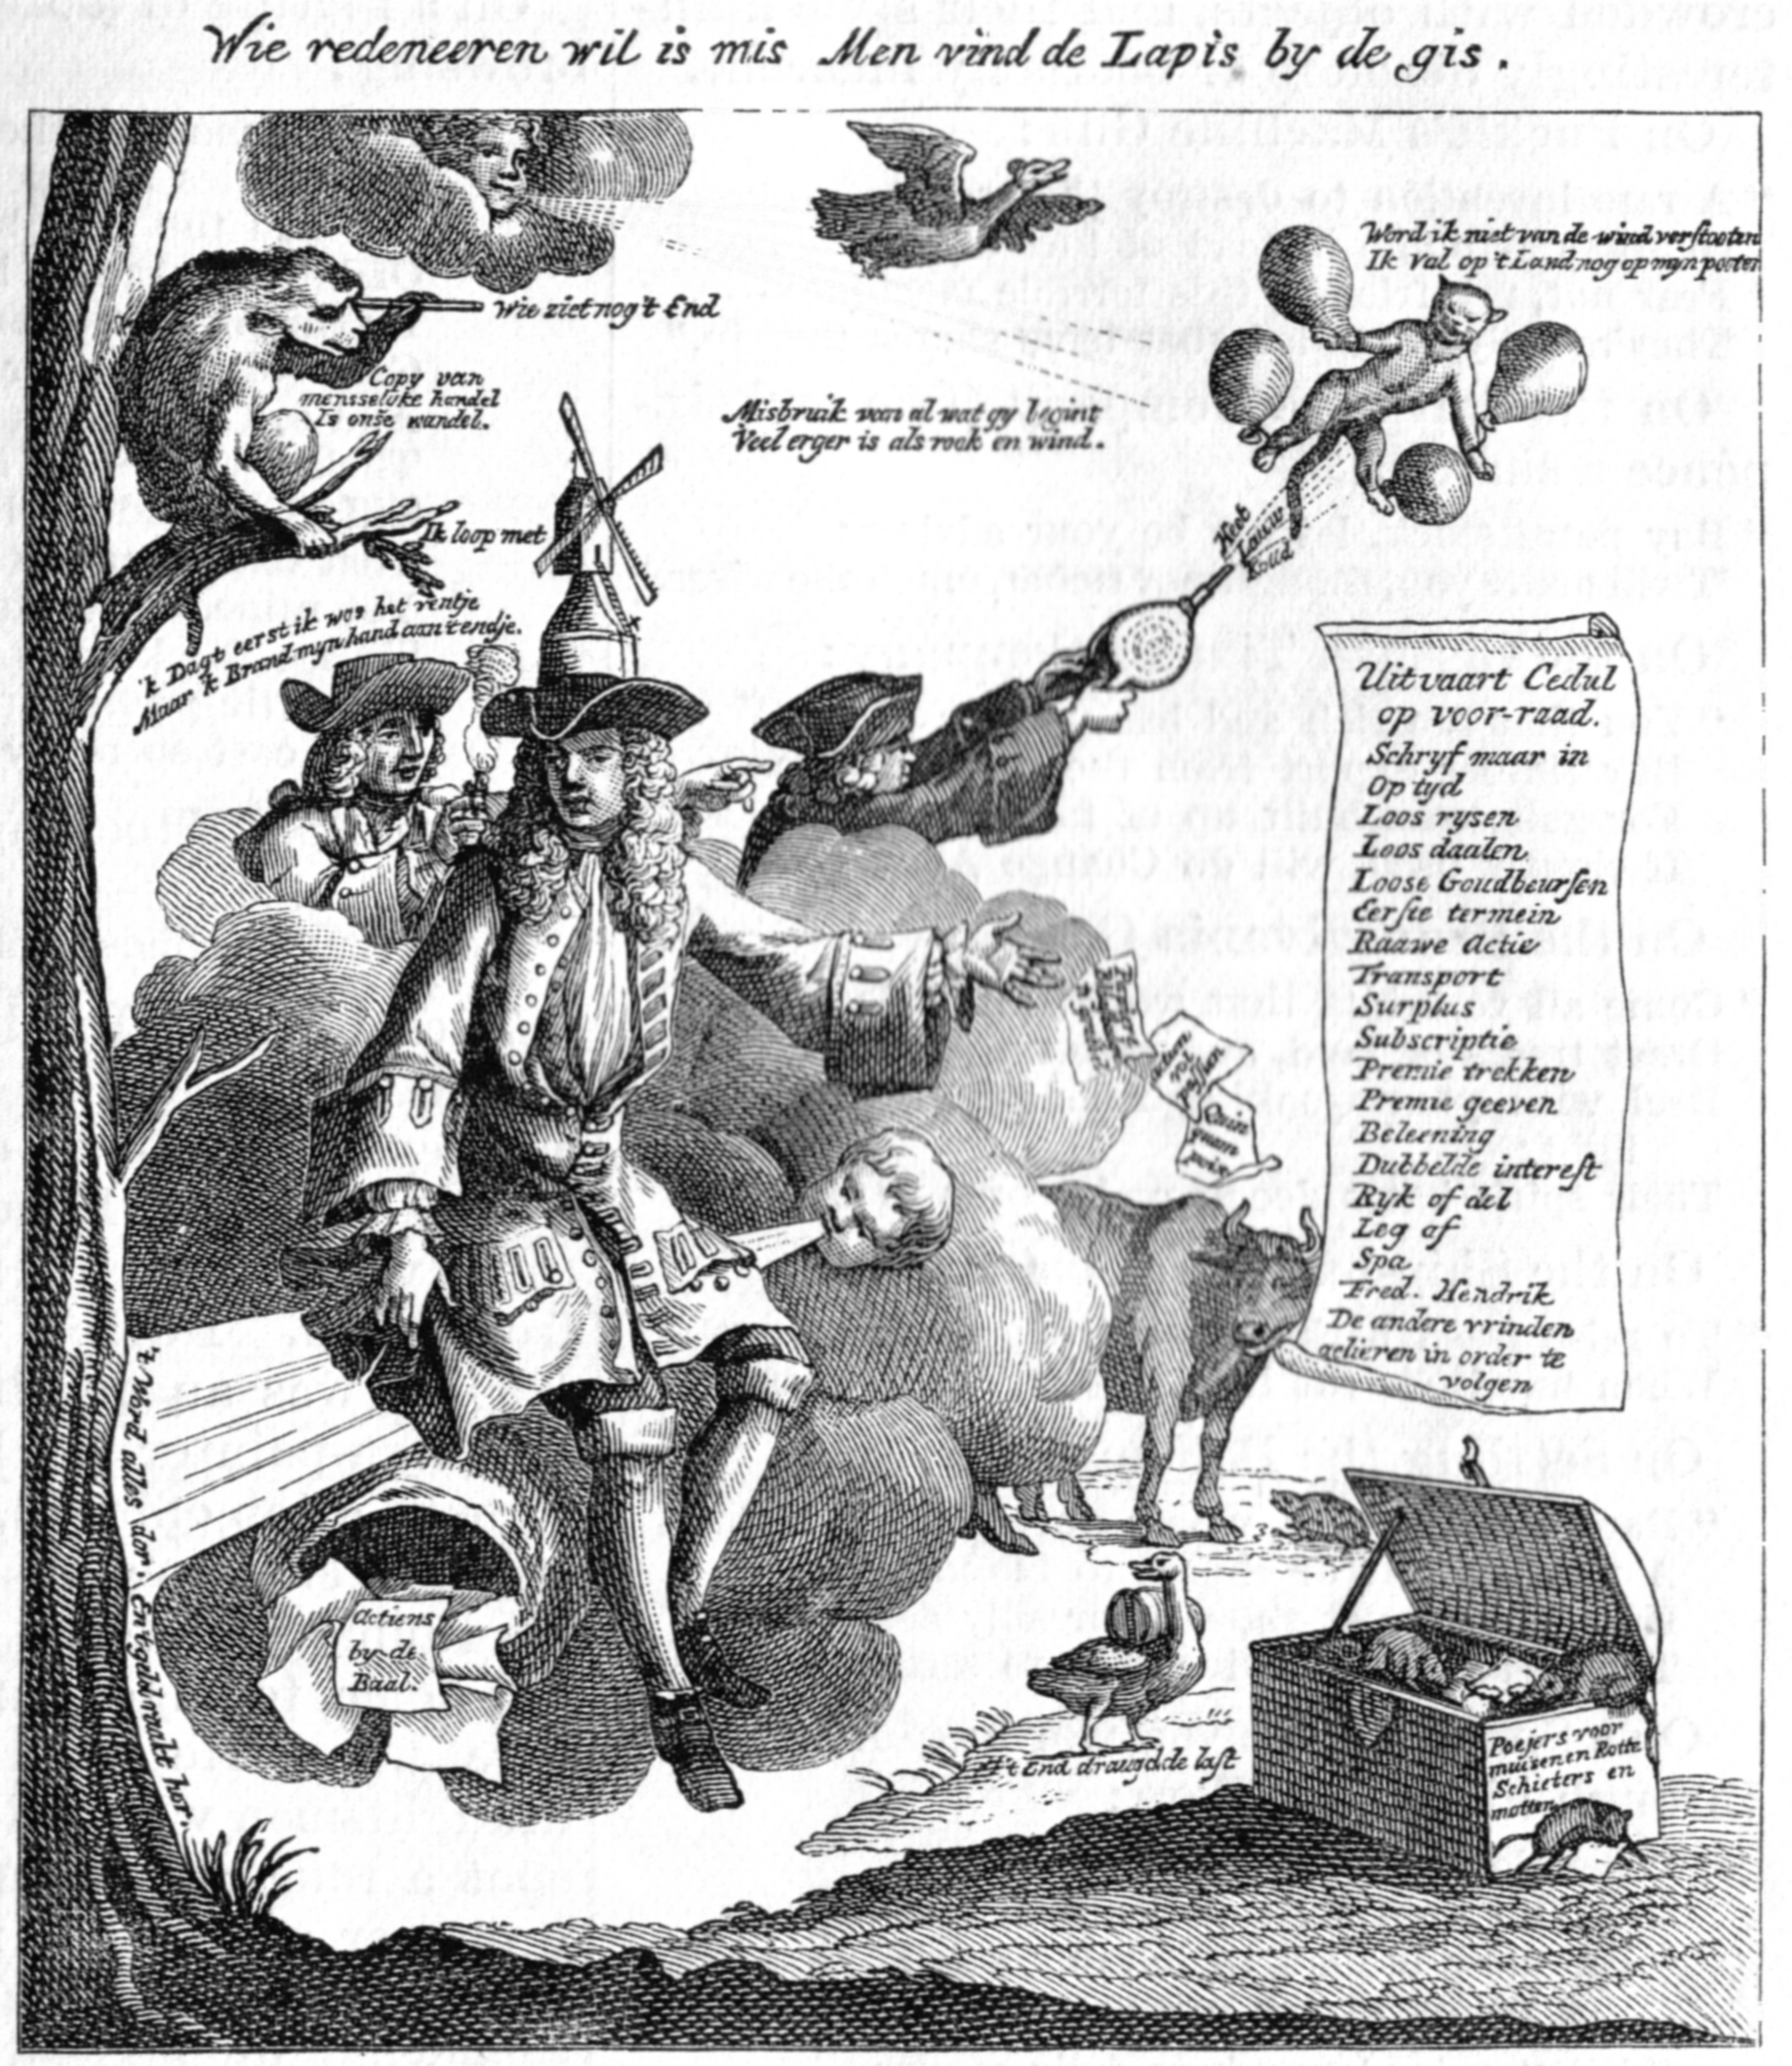

Slide 6
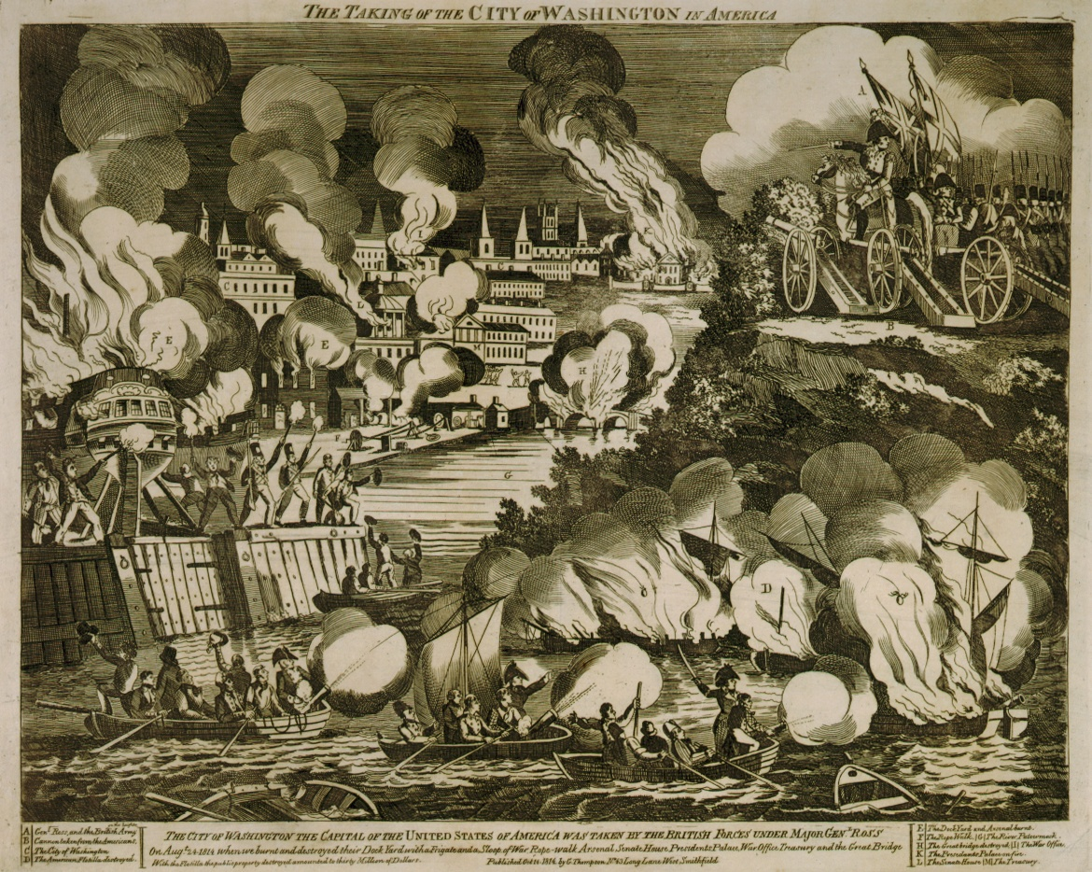

Slide 7
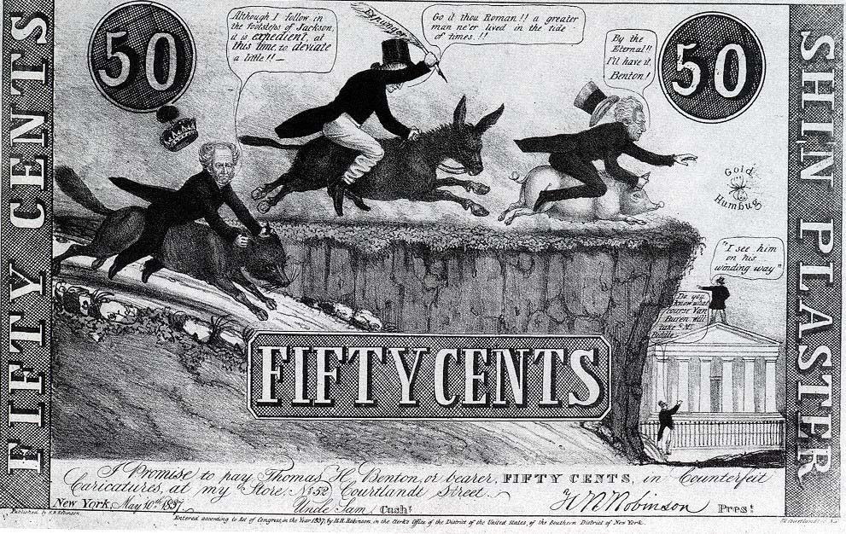

Slide 8
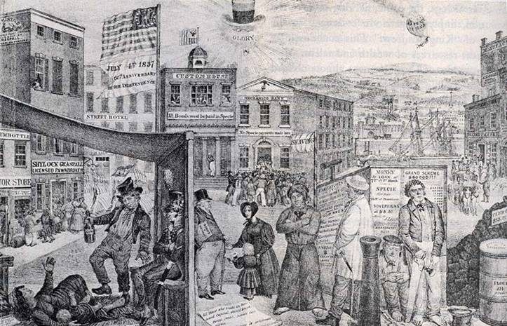

Slide 9
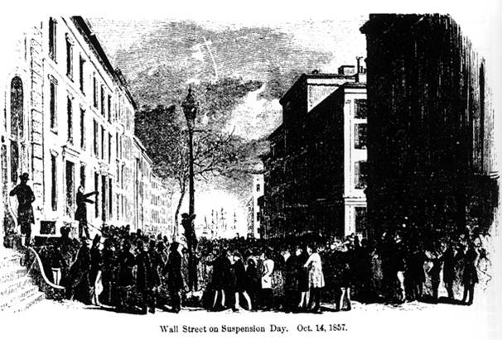

Slide 10
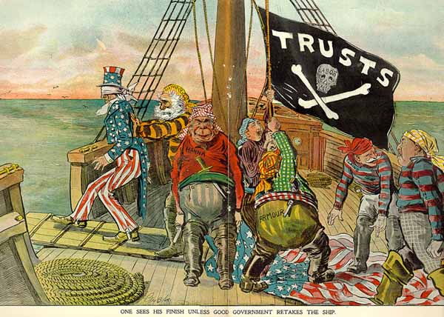

Slide 11
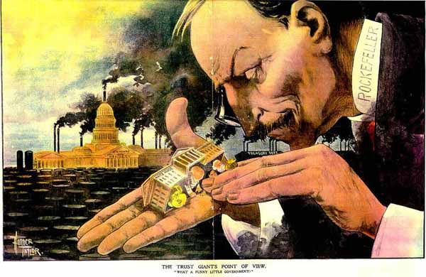

Slide 12
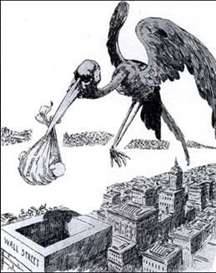

Slide 13
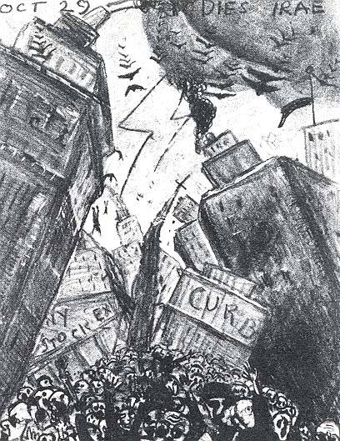

Slide 14
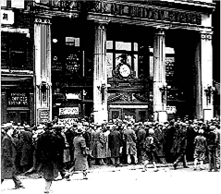

Slide 15
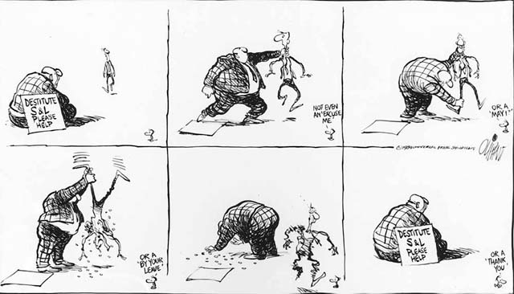
Copyright 1989 by Pat Oliphant

Slide 16
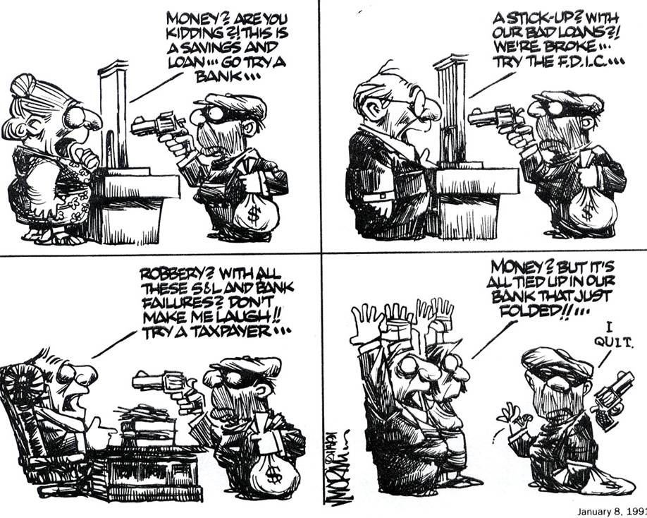

Slide 17
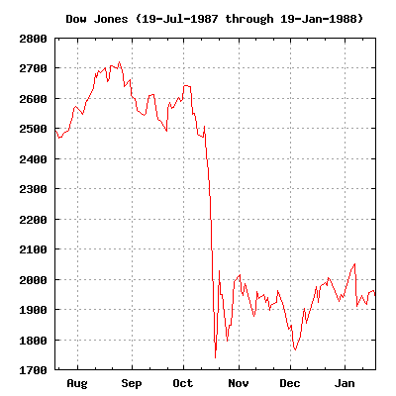

Slide 18
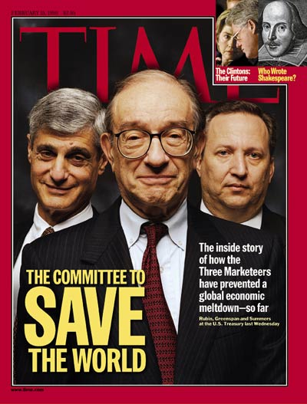

Slide 19


Slide 20


Slide 21


Slide 22


Slide 23
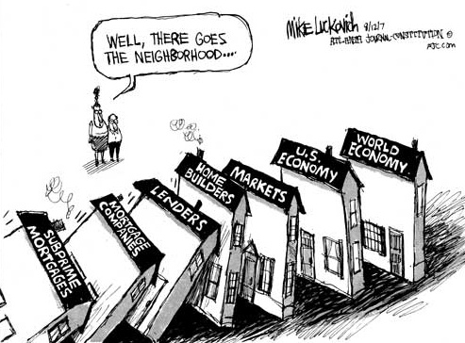
http://www.gonzotimes.com/wp-content/uploads/2012/08/economy1.jpg

Slide 24
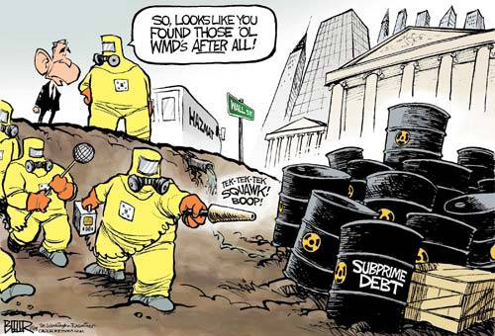

Slide 25
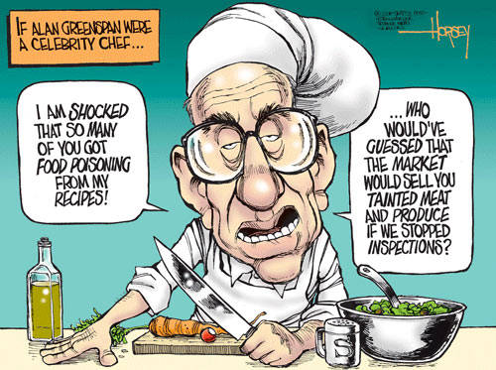

Slide 26
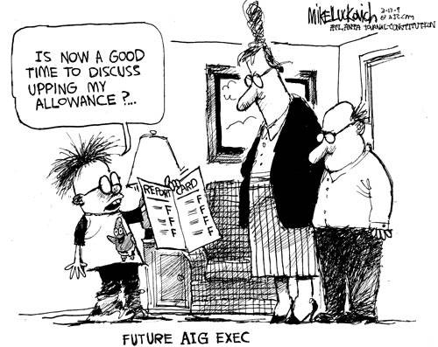

Slide 27
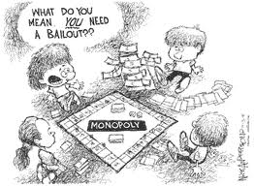

Slide 28
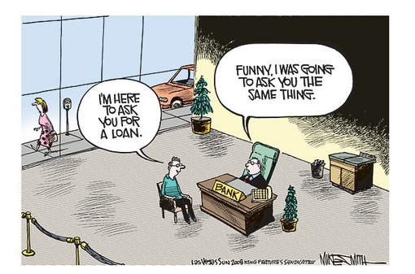

Slide 29
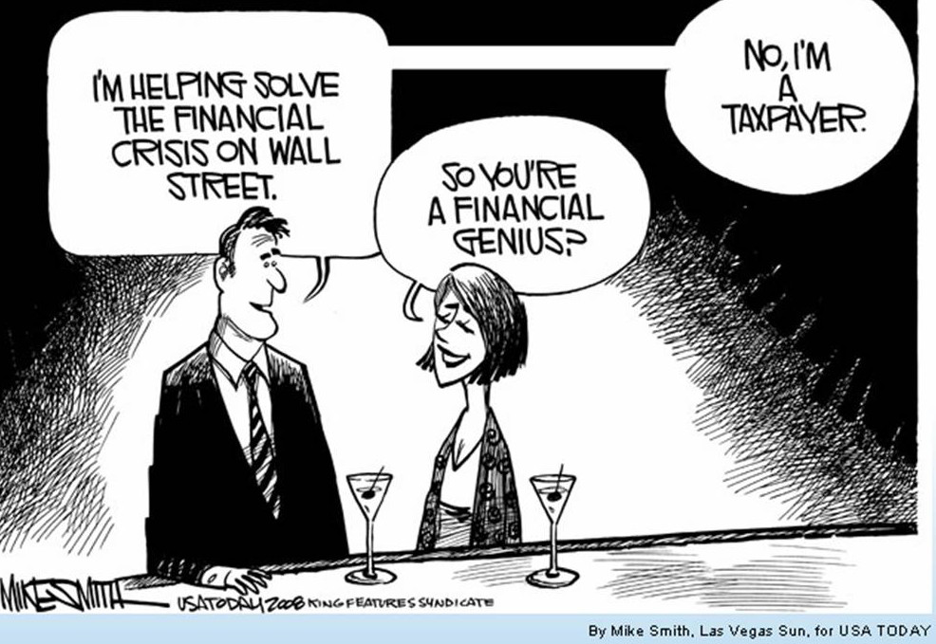

Slide 30
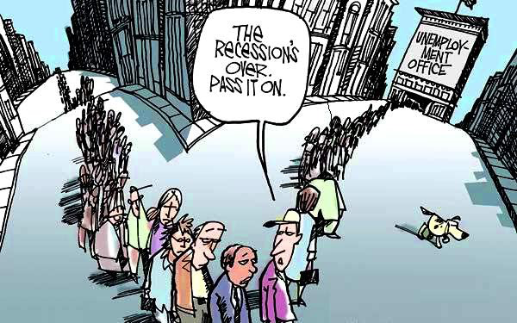

Slide 31
The Financial Crisis of 2007-2009
Asset implosion
Cascades & contagion
Liquidity crunch
Underlying problems
Short-term financing
Excessive leverage
Risk concentration
Shadow banking & regulatory arbitrage
Lack of transparency & conflicts of interest
Weak consumer & investor protection
Inadequate regulation & supervision

Slide 32
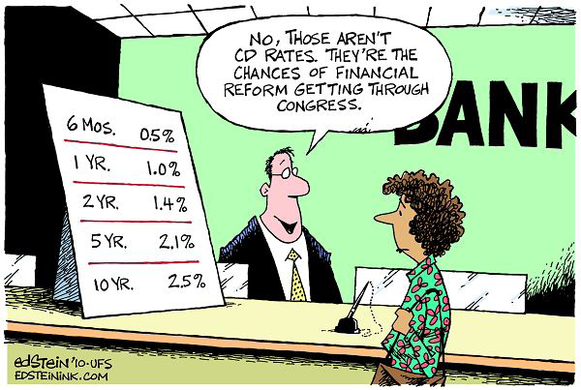

Slide 33
US Dodd-Frank Act
Consolidated supervision
FSOC, OFR, FIO
SIFIs—banks and shadow banks
Holding company reform, counterparty credit limits
Structural reform
Volcker Rule
Size limits
Ending Too Big to Fail
Living Wills
Orderly Liquidation
SIFI surcharge, deposit insurance assessments.

Slide 34
US Dodd-Frank Act
Derivatives
Exchange trading
Central clearing
Margin
Dealer/MSP regulation
Reporting
Payments, settlement & clearance regulation
Repo, wholesale short-term funding
Financial market utilities
Securitization
Transparency
Risk Retention (and Qualified Residential Mortgages)
Rating Agencies

Slide 35
US Dodd-Frank Act
Consumer Financial Protection Bureau
Market-wide coverage, level playing field
Supervision, enforcement, rule-writing
Unfair, abusive, deceptive acts and practices
Mortgage reform
YSP, steering, unfair practices
Ability to pay (and Qualified Mortgages)
Arbitration
Investor protection
Conflicts of Interest
Fiduciary duty
Arbitration

Slide 36
Let’s take a step back…

Slide 37
Financial Stability
Theory
Risk data
Risk analytics
Risk management (structure, incentives, supervision, etc.)
Authority & will to act

Slide 38
Analytics
Metrics
Counter-factual
Matrix
Networks
Complex systems
Agent-based modeling
Crowdsourcing
Analogies (e.g., evolutionary biology)
Adaptive, Modular, Redundant, Diverse

Slide 39
Progress
Resolution authority, cross-border MOUs
Capital, liquidity, TLAC
Derivatives, CCPs, ISDA protocols
Stress testing
Supervision

Slide 40
Challenges
Are capital levels high enough? Simple enough? Risk-based enough? Macro enough?
Who holds TLAC? What about knock-on effects?
Global coordination (capital, resolution, derivatives)
CCPs
SFT haircuts & collateral rules, triparty repo
Shadow banking (MMFs, GSEs, Wholesale Funding, Hedge Funds, Asset Management)
Cumulative, interactive effects of complex regulation
Values: accountability, transparency, democracy

Slide 41

What is the frame?
Idiosyncratic vs. systemic risk
What is the tradeoff between islanding and adaptability?
Banking and shadow banking
What is the regulatory perimeter?
National and International
Who’s in charge of global finance?

Slide 42
Five Ways The Financial System Will Fail Next Time
Amnesia (leverage, liquidity, bubbles)
Regulatory arbitrage
Analytic & management failure
Innovation/disruption
Choices & accidents

Slide 43

Building a More Resilient Financial System
Vertical buffers
Horizontal buffers
Regulatory checks and balances
Transparency
Accountability
Corporate governance
Monetary, fiscal, regulatory, tax, social welfare policies
Resiliency vs. other values (cost, growth, access, innovation)

Slide 44
Innovation & Regulation
Central to growth but hides new risks
Innovation is inherently disruptive
Cycles of history
Dangers (in both directions)
Under-regulate & miss systemic risks
Over-regulate & lock in dinosaurs

Slide 45
Financial Stability
Theory
Risk data
Risk analytics
Risk management (structure, incentives, supervision, etc.)
Authority & will to act
Innovation disrupts all of these.

Slide 46

Regulating in Uncertainty: Innovation
When and how will regulators balance innovation and risk?
ETFs
Tracking errors, run risk, etc.
Synthetic and inverse derivatives amplify and spread risk
High-Frequency Trading
Does High-Frequency Trading undermine financial market stability? Fairness? Efficiency?
FinTech
Consumer protection, payments, bank charter?

Slide 47
Regulatory Innovation
Crowdsourcing
Smart defaults
Private sector pilots with safe harbors
CFPB Project Catalyst
UK FCA
OCC Office of Innovation
Data innovations
LEI
Consumer ownership of financial data in machine-readable form

Slide 48
Regulatory Innovation
Reg Tech
Big Data & Big Analytics
Regulatory Sandbox
Lower barriers to entry for new firms?
Big players too?
Cross agency or council?
Nonprofit utility?
Fintech Bank Charter

Slide 49
Regulation Innovation: the case of consumer financial services
Goal: competition, innovation, meeting needs of consumers & businesses
Consumer ownership of financial data
Data package of identity, usage & relationships
Account switching
Overdraft regulation
Good funds availability
Instant payments
KYC/AML
Payments systems rules & procedures

Slide 50

























Credit Suisse Report: Focus table and charts
Figure 2: India likely to skip a couple of generations in banking Figure 3: Under UPI, smartest apps to steal customer ownership Figure 4: Cost of intermediation high in India
Hi gh mobile penetration
a nd l ow cost driving
di re ct s hift
Sender’s
Bank
Traditional payments
Receiver’s 5.5
Bank
SBI marginal spread (%)
Indian banking evolution
4.5
Branch banking
Cards - Credit/Debit
Internet Banking
Mobile Banking
New age payments
3.5
Evolution of banking - developed m arkets
Sender’s Bank
Payments app
Payments app
Receiver’s Bank
2.5
Number of branches - 125,863
Share in customer txns - 32%
Number of cards - 645mn
Share in customer pymts
- 4%
Number of users - 110mn
Share in customer pymts
- 39%
Number of mobile users
-55mn
Share in customer pymts
- 1.5%
1.5
Mar-09 Mar-10 Mar-11 Mar-12 Mar-13 Mar-14 Mar-15 Mar-1
Marginal spreads = base rate – marginal deposit cost (60%*1Y deposit rate + 40% * CASA). Source: Company data, CS estimates
Source: RBI, Credit Suisse research
Source: Credit Suisse research
Figure 5: Multiple products to witness disruption Figure 6: Digital boost for retail lending Figure 7: US$600bn opportunity up for grabs
^{Insurance distribution} 3,500 Retail loan assets in India (US$ bn)
3,000
USD 3020
bn
Mcap for target segment
Total Mcap
USD600bn
Customer engagement →
Cash management
2,500
5x in 10
years
Asset CAGR of 18% and Mcap to asset of 25%
Savings account
Current accounts
2,000
POS terminals
Credit Cards
1,500
NBFCs, USD41bn
Remittance
MFs
1,000
15%
CAGR
USD 620
bn
Fixed deposits
500
USD 279
bn
Pvt Banks, USD127bn
Fintech, USD2bn
Bill payment
At risk
-
Profitability →
FY09
Others Mortgage Auto
FY16
CV's Personal Gold
FY26E
SME & small business
FY16
FY26
Source: Company data, Credit Suisse estimates
Source: Company data, Credit Suisse estimates
Source: Company data, Credit Suisse estimates

Slide 51
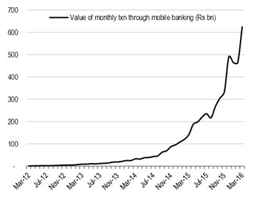

Figure 12: US$1.3 tn consumer payments annually…
Other
Figure 13: …more than 93% of which take place in cash
Figure 15: Already electronic clearing has overtaken paper-based clearing
Remittances
4%
3%
120,000
Rs bn
Medical
6%
Other services & entertainment 10%
Education
5%
Digital 6.6%
100,000
Food 49%
80,000
60,000
Durables & Apparel 11%
40,000
Cash 93.4%
20,000
Conveyance & Utilities 12%
FY15 Total = US$1282bn
-
FY12
FY13
FY14 FY15
Retail electronic clearing
FY16
Source: Company data, Credit Suisse estimates
Source: Company data, Credit Suisse estimates
Paper clearing
However, going forward we expect an accelerated shift to non-cash transactions due to the various factors described below.
Source: RBI
India skipping a generation or two
On the one hand, India has low credit card penetration, low debit card activation and weak internet infrastructure, resulting in low adoption of these payment technologies. Even the usage pattern of debit cards shows that they are being used more as a cash proxy than as true payment instruments.
Figure 14: $850 bn digital payments transactions by 2020
100%
900
90%
$850bn digital
800
80%
transactions by 2020
700
Figure 16: Cards just being used as convenient cash
8.00x
Figure 17: Mobile payments growing exponentially
70%
600
60%
500
7.14x
ATM withdrawals/ POS transactions
50%
UPI+ Payments
UPI + BBPS
7.00x
40%
banks
400
6.00x
30%
300
5.00x
20%
200
4.00x
3.49x
2.94x
10%
100
3.00x
0%
-
2.00x
1.49x
1.26x 1.22x
0.85x
2015 2016
Non-cash-transactions (%)
2017 2018
Cash transactions (%)
2019 2020
Non-cash-transactions (US$ bn)
1.00x
0.18x
0.00x
India
South Brazil China Africa
Russia United Mexico Australia States
Source: RBI, Credit Suisse estimates
Source: RBI, Credit Suisse research
Source: RBI

Slide 52
Financial innovation: what values?
Simplicity
Transparency
Honesty
Fairness
Trust
Empowerment
Inclusion
Privacy
Security
Autonomy
Performance, efficiency, speed, resiliency

Slide 53


