Slide 1
Does accountability deter individuals from serving as independent directors?
Evidence from a corporate governance reform in India
S. Lakshmi Naaraayanan
Hong Kong University of Science and Technology
Kasper Meisner Nielsen
Hong Kong University of Science and Technology
7th Emerging Markets Conference 2016,
IGIDR & Vanderbilt Law School

Slide 2
Motivation
In the wake of corporate governance scandals in recent years, policy makers have called for increasing the independence of directors as well as their accountability to shareholders.
Increasing accountability should improve directors’ incentive to monitor management (Coffee, 1986; Jensen, 1993) and reduce agency problems and entrenchment.
Fear of legal liability could deter individuals from serving as directors (Romano, 1989; Sahlman, 1990), or make them risk averse and thereby reduce board effectiveness.
Does accountability deter individuals from serving on corporate boards?

Slide 3
Background
  Litigation risk
    Armour, Black, Cheffins, and Nolan, 2009;
    Black, Cheffins, and Klausner, 2006;
    Brochet and Srinivasan, 2014
  Director elections
    Cai, Garner, and Walking, 2009;
    Aggarwal, Dahiya and Prabhala, 2015
  Labor market
    Fich and Shivdasani, 2007;
    Ertimur et al., 2012
Prior literature on director accountability has focused on director accountability conditional on wrong doing.

Slide 4
Research Question
We hypothesize that the new stringent law will result in increased turnover of independent directors if accountability deters individuals from serving on corporate boards.
We expect to find stronger deterrence among firms where the pecuniary or reputational incentives to serve as an independent director is weak and in firms that are subject to greater litigation and regulatory risk.
Our contribution
  Accountability deters individuals from serving as independent directors (Ex-ante)
  Existence of costs for shareholders associated with the introducing accountability

Slide 5
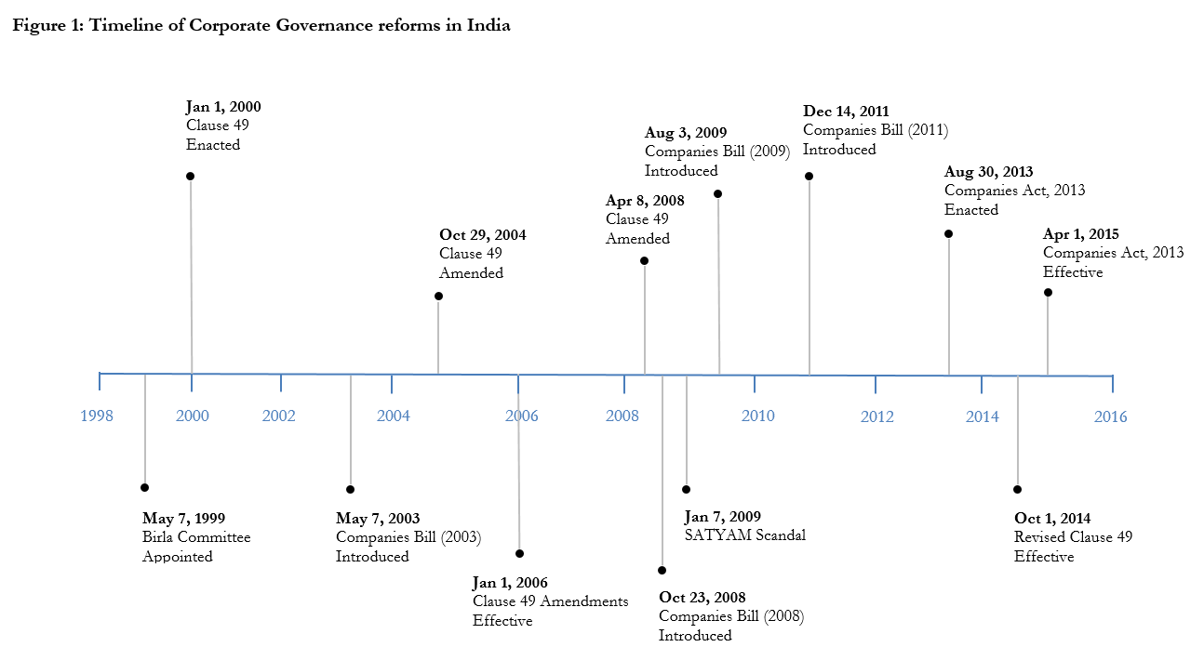
Corporate Governance Reforms: India

Slide 6

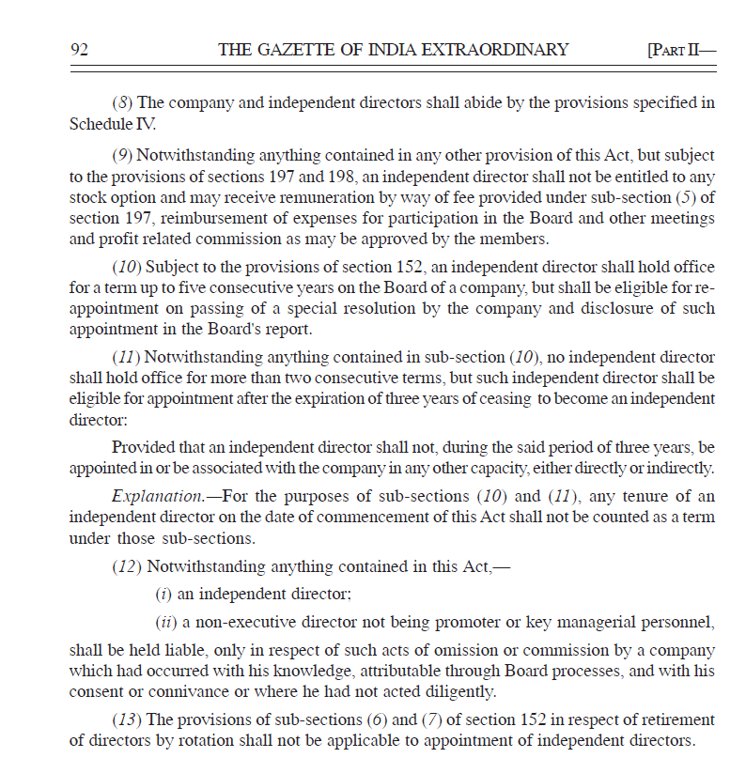
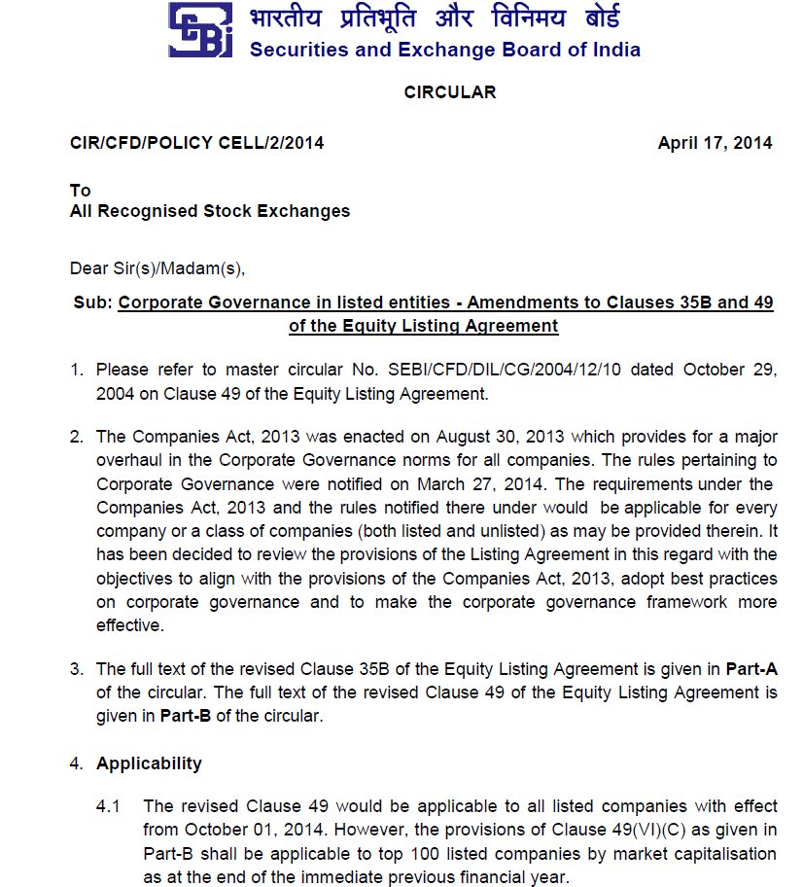
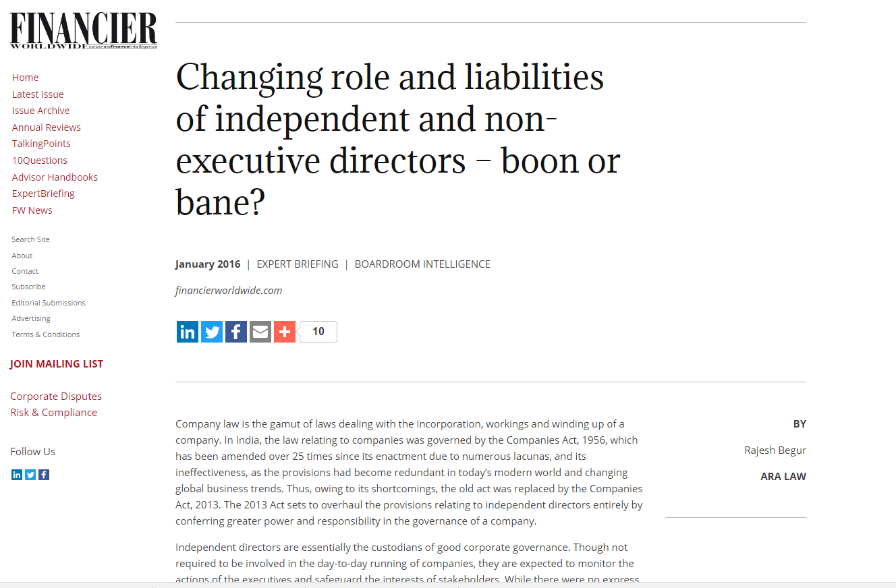
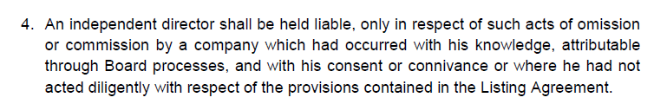
Corporate Governance Reforms: India

Slide 7
Data
Board composition and director characteristics from Indian Boards database
  Board and committee composition at the end of financial year
  Director remuneration and characteristics
Accounting data and financial information from CMIE Prowess
Balanced panel of 1,181 firms listed at NSE from 2010 to 2016
Caveat
  Data on director remuneration only covers the 200 largest firms (by market capitalization).

Slide 8
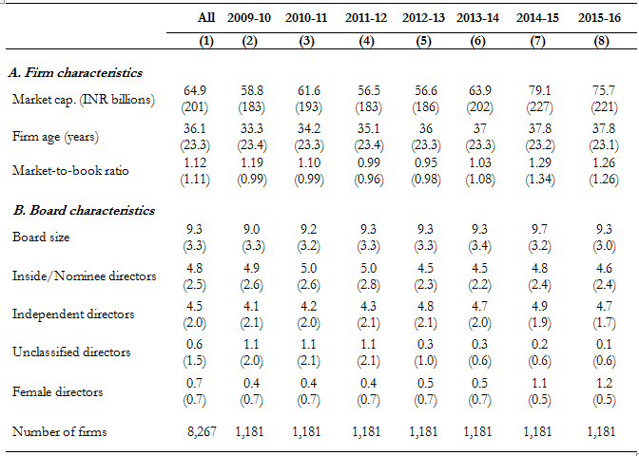
Table 1: Firm and Board Characteristics

Slide 9
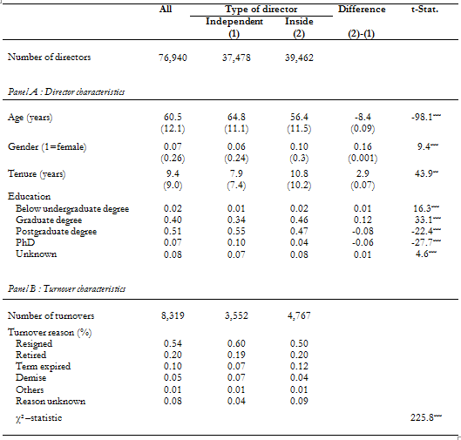
Table 2: Director and director turnover characteristics

Slide 10
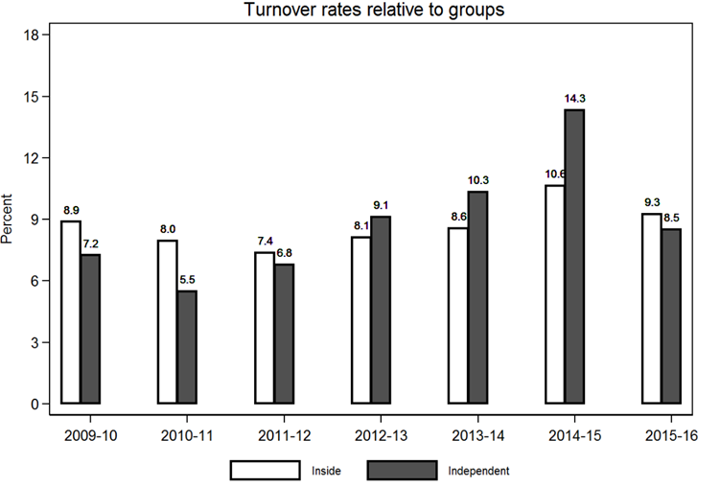
Effect of reform : Turnovers

Slide 11
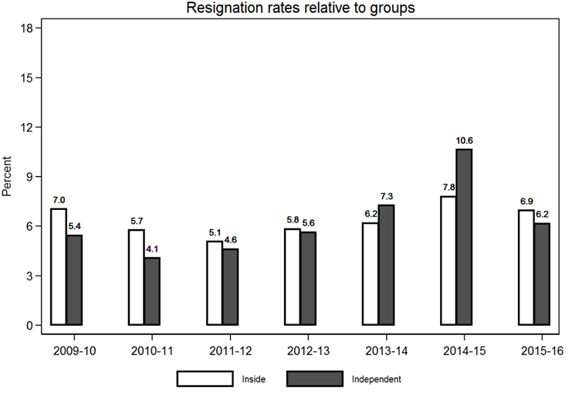
Effect of reform: Resignations

Slide 12
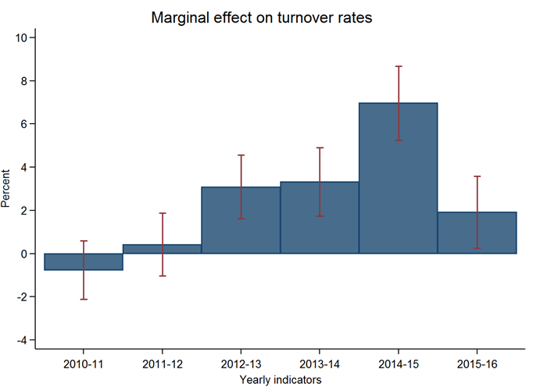
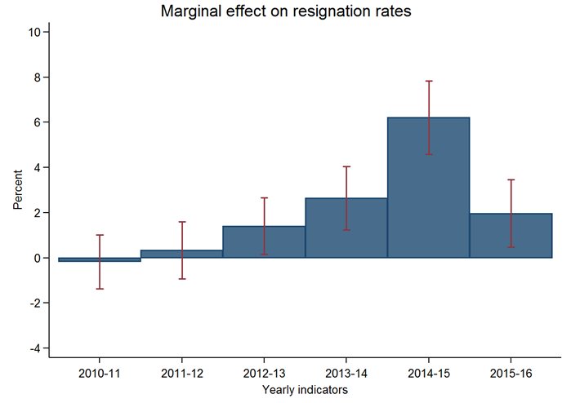
Marginal effects

Slide 13
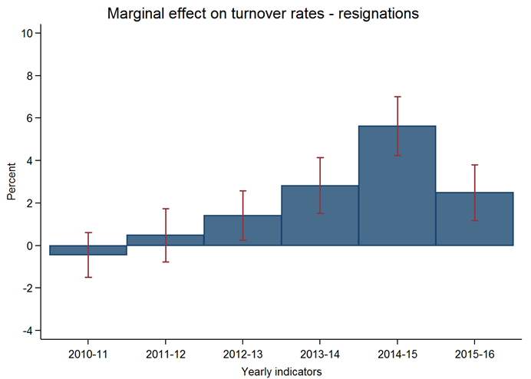
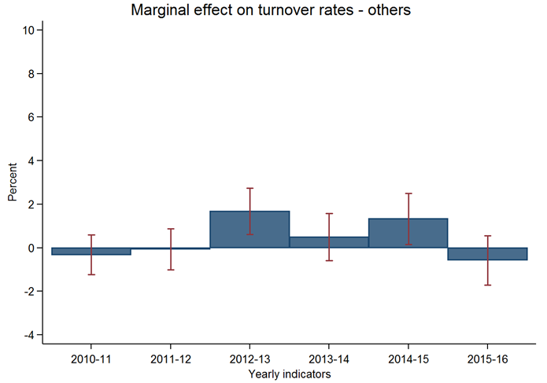
Marginal effects: Resignations vs Others

Slide 14
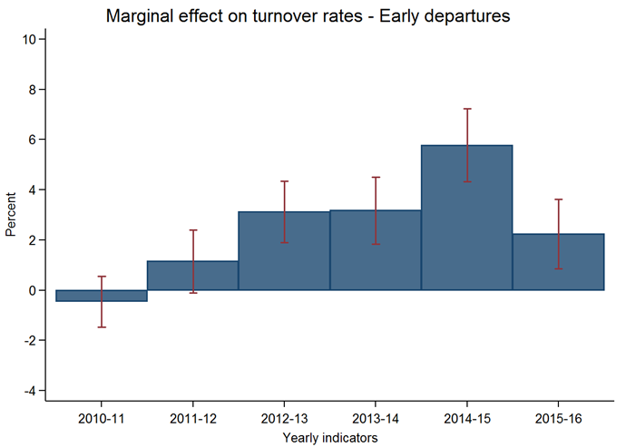
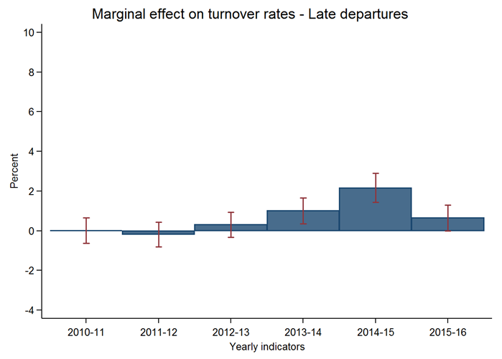
Marginal effects: Early vs Late departures

Slide 15
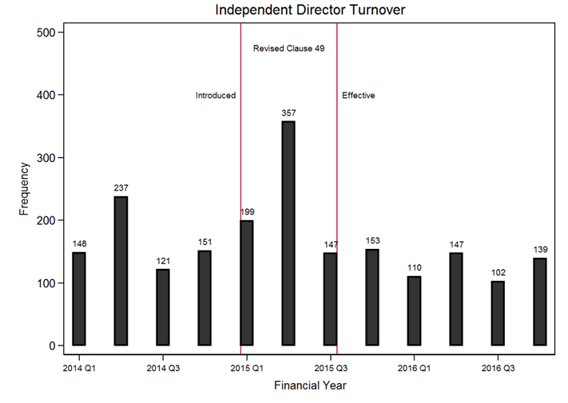
Frequency: Turnovers

Slide 16
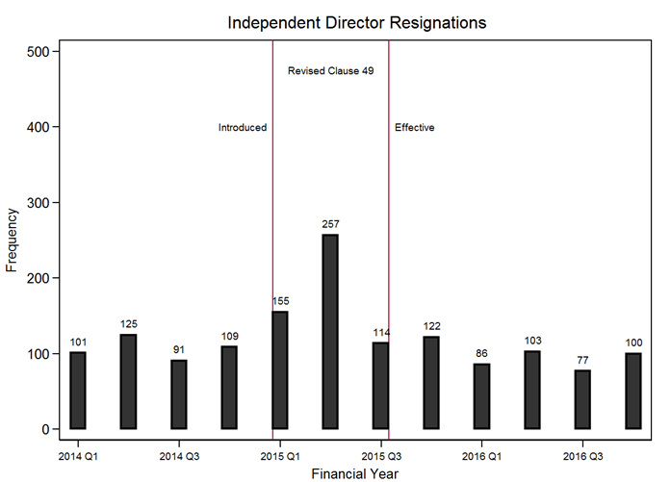
Frequency: Resignations

Slide 17
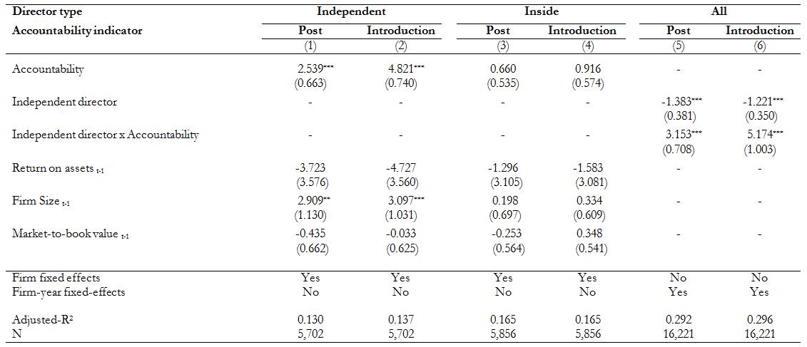
Table 3: Director accountability and turnover

Slide 18
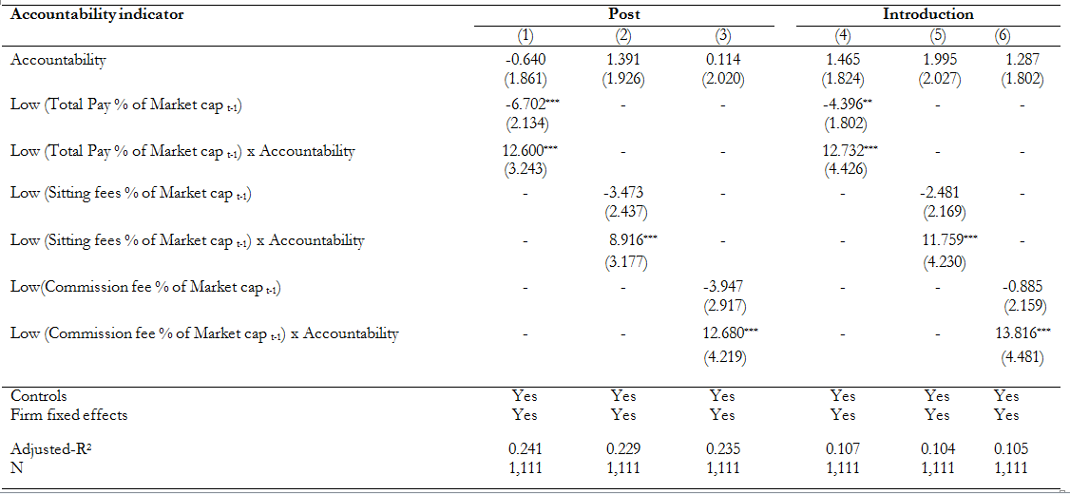
Table 4: Independent director compensation and turnover

Slide 19
Litigation Risk
Non-compliance
  Past non-compliance with listing requirements (SEBI)
  Submission of annual reports (Clause 31), shareholder information (Clause 35), financial results (Clause 41), and the annual corporate governance report (Clause 41)
  Penalties
    Fines
    Suspension of trading
    Delisting
Corporate crimes
  Corrupt Industry classification based on “Bribery and corruption: Ground reality in India” by EY (2013)
Notes:
Non-compliance: Penalties range from fines, suspension of trading, severe cases of delisting from stock exchanges
Corrupt Industry classification:
Most Corrupt: Infrastructure and real estate, Metals and mining, Aerospace and defense, Power and utilities
Corrupt: Telecom, Oil and Gas, Technology, media and entertainment, Financial services
Less Corrupt: Pharmaceutical, Retail and consumer products, Manufacturing
Corrupt state classification:
ALARMINGLY HIGHLY CORRUPT ---- BIHAR, J&K, MP & UP
VERY HIGHLY CORRUPT ---- KARNATAKA, RAJASTHAN & TN
HIGHLY CORRUPT ---- CHATTISGARH, DELHI, GUJARAT

Slide 20
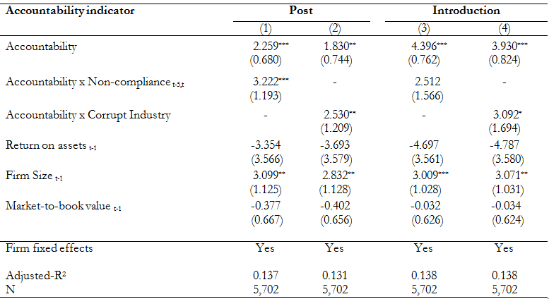
Table 5: Director accountability and litigation risk

Slide 21
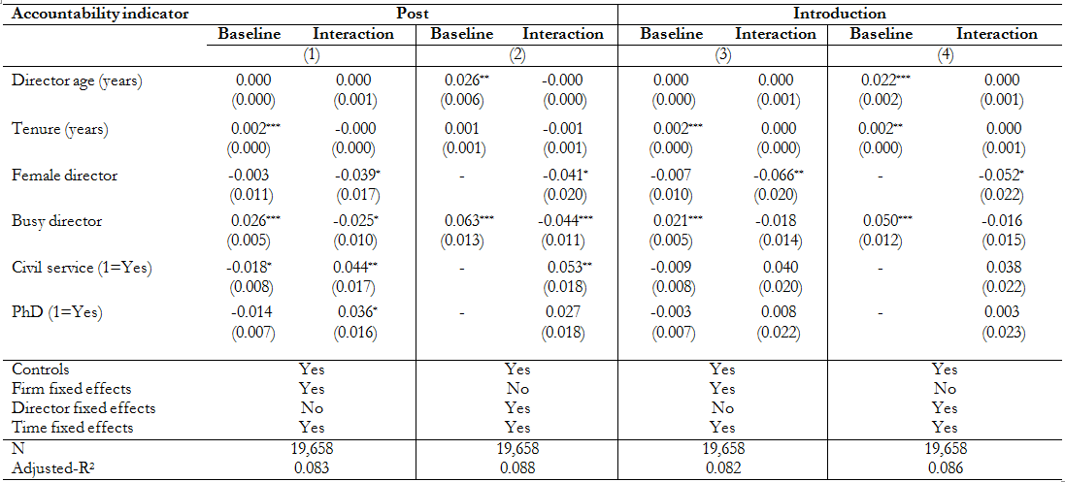
Table 7: Director characteristics and turnover

Slide 22
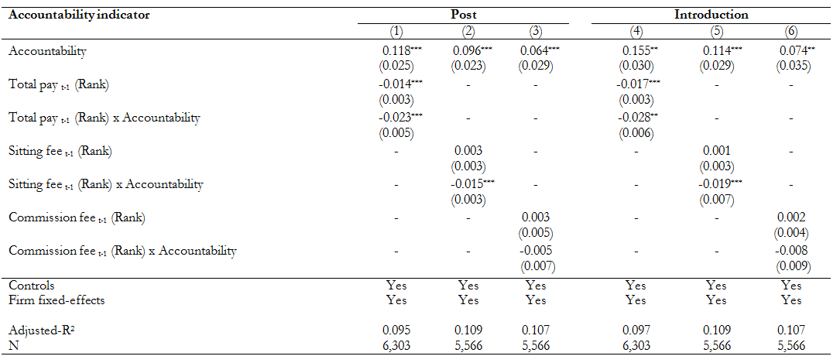
Table 8: Independent director compensation and turnover

Slide 23
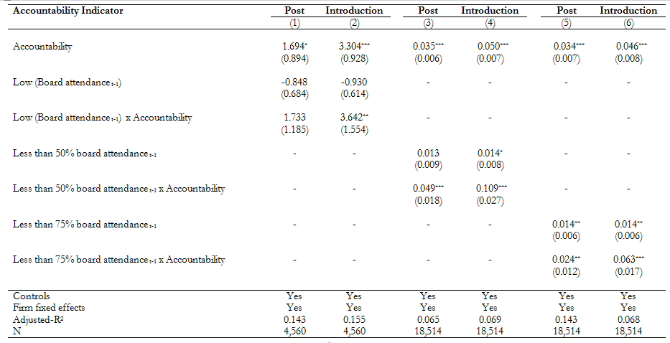
Board meeting attendance

Slide 24
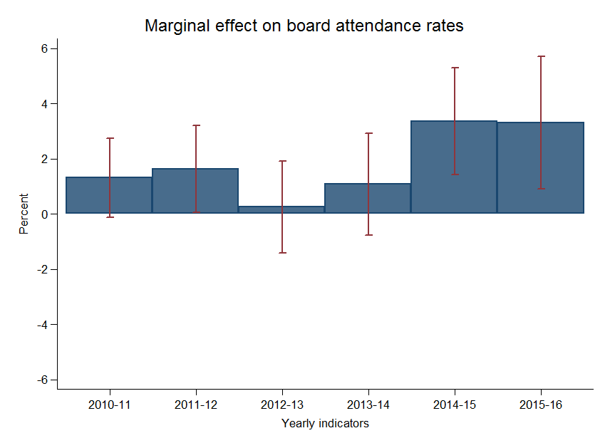
Independent director Monitoring

Slide 25
Alternative specifications
Results are robust to alternative specifications
  Atleast one woman director
  Less than 7 directorships
  Less than 3 completed terms
  Exclude directors with stock options
  Exclude bank & government firms
  Sensitivity to performance

Slide 26
Conclusion
Investigates whether accountability deters individuals from serving as independent directors.
We find after the reform
  Turnover rates and resignation rates increase significantly
  Stronger deterrence among firms where the pecuniary or reputational incentives to serve as an independent director is weak and in firms that are subject to greater litigation and regulatory risk.
Overall, fear of legal liability seems to deter individuals from serving as directors, and could potentially reduce board effectiveness.

Slide 27
Questions?
sln@connect.ust.hk

Slide 28
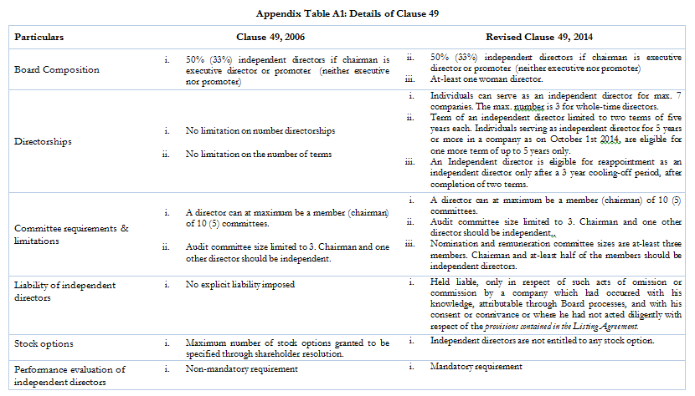
Appendix Table A1

