Slide 1
Can Political Connections Help Nation Building in Emerging Markets? Evidence from Public-Private Partnerships in China and India
Vijaya Bhaskar Marisetty
Hong Nhung Dao
BITS Pilani, Hyderabad Campus
RMIT University

Slide 2
Contents
What is Public-Private Partnership
Research Motivation
Research Methodology
Results
Research Main Findings

Slide 3
What is Public-Private Partnership?
Bundling contracts
Privately temporary ownership of assets
Inter-temporal risk sharing
Project finance
Public-Private
Partnership (PPP)

Slide 4
Research Motivation
Existing literature on political connections and external financing do not support altruistic Social lending Hypothesis (SLH), it supports mainly Political Corruption Hypothesis (PCH)
Mian and Khwaja (2004) present direct evidence against the SLH
The misuse of such connections for private benefits of private sector firms (Cole (2009); Dinc ̧ (2005); Sapienza (2004))
Existing evidence tests SLH by using general corporate lending by banks (Mian and Khwaja (2004)) that are not directly aligned with national building objectives
Political connections might work better in nation building private sector projects as there is a clear alignment and incentives for the ruling party to complete PPPs
We use China and India based PPP contracts, that provide an ideal setting to test the SLH

Slide 5
Questions
1.Whether higher political connections provide better access to bank loans for PPP engaged firms?
2. Whether politically influenced bank loans utilized for high growth investments?
3. Whether political connections reduce firm level credit risk?

Slide 6
Research Methodology
169 and 215 firm-year observations for China (1986-2012) and India (1991-2013)
Data on Bank loans, insider ownership, political connections from annual reports, private firms’ website, Thomson Reuters Eikon, India’s bicameral Parliament
The Heckman two-stage model to circumvent endogeneity issues
PPP - a dummy variable
(1 for PPP firms, 0 for matched non-PPP firms)
Bank loans/sales – total short term and long term bank loans divided by sales
Political connection - a dummy variable (1 if chairman and executive directors being former or current officers in the government, the parliament and the military)
Chen et al, 2013; Heckman, 1976

Slide 7
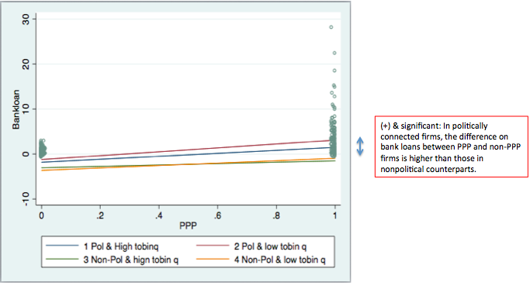
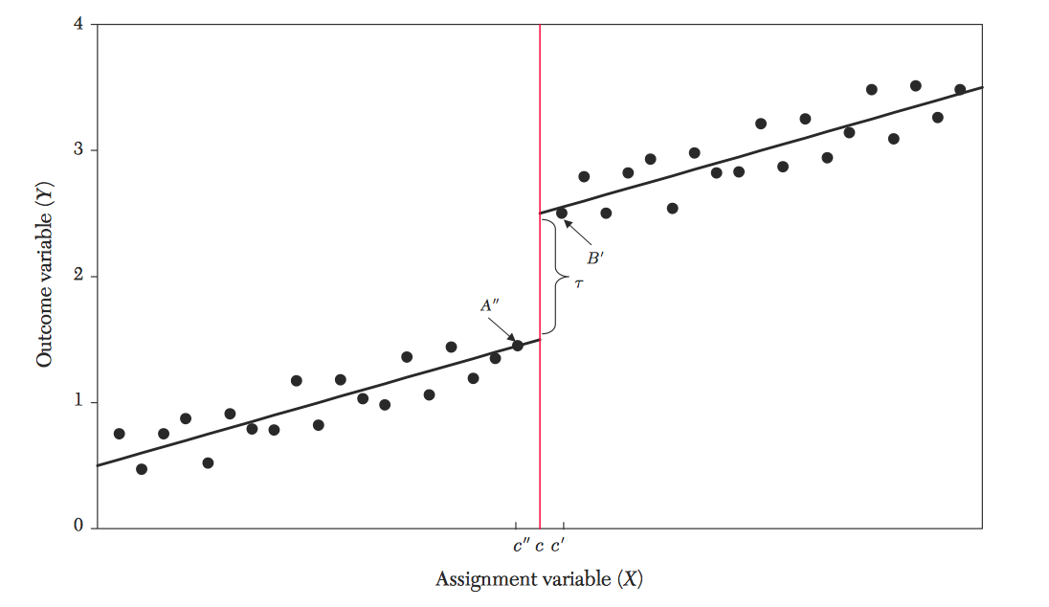
Research Methodology
Slope differences to explore overinvestment
Regression Discontinuity Design (RDD) as an identification strategy
Y: Bank loans/sales
X: Normalized PPP investment years
Robustness tests:
How higher bank lending (resulting from engaging in PPP projects and political connections) influences firm level credit risk.
Using RDD and the election event as the exogenous shock to re examine the effect of political connection on firms’ credit risk

Slide 8
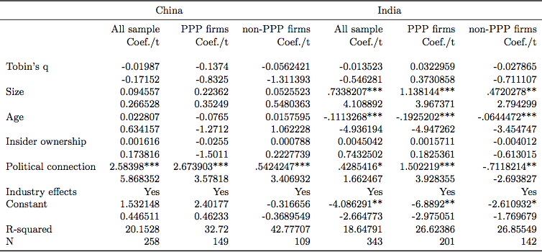
Results
Role of Political Connection on Bank Lending

Slide 9
Results
Heckman two-stage models – Slope differences
Stage 1. The probit estimate of PPPs Y=PPP dummy | China (n=288) |  |  | India (n=348)
Political connection | 0.303* |  |  | 0.086
Control variables (Leverage, Size, Age, Tobin’s q, Industry effects…)
Stage 2: The effects of PPP & Political connections on Bank loans Y= Bank loans/sales | All sample | High-q | Low-q | All sample | High-q | Low-q
PPP* Political connection | 1.807** | 2.643*** | 0.949 | 7.911*** | 8.646** | 8.228**
Other variables (PPP, Political connection dummy, Firm control, Mills’ ration, Industry effects…)
Slope Differences - Overinvestment
(Pol & high q ) – (Non-pol & high q) | 1.799* |  |  | 4.946
(Pol & low q ) – (Non-pol & low q) | 1.668 |  |  | 9.978*

Slide 10
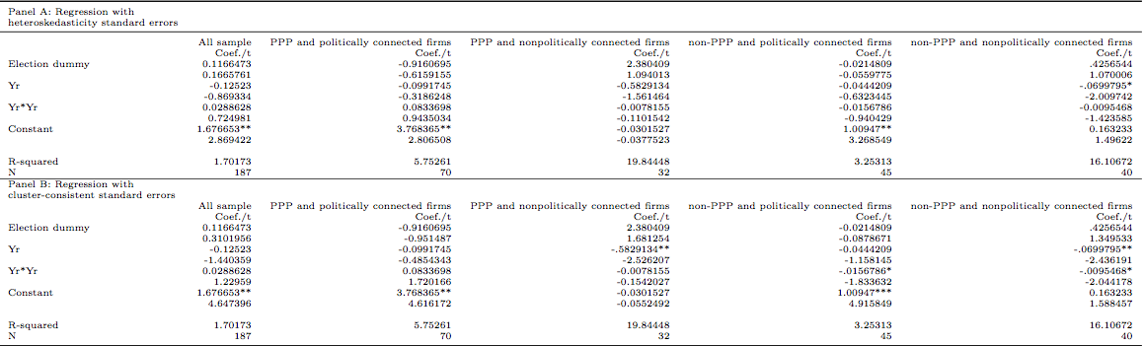
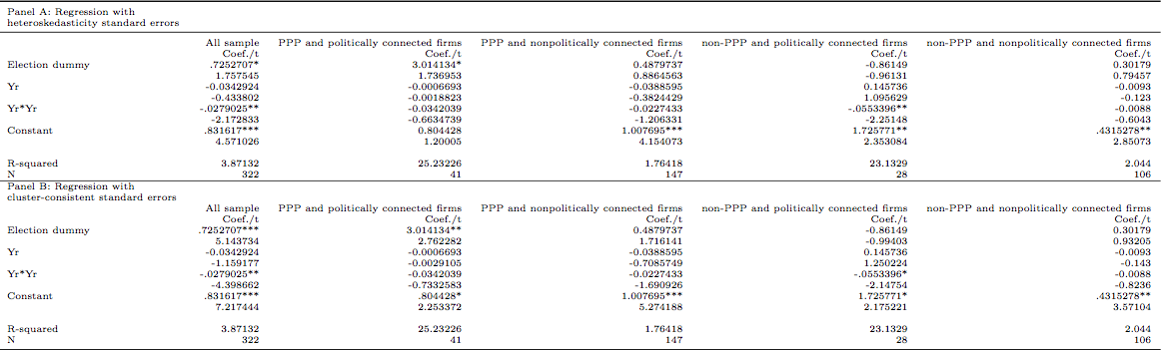
Results: Regression Discontinuity Design
Chinese firms:
No significant results among 4 groups
Indian firms:
Only PPP and politically connected firms experience higher bank lending after the election event

Slide 11
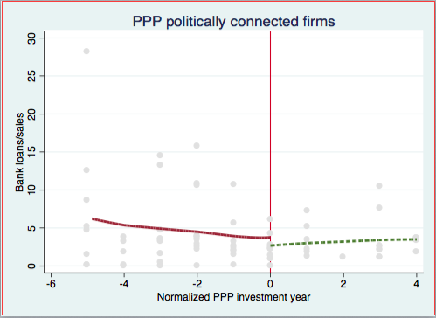
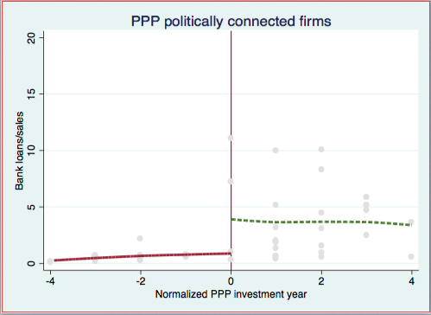
Results
Regression Discontinuity Design Graph
China
India
3.014*
-0.916
In India, politically connected firms benefit more through higher bank loans when the incumbent party or leaders regain their seats in the Government.

Slide 12
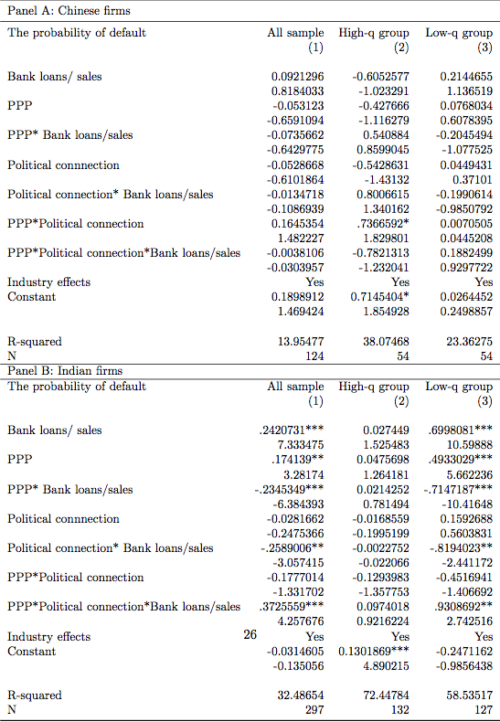
Results
Robustness Tests:
How higher bank lending (resulting from engaging in PPP projects and political connections) influences firm level credit risk
The Indian PPP firms with political connections allocate higher bank lending to low-growth firms that have higher probability of default. This lends support to the PCH in India.

Slide 13
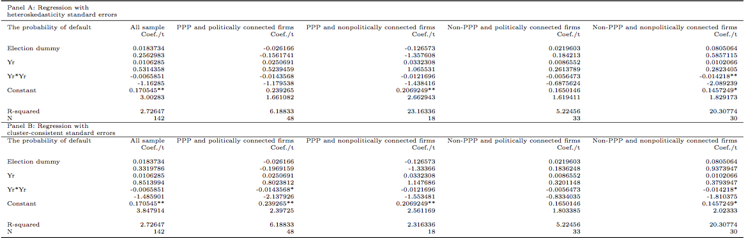
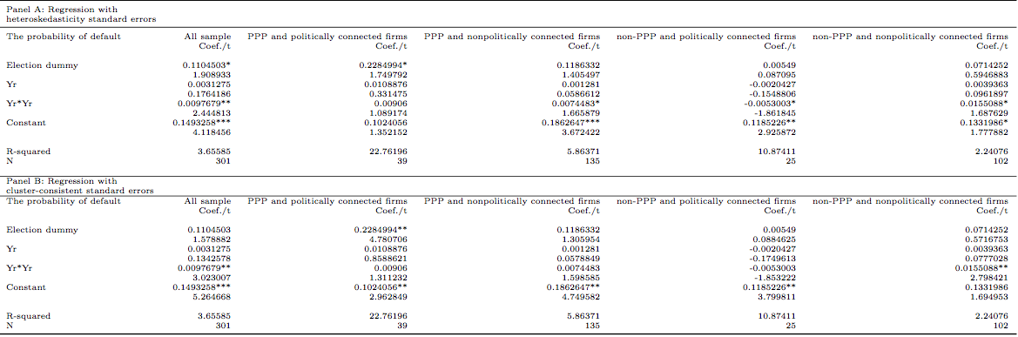
Results
Robustness Tests:
Using RDD and the election event as the exogenous shock to re examine the effect of political connection on firms’ credit risk
Only the Indian PPP and politically connected firms experience higher credit risk after the election event. This further supports the negative effect of bank lending in the Indian market.

Slide 14
Research Main Findings
Politically connected PPP firms, on average have higher access to bank loans compared to competing and matched non-PPP firms
Chinese PPP projects with political connections, receive significantly higher bank loans for more productive firms (compared to non-PPP politically connected firms), while in India, there no marked differences.
PPP firms that have political connections, overinvest mainly in the Indian market and not in the Chinese market
In India, firms that are politically connected, benefit more through higher bank loans when the incumbent party or leaders regain their seats in the Government
The probability of default significantly increases for Indian PPPs that overinvest
>>> Our results suggest that:
Political connections help nation building in China (supporting the Social Lending Hypothesis).
Political connections deter nation building in India (supporting the Political Corruption Hypothesis).

