Slide 1
Political Turnover, Ownership, and
Corporate Investment
Cao Xiaping, 中山大学岭南学院
Brandon Julio, University of Oregon
Tiecheng Leng，中山大学岭南学院
Alex(Sili) Zhou, Singapore Management University
Notes:
Good morning. It is my honor to present our paper “Political Turnover, Ownership and Corporate Investment” in San Destin. This is still a working paper and I welcome all suggestions and comments.

Slide 2
Motivations
Political uncertainty is shown to cast real economic impact on corporate investment ex ante
  Julio and Yook (2012)
Political connections affect firm’s value (often negative, consistent with grabbing hand view of Shleifer’s and rent seeking behavior)
  Goldman, Rocholl and So (2009)
  Fan, Wong and Zhang (2007)
Notes:
The relationship between politics and economic outcomes has a long history in research. One important channel is that politics influence real business decision through uncertainty and instability. Empirically, political uncertainty has been shown to have real economic impact on corporate finance in other countries. Julio and Yook 2012 examine the firm-level investment corresponding with the event of national elections across 48 countries and they find that corporate investment temporarily decreases before election outcomes as firms become more cautious anticipating the election outcome. The other interesting channel is whether political connections improve firms’ value. Goldman et al (2009) using the hand-collected data set on the political connections of board members and show a positive abnormal stock return following the announcement of the nomination of a political connected individual to the board. Fan et al (2007) manually collected CEO and board data from newly listed firms and indicate that those firms with political connected CEOs often have poor governance and performance.

Slide 3
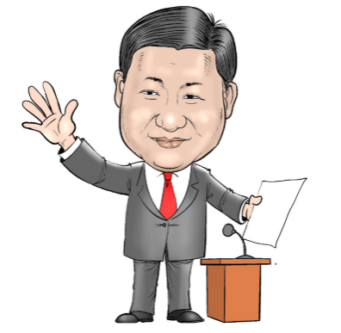
Motivations – Why China?
China’s institutional setting is unique
  Largest emerging market with high investment ratio
    Investment/GDP ratio in 2013: 47.1% (China):
    16.8% (U.S.) 27.4% (South Korea) 21.2% (Japan)
  Unique politician transition system
    Performance-based promotion scheme creates local officials’ tournament-like incentives in China (Maskin, Qian and Xu (2000), Li and Zhou (2005), etc).
Notes:
Why we choose China? China is the world’s largest emerging economy and has a unique feature of institutional setting. In 2013, the investment-to-GDP ratio in China was 47.1% and much higher than other countries. China has a unique political transition system. The connection between the economy and government transition is extremely close in China. Provincial governors are held responsible for promoting local economic development, which is a crucial indicator in personnel evaluations made by the Beijing central government. Those provincial governors who can deliver the best GDP growth ﬁgure during their tenure will have a higher chance of promotion later on. Such performance-based promotion scheme creates tournament-like incentives for local ofﬁcials in China.

Slide 4
Motivations – Why China?
China’s institutional setting is unique
  A politics-fuelled investment boom is highly anticipated when new officials take over at both central and local levels.
    For example, the 4-trillion RMB fiscal stimulus plan announced in Nov 2008.
    Guizhou Province spend RMB 3 trillion on boosting tourism in 2012 (Financial Times) after the new party secretary took office.
    Chongqing City spend RMB 1.5 trillion on boosting seven strategic industries such as telecommunication
    after Bo Xilai hold the top post there.
Notes:
Beside that, political leaders are appointed rather than elected. A politics-fuelled investment boom accompanied with virtually every new congress is anticipated when a new slate of officials takes over at both central and local levels. Due to career concerns, when new governors take local offices, they plan well their term. It is not uncommon for new local governors to s- tart to announce ambitious investment plans right after their appointments. For example, the Financial Times (2012) observed that “The investment projects that have been announced in recent weeks have been described as ‘stimulus’ initiatives to prop up the economy. Among others, Guizhou province wants to spend RMB 3 Trillion on boosting tourism, while the city of Chongqing is aiming for an RMB 1.5 Trillion investment in seven strategic industries such as telecommunications”.

Slide 5
Motivations – Why China?
China’s institutional setting is unique
  Political leaders can cast their influence on SOEs through direct and indirect channels.
    Direct: preferential treatment in bank credit, government subsidies, and market entry compared to private enterprises (Faccio et al. 2006, Claessens et al. 2008, Li et al. 2008).
    Indirect: personnel decisions (e.g., top executives and party secretary appointment)
    (Fan, Wong and Zhang 2009).
Notes:
Finally, since the government is the largest and controlling shareholder in SOEs, they can influence SOEs directly and indirectly. For example, political leaders can inﬂuence SOEs directly through arranging preferential treatment in bank credit, government subsidies, and market entry compared to private enterprises (Faccio et al. 2006, Claessens et al. 2008, Li et al. 2008). Political leaders can also cast their inﬂuence on SOEs through indirect channels such as affecting personnel decisions (e.g., top executives and party secretary appointment). Various levels of governments in China thus often seek to affect/direct investment in order to achieve policy goals, especially in SOEs (Fan, Wong and Zhang 2007).

Slide 6
Hypothesis
Political turnover and the incentives of the provincial governors influence real corporate decisions (both ex ante and ex post):
  Firms decrease investment right before turnover.
  After the turnover, SOEs crowed out non-SOEs.
  Misallocation of capital and investment inefficiency in post-turnover.
  After the turnover, incentives of the new governors exert their influence on investment through SOEs.
Notes:
We hypothesize that the incentives of provincial political turnovers can have a significant impact on local firm-level investment. We expect that firms will decrease investment right before turnover due to the political uncertainty concerns as the literature suggested. After the turnover, SOEs will increase investment significantly, while non-SOEs experience investment decline, suggesting that the political boost in investment for SOEs acts to crowd out non-SOEs investment. After the turnover, due to career concerns, new governors exert their influence on investment through SOEs in an effort to boost economic growth and increase the likelihood of future political promotion. Such political turnover patterns of corporate investment in China represent a misallocation of capital and investment efﬁciency decline in post-turnover.

Slide 7
Main Findings
  Corporate investment may be affected due to political uncertainty ex ante or political influence ex post:
  Firms reduce investment by 4.4% on average in the year before the turnover.
  SOEs increase in investment by 6.0% in the year following the turnover, while non-SOEs experience a reduction in investment, suggesting political influence exerted over SOEs crowds out investment for non-SOEs post-turnover.
  Investment efficiency generally declines post-turnover and this is more pronounced for non-SOEs than SOEs.
  The increase of post-turnover on investment are mainly driven by normal turnovers, and turnovers with less-educated or local-born successors.
Notes:
Here is what we find. We find evidence consistent with the hypothesis that political turnover and the incentives of the new provincial governors influence real corporate decisions through their influence on SOEs. Corporate investment, especially SOEs may be affected due to the political uncertainty ex ante or political influence ex post. We find that firms reduce investment by 4.4% on average in the year before the turnover. Most importantly, the primary contribution of this paper is that there is a divergence in investment rates between SOEs and non-SOEs in the post-turnover year. Specifically, we find that SOEs increase in investment by 6.0% while non-SOEs experience a reduction in investment in the year following the turnover. This wedge in investment suggests a political influence exerted over SOEs crowds out investment for non-SOEs post-turnover. We also find that the increase of post-turnover on investment are mainly driven by normal turnovers and turnovers with less-educated or local-born successors. Meanwhile, investment efficiency generally declines post-turnover and this is more pronounced for non-SOEs than SOEs.

Slide 8
Data
  Hand-collected 113 turnovers of provincial governors between 1998 and 2012.
    Contains detailed personnel information regarding governor’s age, education, birth place, previous working experience and the timing of appointment. Compiled from various internet sources.
    Turnover year (0) is defined as the calendar year in which the turnover occurs.
Firm characteristics data (CSMAR).
  Macroeconomic variable (Wind).

Slide 9
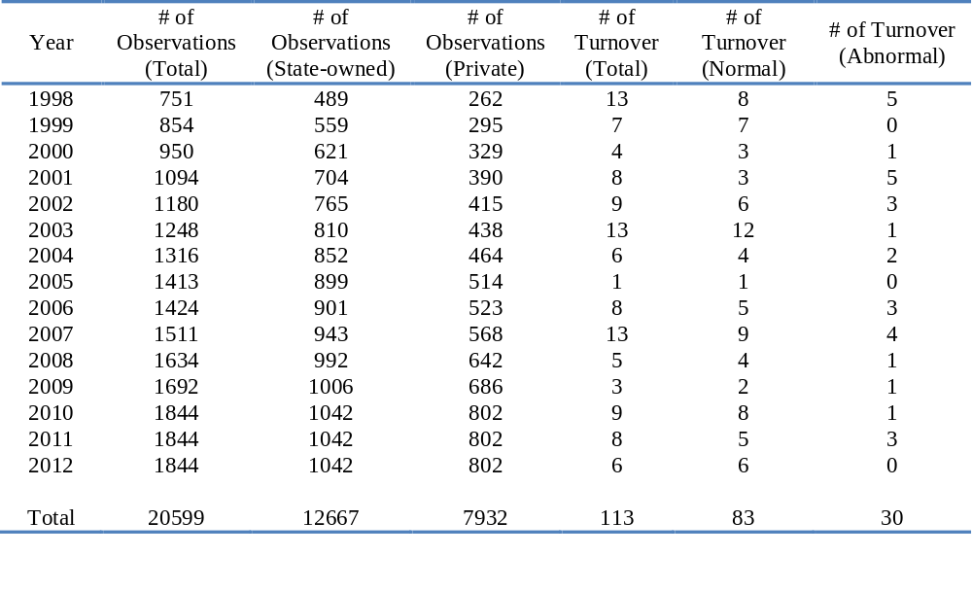
Summary Statistics
Notes:
Following Chen et al (2005) and Li and Zhou (2005), we classify turnovers into normal turnover (promotion or parallel turnover) vs. abnormal turnover (retirement and termination due to death, resign, demotion or indictment). Total 113 provincial governor turnovers and 71% are classified as normal. Firm observations increase over time reflecting increased IPO volume over the sample period. Increasing pattern ends in 2010 as we exclude firms with less than 3 obs (IPO year >= 2010) in the sample.

Slide 10
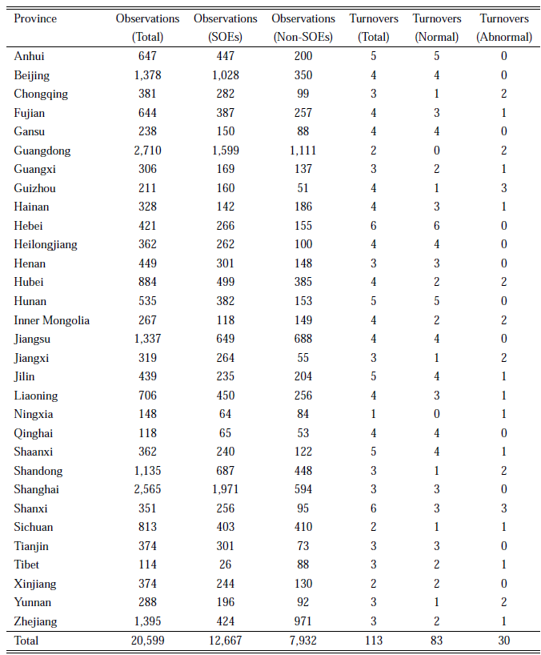

Slide 11
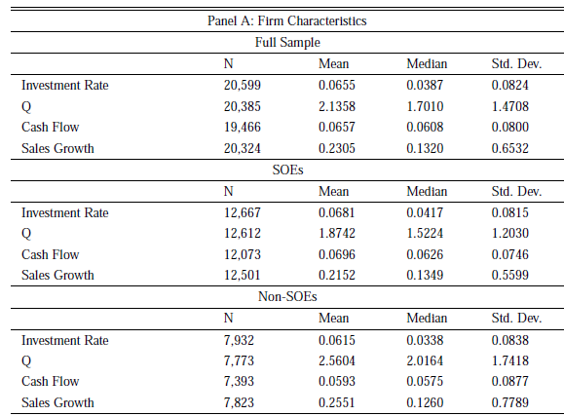
Key statistics

Slide 12
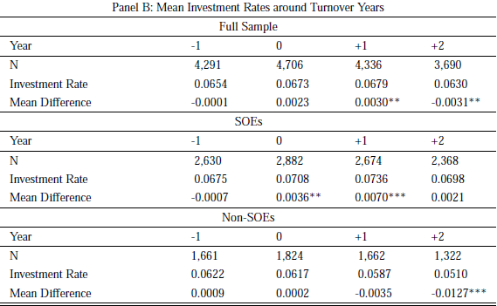
Univariate test of investment

Slide 13
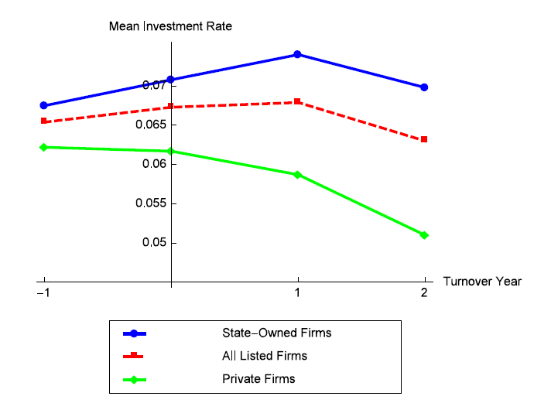
Mean Investment Rates around Turnover Years
Notes:
The Figure shows a clear pattern for the mean investment rates for the full sample, SOEs and non-SOEs separately during the turnover event time window. Let us focus on the investment rates first. The investment rates for the whole sample shows an increasing trend and the trend pattern is much noticeable for SOEs. For SOEs, investment peaks one year post-turnover; while for non-SOEs, investment generally peaks one year pre-turnover and it then decreases quickly. As for the wedge between investment rates of SOEs and non-SOEs, we can see the wedge is the smallest at one year pre-turnover, while it becomes larger and larger after the turnover. This trend may indicate potential crowding out effect for SOEs with non-SOEs during the post turnover period.

Slide 14
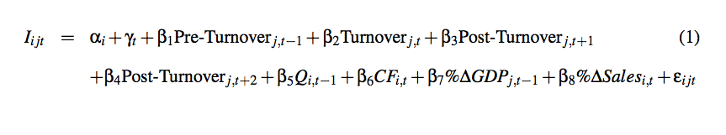
Regression Specification
Augment Investment-Q
  Dependent variable: Firm-level investment
  Variables of interest: Turnover event dummies
  Controls: Q, cash flow, provincial GDP growth and sales growth
Notes:
To test the changes in the investment dynamics of firms across the turnover cycle, we employ an augmented investment-Q specification and estimate the baseline panel regression model. In the model, i stands for the firm, j indexes the province, and t denotes the year. The dependent variable is the firm-level investment rate, which defined as capital expenditures scaled by lagged total assets. The primary interest variables are time-province dummies measuring the periods before and after the turnover event. Other control variables include Tobin’s Q, cash flow, provincial-level real GDP growth rates, which are used to control for firm investment opportunities and provincial economic conditions, and sales growth as an addition control for expected future demand. To control for time-variant unobservable variation, we include both firm and year fixed effects in the baseline investment regression. This specification captures the within-firm variation in corporate investment around turnover event years. Standard errors are clustered at the firm level in all specifications.

Slide 15
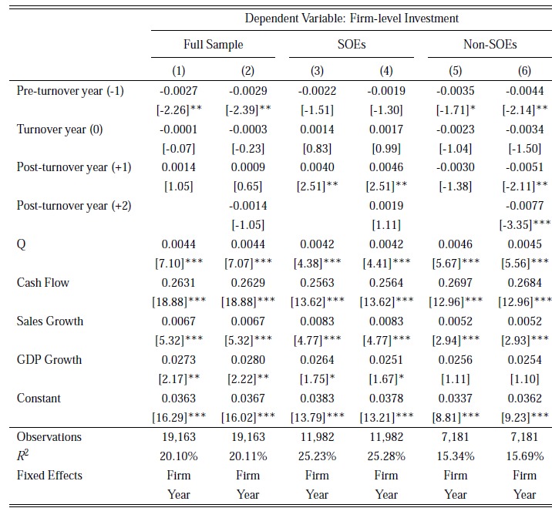
Baseline Regressions (Slope)
Notes:
Table 4 reports the empirical results for our baseline specification. For the full sample, we find a negative association between pre-turnover dummy and corporate investment rates, which is consistent with Julio and Yook (2012). As previous table and figure shows, there are important differences in investment behaviors between SOEs and non-SOEs over the provincial turnover cycle. Given these differences, we divide the full sample into two groups by their ownership type. For SOEs, we see a large increase in investment rates in the post-turnover year. In terms of economic magnitude, the coefficient in specification 3 is about 6.0% increase in investment rates in the one-year post-turnover years, relative to mean investment rates in other years. Column 5 and column 6 report the regression results for the sample of non-SOE firms. We find that non-SOEs generally invest less in the pre-turnover period.

Slide 16
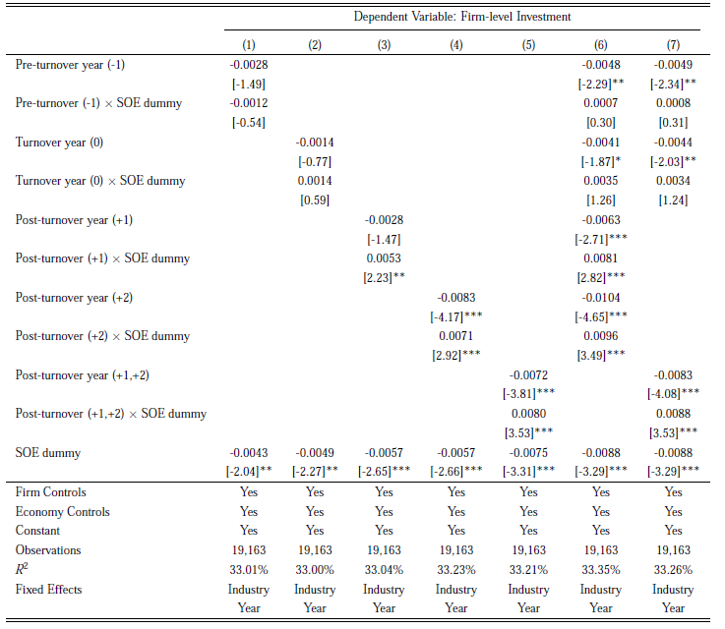
Crowding Out Effect (Wedge)
Notes:
The prior literature focusing on political turnover and investment has largely ignored the investment policies of SOEs may crowd out the investment of private firms in the post-turnover period. Government-led investments and expenditure projects are normally announced right after new governors’ appointments as stimulus initiatives to prop up the local economy. Majority of these new investment projects are initiated through SOEs. To test for this crowding out effect, we include a SOE dummy as well as interaction terms between the SOE dummy and post-turnover indicators on full sample. The results show SOE investment increases significantly relative to that of the private firms in various post turnover periods and indicates that SOE crowds out private investment following the political turnover.

Slide 17
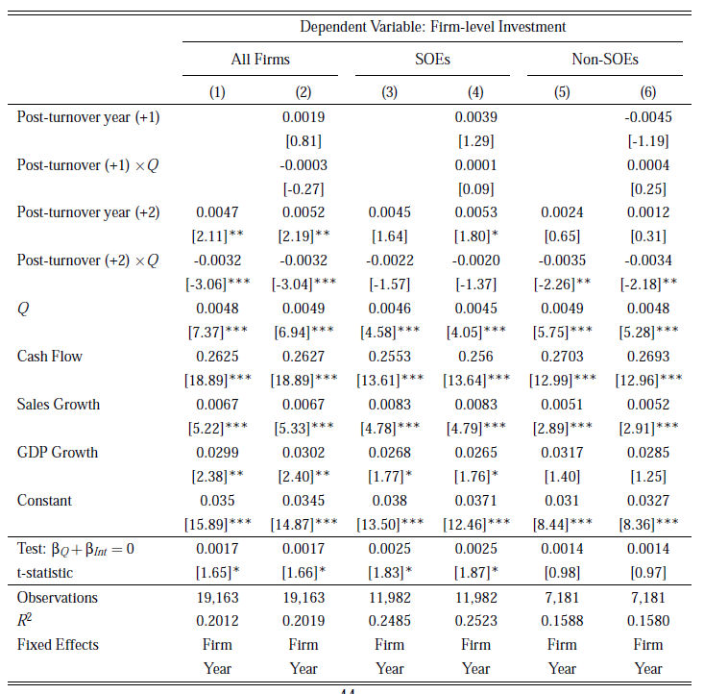
Investment Efficiency
Notes:
A natural question to ask following the crowding out is whether and to what extent such effect will affect post-turnover investment efficiency of SOEs and non-SOEs: If the post-turnover crowding out effect causes serious resources misallocation between SOEs and non-SOEs, we expect investment efﬁciency decline, with this inefficiency more pronounced for non-SOEs than SOEs. The coefficients on the interaction terms between the two-year post-turnover dummy and Q are negative and significant in specifications 1 and 2, while the interaction terms between the one-year post-turnover dummy and Q are not significant. This negative interaction term suggests that investment efficiency declines in the post turnover period in that investment expenditures are less correlated with growth opportunities, which is consistent with potential capital misallocation. Both the t-stats and the magnitudes show that SOEs experience insigniﬁcant investment efﬁciency drop after the turnovers. On the other hand, non-SOEs exhibit economically signiﬁcant deterioration in investment efﬁciency post-turnover.

Slide 18
Robustness
Party secretary turnover
Heterogeneity in type and incentives of politicians
Neighborhood Dif-in-Dif estimation
Notes:
Next, we will do some robustness check.

Slide 19
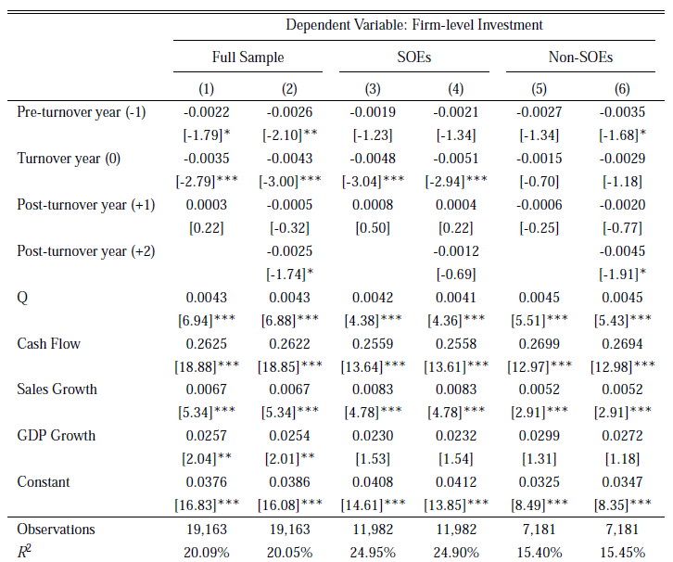
Party Secretary Turnover
Notes:
Firstly, we look at the difference in investment behavior between the appointments of provincial governors and that of party secretary. China has a unique dual leadership system and it is important to distinguish their role. Provincial governor is like a CEO in a firm while party secretary much more like a chairman. As a placebo test, we re-estimate the baseline investment regression using the turnovers of party secretaries. We find that across all samples that the post-turnover investment behavior of Chinese firms does not change significantly after the turnover of a party secretary and we do not see the divergence in investment activity between SOEs and non-SOEs.

Slide 20
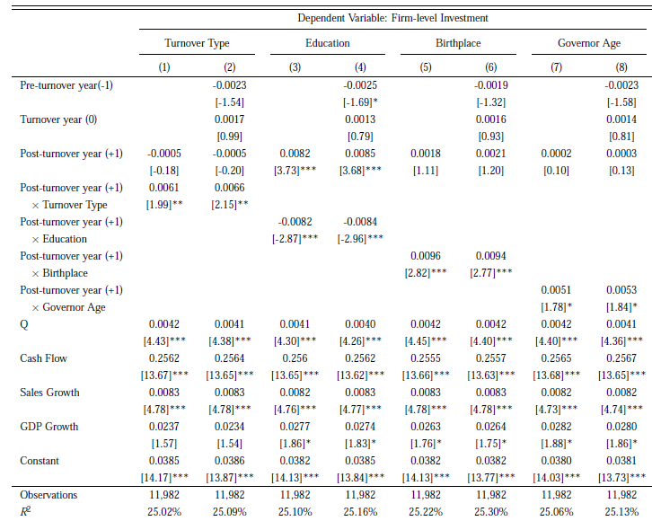
Heterogeneity in Types and Politicians
Notes:
Then, we investigate the cross-sectional heterogeneity in the strength of the incentive to boost investment across politicians. Generally, we divide our full sample into two groups by introducing an interaction term between a dummy variable with one year post turnover. We find that the increase investment among SOEs mainly take place in provinces where the political turnovers involve normal transitions (the timing can be predicted), less-educated immediate successors, when successors are born locally (more political influence ex post), and successor’s age between 55 and 60 years old.

Slide 21
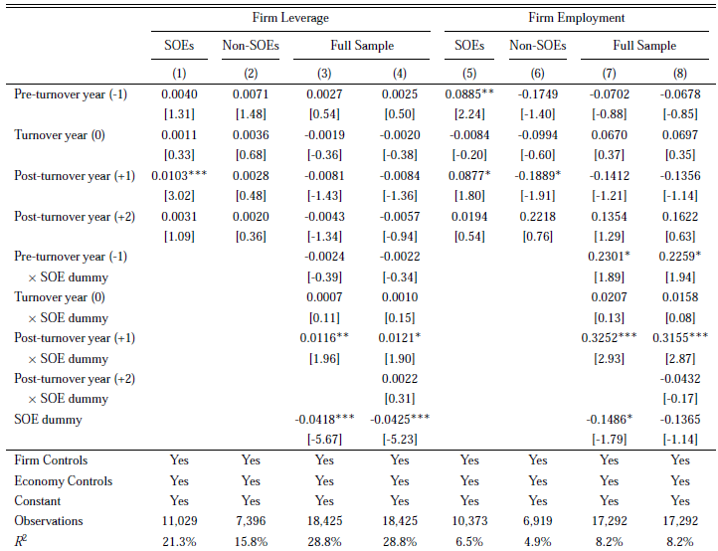
Channels

Slide 22
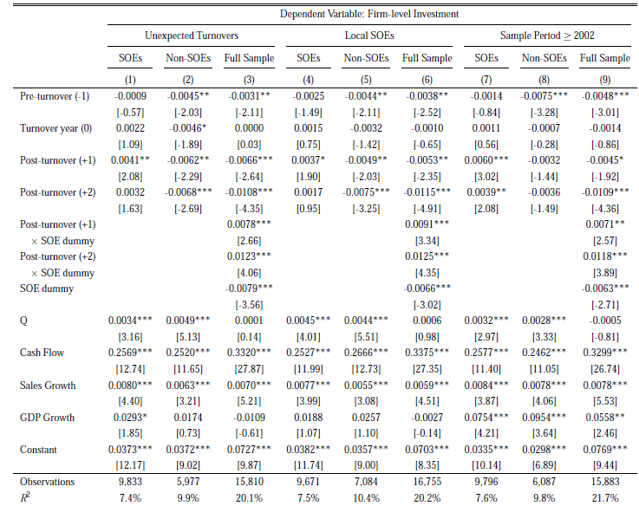
Robust tests

Slide 23
Conclusion
Corporate investment can be affected due to political uncertainty ex ante or political influence ex post:
  Firms reduce investment by 4.4% on average in the year before the turnover.
  SOEs increase in investment by 6.0% in the year following the turnover, while non-SOEs experience a reduction in investment.
  Political influence of new governors exerted over SOEs crowds out investment for non-SOEs post-turnover.
  Investment efficiency generally declines post-turnover and this is more pronounced for non-SOEs than SOEs.
  The post-turnover increase in investment on SOEs is mainly driven by normal turnovers, and turnovers with less-educated or local-born successors.

