Slide 1
Unemployment Insurance and Takeovers
Lixiong Guo
University of Alabama
Jing Kong
Michigan State University
Ronald Masulis
University of New South Wales
December 12, 2019

Slide 2
Motivations
The M&A market plays an important role in allocating assets and increasing economic efficiency.
A large literature explores manager-shareholder conflicts of interest.
  Most recent study: Jenter and Lewellen (2015)
Shareholder-employee conflict of interests can also be important, but it is much less studied.
  Recent studies examine how this conflict is exacerbated by employee rights & legal protections
    For example, John, Knyazeva & Knyazeva (2015) and Dessiant, Golubov & Volpin (2017)
  Yet we know little about market mechanisms that can mitigate this conflict!
This paper helps fill this void by closely examining unemployment insurance (UI) and whether it can serve as an effective mechanism to lower takeover market frictions.

Slide 3
Unemployment Insurance
Public UI is a common labor market feature in developed countries.
In the US, 97% of wage & salary workers who lost their jobs due to restructuring are eligible for federal-state sponsored UI benefits.
  The UI system provides a temporary income to laid-off workers, which can significantly reduce their unemployment risk.
Prior studies find that UI compensation has economically meaningful effects on worker behavior & major firm policies.
  For example, Hsu, Matsa and Melzer (AER, 2018) estimate that an added $3600 in maximum total UI benefits reduce mortgage delinquencies by 114 basis points.
  This means that a change in UI benefits can have an economically significant impact on the lives of unemployed workers.
Thus, we expect UI compensation to reduce employee opposition to takeovers and improve the takeover market’s level of efficiency.

Slide 4
Background of UI in the U.S.
UI is provided by a joint federal-state system in the U.S.
  The basic framework is the same nationwide, but states vary in important parameters of the program and the adjustment of the benefits over time.
Due to uncertain legislative approval of UI law changes, UI benefit changes are mostly exogenous to economic fundamentals.
  In 2002, California passed its first increase in unemployment benefits in more than a decade from $230 to $330 weekly. It seems to be tied to the year-end gubernatorial election.
  In 1990, New York state increased its UI benefits by 36%, the first increase in 5 years. The delay is due to political haggling over other issues.
We exploit large changes in UI benefits within each state to establish a causal effect on takeovers.
  We examine the effects on both takeover likelihoods & economic gains.

Slide 5
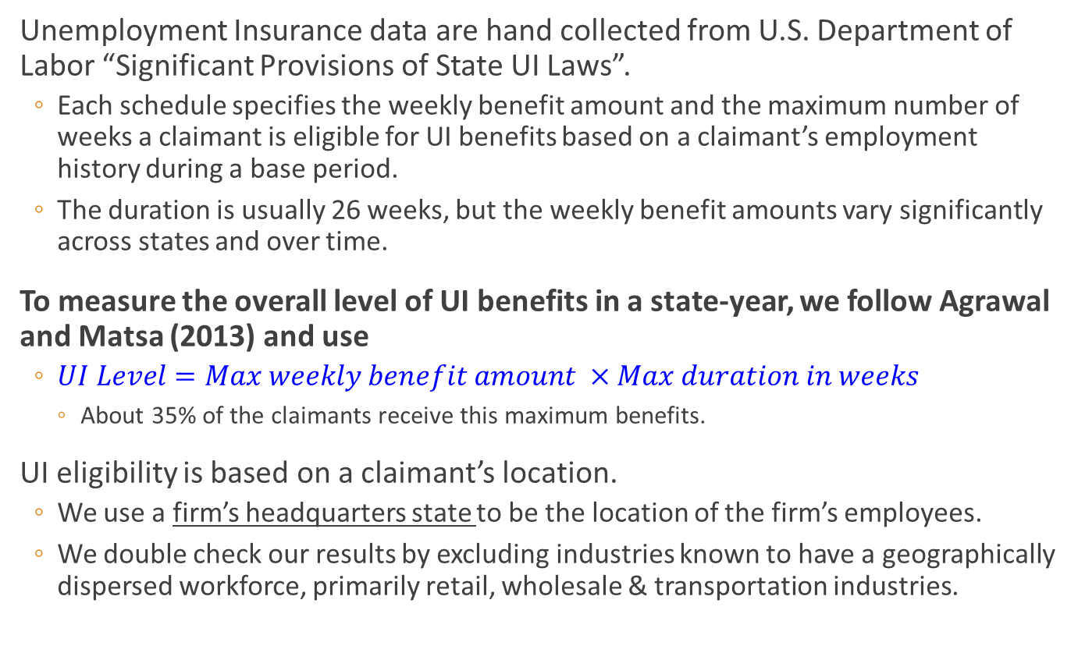
Data and Measurement of UI Benefits
Unemployment Insurance data are hand collected from U.S. Department of Labor “Significant Provisions of State UI Laws”.
  Each schedule specifies the weekly benefit amount and the maximum number of weeks a claimant is eligible for UI benefits based on a claimant’s employment history during a base period.
  The duration is usually 26 weeks, but the weekly benefit amounts vary significantly across states and over time.
To measure the overall level of UI benefits in a state-year, we follow Agrawal and Matsa (2013) and use
  $UI Level=Max weekly benefit amount ×Max duration in weeks$
    About 35% of the claimants receive this maximum benefits.
UI eligibility is based on a claimant’s location.
  We use a firm’s headquarters state to be the location of the firm’s employees.
  We double check our results by excluding industries known to have a geographically dispersed workforce, primarily retail, wholesale & transportation industries.

Slide 6
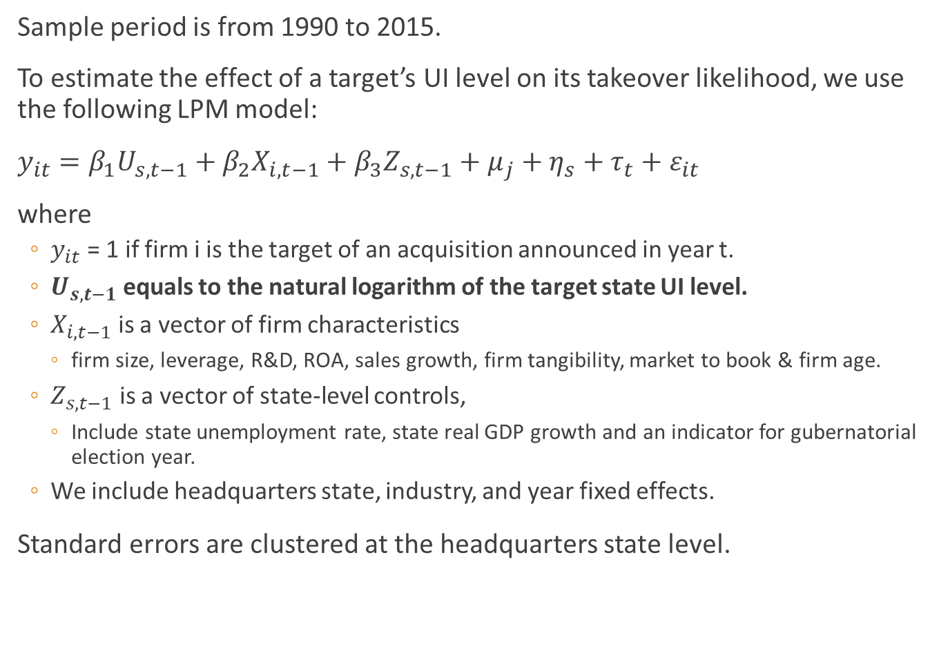
Empirical Specification
Sample period is from 1990 to 2015.
To estimate the effect of a target’s UI level on its takeover likelihood, we use the following LPM model:
$y_{it}=β_{1}U_{s,t−1}+β_{2}X_{i,t−1}+β_{3}Z_{s,t−1}+μ_{j}+η_{s}+τ_{t}+ε_{it}$
where
  $y_{it}$ = 1 if firm i is the target of an acquisition announced in year t.
  $U_{s,t−1}$ equals to the natural logarithm of the target state UI level.
  $X_{i,t−1}$ is a vector of firm characteristics
    firm size, leverage, R&D, ROA, sales growth, firm tangibility, market to book & firm age.
  $Z_{s,t−1}$ is a vector of state-level controls,
    Include state unemployment rate, state real GDP growth and an indicator for gubernatorial election year.
  We include headquarters state, industry, and year fixed effects.
Standard errors are clustered at the headquarters state level.

Slide 7
Table 3: Baseline results on takeover likelihood

Slide 8
Exploring of takeover channels likelihood
In some target firms, employees can have a formal channel to influence the takeover outcomes of their firms.
  Collective bargaining agreements can give employees a veto right
  Voting rights associated with large employee equity holdings arising from ESOPs, 401k plans, profit sharing plans, etc.
Also, in some target firms, boards more apt consider the impact of a takeover on employees.
  When UI benefits are higher, the board may be more willing to accept a takeover offer and vice versa.
  Boards with female directors can be more likely to consider employee interests.
  Firms that treat employees well before a takeover are more likely to consider employee interests.
  Firms in labor intensive industries may show more care for employees.

Slide 9
Table 5: Employee formal influence
Highly Unionized Industry is an indicator that equals to 1 if the union coverage rate in the firm’s industry is above the sample median and 0 otherwise.
Columns 3 and 4 are estimated over the period from 2000 to 2015 for which annual summaries of ESOP data are available from U.S. Department of Labor.
ESOP is an indicator that equals 1 if the ESOP holding is above 15% of outstanding shares in the year and 0 otherwise.

Slide 10
Table 6: Target board stakeholder orientation
Female directors is an indicator which equals 1 if a firm has at least 1 female director on the board, and 0 otherwise.
Employee friendly board is an indicator which equals 1 if a firm’s total employee strength index value from the KLD database is above the sample median, and 0 otherwise.
Labor intensity equal to total compensation divided by total GDP output of the firm’s industry (This variable is not time-varying).
Notes:
Add a Yes & No Other Controls!

Slide 11
Director Duties (DD) laws & the UI effect
In Table 6, we have controlled for time-varying state-level omitted variables by including state by year fixed effects.
But there can still be an omitted variable at the firm or industry level that is correlated with the cross-sectional differences in stakeholder orientation and at the same time, the strength of the UI effect.
To further pin down the channel of target board concern for their employees, we exploit the staggered passage of DD laws by individual states as an exogenous shock to a board’s stakeholder orientation.
A DD law allows a target board to consider the impact of a takeover on all stakeholders when evaluating the offer.
  Basically, the DD law provides added legal protection to a board’s decision to reject a takeover offer that is attractive to shareholders by asserting that other stakeholders are hurt.

Slide 12
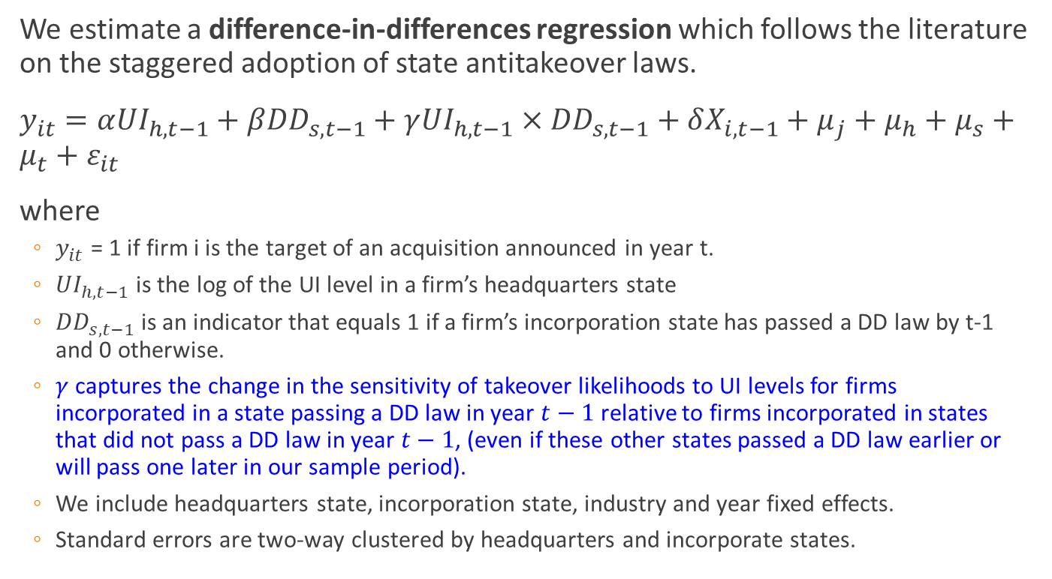
Empirical specification for DD law effect
We estimate a difference-in-differences regression which follows the literature on the staggered adoption of state antitakeover laws.
$y_{it}=α{UI}_{h,t−1}+β{DD}_{s,t−1}+γ{UI}_{h,t−1}×{DD}_{s,t−1}+δX_{i,t−1}+μ_{j}+μ_{h}+μ_{s}+μ_{t}+ε_{it}$
where
  $y_{it}$ = 1 if firm i is the target of an acquisition announced in year t.
  ${UI}_{h,t−1}$ is the log of the UI level in a firm’s headquarters state
  ${DD}_{s,t−1}$ is an indicator that equals 1 if a firm’s incorporation state has passed a DD law by t-1 and 0 otherwise.
  $γ$ captures the change in the sensitivity of takeover likelihoods to UI levels for firms incorporated in a state passing a DD law in year $t−1$ relative to firms incorporated in states that did not pass a DD law in year $t−1$, (even if these other states passed a DD law earlier or will pass one later in our sample period).
  We include headquarters state, incorporation state, industry and year fixed effects.
  Standard errors are two-way clustered by headquarters and incorporate states.

Slide 13
Table 7: DD laws and the UI effect

Slide 14
Target UI and Shareholder Gains
Expected deal synergies
  Higher UI benefits can facilitate greater workforce reductions.
  However, higher levels of layoffs increase acquirer payroll taxes in the future because of “experience rating”.
  The net benefit depends on whether the expected immediate gains from workforce restructuring outweighs the expected rise in future payroll taxes.
  Even if the net benefit is negative, UI can still increase takeover likelihood because it reduces target opposition to takeovers. But then, the increased activity would be driven by value-decreasing deals pursued by entrenched managers.
  Expected synergies is measured by acquirer CAR[-2,+2] + target CAR[-2,2]
Takeover premium
  Greater expected deal synergies can lead to higher takeover premium.
  Lower resistance can lead to lower takeover premiums.
  The net effect depends on the magnitude of the two opposite forces.
  Takeover premium = purchase price/target stock price 4 weeks prior to announcement

Slide 15
Table 8: Expected deal synergies

Slide 16
Table 9: Takeover premium and acquirer CAR
Do Target Shareholders Gain from higher UI level?
Our back-of-envelop calculation takes into account both the higher takeover likelihood and the lower takeover premium.
Our calculation shows that a 10% rise in target UI level increases target shareholder expected gain by 0.3% of the firm’s market capitalization.
Notes:
Our calculation is based the average takeover premium of 43%, the unconditional takeover likelihood of 3.3% and our estimate that a 10% increase in target UI benefit level leads to a 94 bp increase in takeover likelihood but a 24 bp decrease in takeover premium as follows: (3.3%+0.94%)*(43%-2.4%)-3.3%*43%=0.30%.

Slide 17
Table 10: Target UI and post-merger workforce restructuring

Slide 18
Conclusions
This study provides evidence and identifies channels through which state UI in the U.S. mitigates shareholder-employee conflicts of interest at both targets & acquirers and results in improved efficiency of the takeover market.
Our paper complements existing studies on shareholder-employee conflict of interests in takeovers by showing an alternative mechanism to mitigate these conflicts without changing the employee protection laws.
  Even when employees have strong legal rights or protections, they respond to financial incentives in their degree of opposition to takeovers because active opposition is costly to employees.
Existing literature assumes that target boards only consider shareholder interests & managerial interests when making takeover decisions. We provide new evidence that they appear to also consider employee interests.

Slide 20
UI Financing
UI benefits are primarily financed by payroll taxes on insured employers.
  A firm’s payroll tax rate depends on its layoff history and increases in steps. This system is called “experience rating”.
  For most firms in almost all states, the experience rating is incomplete.
    The tax rates do not increase sufficiently so that the benefits received by unemployed workers exceed the incremental cost to firms.
    In addition, there are large ranges on the top and bottom, over which a firm’s layoff history has no effect on its tax payments
UI benefits are first paid out of individual state trust funds. When the state funds are exhausted, a state is eligible to tap into federal funds.

Slide 21
Recent Literature on Employee-Shareholder Conflicts in M&As
Dessiant, Golubov and Volpin (2017): Increases in a country’s employment protection reduce takeover activity by 14-27% and reduce the combine synergy by more than half.
  Labor restructuring is a driving force of mergers and a source of synergy
John, Knyazeva and Knyazeva (2015):
  State-level employee protection in the U.S.
  State that have passed the right-to-work statutes experience higher bidder returns and synergies.
  Target firm state employee rights do not matter.
  Focus on employee-shareholder conflict of interest in bidders.
Tian and Wang (2016):
  Firms narrowly passed unionization votes are less likely to receive takeover bids and receive lower premiums.

Slide 22
Literature on Unemployment Insurance
Meyer (1990,1995): UI affects a worker’s unemployment duration.
Gruber (1997): UI helps workers to achieve better consumption smoothing.
Engen and Gruber (2001): Increase in UI => Less household precautionary savings.
Gormley, Liu and Zhou (2010): UI encourages individual stock market participation.
Agrawal and Matsa (2013) : Increases in UI => Higher leverage.
Ellul, Wang, and Zhang (2015): Increase in UI => More powerful incentive pay to the executives.
Hsu, Matsa and Melzer (2018): UI helps the unemployed avoid mortgage default and thus reduce the deadweight losses from loan default.
Ellul, Pagano and Schivardi (2018): UI has a substitute relation with a family firm’s provision for employment stability to their workers.

Slide 23
Data and Sample
Sample period is from 1990 to 2015.
M&A data from SDC
  Announced between January 1, 1990 to December 31, 2015.
  Transaction value above $1 million.
  The acquirer owns less than 50% of the target before the deal and 100% after.
  Exclude self-tenders, exchange offers, repurchase, spin-offs, recapitalizations, LBOs.
  Excluding financials and utilities.
Stock and financial data from CRSP and Compustat.
Corporate governance data are obtained from the ISS database (formerly RiskMetrics).
ESOP ownership data are from the Department of Labor’s private pension plan dataset.

Slide 24
Appendix: Target UI and acquirers’ target selection
All else equal, whether acquirers prefer to bid on target firms in states with higher UI benefits?
Following Rhodes-Kropf and Robinson (2008), we match equal actual target firm with a group of pseudo target firms satisfying
  In the same Fama-French 48 industry.
  In the same Market Cap and B/M quintiles of CRSP-Compustat merged database in the year of the takeover bid.
Estimate a regression where the dependent variable equals to one for actual target and zero for pseudo target firms.
Controlling for geographical distances between the acquirer and target and pseudo target firms.
We find that target UI level is positively related to being the actual target firm.

Slide 25
Table 1: Summary Statistics

Slide 26
Table 2: Summary statistics of changes in UI levels by state

Slide 27
Table 4: Addressing three alternative explanations

Slide 28
Director Duties (DD) laws & the UI effect
Anecdotal and survey evidence from as early as the mid-1960s suggests a large majority of managers would in practice consider any sizable impacts of a takeover on its various stakeholders (Donaldson and Preston, 1995).
Explaining the recent change in the Business Roundtable’s new statement of corporate purpose, Alex Gorsky, Chair of the Roundtable’s Corporate Governance Committee, stated that “BRT has always maintained that investing in employees and communities is an essential part of generating value for shareholders. But the fact is, words matter. And our own language was not consistent with the ways our member CEOs strive to run their companies every day.”
Hence, the passage of a DD law is likely to increase a target board’s stakeholder orientation.

Slide 29
Contributions
Our finding that certain target boards consider employee interests when making takeover decisions suggests that the role of UI is likely to increase in the future.
  Greater female representation on the board.
  Business Roundtables’ recent change in statement of corporate purpose.
Our study also adds to the list of economic benefits that policy makers should consider when setting UI benefits.

Slide 30
Acquirer UI & labor conflicts in acquirers
Takeovers can increase the unemployment risk of acquirer employees as well, although generally to a lesser extent than to target employees.
John, Knyazeva and Knyazeva (2015) find this creates shareholder-employee conflict of interests in acquirers.
  Strong labor right acquirers are associated with lower acquirer CARs and greater likelihood of making diversifying acquisitions.
If our evidence on target UI can be explained by its mitigating effect on labor conflict, then UI available to acquirer employees should also be able to mitigate the labor conflicts for the acquirer.
We expand our sample to also include deals where a private target is acquired by a public acquirer.
We use acquirer headquarter state UI level to proxy for the firm’s UI.

Slide 31
Table 13: Acquirer UI and acquirer CAR

Slide 32
Table 14: Acquirer UI and acquisition likelihood

Slide 33
Changes in the number of employees

