Slide 1
Chennai 2015: A novel approach to measuring the impact of a natural disaster
Samir Shah
14th December 2019

Slide 2
The Paper
Science to impact assessment of natural catastrophies is the need of the hour in order to direct the right responses
Authors throw light on one such event – the Chennai 2015 floods

Slide 3
Conclusions from the Paper
Immediately after the floods, households see increase in consumption expenditure, specifically in food, power and fuel
Expenditures fall after a year
Households seen to financing these expenditures by not saving and/or postponing asset purchases
The more financially vulnerable households show lesser increase in expenditure increases
No significant impact on income levels in households after the floods
* Data derived from CMIE’s Consumer Pyramids Household Survey (CPHS)

Slide 4
Some observations
links between increase in expenditure as a coping mechanism needs deeper assessment. The authors report significant increases in food, power and fuel and health expenses, two months after the Chennai floods. While increase in health expenditure is plausible and convincing owing to illness from water borne diseases potentially caused due to floods, why would there would be an increase in food and power & fuel expenses?
Comparing the study results with Dvara’s Krishnagiri (KG) study- The KG study finds that the incidence of shocks came with significant financial costs and occasionally loss of working days. However, the financial costs were reflected in terms of increase in relevant expenses related to the shock. For example, a health shock was associated with increase in health expenses and shock related to business/livelihood was associated with expenses related to repair of assets of property. The KG study does not document increase in food or other day to day expenses post shock.
Substantial relief packages by the TN Government immediately after the floods, while the study mentions this point, it may worth fleshing out whether these cash transfers could have been the reason for an increase in consumption expenditure.
Lastly, the study finds no significant impact on income as a result of the floods. A disaggregated analysis by the types of occupation that the households are involved in might throw further insights on impact of floods on monthly income of households (hypothesis being that households working on daily or weekly wages had a greater impact on their income as a consequence of floods than salaried households).

Slide 5
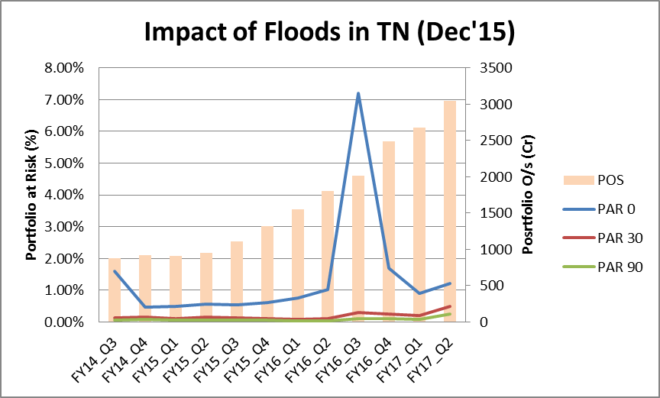
The MFI experience during Chennai floods

Slide 6
The MFI experience…
PAR 0-30 peaked in Dec-15 in these districts significantly: Tiruvallur (10.0%), Chennai (7.9%) and Kanchipuram (5.5%).
Limited roll forward of PAR 30 or losses (PAR 90) is indicative of subsequent collections.
This may be attributed to the following:
Resilience of the underlying borrower
Accommodative collections practices of MFIs
General observation is that MFI customers are one repayment behind for the first 3-6 months and then come back on track after 6 months after such events

Slide 7
Thank you

