Slide 1
Unshrouding Relevant Information of Financial Products: Do Rules of Thumb Work? Vimal Balasubramaniam; Olga Balakina; Aditi Dimri; Renuka Sane
Notes:
Elon Musk vs

Slide 2
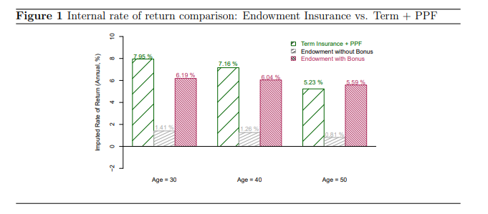
Praises…
Scope of Financial Mis-selling
Very Rampant; Esp in Emerging Economies
Right product to test .. Bundled product in Insurance stark example .. 80% of cumulative premiums for these products
Traditional Solutions suggested has failed to improve the condition – Disclosure; Regulated sales; Improving Financial Literacy; Creation & Supply of unbiased product
Primarily because consumers of financial product tend not to know what they don’t know/constraints; basic finance literacy doesn't directly help in decision making

Slide 3
Praises…
Educating on “simple heuristic based rules” approach?
For all the financial theories, sophisticated investors also depend rule of thumb; Starting from projected returns/discount rate…
Need of simplify financial literacy seems to be accepted largely.. How to make it happen we aren’t sure
No Theory working .. RCT to the rescue
RCT esp has been used in evaluating a number of educational interventions since 1980, well established in area
Findings show increase in “right decision”
Vis-à-vis literature finding interventions to improve financial literacy explaining only 0.1% of the variance in financial behaviors studied
Can piggyback on Fintech revolution.. FinBots
Fintech has also brought the need, rapidly linking masses/less financially sophisticated investors to financial product

Slide 4
Some Concerns
4 aspects of Financial Literacy suggested:
Instrument Specific Literacy vs General Literacy
Financial Literacy to avoid big mistakes rather than assist in best possible choice
Focussed on Simple Heuristics (Lit)
Ideally reached at time of sale (Lit)
Looking for angel??..
Correct content, with Rule of Thumb approach, delivered in short videos at the time of sale..
May not be an impossibility with FinTech
Still… the timing.. Literature establishes memory constraint in financial information
Improvement in choice, but Limited Impact in information ex Bonus returns and inflation consideration

Slide 5
Some Concerns
Leveraging supply side part missing
That intensity of misselling is highest in Insurance product, which also has a skewed supply side incentive vis-à-vis other financial product suggest strong role of sellers and their incentive
Short videos to be done prior to sales, forced through regulation? Suppliers best placed for timing
Standard videos for products to be built

Slide 6
Some Concerns
Pedagogic Study?
What is meant by Rule of Thumb? How to design? Can it be made more effective
Maybe sets of Rule of Thumbs should be tried.. What should go in what should not
Would have loved to see Rule of thumbs and their designing used in experiment
Some in Methodology..
RCT … 1 experiment…
Phone Survey only for Term…
Clearly conveyed which product is better: Rote learning possibility & value .. Two month experiment

