Slide 1

Data Source: SKYTRAX

Slide 2


Airlines Analysis on travelers
A Comparative Study of SIA, EVA, ANA, Emirates, and Lufthansa
Presented by:
Data Dynamos
Ho Kwok Leong, Richard, Nabilah
Notes:
This comprehensive analysis project aims to uncover valuable insights from customer feedback, empowering airlines to enhance service quality, boost customer satisfaction, and make data-driven business decisions. By combining the power of SQL queries and Python data analysis techniques, we will explore the provided database, extract and prepare relevant data, and generate actionable insights that can drive continuous improvement in the airline industry.

Slide 3





Singapore Airlines (SIA) is Singapore's flag carrier, celebrated for its exceptional service and modern fleet. With a vast global network, including subsidiaries like SilkAir and Scoot, SIA offers premium travel experiences and global connectivity.
Emirates: Leading Dubai-based airline with a modern fleet, serving over 150 destinations globally with luxury amenities and award-winning entertainment.
Lufthansa: Leading German airline with a global network, modern fleet, and premium service to over 220 destinations worldwide.
EVA Air: Leading Taiwanese airline with a modern fleet, serving over 60 international destinations. Renowned for quality service and luxurious cabins, EVA Air offers passengers a premium travel experience.
All Nippon Airways (ANA): Leading Japanese airline with a modern fleet, serving over 100 destinations globally. Renowned for exceptional service and punctuality, ANA offers passengers a premium travel experience.

Slide 4




Driving Actionable Insights
Customer-Centric Focus
Service Quality
Personalization
Innovation
Prioritize initiatives that directly address customer pain points
Leverage customer feedback
Identify areas of excellence and opportunities
Targeted strategies to consistently deliver high-quality services across all aspects of the airline's operations.
Segmentation insights to personalize the travel experience
Cater to the unique needs and preferences of different traveler types and classes.
Embrace a culture of continuous improvement
Staying ahead of evolving customer expectations and industry trends
Notes:
Prioritize initiatives that directly address customer pain points and enhance the overall travel experience. Leverage customer feedback to guide service improvements and innovation.
Identify areas of excellence and opportunities for improvement.Implement targeted strategies to consistently deliver high-quality services across all aspects of the airline's operations.
Utilize customer data and segmentation insights to personalize the travel experience, catering to the unique needs and preferences of different traveler types and classes.
Embrace a culture of continuous improvement, exploring new technologies, processes, and service offerings to stay ahead of evolving customer expectations and industry trends.

Slide 5
Exploring the Data Landscape
What do we aim to achieve through our analysis?
Comprehensive Data Model
Establish Data Relationships
Exploration Opportunities
Notes:
Why do we want to conduct the analysis
Comprehensive Data Model The provided database schema offers a rich and interconnected dataset, encompassing key information about airlines, customer reviews, and various aspects of the travel experience. This comprehensive data structure enables us to conduct in-depth analysis and uncover meaningful insights.
Data Relationships The schema highlights the relationships between the Airlines and Reviews tables, allowing us to explore the connections between airline performance and customer feedback. This will be crucial in understanding the factors that drive customer satisfaction and identifying areas for improvement.
Exploration Opportunities The diverse data points, including traveler type, class of travel, rating, and review text, present a wealth of opportunities for exploration. By leveraging SQL and Python data analysis techniques, we can delve into the nuances of customer feedback and airline performance.

Slide 6
Obtaining a dataset
Market Analysis & Sentiment
Transforming the data
Loading into a DB
Content

Slide 7
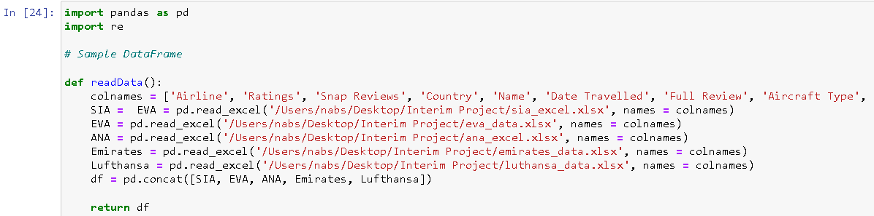
After obtaining 5 airlines dataset, Merging all into 1 dataset

Slide 8
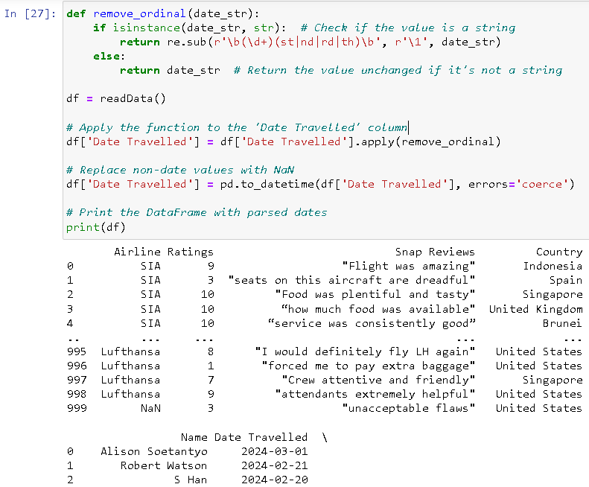
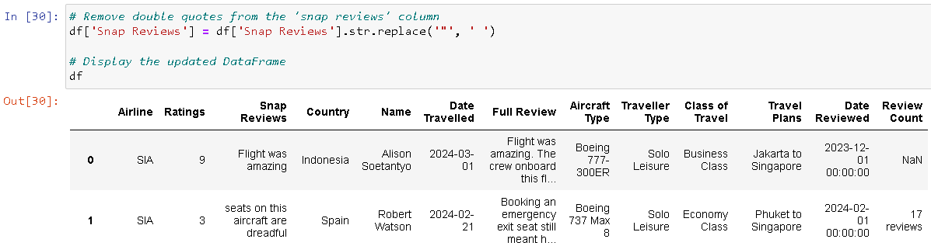
Cleaning up the dataset

Slide 9
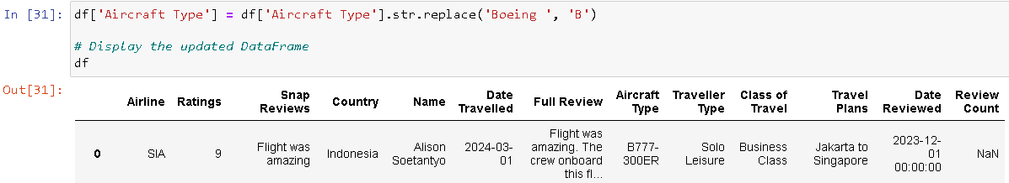
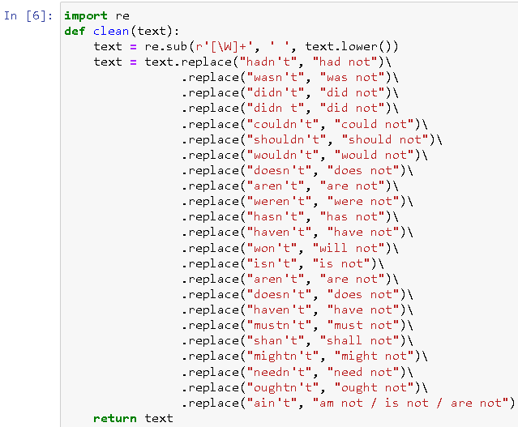
Cleaning up the dataset

Slide 10
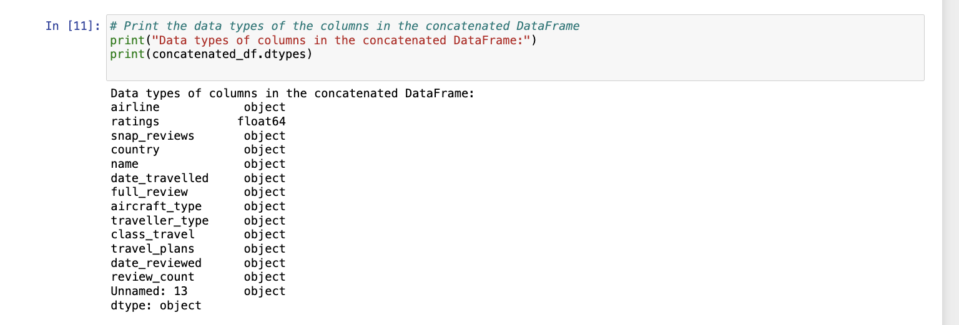
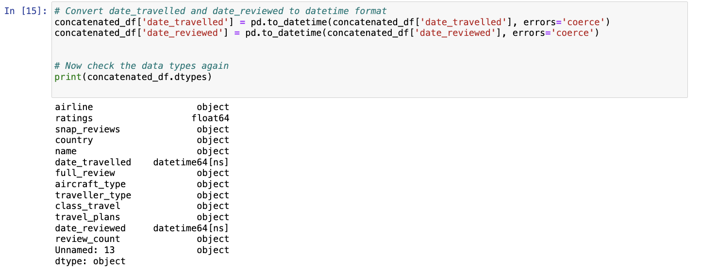
Cleaning up the dataset
Notes:
Transformation process :
After obtaining the dataset, we had to concatenate the 5 different airline dataset together and edit undesirable parts. For example, we had a column ‘date travelled’ where it was not all formatted the same. We ran it through Python to change all of ‘objects’ into ‘datetime’.
Notes : highlight that date in 1st screenshot is a object, 2nd screenshot formatted to datetime

Slide 11
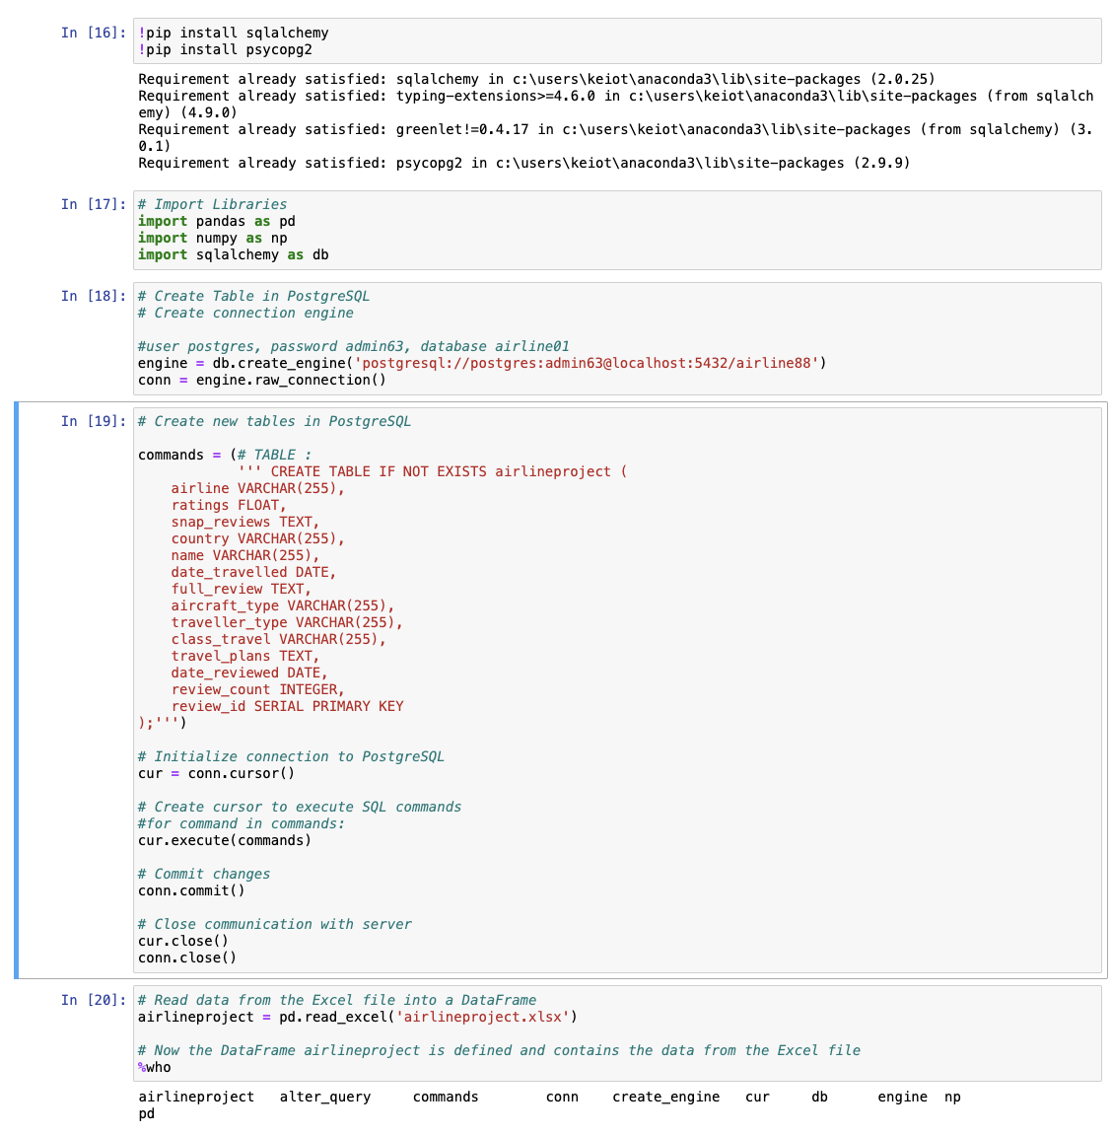
Loading the clean data into a database
Using Python
Importing relevant libraries
Creating a table with chosen columns
Populating data into the created table

Slide 12
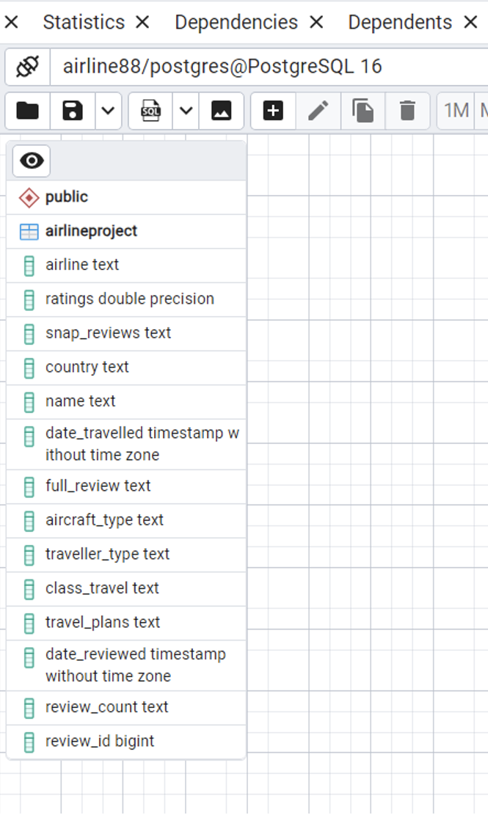
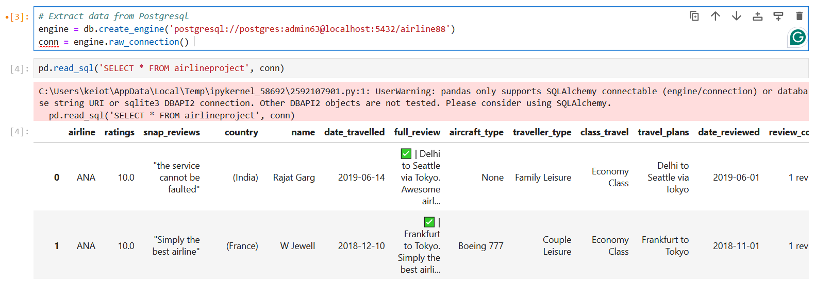
Loading the clean data into a database
Establishing our Entity-Relationship Model (ERD)
Extraction of data from Postgresql

Slide 13
Sentiment Analysis: Uncovering the Voice of the Customer
Sentiment Scoring
To gauge the overall sentiment expressed in customer reviews
Ranging from positive to negative
Identifies areas of strength and opportunities for improvement from the customer's perspective
Thematic Analysis
Using Natural Language Processing (NLP) we can identify common themes and topics discussed in the review text
Provides valuable insights which guides targeted improvement efforts
Temporal Trends
Analyzing sentiment and thematic trends over time can reveal how customer perceptions evolve
Improves ability to address emerging concerns
This dynamic understanding can inform strategic planning and decision-making.
x
Notes:
Sentiment Scoring
By applying sentiment analysis techniques, we can gauge the overall sentiment expressed in customer reviews, ranging from highly positive to negative. This analysis can help identify areas of strength and opportunities for improvement from the customer's perspective.
Thematic Analysis
Leveraging natural language processing, we can identify common themes and topics discussed in the review text. This can provide valuable insights into the specific aspects of the airline experience that customers value or find frustrating, guiding targeted improvement efforts.
Temporal Trends
Analyzing sentiment and thematic trends over time can reveal how customer perceptions evolve, enabling airlines to stay attuned to changing expectations and proactively address emerging concerns. This dynamic understanding can inform strategic planning and decision-making.

Slide 14
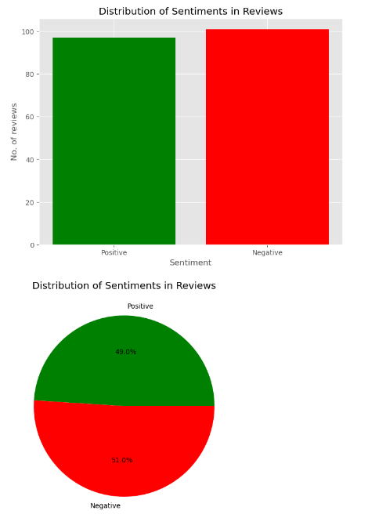
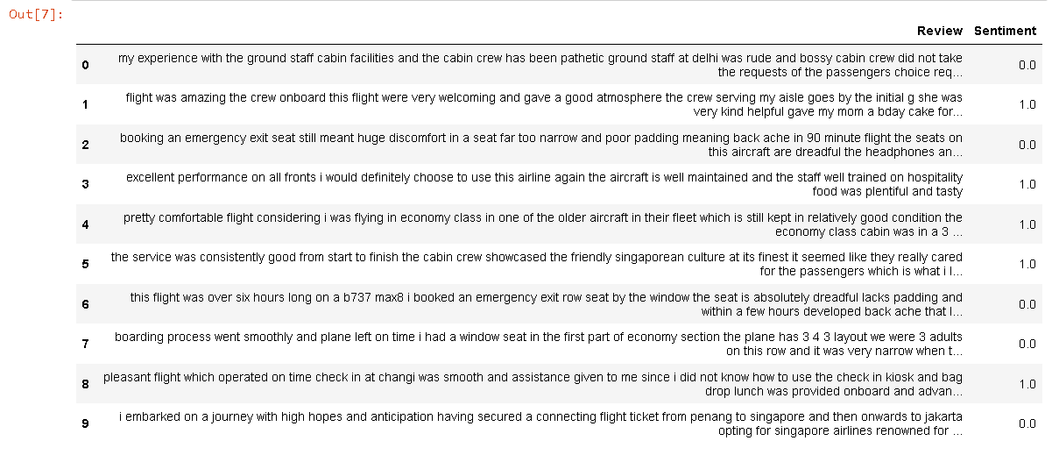
Sentiment Analysis on Reviews

Slide 15
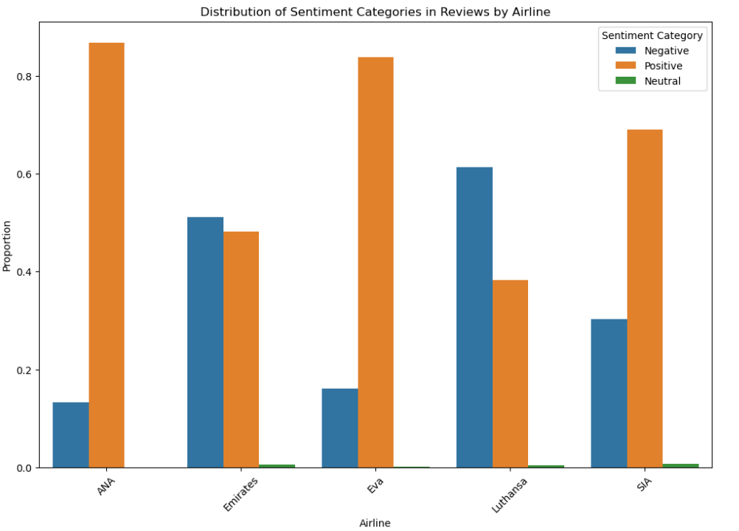
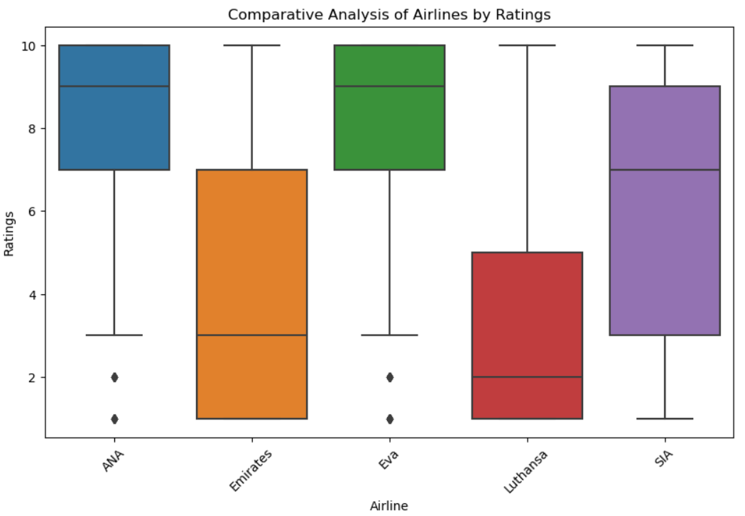
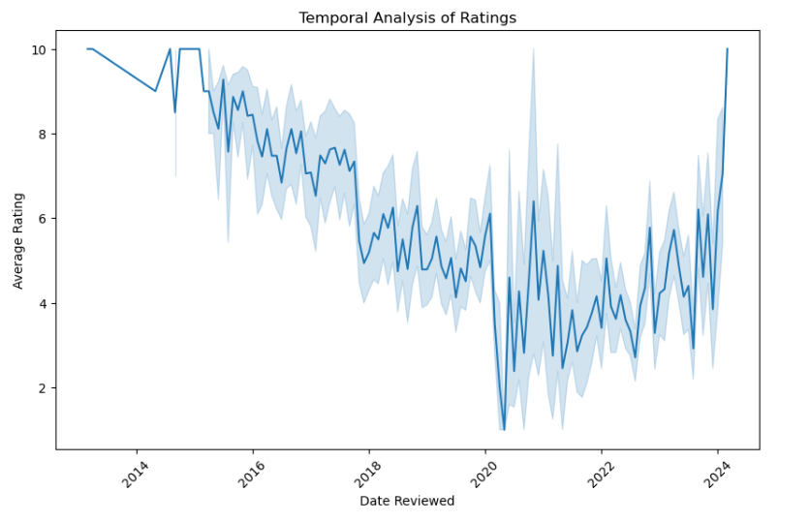

Slide 16
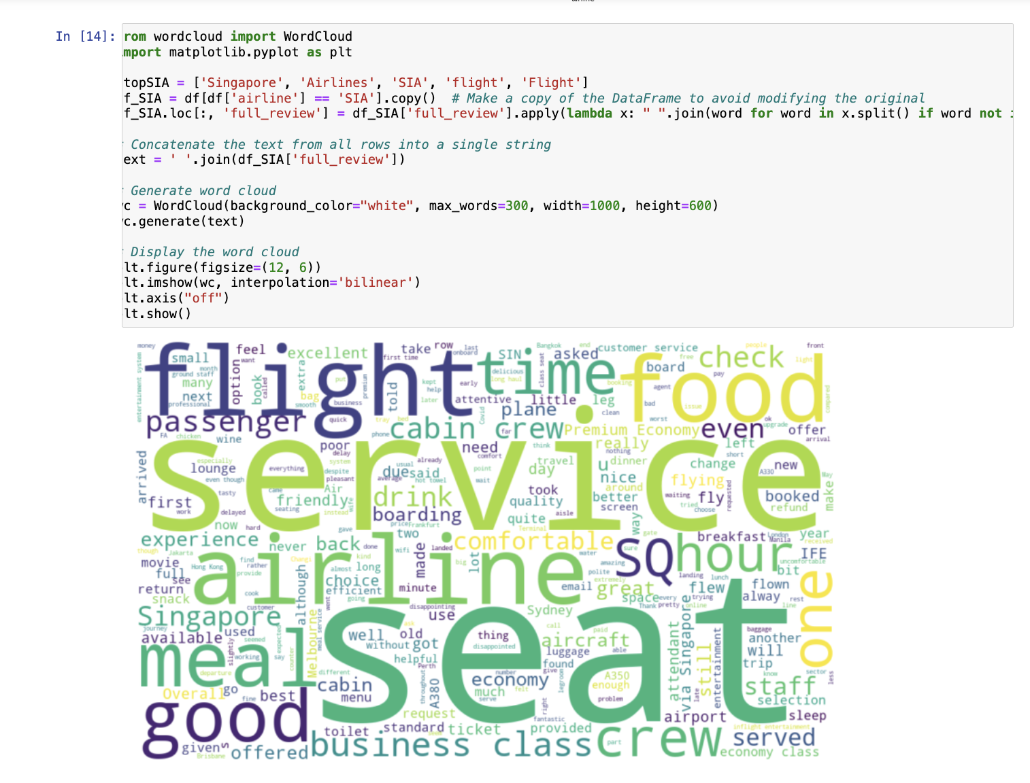
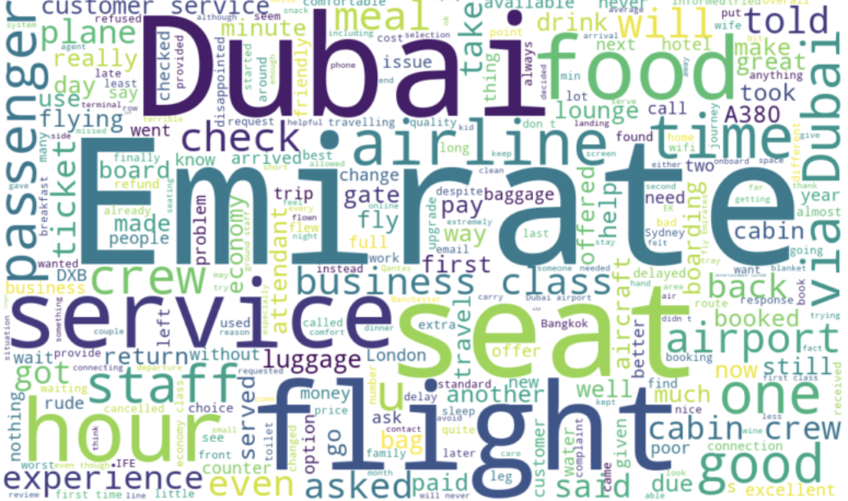
Word Cloud to understand customer trends
Key points
1. Service
2. Seats
3. Food
4. Flight
5. Business Class

Slide 17
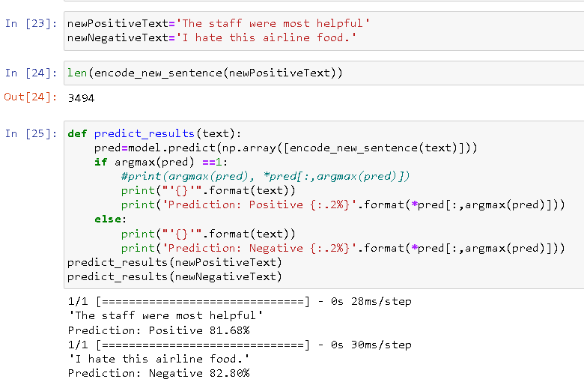
Training a model to auto-detect positive or negative feedback from travelers benefits airlines by:
Improving efficiency and handling large volumes of feedback.
Providing real-time insights for prompt responses and continuous improvement.
Enhancing customer experience and satisfaction.
Supporting data-driven decision-making and personalization.
Offering a competitive edge and brand reputation management.

Slide 18
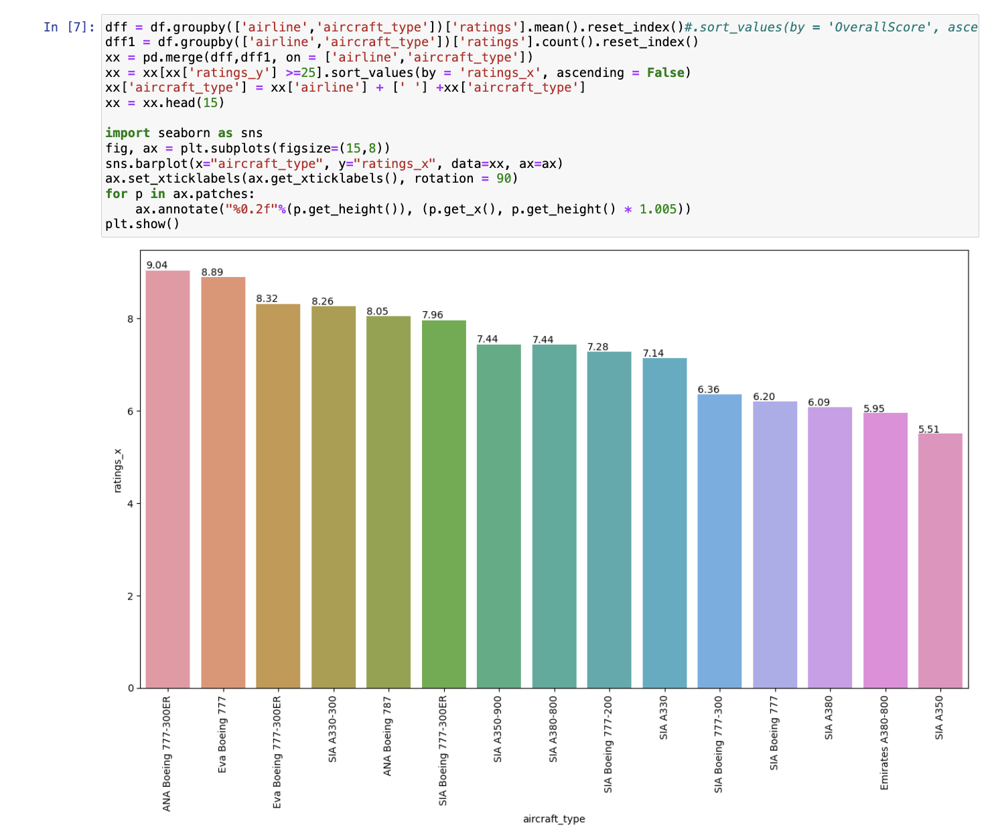
Comparison of the aircraft type vs overall ratings

Slide 19
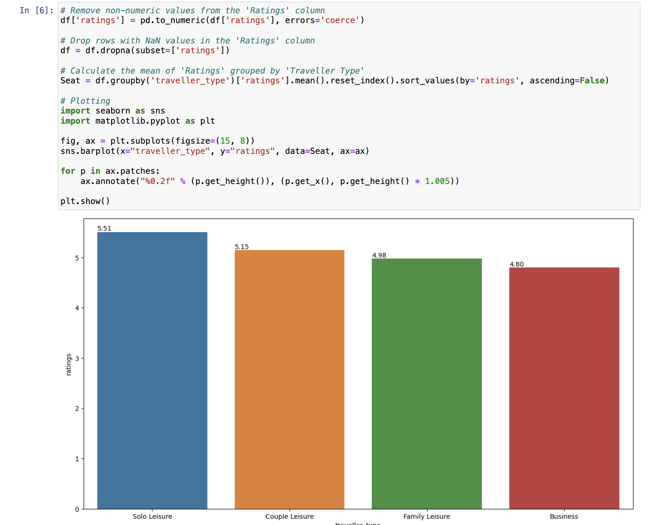
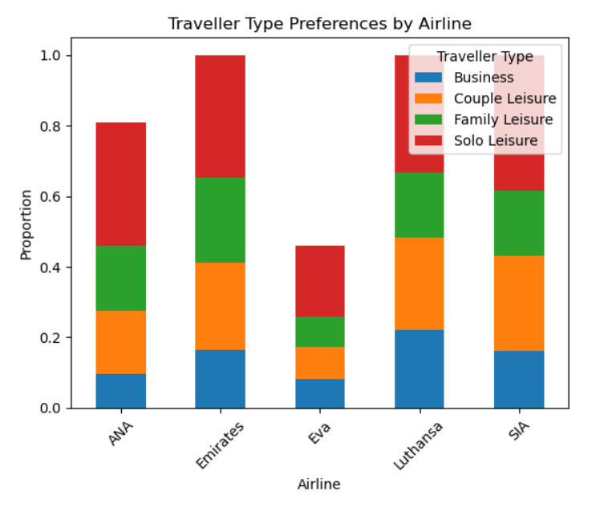
Traveler type

Slide 20
Limitations:
Data Availability and Accuracy: Getting accurate and up-to-date data can be challenging as airlines often release this information periodically and may not provide detailed breakdowns.
Customer Sentiment and Perception: Assessing customer satisfaction and perception involves analyzing qualitative data from various sources, such as reviews and surveys. Interpreting this data accurately to understand customers preferences can be challenging.
Global Events and Crises: The airline industry is vulnerable to global events and crises such as pandemics, natural disasters, terrorist attacks, and economic downturns. And these can affect the accuracy of our analysis.

Slide 21
Conclusion: Unlocking the Power of Customer Feedback
This interim assessment analysis has showcased the immense value that can be extracted from customer feedback data to drive meaningful improvements in the airline industry. By leveraging the power of Python data analysis techniques, we can guide airlines in enhancing service quality, boosting customer satisfaction, and making informed, data-driven decisions.
From exploring the data landscape and conducting analysis to applying sentiment analysis and generating actionable recommendations, this assessment has demonstrated the holistic approach required to harness the true potential of customer feedback. By fostering a data-driven culture and embracing a continuous improvement mindset, airlines can translate these insights into tangible business results and cement their position as industry leaders in customer experience.
As airlines strive to navigate the evolving industry landscape and meet the changing expectations of their customers, this analysis project serves as a blueprint for unlocking the transformative power of data-driven insights. By empowering airlines to listen to the voice of the customer and make strategic, evidence-based decisions, we can collectively elevate the customer experience and drive the industry forward.

