Slide 1
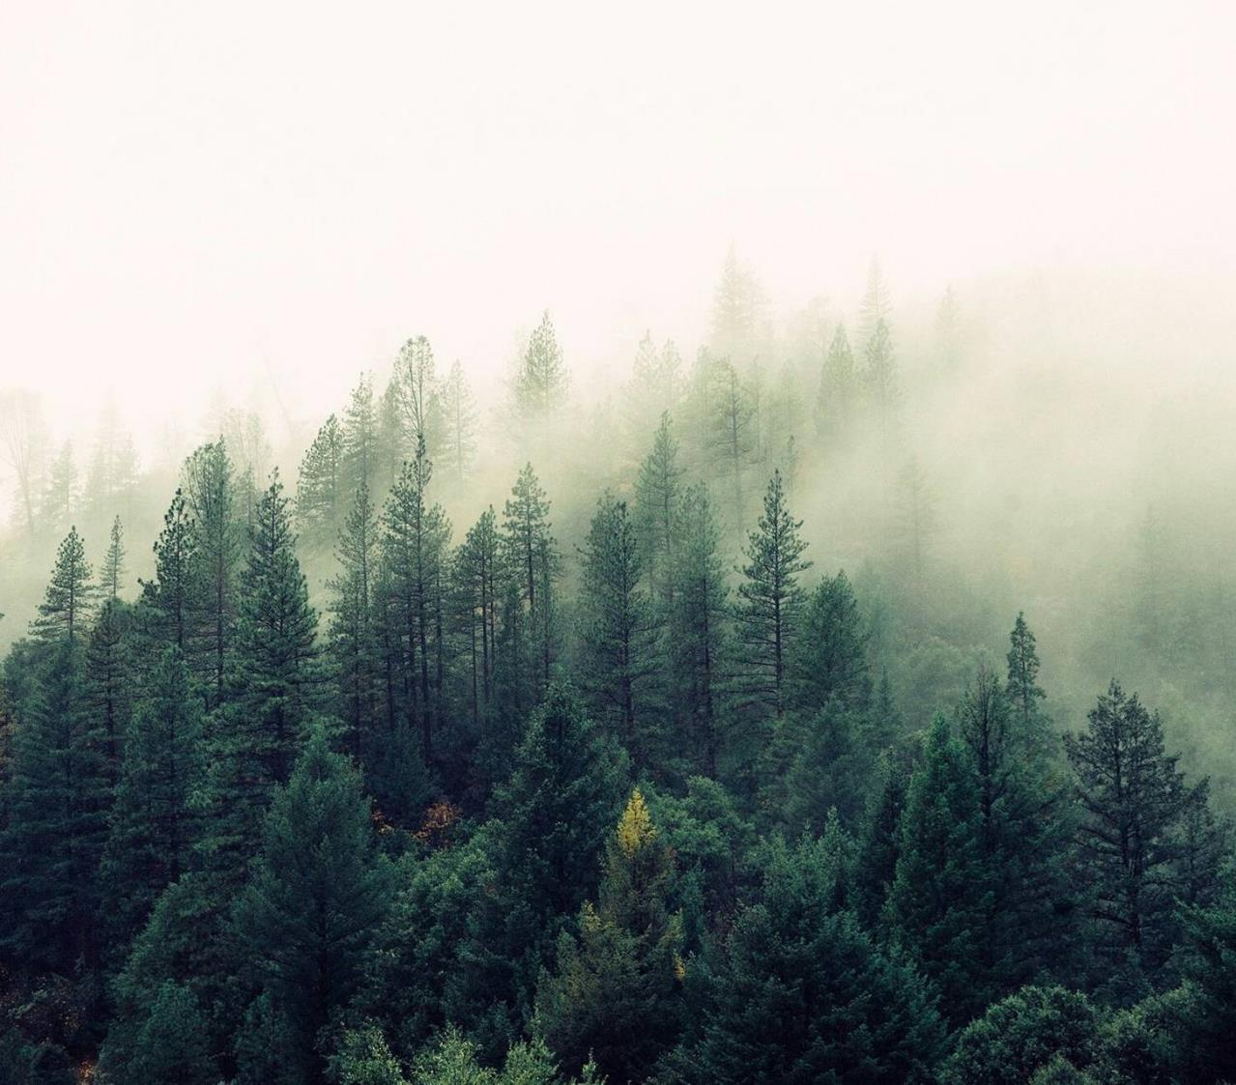
Animal Scouter
João Leite
João Reis
Luís Batista

Slide 2
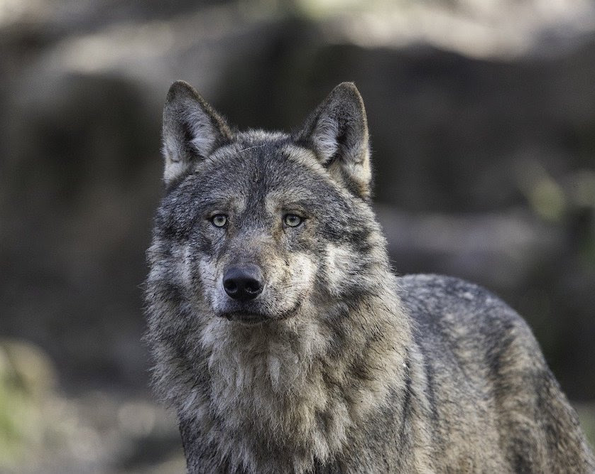
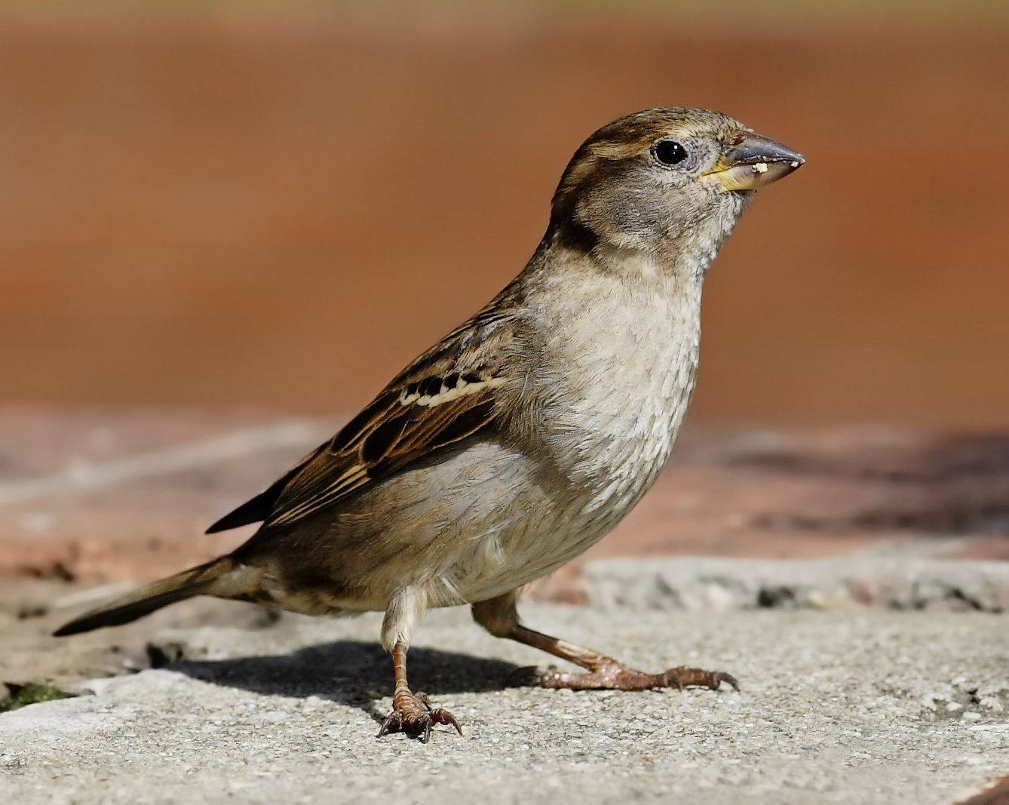
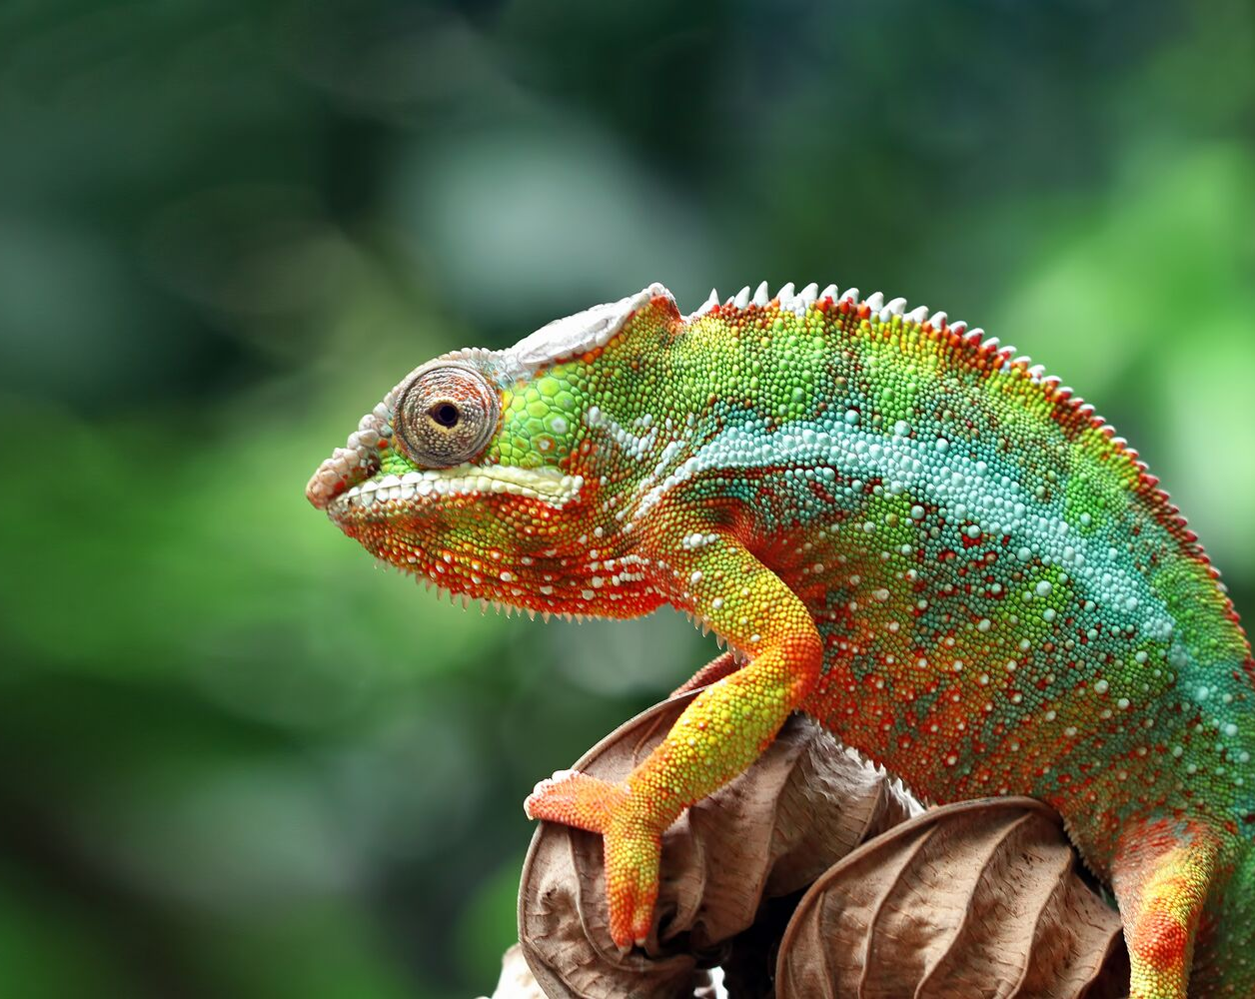
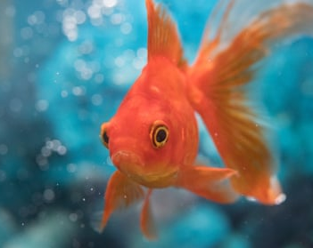
Schedule
Data: Sources and Transformations
Data: Operations
Demo

Slide 3
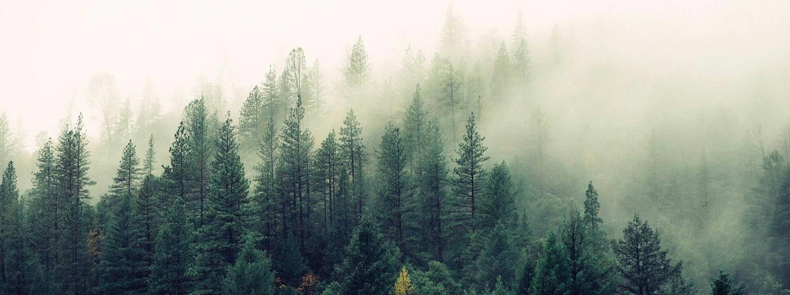
Data
Sources Transformations

Slide 4
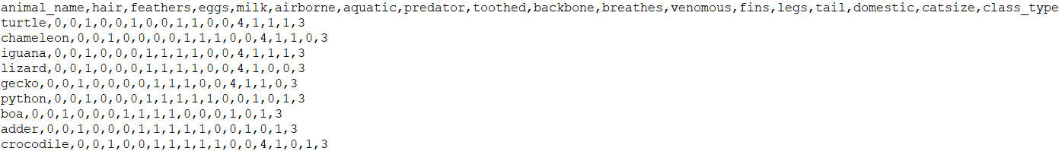
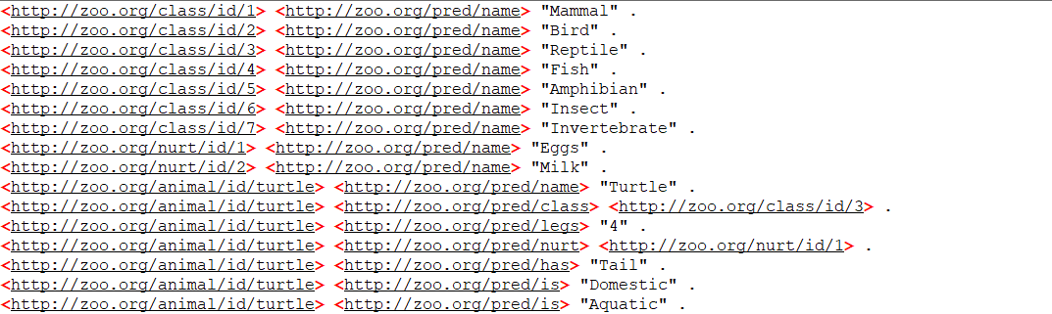
Data: Sources and Transformations
.csv file
.nt file

Slide 5
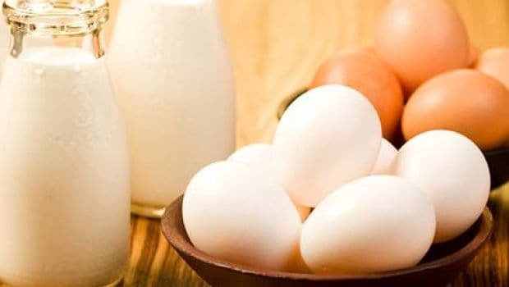
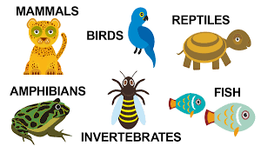
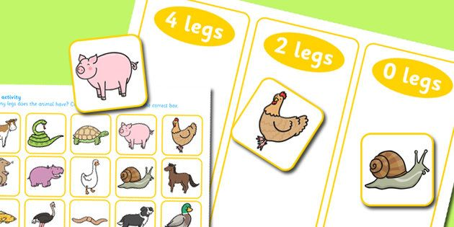
Characteristics used
and more!

Slide 6
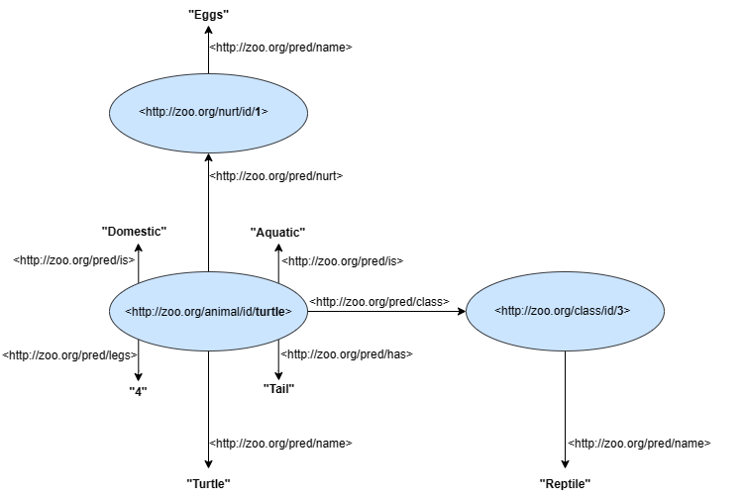
Graph example

Slide 7
Data
Operations

Slide 8
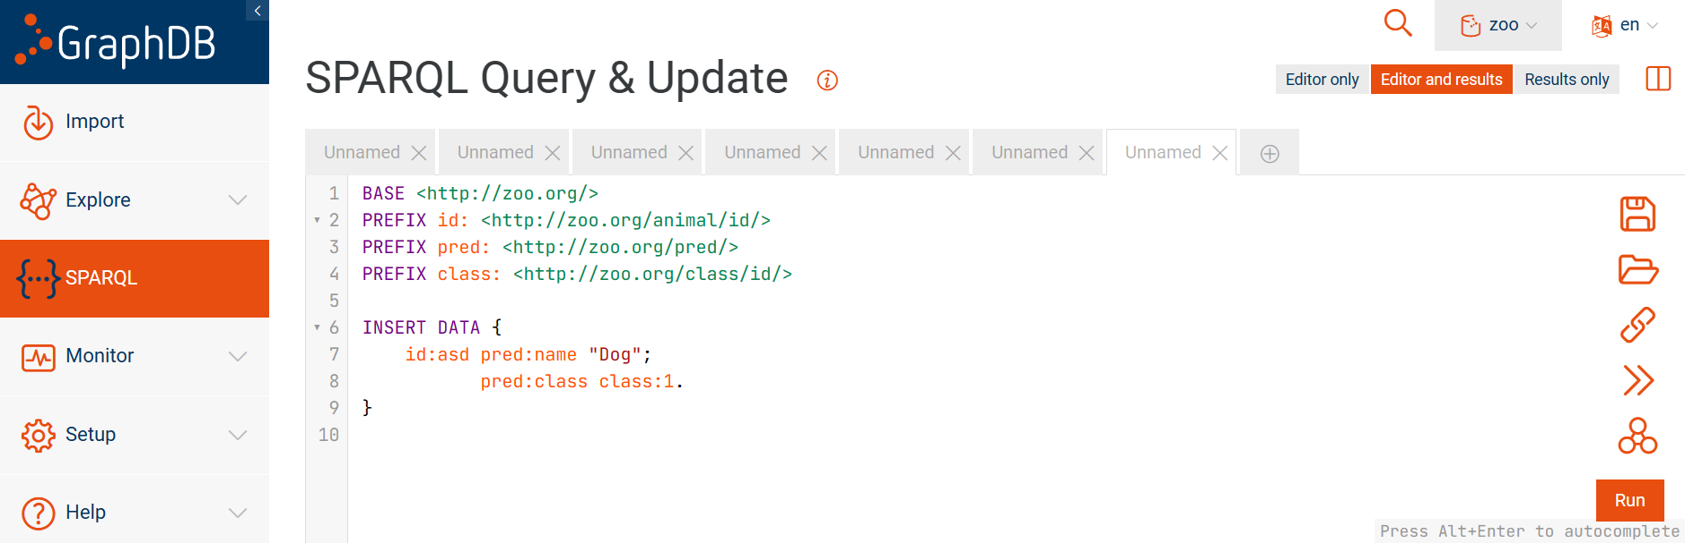
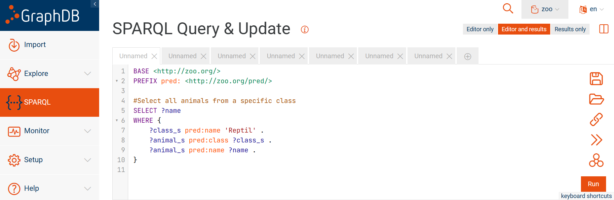
Data: Operations
Configs
Queries / ASK
Insert
Delete
Select
Filters
Intersection
Ask
Insert Example
Select Example

Slide 9
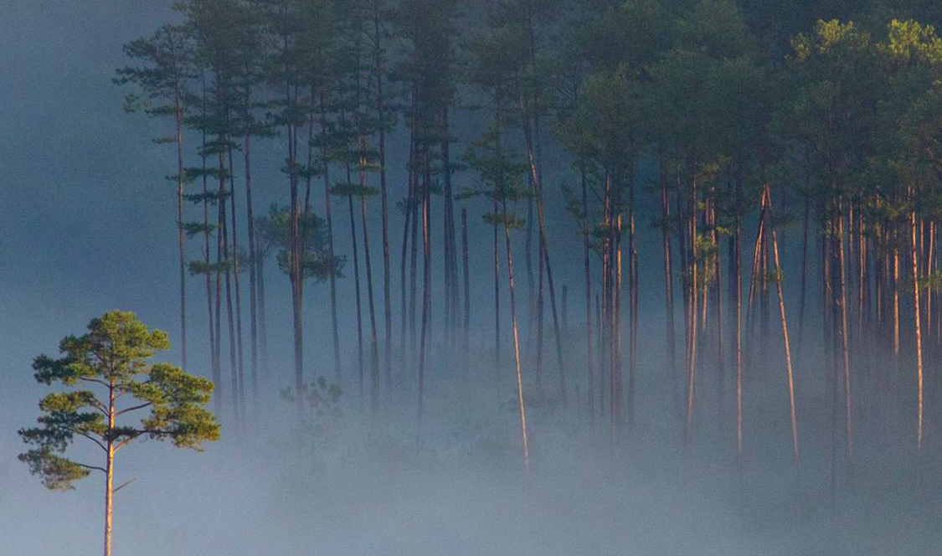
Thank you
Demo Time!

