Slide 1
Histogram equalization and optimal profile compression based approach
for colour image enhancement
Chin Yeow Wong a , Guannan Jiang a , Md Arifur Rahman a , Shilong Liu a , Stephen Ching-Feng Lin a ,
Ngaiming Kwok a,d, ⇑ , Haiyan Shi b , Ying-Hao Yu c , Tonghai Wu

Slide 2

Team_D.7
Priyansh Gupta (2019101080)
Astitva Ranjan (2019112025)
Mohd Hozaifa Khan (2021701026)
Bhavya Jain (2019101095)
Github repo link for cloning: https://github.com/Digital-Image-Processing-IIITH/dip-project-team_d-7.git

Slide 3


1. Contribution
Priyansh Gupta Implementation of UI, contrast stretching, colour space conversion, mean shifted HE , Compression profile, Optimal value of Gain factor. Analysis of image(300) dataset.
Mohd Hozaifa Implemented different metrics like entropy, colour richness, PSNR, sharpness etc. and saturation maximization. Also studied from many resources and suggested different HE techniques (are listed in ppt).
Astitva Ranjan Prepared project proposal, tested working of different components and put together all the components together for final submission. Also prepared ppt for the presentation.

Slide 4
Given Cloudy Coloured images
How to enhance them
To a better version?
Tip
Sometimes things which don’t look impressive may contain hidden information that may be helpful in beautifying itself after a little bit of efforts.

Slide 5
Already did! Assignment-3.
We already did enhance such an image using linear contrast stretching and histogram equalization for a coloured image. So what’s the issue here? Seems quite easy right?

Slide 6
Problem Statement
We can clearly observe that there are few problems in just using the previously mentioned two techniques. The first one is that there are many artefacts in the output near low and high intensities and second is that there is a loss of saturation in the final rgb image.

Slide 7
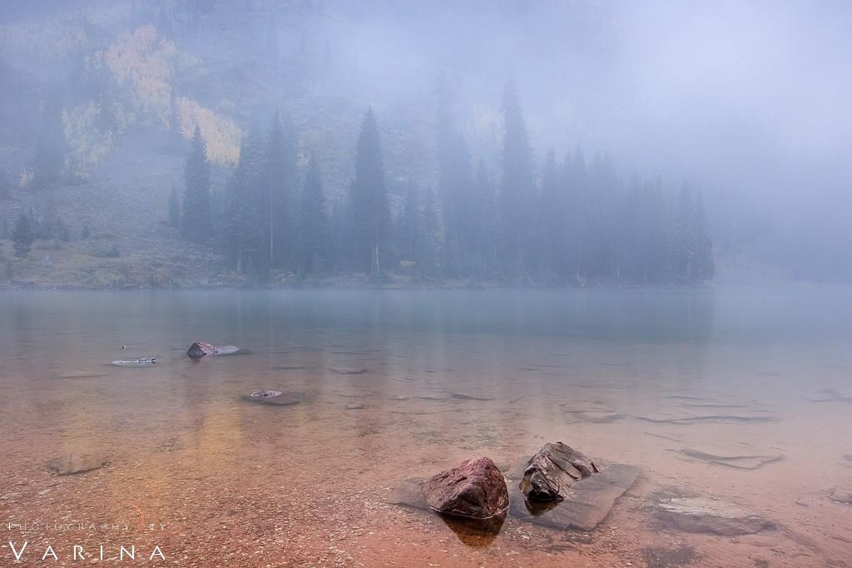
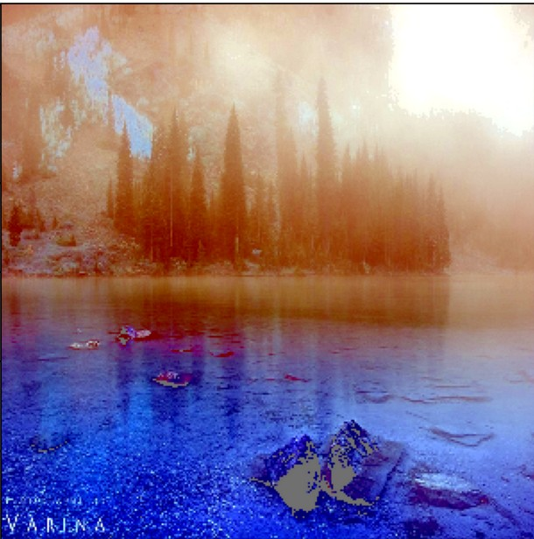
Contrast stretching+HE
Input Image: Enhanced Image:

Slide 8
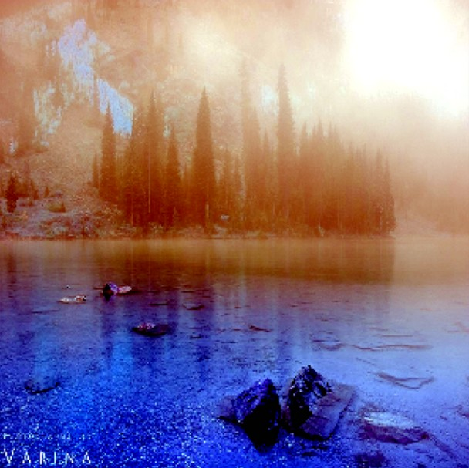
Proposed pipeline vs General
Enhanced Image(with compression profile+saturation max): Enhanced Image without compression:

Slide 9
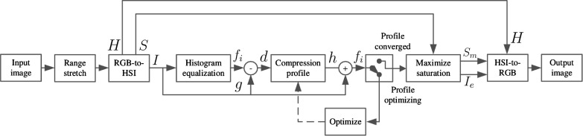
Proposed pipeline in research paper:

Slide 10
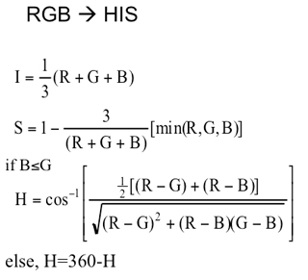
RGB to HSI conversion:

Slide 11
Histogram Equalization:
We first find Xmean = mean of all intensities in the image.
Xdel = min(255-Xmean , Xmean)
[Xl, Xr] = [Xmean-Xdel , Xmean+Xdel]
Xi = Xl + (Xr-Xl)✕P(Xi)

Slide 12
Profile Compression:
Let G be original image and F be output of HE and D be F-G.
Now we want a function such that we can compress the HE:
F(u,v) = G(u,v)+H(u,v)✕D(u,v) , such that
H(u,v) -> 1 for a small D(u,v)
H(u,v) -> 0 for a large D(u,v)

Slide 13
Hyperbolic Profile Compression:
As suggested in the research paper, we used this hyperbolic tangent function:
H = 0.5 ✕ (1 + TanH[ K ✕( 1- D/128 ) - 3])
K is called gain factor.

Slide 14
How to find optimum gain factor:
Our one main target is to increase the entropy, so we want to find K such that entropy
Is maximized. We first find a range [Kl , Kr] by applying Golden Section Search
Algorithm on a range of [0 , 1e6] .
After this we got a range of [1.5 , 4.5] for most of the images so we could use this
Range to find the best value of gain factor.

Slide 15
Saturation Maximization:
Convert this new HSI to corresponding RGB.
Now again convert resultant RGB to HSI
New Saturation = max(S_{out} , S_{in})
Now again covert this final HSI to RGB to get actual output.

Slide 16
Score Metrics:
Entropy: Measure information content in the image.
Sharpness: Compute Sharpness measure of Gray scale Image
ColorFullNess: It is related to range of color and its value decreases when image is taken in bad weather condition.
Color Richness: Mean of Saturation
Abs Mean Brightness Error: This metric is associated with global change in brightness.
Peak Mean Squared Error: This metric is associated with noise content in the image and thus a measure of quality of image.

Slide 17
Results and Observations
Tip
Don’t wait till the end of the presentation to give the bottom line.
Reveal your product or idea (in this case a translation app) up front.

Slide 18
Dataset of images:
We tried to enhance two images low1, low2 which are present in the parent directory.
In order to check different score metrics we compared their value for proposed method and general method by performing enhancement on a dataset of 300 images of flowers.
Link to dataset: - https://drive.google.com/drive/folders/1HKp2G6NbLkW2lCtsdGi9Qr-OWc1g99-_?usp=sharing

Slide 19
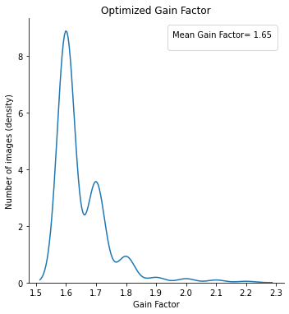
Gain Factor.
The mean value of optimal gain factor is 1.65 over 300 images.
Gain factor depends on the information content of the input image.

Slide 20
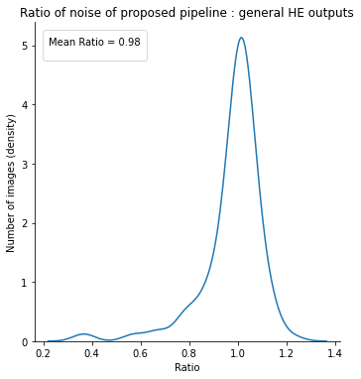
Noise
This shows that there is slightly less noise in the output of proposed pipeline.

Slide 21
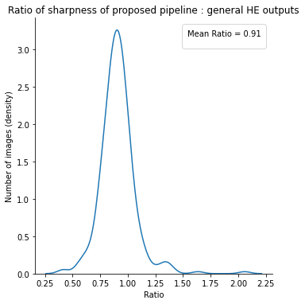
Sharpness
This shows that output of proposed pipeline is less sharp as compared to one produced by general HE. This means gradient is less in proposed pipeline output( ideal case ).

Slide 22
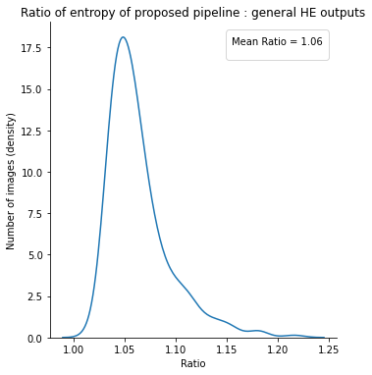
Entropy
This shows that output of proposed pipeline has more entropy( more information ) as compared to one produced by general HE.

Slide 23
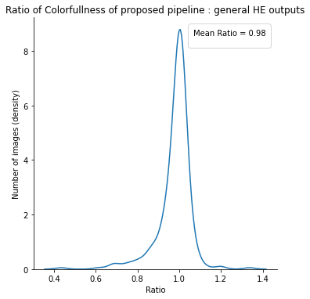
Colorfullness
So output of proposed pipeline is slightly less colorfull than general HE but still this trade-off is acceptable as we are able to remove artifacts.

Slide 24
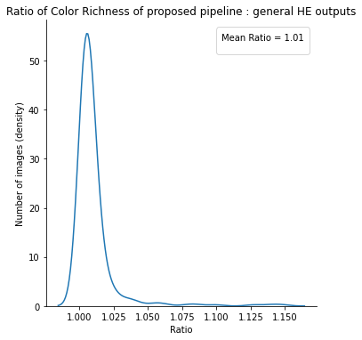
Color Richness
Because of saturation maximization step we have more rich color in proposed pipeline of research paper.

Slide 25
Thank You!
Wait! Not this*******

Slide 26
Thank You!
Looks good now^^

