Slide 1
Extracting keyphrases and finding relations from scientific publications (research papers).

Slide 2

The akatsuki of Lolis
Team Number = 11
Priyansh Gupta (2019101080)
Harshit Sharma (2019101083)
Bhavya Jain (2019101095)
Github repo link for cloning used datasets and saved models: https://github.com/xLeviackermanX/intro-to-nlp-project.git

Slide 3


Given Scientific Documents How to extract keyphrases?
How to do this task
automatically?
Tip
Sometimes things which don’t look impressive may contain hidden information that may be helpful in beautifying itself after a little bit of efforts.

Slide 4
First approach/idea
We can first make candidate set of keyphrases by storing all 1-6 grams. Then we can try to come up with some score mechanism which will rank these phrases and we can then say that top 10 or 15 ranked phrases are my keyphrases.

Slide 5
Implementation of this rank approach
Firstly preprocess the text, tokenize it by using lemmatization. Remove all the candidates with stopwords only. Create a word vocabulary for this document.

Slide 6
Graph construction
Now construct a graph containing each word of vocab as it’s nodes and there are weighted undirected edges between these words. These edge weights depends upon how much the connected two words appear in document at what distance.

Slide 7
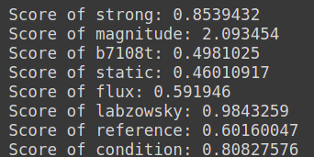
Find Scores
Now we can find score for each node(word) using a method similar to finding page rank. So we will iteratively find scores of each word in doc.
Remember to make scores of stopwords zero after finding convergence.

Slide 8
Now rank them
Now for each phrase in candidate set the score of phrase is defined as sum of score of all tokens(words) that appear in the phrase. Now sort all the phrases based on their score and take top 10 or 15 phrases.

Slide 9
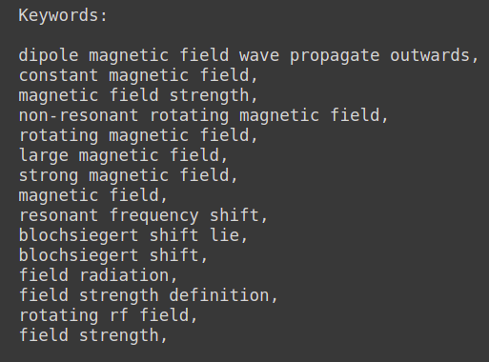
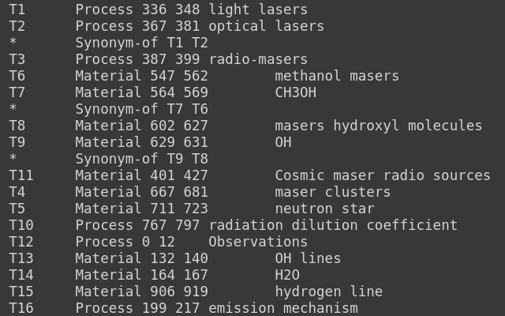
Example output
Predicted: Actual:

Slide 10
Example output
Predicted: Actual:

Slide 11
Second Approach(model training for binary classification)
Extract features out of candidate keyphrases. These features are:
Standard deviation
frequency
length
line_position
parabolic_position
part_of_speech
nth position_list

Slide 12
Classification
Now we trained a model for binary classification using SVM and logistic regression.
It was important to take positive and negative samples in equal ratio in the training set.

Slide 13
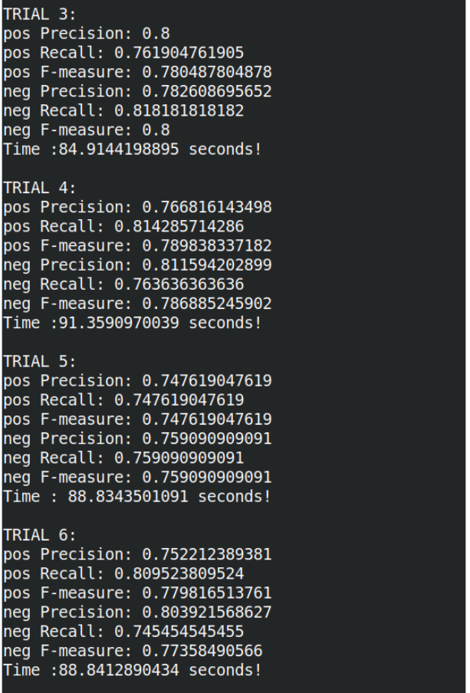
Results
(wiki20
dataset)

Slide 14
Score Metrics that we used:
Accuracy
Negative and positive precision
Positive and negative Recall
Positive and negative F1 score

Slide 15
Classification of Keyphrases into 3 classes:
{Task, Material, Process}
Tip
Don’t wait till the end of the presentation to give the bottom line.
Reveal your product or idea (in this case a translation app) up front.

Slide 16
Dataset of Semeval:
The dataset contains .xml and .ann files. Two scripts were provided along with the dataset to read from xml files and convert them into text passages.
.ann files contained keyphrases and their type.
Link to dataset: - github repo

Slide 17
Input:
We took 4 tokens of keyphrase, 4 tokens from the left context and 4 tokens from right context.
So the input sequence was of length 12 tokens.
Link to dataset: - github repo

Slide 18
Embedding:
We initialized word embeddings with glove embeddings and then later trained our own model to fine tune them.
Embedding size = 100

Slide 19
Model:
First had embedding layer, followed by use of 2 CNN layers of 64 filters and different kernel size. The output of two layers were concatenated and then sent to LSTM layer followed by 2 FCN layers performing classification into three classes.

Slide 20
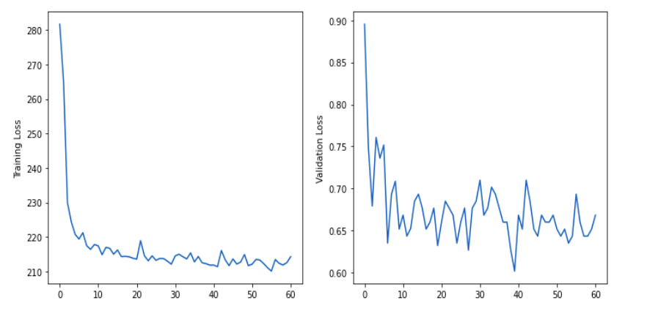
Training
Loss
Curves

Slide 21
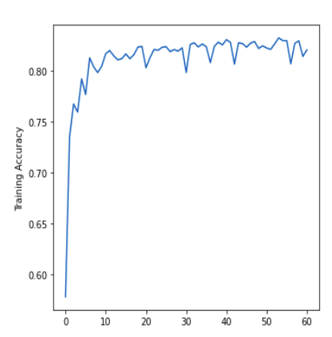
Accuracy
curve

Slide 22
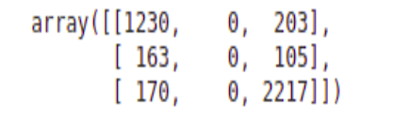
F1 scores and Confusion Matrix
F1-score on test data for keyphrase classification is 0.8431996086105675.

Slide 23
Why classification for class Task fails?
we observed that in the training data, distribution of Material, Process and Task
keyphrases was 40, 44 and 16 percent respectively, showing that class Task is underrepresented in data.

Slide 24

Thank You!

