Slide 1


Slide 2
What is MariaDB?
Database Management Software
Release: 2009
Uses MySQL
Basically same features as MySQL

Slide 3
Why does MariaDB exist?
MySQL

Slide 4


Slide 5


Slide 6
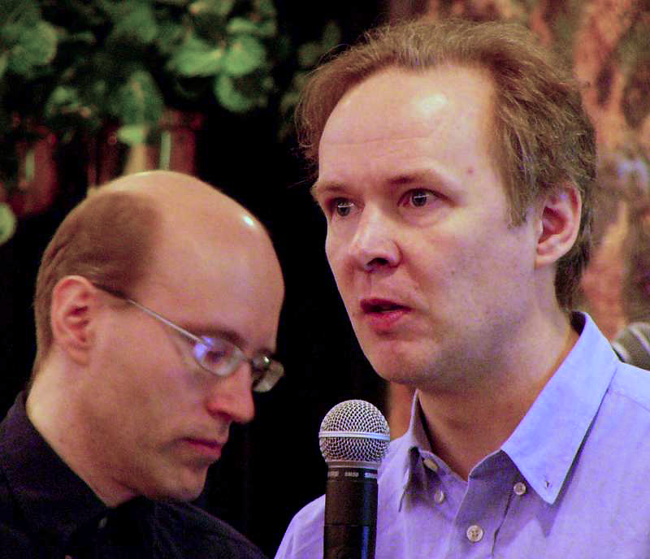

Ulf Michael Widenius
Notes:
Max -> MaxDB; MaxScale

Slide 7
Why should I use MariaDB?
Open source
Active developement
Active community
Leaded by experts
24/7 support by experts
Bright future
Open documentation
Big data

Slide 8

Thank you for your attention!

