Slide 1


Slide 2
Structure
What is MariaDB?
Why was it created?
Why should I be using MariaDB?
Example

Slide 3
What is MariaDB?
Database Management Software
Release: 2009
Uses MySQL
Basically MySQL
Why does it exist?!

Slide 4
Why does MariaDB exist?
MySQL

Slide 5


Slide 6


Slide 7
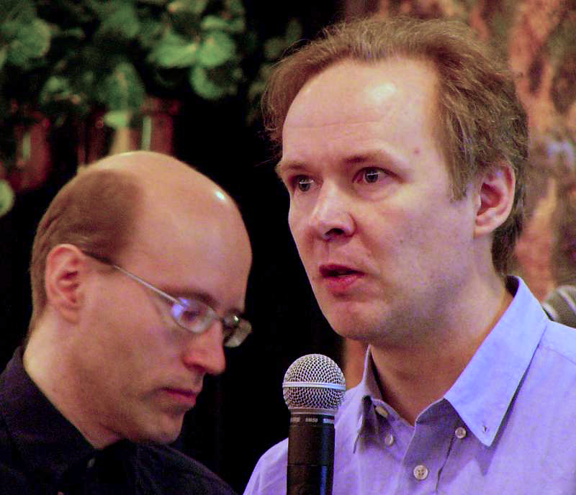

Ulf Michael Widenius
Notes:
Max -> MaxDB; MaxScale

Slide 8
Why should I use MariaDB?
Open dource
Active developement
Active community
Leaded by experts
24/7 support by experts

Slide 9

Thank you for your attention!

