Slide 1
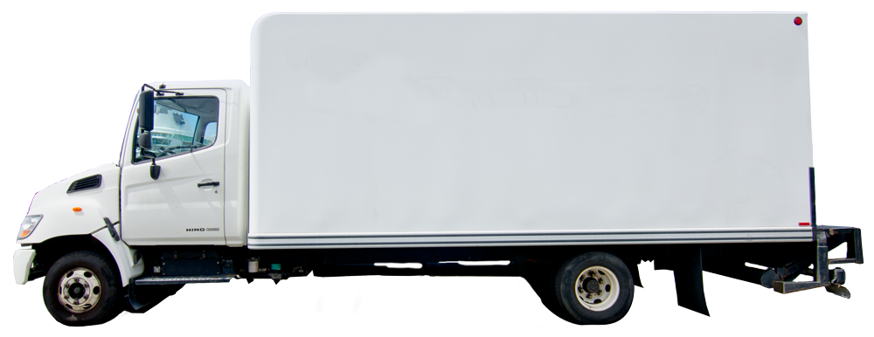
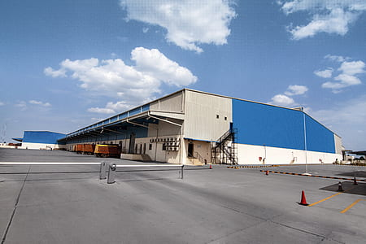
Emmanuel Diaz
CSD-380 Mod 5.2 VSM Assignment
Prof. Adam Bailey
Arrival and Setup
ETA: 5mins
Park the truck, set safety cones and open ramp and back door.
Staging and Unloading
ETA: 10mins
Locate products, stage and unload from the truck
DEX Data Exchange
ETA: 5 minutes
Connect to store’s computer to send/receive invoice data via DEX.
Check-In Process
ETA: 25-30mins
Scan product into the store’s inventory, adjust invoices, and finalize check-in process.
Return to warehouse
ETA: Drive time(aprox 18-30mins)
Drive back to warehouse to close out day.
Reloading and Cleanup
ETA:15-20mins
Sort cardboard, reload truck and clean up before leaving.
Precision Ordering
ETA: 25-30mins
Use the forecast system to scan backstock and inventory gaps to order for next delivery.
Stocking and Rotation
ETA 2-4hrs
Work product into gondola and perimeter displays, evaluate areas that require restock, rotate and relocate.
End of day at warehouse

