Slide 1
HR Vacation App
apply for vacations effortlessly

Slide 2
About
HR Vacation App is a JavaFX-based desktop application that allows employees to request vacation time by submitting requests, which HRs can view, accept, or reject.

Slide 3
Developer
This is Mahmoud Mansour and I will take you step by step to fully understand how the application works.
Contact me at MElsayedMansour96@gmail.com

Slide 4
Project
The HR Vacations App is hosted on GitHub, and the repo contains all of the data displayed in this presentation.
Click here to go to the GitHub repository

Slide 5
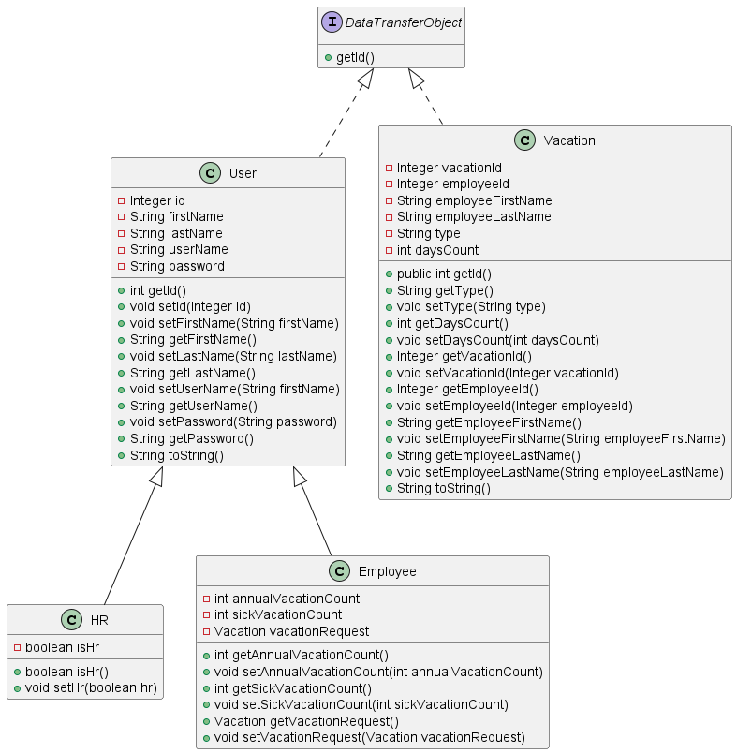
Class Diagrams
1. Models

Slide 6
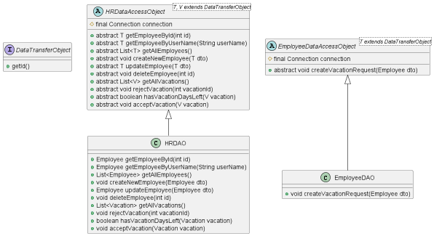
Class Diagrams
2. DAOs

Slide 7
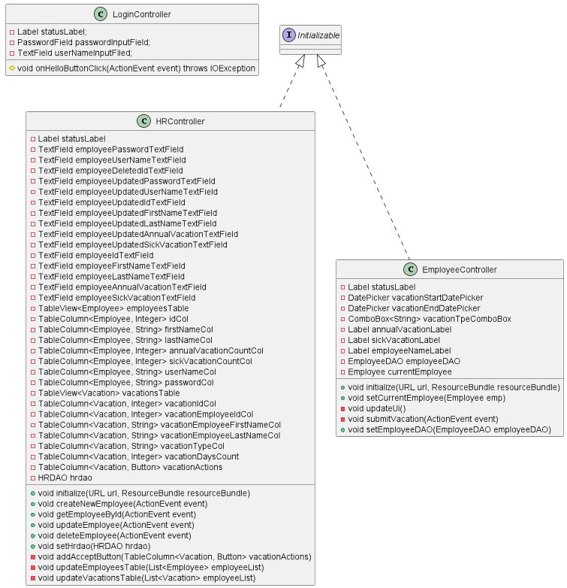
Class Diagrams
3. Controllers

Slide 8
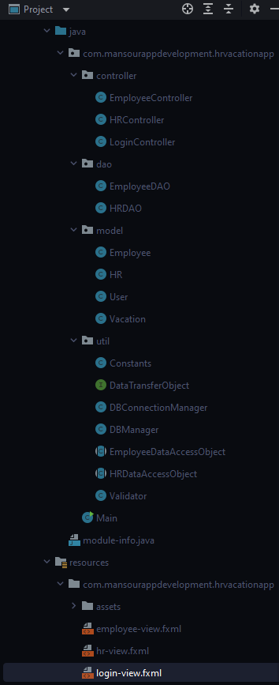
Project Structure
The app consists of
Controllers – To control the GUI (fxml files)
Utils – Constants, Validation, Database Managers, and other helper classes.
Models – Which contains the entities that we will use during the app.
DAOs – Classes that define how we perform database operations.
Resources – Contains fxml files that represent the GUI and assets sub directory which contains the icons used in the app.

Slide 9
Code
For simplicity, I will just provide the code for the required user stories shown below, however the whole code base is hosted here on GitHub as stated before.
User Stories:
As employee can select vacation type from list, contains (Annual &Sick) options
As employee can select start & end date of Vacation
As employee can submit vacation
As employee can view his balance
As system update days based on end date & start date have been selected, should exclude weekends.
As system deduct the requested vacation from employee’s balance automatically without his manager approval.
As system updates balance on view.

Slide 10
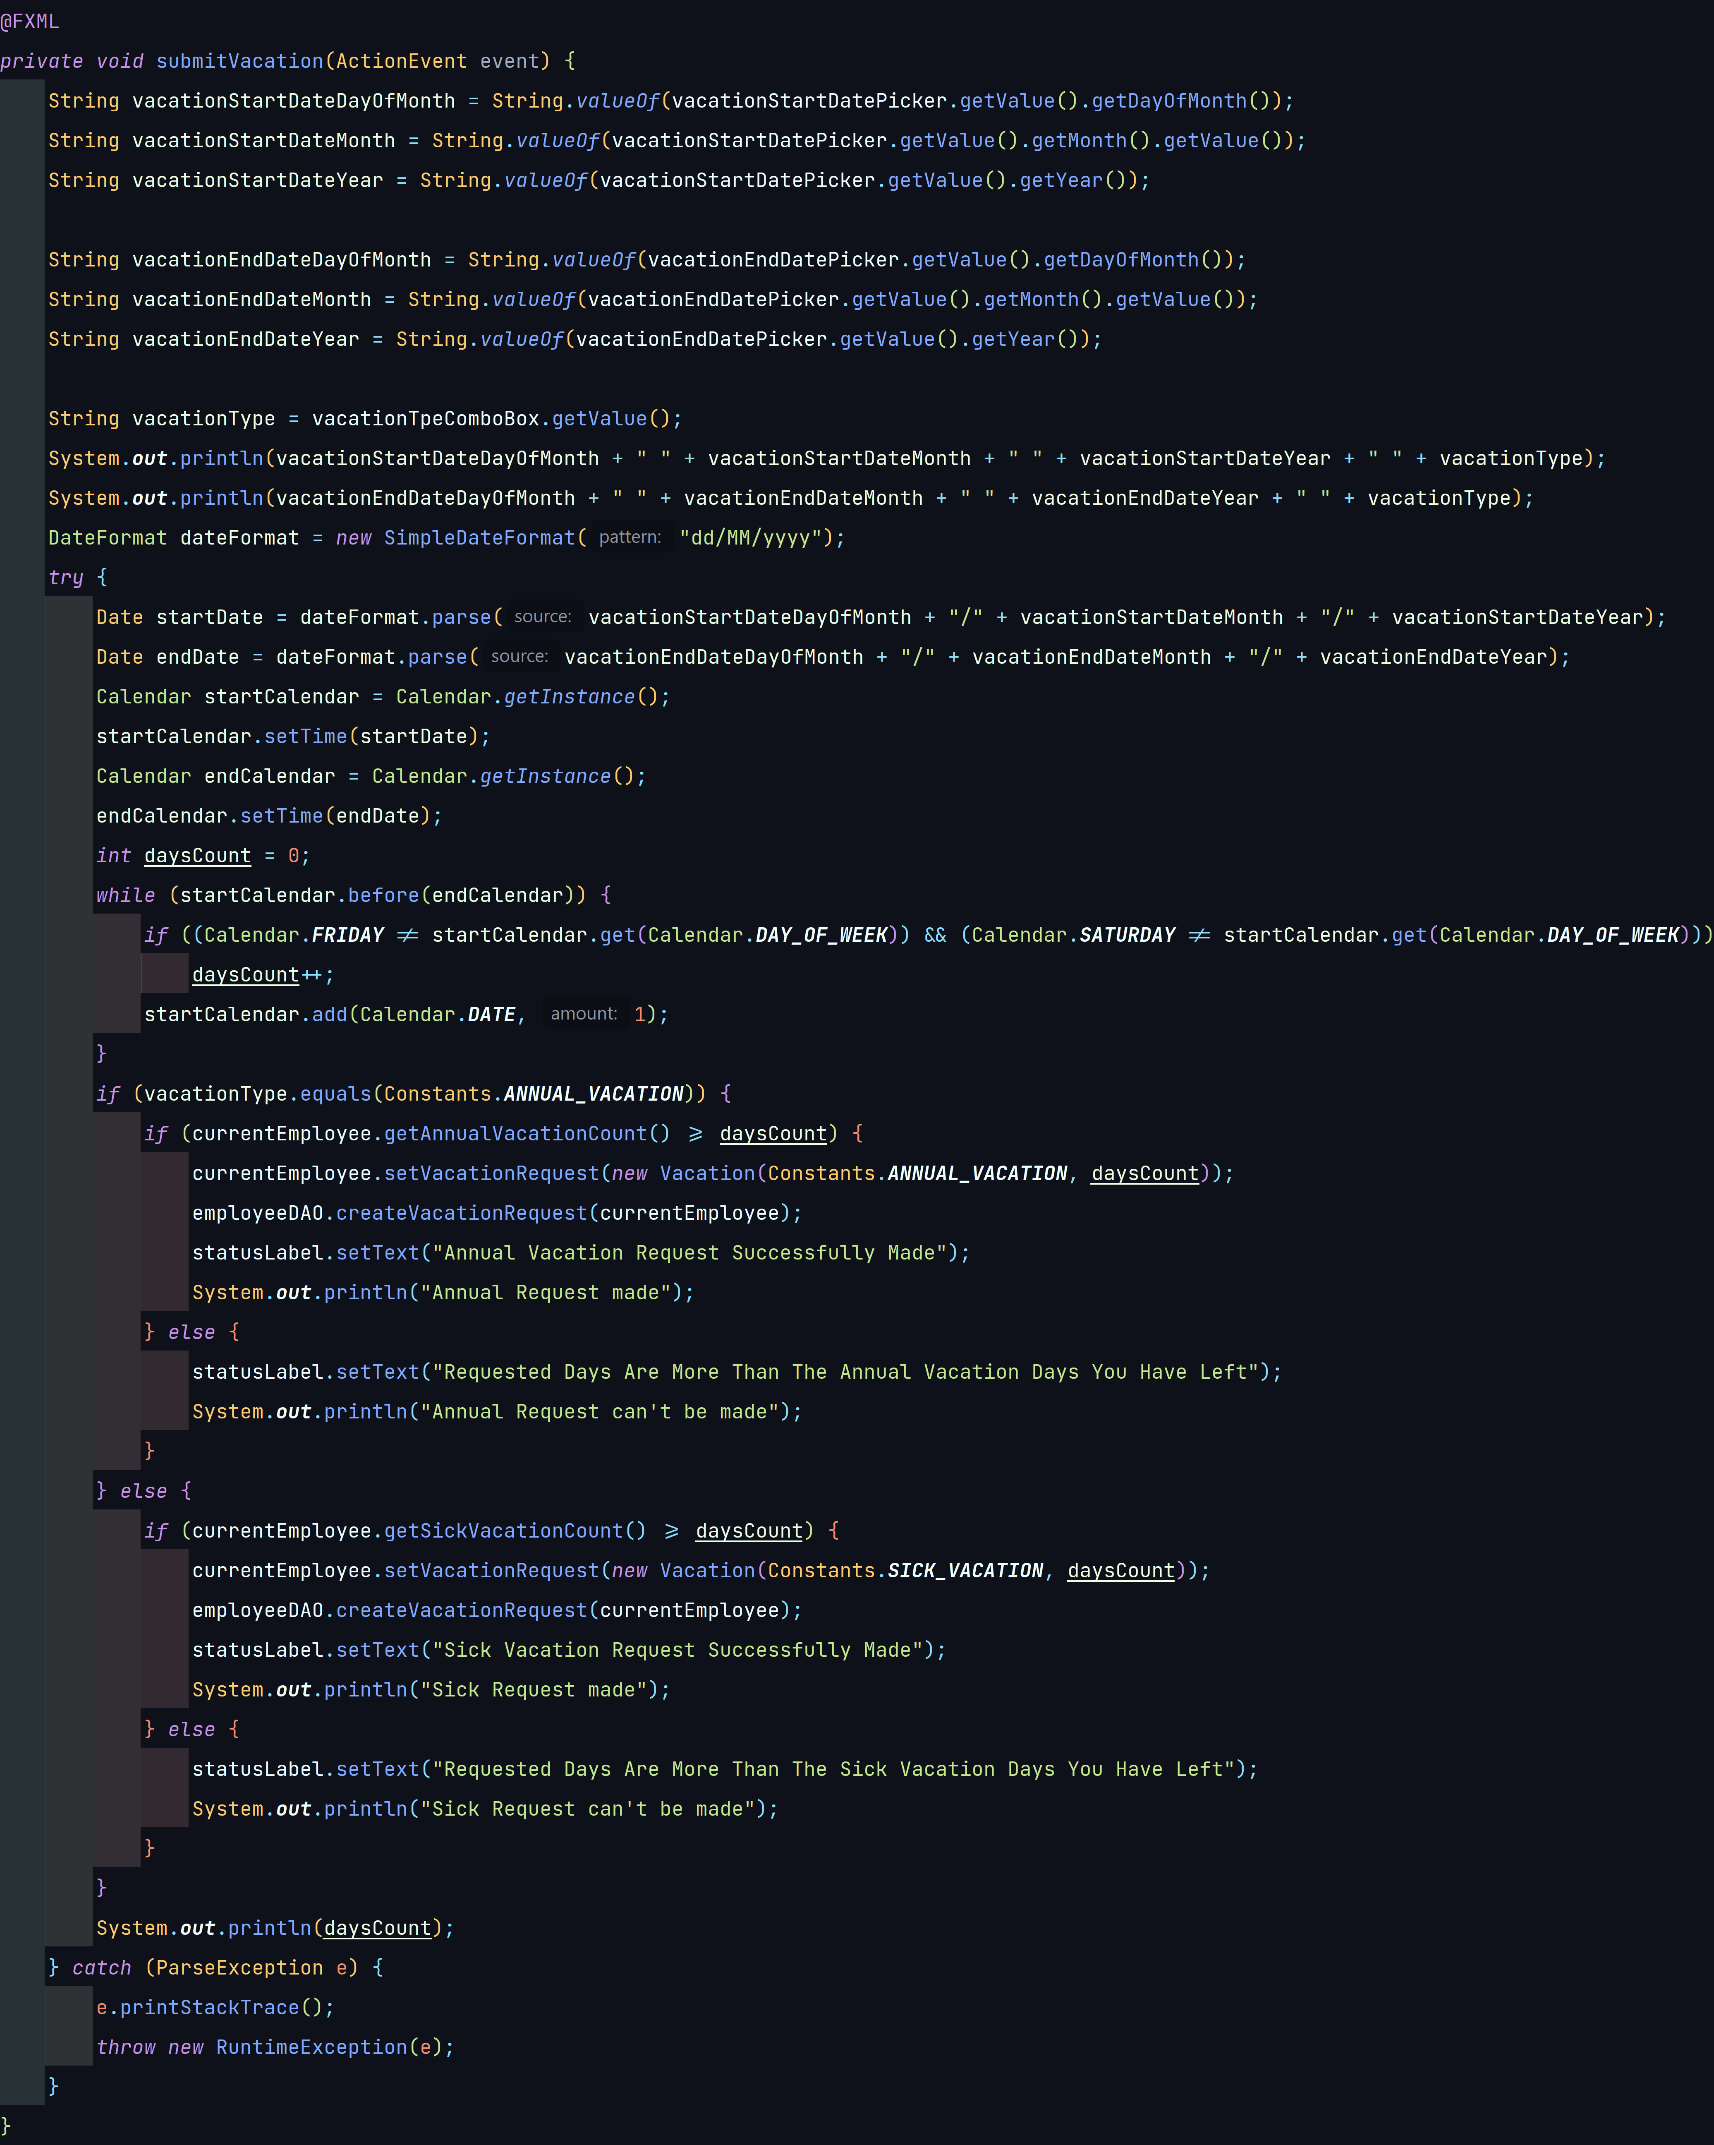
Code
1. As employee can select vacation type from list, contains (Annual &Sick) options
EmployeeController Class

Slide 11
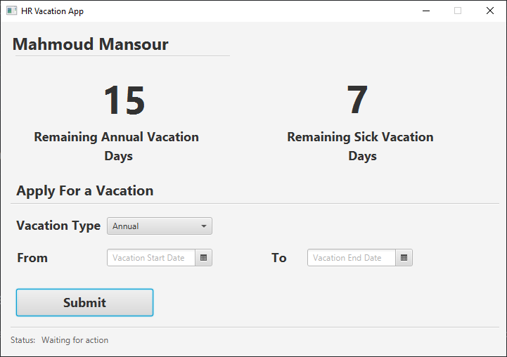
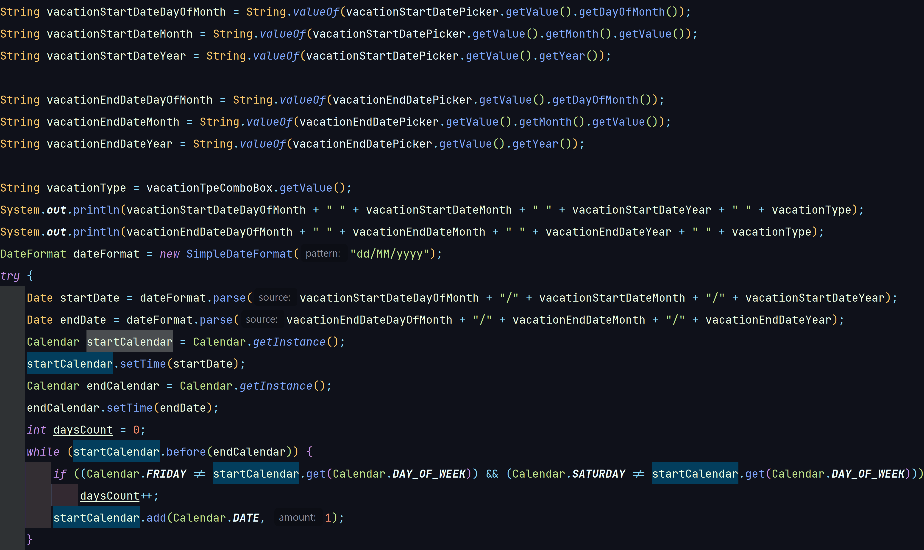
Code
2. As employee can select start & end date of Vacation
EmployeeController Class

Slide 12
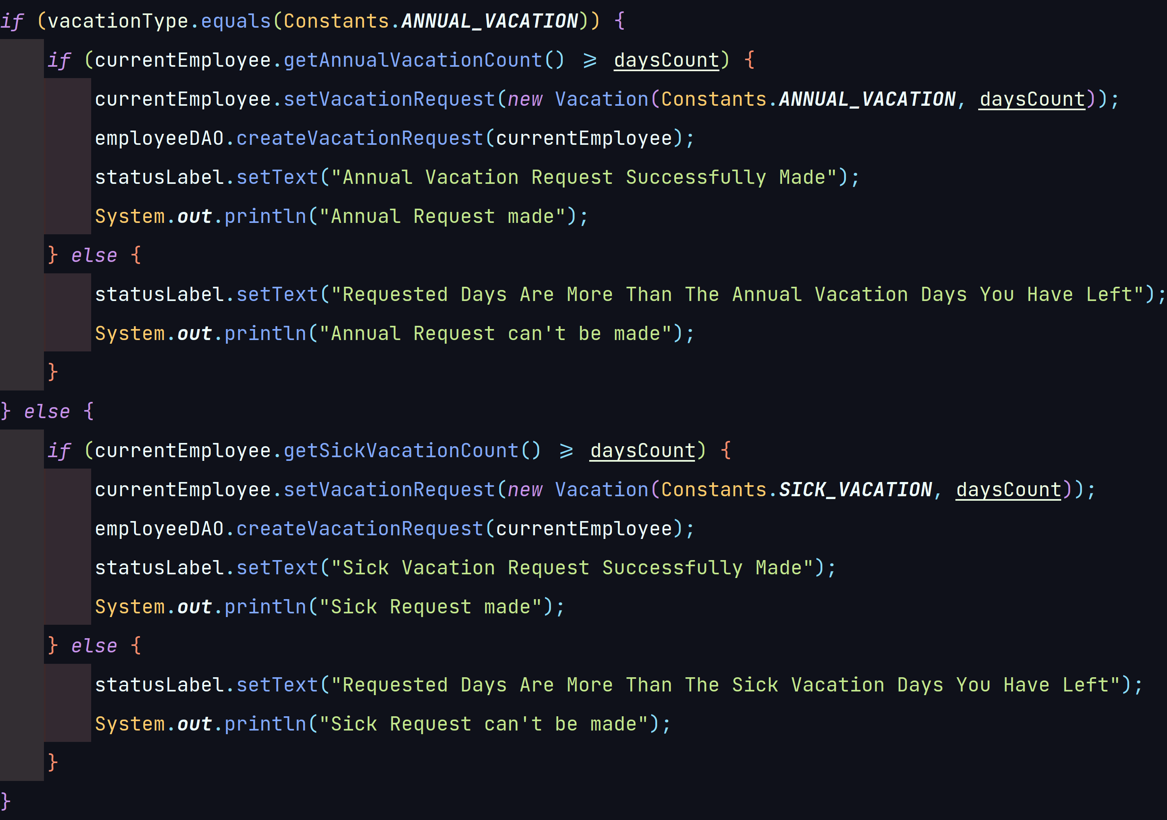
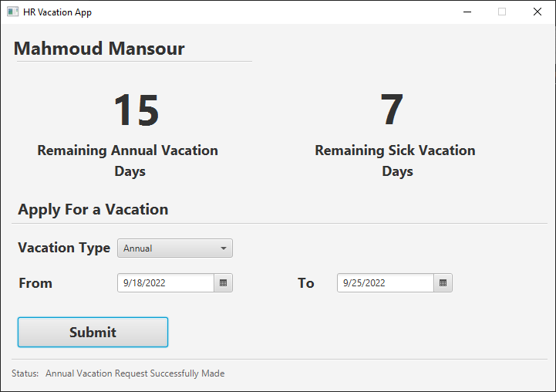
Code
3. As employee can submit vacation
EmployeeController Class

Slide 13
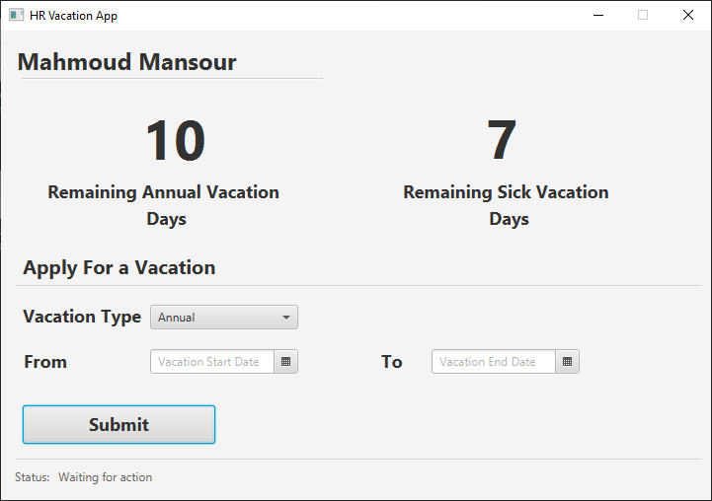
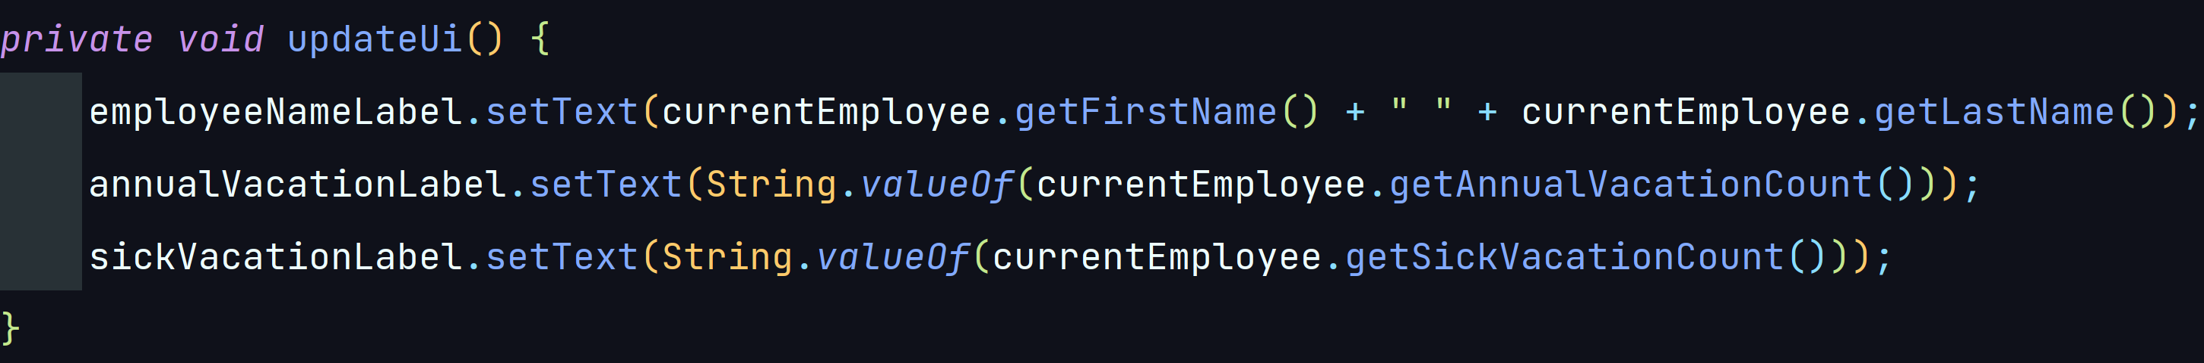
Code
4. As employee can view his balance
EmployeeController Class

Slide 14
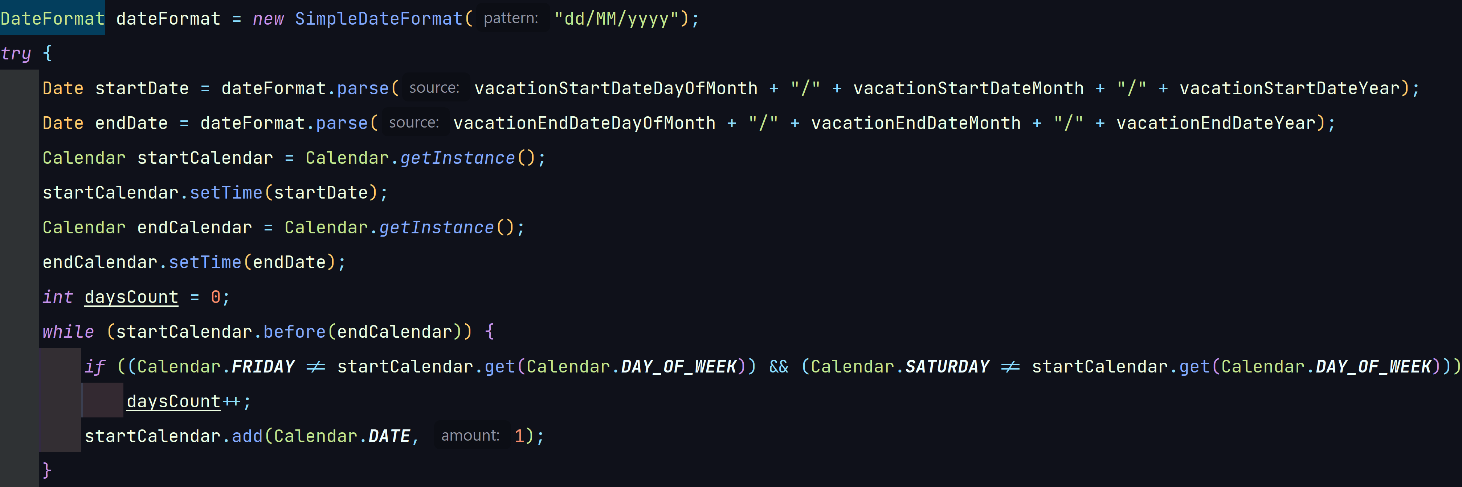
Code
5. As system update days based on end date & start date have been selected, should exclude weekends.
Excluding weekends is done from the employee controller as he submits a new vacation request.
EmployeeController Class

Slide 15
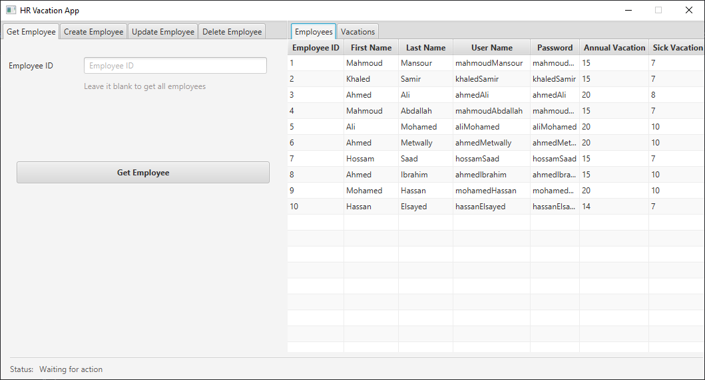
Code
5. As system update days based on end date & start date have been selected, should exclude weekends.
This section has been slightly expanded ;). Allowing HR to get, create, update, and delete employees, as well as view all vacation requests and reject or accept them.

Slide 16
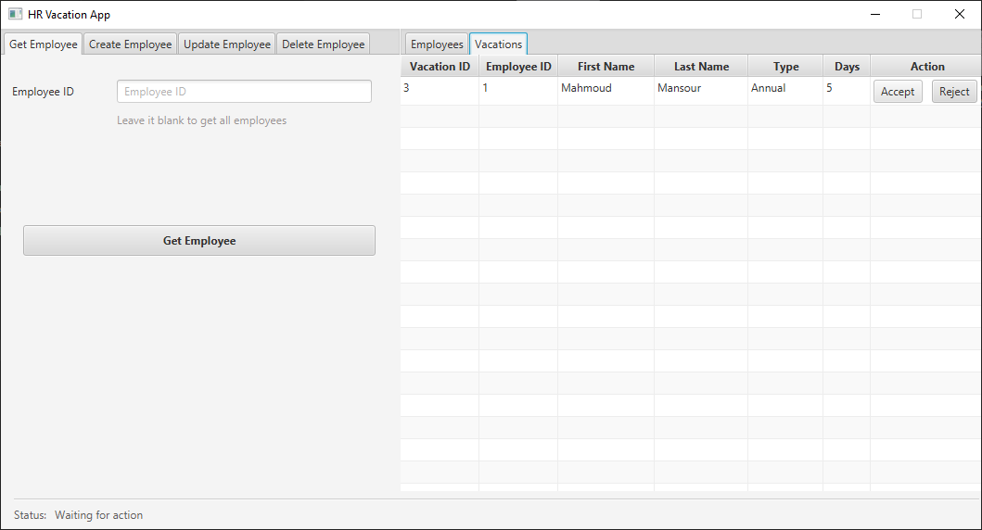
Code
5. As system update days based on end date & start date have been selected, should exclude weekends.
This is what the HR sees when Mahmoud Mansour submitted a vacation request in step 3 and since the HR accepted it, it is subtracted from Mahmoud’s annual vacations record in the database. And if Mahmoud tried to log in again as in step 4 he will see his new vacations.

Slide 17
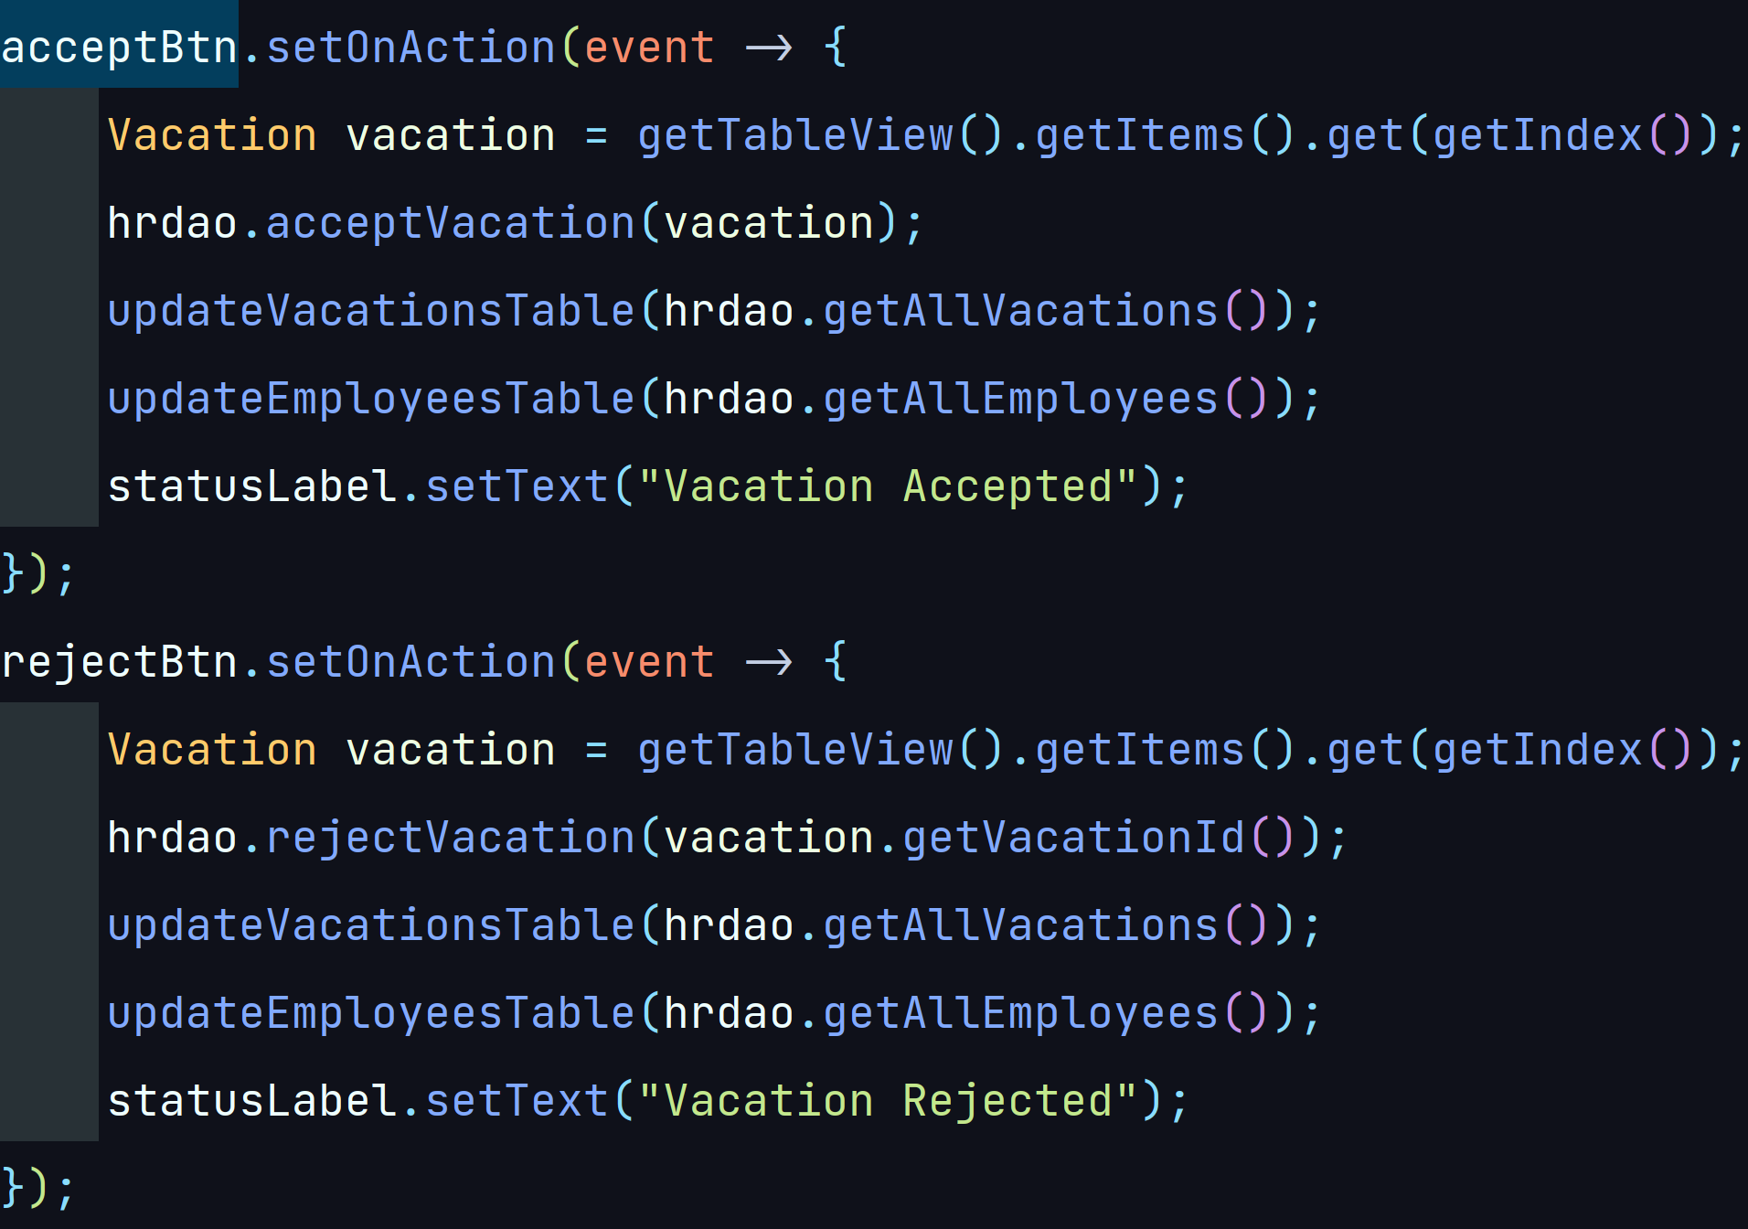
Code
5. As system update days based on end date & start date have been selected, should exclude weekends.
6. As system deduct the requested vacation from employee’s balance automatically without his manager approval.
Using the two buttons shown in the previous slide, HRs can call the acceptVacation(Vacation vacation) or rejectVacation(int vacationId) methods defined inside the HRDAO Class.
HRController Class

Slide 18
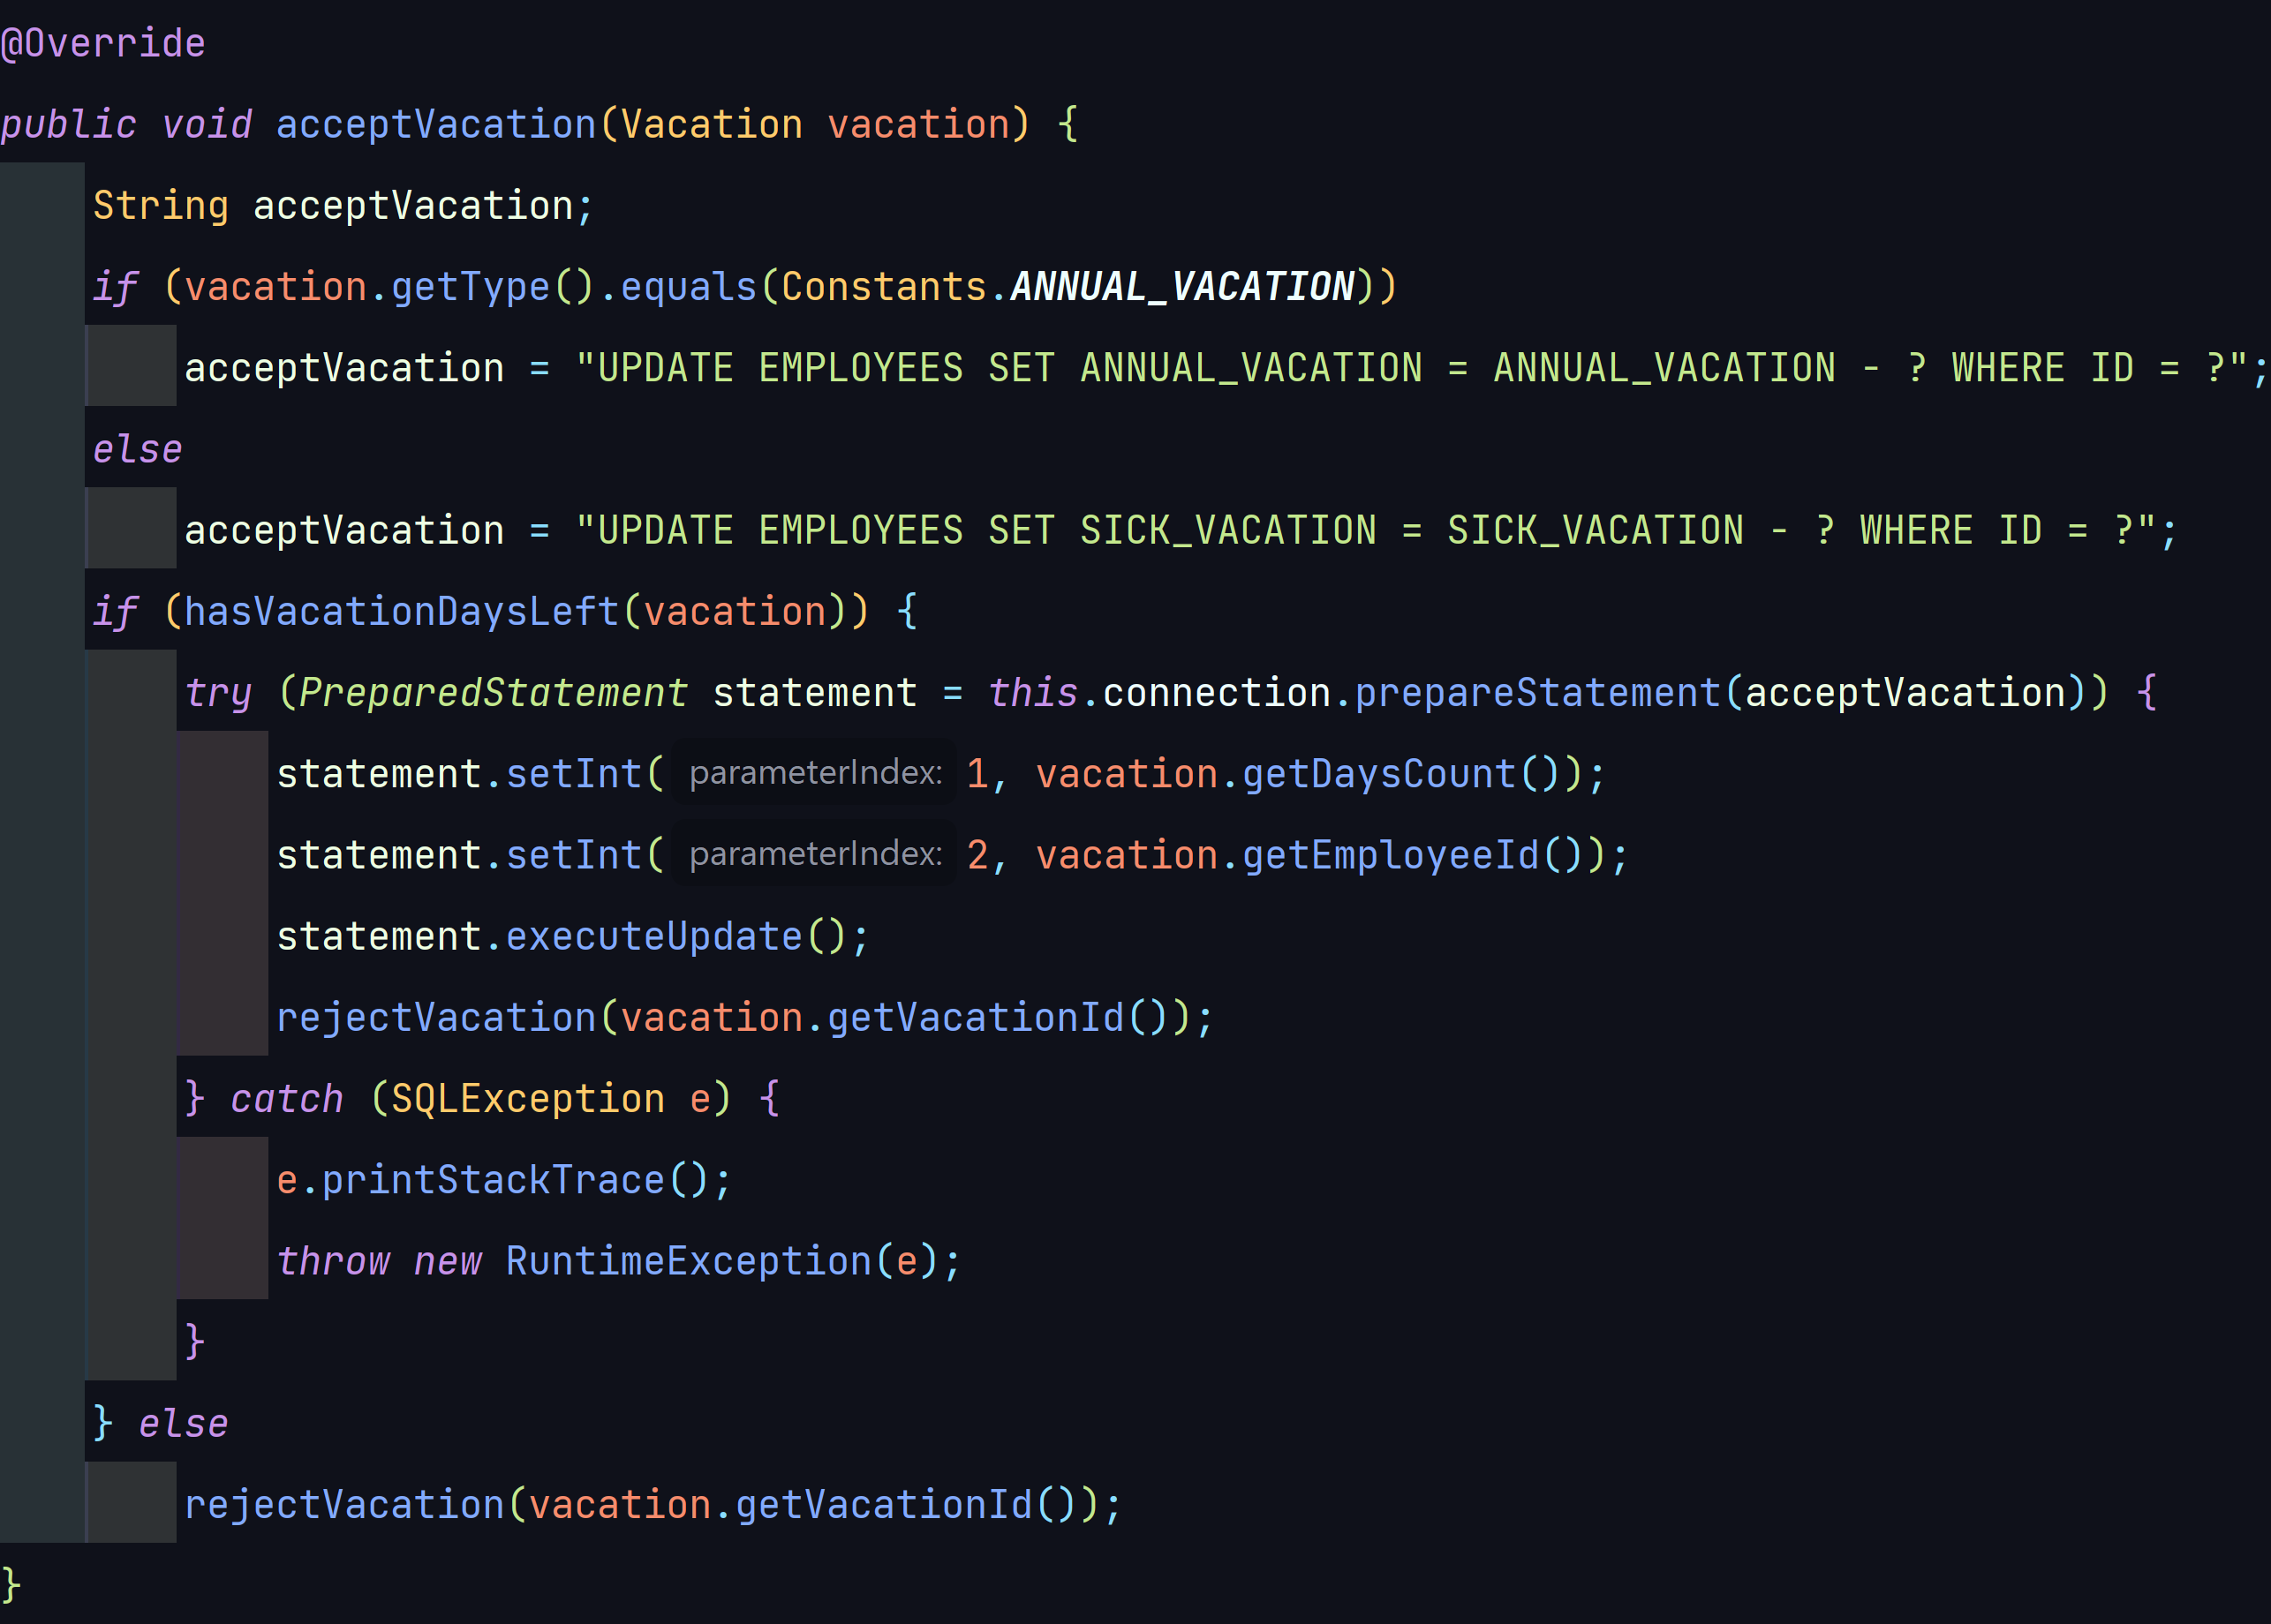
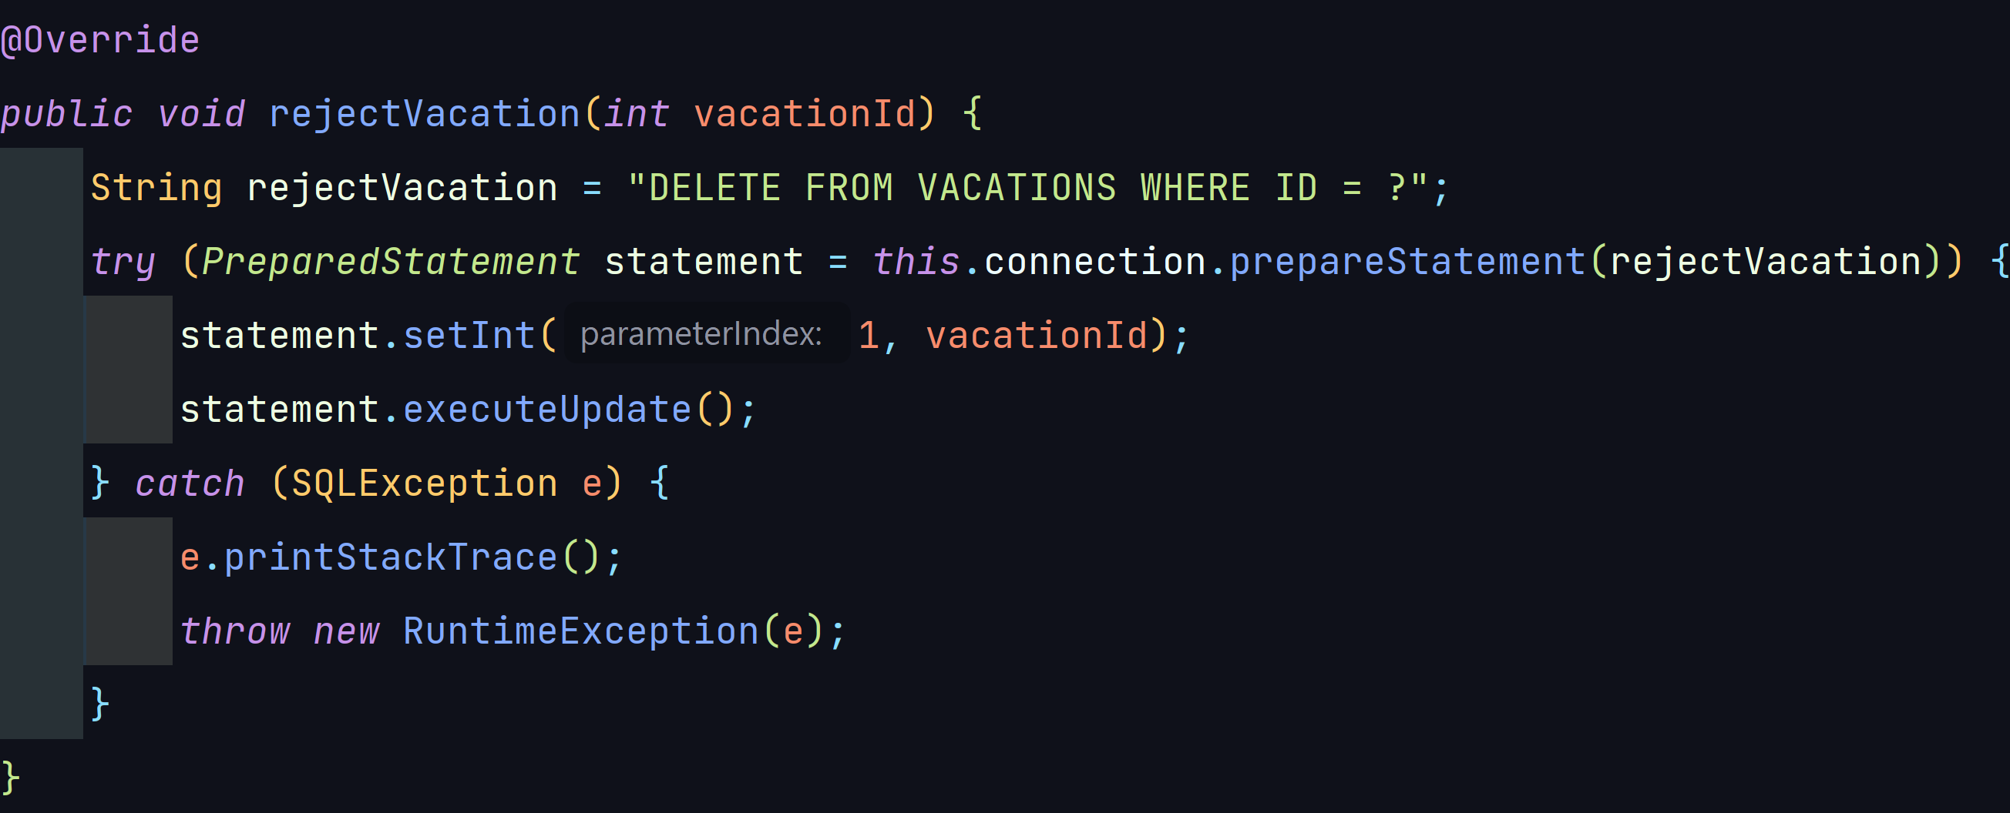
Code
6. As system deduct the requested vacation from employee’s balance automatically without his manager approval.
acceptVacation(Vacation vacation) and rejectVacation(int vacationId) methods.
HRDAO Class

Slide 19
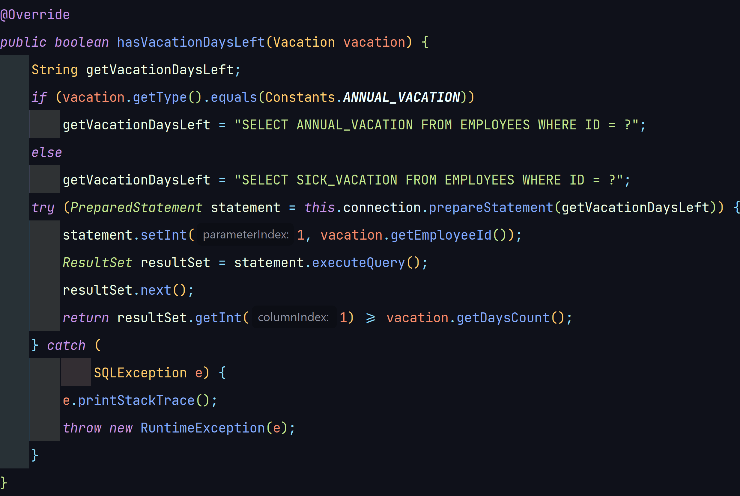
Code
6. As system deduct the requested vacation from employee’s balance automatically without his manager approval.
acceptVacation(Vacation vacation) makes use of the hasVacationDaysLeft(Vacation vacation) to make sure that the employee who requested the vacation has days left in his account.
HRDAO Class

Slide 20
Code
6. As system deduct the requested vacation from employee’s balance automatically without his manager approval.
acceptVacation(Vacation vacation) makes use of the hasVacationDaysLeft(Vacation vacation) to make sure that the employee who requested the vacation has days left in his account.
HRDAO Class

Slide 21
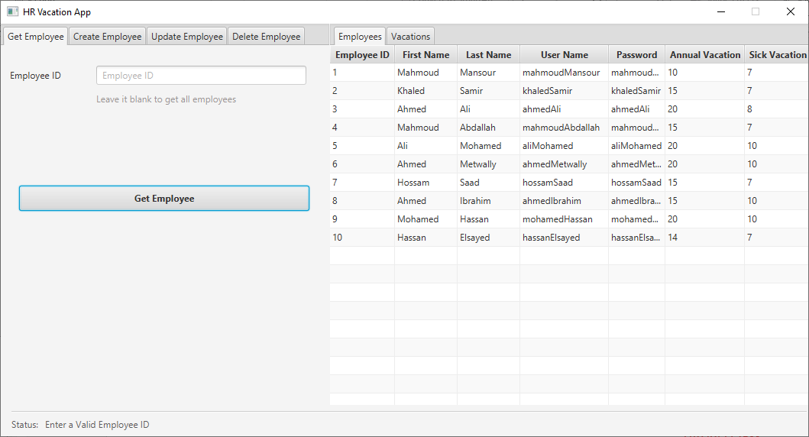
Code
7. As system updates balance on view.
As shown, Mahmoud Mansour's annual vacation days have been reduced to 10 because his request for 5 days was approved by HR.

Slide 22
Thank You!

