Slide 1
Car Rental System
Presented By:
Bishwas Pudasaini
3276628
Rajkumar Kafle
3276627
BCA 6th Semester
Madan Bhandari Memorial College

Slide 2
Table of Contents
Introduction
Problem Statement
Objectives
Requirements
Feasibility Study
DFD, ER Diagram
Gantt Chart
Expected Output

Slide 3
Introduction
Android based application
System script written in android studio
Uses SQLite for data store
User friendly interface

Slide 4
Problem Statement
Slow performance speed
Compatibility
Inadequate renting products information
Safety and security issues

Slide 5
Objectives
To provide application compatible in every gadgets
To facilitate easy and efficient retrieval of data
To provide better vehicles searching functionality
To provide system with enhanced security

Slide 6
Requirements
Functional Requirements | Non-Functional Requirements
User registration and account management | Performance
Car Catalog | Security
Search functionality | Reliability
Order Management | Usability
Security and privacy | Availability
Payment gateway integration | Accessibility
Compatibility

Slide 7




Feasibility Study(Technical)

Slide 8



Feasibility Study(Operational)
User Interface
Workflow Integration
Training and Support

Slide 9
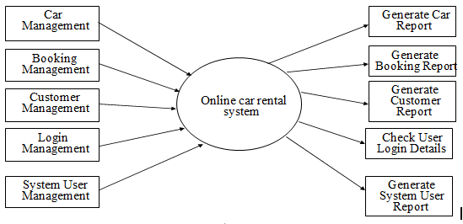
Level 0 DFD

Slide 10
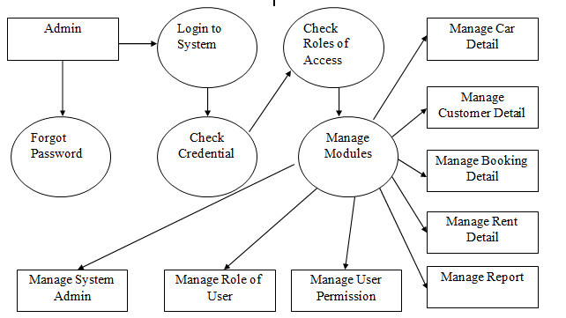
Level 1 DFD

Slide 11
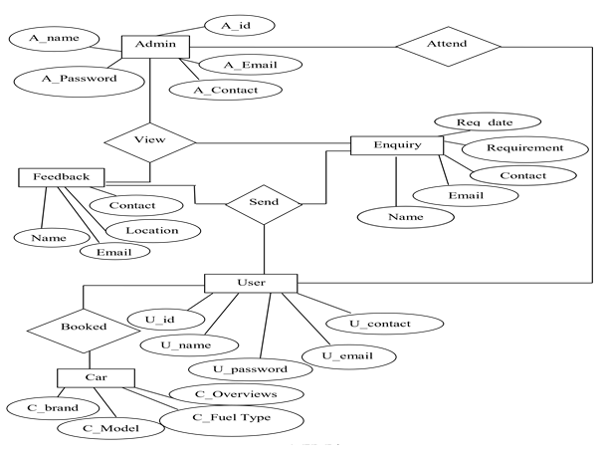
E-R Diagram

Slide 12
Gantt Chart

Slide 13
Outcome
Enhanced Security
Compatible in almost every gadgets
Contains adequate renting products information
Feature of several payment gateways
Global accessibility

Slide 14
Thank You !!!
Any Queries?

