Slide 1
Stock Market Trading Agent
An autonomous agent that decides when to buy, sell, or hold Apple (AAPL) stock
by analyzing technical price indicators, aiming to maximize portfolio returns.
Emiliano Velásquez | SoSe26 | 3sem B

Slide 2
Environment Analysis
Russell & Norvig Environment Model
Property
Classification
Reasoning
Observable
Partially Observable
Agent sees prices & volume, but NOT all market forces (news, macro, sentiment)
Deterministic vs Stochastic
Stochastic
Market is driven by countless unpredictable external factors
Episodic vs Sequential
Sequential
Current trades affect portfolio state and all future decisions
Static vs Dynamic
Dynamic
Market changes continuously, even while the agent is deliberating
Discrete vs Continuous
Continuous
Prices and volumes take continuous real values
Single vs Multi-agent
Multi-agent
Millions of traders acting simultaneously influence prices

Slide 3
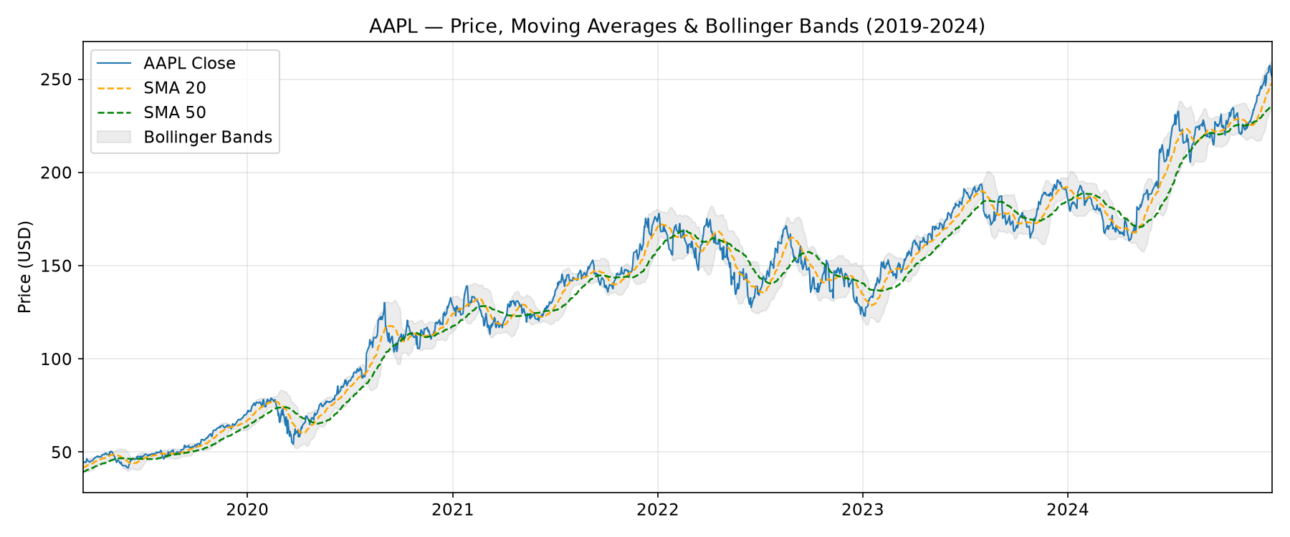
Dataset
AAPL - Yahoo Finance | 2019-2024
Source: Yahoo Finance (via yfinance library)
Represents: Apple Inc. daily stock data, 6 years
Size: 1,460 trading days | 5 raw features (OHLCV)
Agent sensors: real-time price feed, volume, computed indicators
Data checks:
- Near-balanced classes: 53.8% UP days / 46.2% DOWN days
- High daily noise, market is inherently stochastic
- No external data (news, macro), intentional simplification
Feature
Description
Captures
RSI
Relative Strength Index (14d)
Overbought / Oversold
SMA_ratio
SMA20 / SMA50
Trend direction
BB_position
Bollinger Band position
Proximity to support/resistance
MACD
12d EMA - 26d EMA
Momentum shift
Daily_return
Daily % price change
Short-term momentum
Volume_change
Daily volume % change
Market conviction

Slide 4
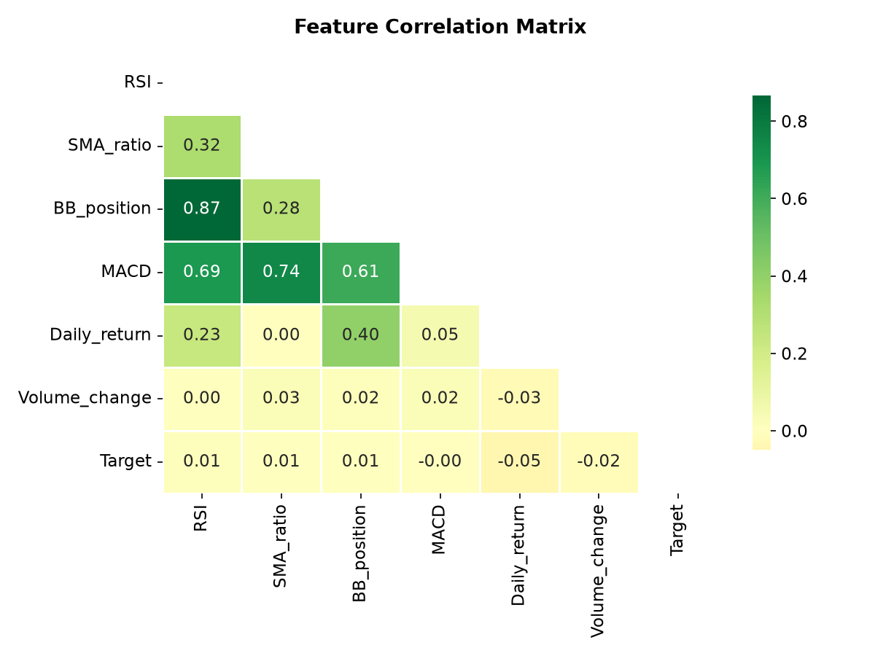
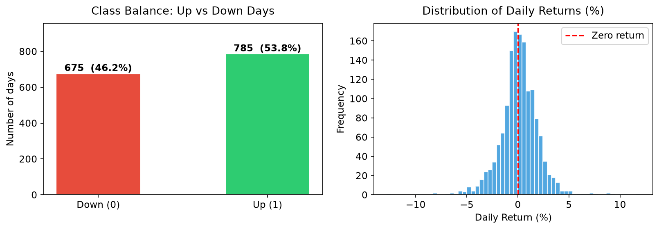
Data Analysis
Understanding structure, relationships, and distributions
Key findings:
- RSI & BB_position are positively correlated (both track price extremes)
- Daily_return has near-zero correlation with Target, meaning market is hard to predict
- Returns follow a near-normal distribution centered at around 0% (efficient market)
- Class balance is healthy: 53.8% UP vs 46.2% DOWN, no resampling needed

Slide 5
Model & Agent Architecture
Supervised Learning — Binary Classification
Percepts
(Price, Volume)
>>>
Feature Engineering
(RSI, SMA, MACD...)
>>>
Random Forest
Classifier
>>>
Decision
BUY / SELL / HOLD
>>>
Market
Action
Type: Supervised Learning
Primary Model: Random Forest Classifier
- n_estimators = 200 trees
- max_depth = 6
- Handles non-linear relationships
- Provides feature importance
Baseline: Logistic Regression
- Used to compare vs. random forest
- Requires feature scaling (StandardScaler)
Train / Test Split: Temporal (no shuffle)
- Train: Mar 2019 -> Oct 2023 (80%)
- Test: Nov 2023 -> Dec 2024 (20%)
- Shuffling would cause data leakage in time series
Decision Rule:
- Predict UP -> BUY (if no position held)
- Predict DOWN -> SELL (if position held)
- Low confidence -> HOLD

Slide 6
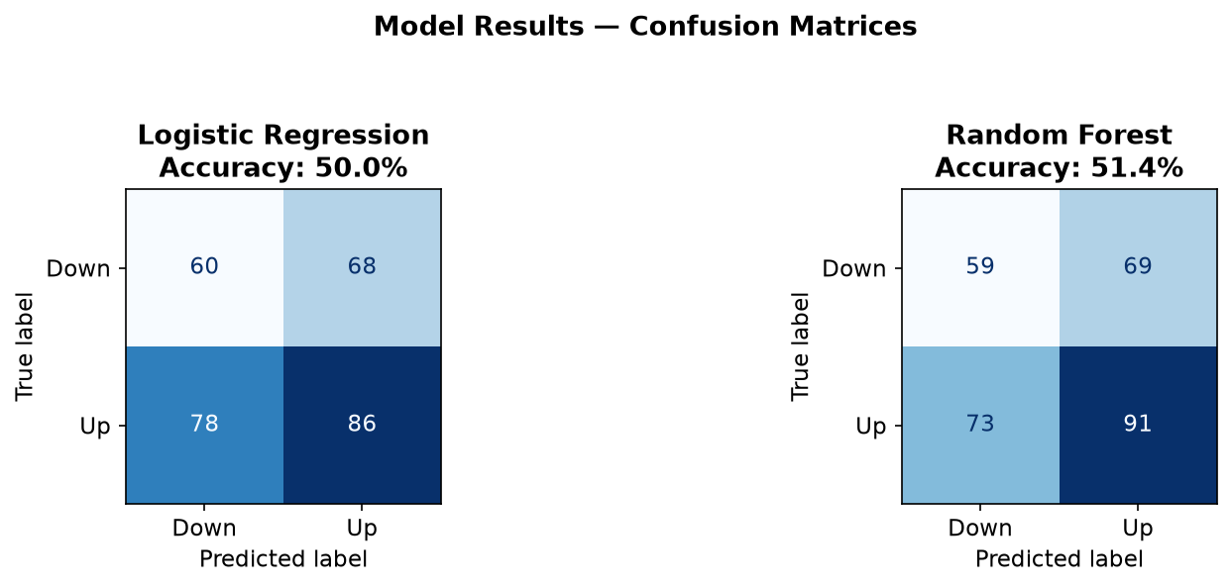
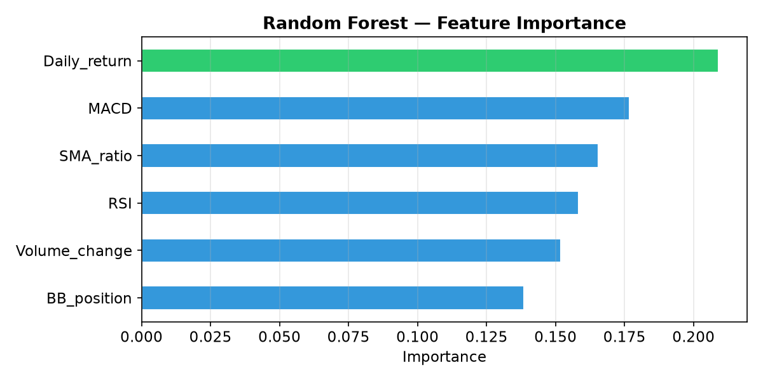
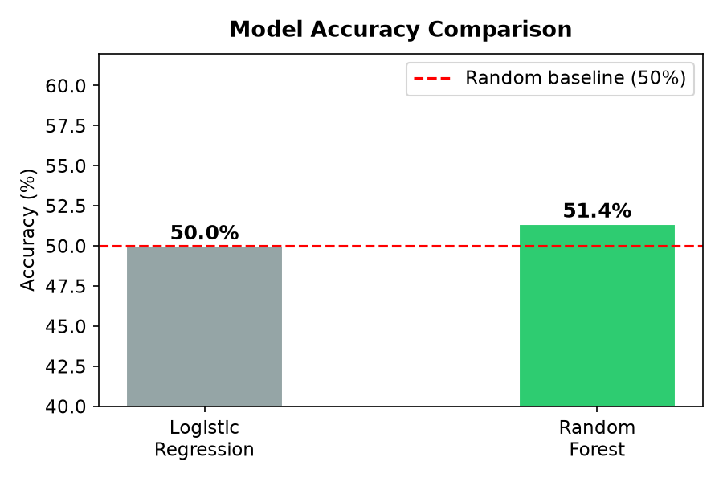
Model Results
Random Forest vs. Logistic Regression
Random Forest: 51.4% | Logistic Regression: 50.0% | Random baseline: 50.0%
Why is accuracy low? The stock market is stochastic, news, macro events, and sentiment are not in the dataset. This is expected, not a failure.
Improvement ideas: add news sentiment analysis, macro indicators (interest rates, VIX), or switch to Reinforcement Learning.

Slide 7
Model in the Agent System
From learned model to real-world decisions
How the model fits the agent:
- Acts as the agent's "market perception module"
- Each trading day: percepts -> features -> prediction -> action
- Model output feeds directly into the agent's decision logic
- Agent can threshold confidence: only act when P(class) > 0.6
What the model enables the agent to understand:
- Whether current technical indicators signal a buying or selling opportunity
- Which features matter most (Daily_return is the top predictor per feature importance)
- The uncertainty of each prediction (probability scores, not just 0/1)
Real-world limitations of this model in the agent:
- 51% accuracy means high uncertainty -> agent must use risk management (stop-loss, position sizing)
- Model trained on past data -> may fail in new market regimes (e.g. 2020 COVID crash)
- No memory of its own past trades -> a real agent would need state tracking
- Missing percepts: news sentiment, earnings reports, macroeconomic data
- Future direction: combine this supervised model with RL so the agent learns from its own P&L

